Slide 1
Forensic Accounting: Detecting Financial Anomalies Using Benford’s Law
DASC 10003: Group 7: Ian Horton, Harlie Lockhart, Tre McEntire

Slide 2
Project Overview
Our project explores how data science can uncover signs of financial irregularities. We analyzed real data from the U.S Securities and Exchange Commission (SEC) to test whether company financial reports follow Benford’s Law, a mathematical principle that describes how digits normally appear in natural datasets.
We used:
Python for data cleaning and visualization
Jupyter Notebook to combine our code, visuals, and explanations into one place

Slide 3
Dataset Overview
We used SEC Financial Statement Data from 2020 through 2024, including quarterly filings from publicly traded companies.
Key data included:
Revenue, expenses, assets, and liabilities
Company names, industry codes, and fiscal periods
We chose this dataset because it is publicly available, trustworthy, and ideal for analyzing financial patterns and detecting anomalies.

Slide 4
Hypotheses
Null Hypothesis: Companies have no errors and will follow Benford’s Law
Hypothesis: Companies with unusual revenue or expenses fluctuations are more likely to face SEC enforcement actions.

Slide 5
Data Processing
To prepare the data for analysis, we:
Downloaded and unzipped multiple SEC quarterly datasets
Merged financial data (num.txt) with company details (sub.txt)
Removed missing, negative, and non-USD entries
Focused on key variables like revenue and expenses
After cleanings, we had a single dataset ready for exploration and analysis.

Slide 6
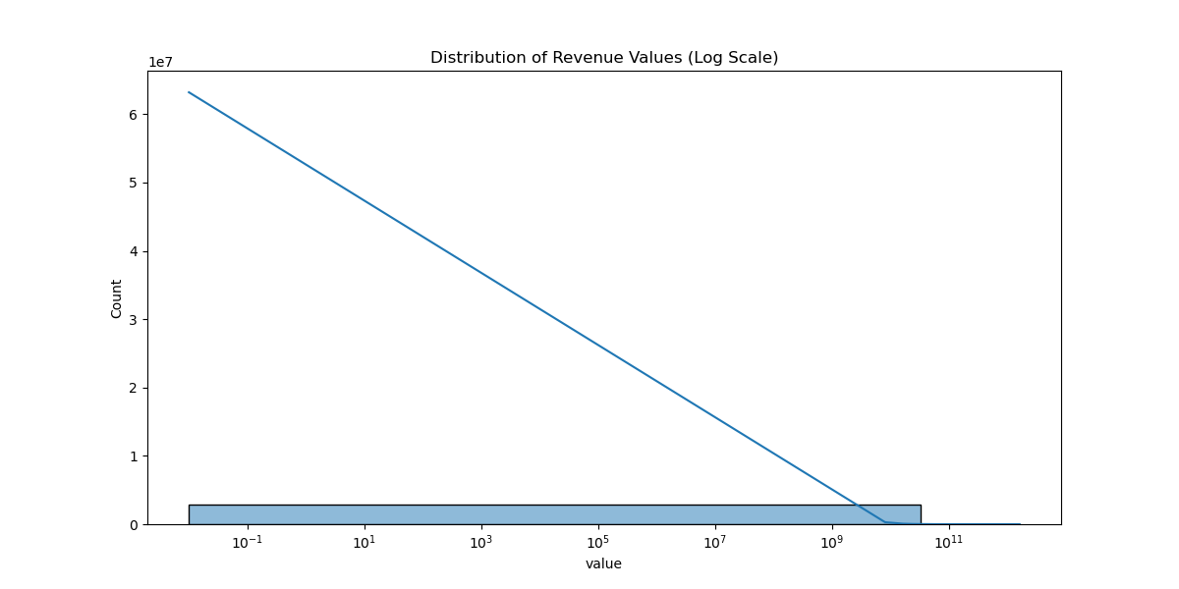
Exploratory Data Analysis
Before testing our hypotheses, we explored the data to understand overall patterns.
We:
Created histograms to show overall distribution of revenue
Made scatter plots comparing revenue and expenses
Used boxplots to examine revenue across industries
Most companies were consistent, but some had large variations worth deeper analysis.
Log-scaled distribution of company revenue values showing overall data spread.

Slide 7
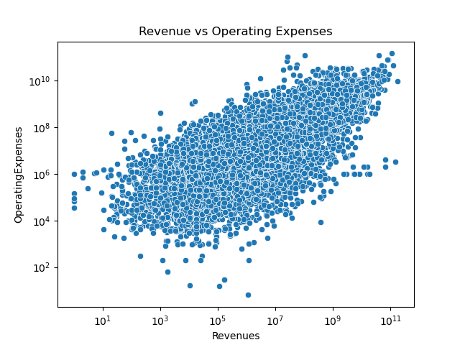
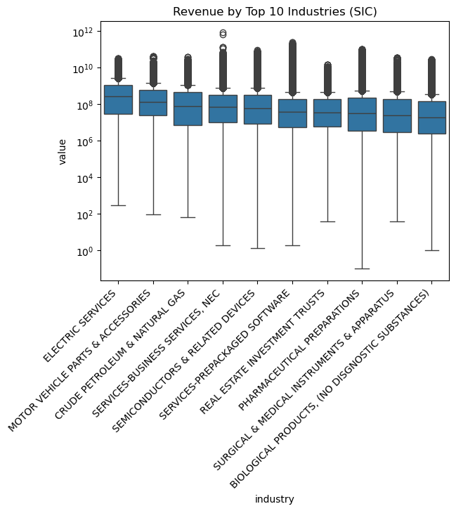
Exploratory Data Analysis: Industry Patterns
Industry-level data shows wide variation in revenue values.
Revenue and operating expenses display a general positive correlation across firms.
Revenue distribution across industries, illustrating variance and potential reporting inconsistencies.
Correlation between Revenue and Operating Expenses.

Slide 8
Benford’s Law Analysis
We extracted the first digit of each revenue value and compared it to the expected Benford distribution.
Then we ran Chi-square tests to measure how closely each company followed the law.
Findings:
Most companies fit the expected pattern, but some deviated significantly, potential red flags or irregular reporting.

Slide 9
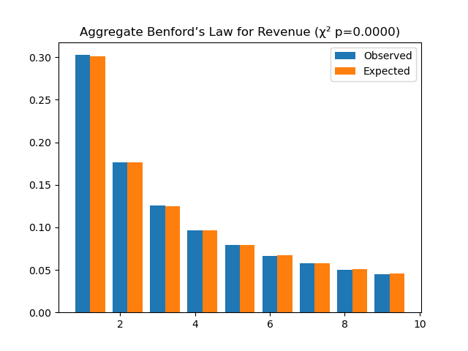
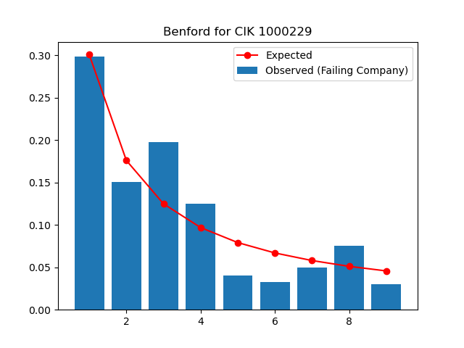
Company-Level Benford Comparisons
This is a company called Core Laboratories, Inc. that was investigated by the SEC.
Aggregate comparison of actual vs. expected first-digit frequencies following Benford’s Law.
Notes:
Speaker Notes: Here you can see our aggregate Benford’s expectations on the left, which shows how the overall dataset fits the expected pattern. On the right, we zoomed in at the company level, where you can see a company CIKs that deviated substantially.

Slide 10
Statistical Test Results and Hypothesis Outcomes
Hypothesis | Description | P-Value | Interpretation
H1 | More financial outliers in Benford-deviant companies | 0.585 | Not significant
H2 | Higher absolute z-scores in Benford-deviant companies | 0.096 | Weak evidence (marginal)
H3 | Weaker revenue-expense correlation in Benford-deviant companies | 0.030 | Statistically significant
While most tests were not statistically significant, Hypothesis 3 showed a meaningful relationship: companies that deviated from Benford’s Law tended to have weaker correlations between revenue and expenses.
Notes:
Speaker Notes: Here’s how our hypotheses performed statistically. We didn’t find strong evidence for more outliers or higher z-scores, but the correlation result stood out. Firms deviating from Benford’s Law had weaker internal consistent between revenue and expense, which could signal irregular reporting behavior.

Slide 11
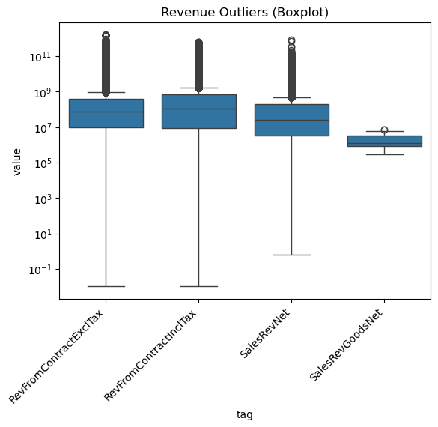
Outlier Detection
Boxplot analysis reveals extreme revenue outliers across multiple financial metrics.
Most firms cluster within normal ranges, but some report significantly higher findings.
These findings align with the skewed revenue distribution observed earlier.
Boxplot showing extreme revenue outliers across financial variables.

Slide 12
Key Insights and Implications
From our work so far, we learned that:
Benford’s Law is effective for identifying irregular patterns
Outlier detection supports which companies stand out statistically
Using Python provides a balanced and reliable workflow
These methods could support real-world fraud detection and auditing efforts

Slide 13
Challenges and Limitations
Challenges we faced included:
Large dataset sizes and lengthy cleaning processes
Missing or inconsistent financial entries
Difficulty matching company filing to enforcement actions
Heavy computational demands from multi-year data
Despite these, our analysis provided valuable insight into financial reporting trends.

Slide 14
Conclusions
Our project demonstrated how data science supports forensic accounting. By comparing financial reports against Benford’s Law and detecting statistical outliers, we can identify patterns that may indicate financial irregularities.

Slide 15
References
U.S. Securities and Exchange Commission (SEC). (2024). Financial Statement Data Sets. https://www.sec.gov/dera/data/financial-statement-data-sets
U.S. Securities and Exchange Commission (SEC). (2024). Litigation Releases and Enforcement Actions Data. https://www.sec.gov/litigation/litreleases.htm
Data.gov. (2024). Open Data Portal. https://www.data.gov/

