Slide 1

Object and classes

Slide 2
Object oriented programming
OOP is a programming paradigm that provides means to structure programs so that properties and behavior are bundled into small isolated units called objects. For instance, an object could represent a person with properties like name, age and behavior such as talking, walking and breathing.
OOP is an approach for modelling real world things such as cars, as well as the relationships between the, like companies and employees.
Primitive data structures like strings are designed to represent simple pieces of information such as a name, or the price of an apple. Objects is a way to tie several primitive (or other objects) together to represent something more complex.

Slide 3
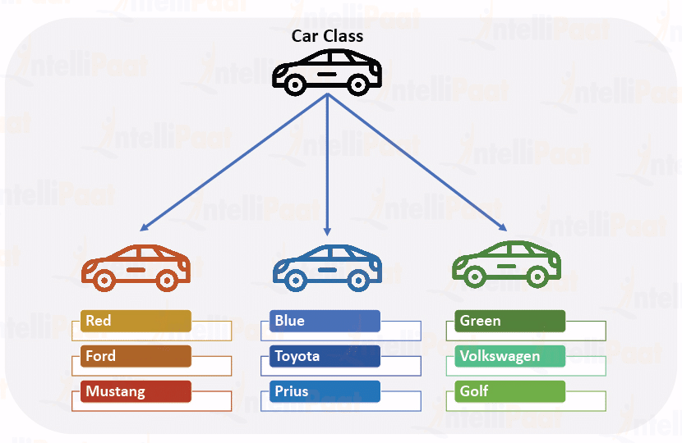
Classes and objects
An object is a collection of data(variables) and methods(functions) that act on that data. A class is the blueprint used to create copies of that object also called instantiating(creating an instance of) the class
The same way many houses can be built using the same blueprint, we can create many objects from a class. These objects are not in any way connected to each other
Classes are defined using the class keyword they create their own local scopes. Variables and methods defined in classes are accessed using the . (dot) operator
Class names should use PascalCase

Slide 4
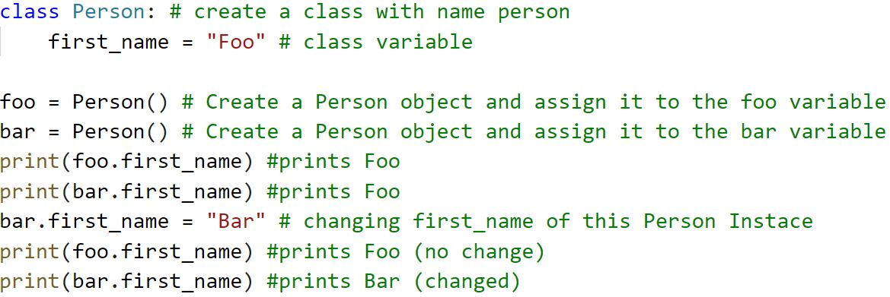
Objects
To create a new object of a class call the class as you would a functions for example Person() and assign that to a variable.
Instance variables are not shared between objects of the same class except for class/static variables (more on that later)
So each object can be viewed as describing their own variant of a class

Slide 5
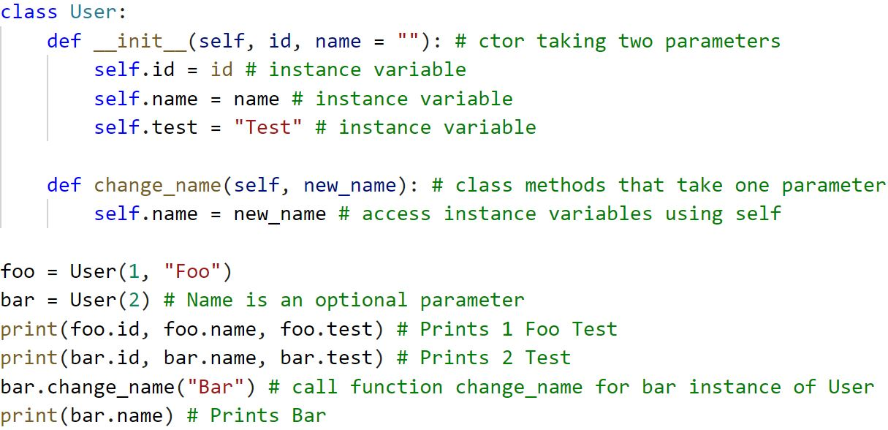
Self
To be able to access variables and methods from the class we need to use the special self keyword. Self holds a reference to itself. So what you are doing is instruction python to get my own(self) copy of the variable
All methods defined in a class must use the self keyword as its first parameter to be able to access the instance variables of the object

Slide 6
Instance variables
Instance variables are unique for each instance of a class changing these variables does not affect other objects instances variables. These should be the default variable type that you use in classes
Instance variables are defined with self.variable_name in the constructor

Slide 7
Class variables
This means that the class owns the variable—it is contained within the class—so all instances of the class will be able to access that variable. Class variables are shared by all instances that access the class
These static variables can be accessed without creating an instance of the object
By convention these are placed directly below the class and above the constructor

Slide 8
Constructors, methods
Constructors(ctor) are automatically called before the class is created and should be used to setup everything that is required for the class to function. For example if a user must have an id that id should be set in the constructor
A constructor is a function with the name __init__(self, name) any parameter passed must be passed when creating objects for example Person("Name")
Functions in classes are called methods the first parameter in methods must be self. When calling methods you do not need to pass self python sets that parameter automatically.

Slide 9
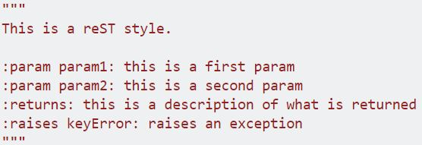
Doc strings
In python many classes, methods and properties are documented by using doc strings. The format of the doc string is based on which standard you follow. Following what is already used in a project is considered best practice. The example uses reST
When writing doc string try to not write redundant comments the method get_id does not need a comment saying "This gets id" what is more interesting in this case might be where it gets id from, what is the format of the id, what would happen if there was no id ? Describe what something does, its limitations, its expectation etc.
Doc strings are delimited by """(triple double quotes) and placed after a def or class statement
They are important when sharing code as doc strings are used by IDE's to generate documentation

Slide 10
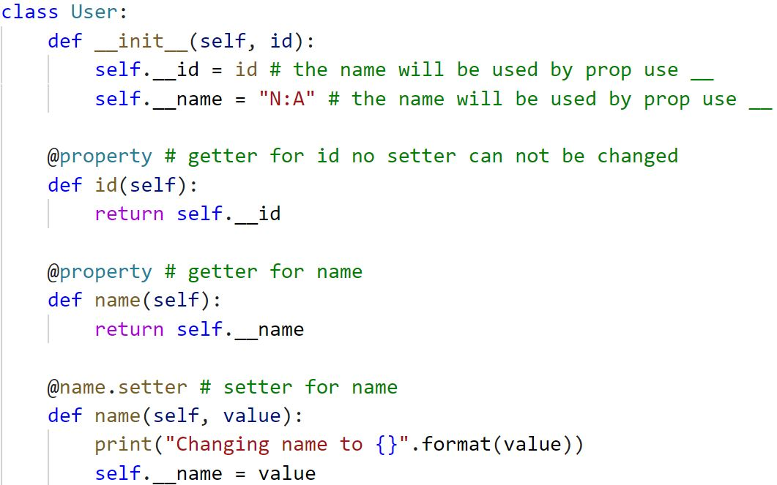
Properties
Instead of directly changing instance variables many OOP languages instead use properties (also called getter/setter) this allows extra behavior to be added before changing instance variables such as validation
In python this can done by using the @property decorator which should be placed above a function with the name of the property
Propeties also allows the ommision of setter or getter which makes it possible to create instance variables that cannot be modified or not read
Because properties share naming with their backing instance variable. Instance variables that use properties should start with double underscores
It's considered bad practice to use setters to change other instance variables

Slide 11
Critisims of OOP
Some prevelant figures withing programming belives OOP to be a bad paragdim because "it does not reach its stated goals of reusability and modularity and for overemphasizing one aspect of software design and modeling (data/objects) at the expense of other important aspects (computation/algorithms)"
Which is a fair point, in OOP languages where everything is contained in classes where you need to invent strange concept such as handlers to encaspulate actions that do not belong to an object (Garbage does not take it self out). This is not an issue in Python where we can choose to use objects to solve specific problems.
Despiste these critisisms no evidence have been brought forth to support this claim and OOP is still the most used programming paragdim today and knowing how to work with it is very important.

