Slide 1

Flask for REST API

Slide 2

Python package index (PyPI)
The official third-party software repository for python is called python package index abbreviated (PyPI) can be found at pypi.org
The package manager pip uses PyPI as its source for packages. Pip comes preinstalled with python and should be used to handle all package installation and updated.
Pip can be used by calling it directly in for example cmd.exe or in the context of the python environment
pip install package-name can be used to install packages
pip list can be used to list all install packages
pip search can be used to do free text searches

Slide 3

Flask
Flask is a micro web framework that can be used to create both web site and API's
Standard Flask is barebone by design that's what micro means in this context, advanced features can be added by using extensions
Install flask using pip. The flask package is called "Flask" i.e. call pip install Flask
Documentation https://flask.palletsprojects.com/en/1.1.x/

Slide 4
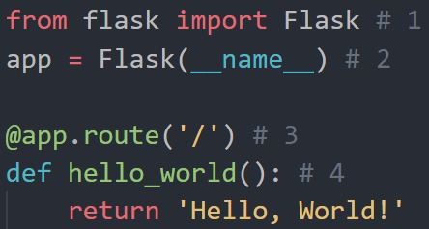
Hello world in Flask
This is what we do in the code example on the right:
We import Flask
We create an instance on the Flask class. The first argument is the name of the application's module or package. If we use a single module we must pass __name__. Flask uses this when importing external files
We then use the route() decorator to tell Flask what URL should trigger the function. The route(‘/’) is the start page
And create an endpoint(function) that will be called when the URL is visited

Slide 5
Running flask
The default name of a flask application is app.py. If we use that as the name of the file containing our flask code.
To start our application we can use either flask run or python –m flask run
To debug a flask application in Visual Studio Code. Select the debug configuration flask and enter the name of the file that contains your flask code.
If you want to use another name for your flask file set an environment variable called FLASK_APP to that files name. Start it normally i.e flask run or python –m flask run

Slide 6
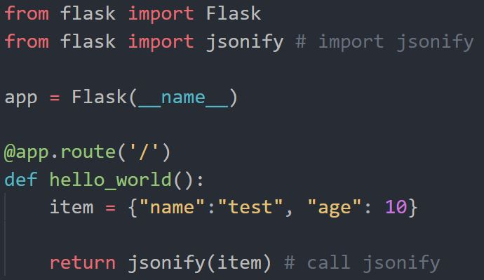
Using Flask as a REST API
There does not exists any difference between Flask for API’s and for web application
The only difference is that REST API’s generally return data formatted using JSON or XML instead of web pages
To convert our response to JSON we can use the built-in Flask function jsonify(). Which will convert an dictionary or simple type(not objects) to a json formatted string containing the variables in the object and also setting headers for the response
Jsonify needs to be imported from flask.
To test API’s we will be using Postman

Slide 7
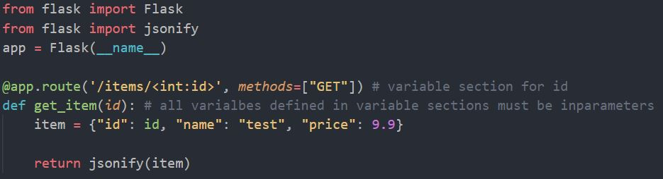
Flask routes
When defining the route we should set which HTTP verb the endpoint is for. Remember that many verbs can and should share the same URL
In routes you can set a variable section which will be populated when the route is hit based on what the variable section contained. This is done using <type:name>. All variable names that exists in variable sections must have matching inparameters in their function
Which HTTP Verbs that should be used can set with the methods parameter. The methods parameter accepts a list for example [“POST”, “PATCH”]

Slide 8
Demo API
In the coming examples we will be working with creating a To-Do API
Within this To-Do API we will be handling Tasks. A task have a title, can be assigned to someone, is either done or not and can have a description
We will be hosting the tasks in a list of dictionaries directly on the server so they will not persist between executions of the application

Slide 9
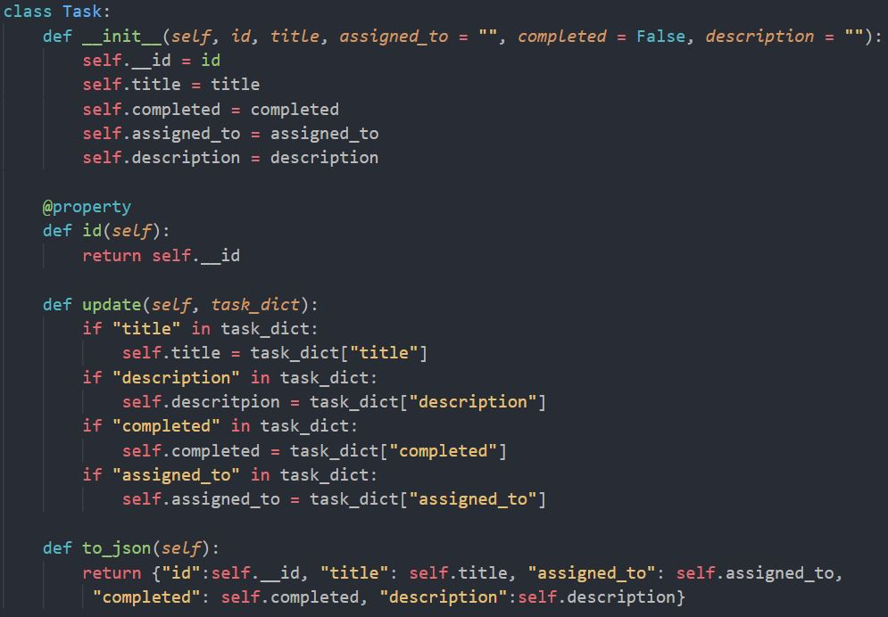

Slide 10

Task import(this is at the to of all examples)

Slide 11
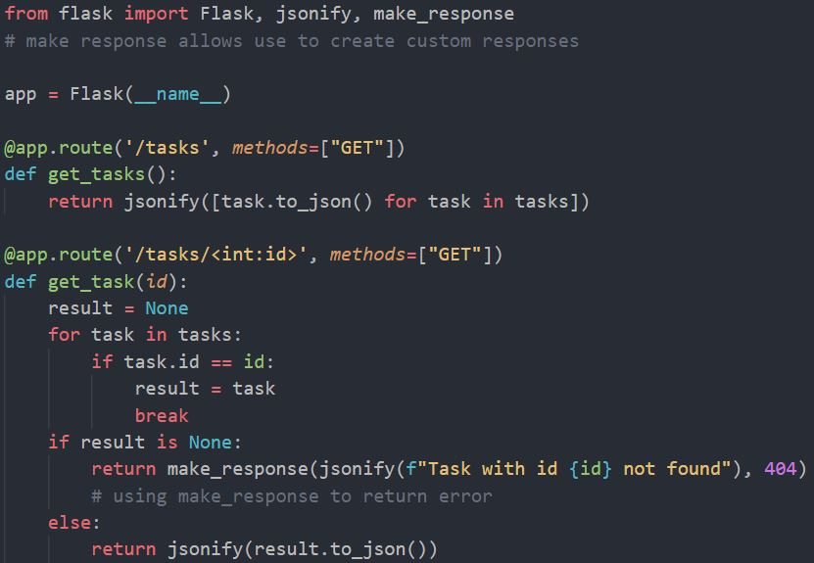
GET in Flask
A GET endpoint should return JSON formatted data.
A GET endpoint often read parameters that are in the URL for example task/id. This can be done by adding parameters in the route decorator using this format <type:name>.
GET endpoint often returns 404 not found error. To return json responses with custom return codes we can use the module make_response. This module can be imported from the flask package

Slide 12
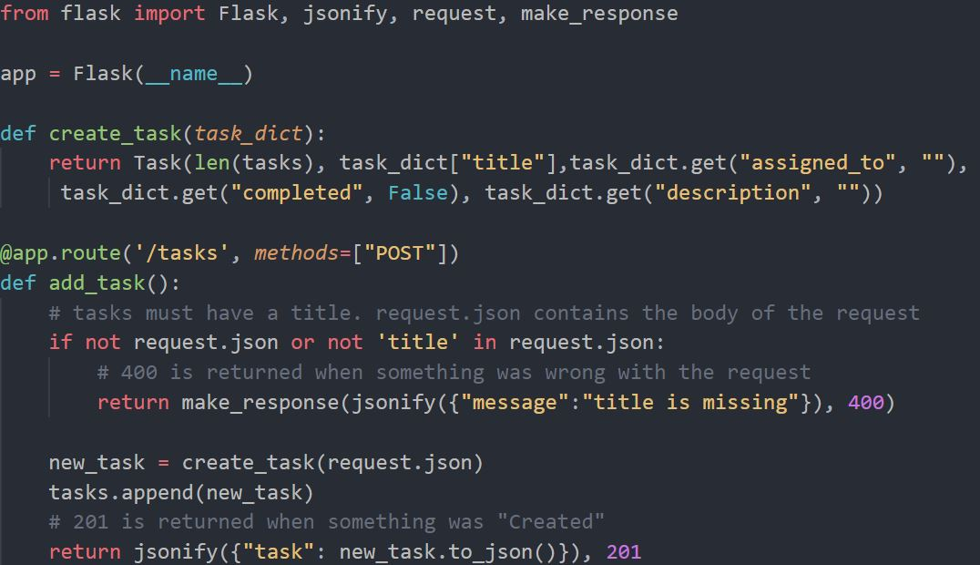
POST in Flask
When using POST requests you often pass data in the body of the request or in the header. So when using POST requests we will work against a request object. This object needs to be imported from the flask package
The request object contains a bunch of properties but the most important for us is the request.json property that contains the content of the request body formatted as json which can be accessed as a dictionary.
The most common post error is 400 bad request. This should be returned when the input from the request is in some way wrong
When creating something we should return a 201-http code
In the to-do API we want to be able to create new tasks. When creating a Task a title is required as input all other is optional.

Slide 13
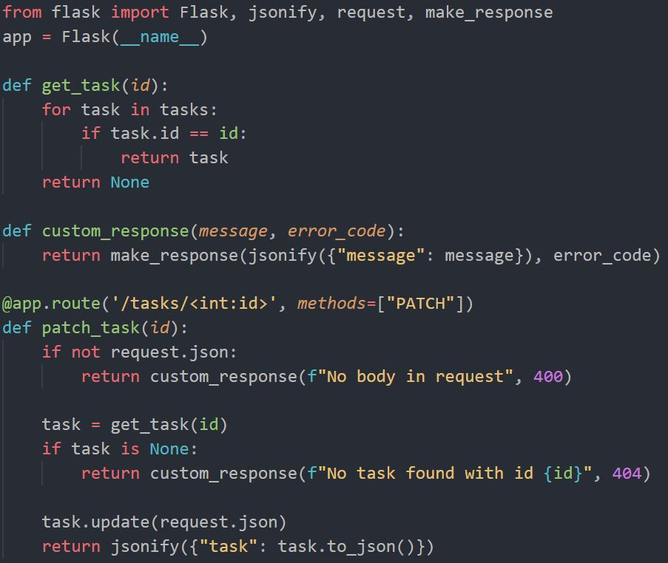
PATCH in Flask
PATCH almost works the same as POST we have a request object with a json part.
But since PATCH only updates existing resources, we need to check that the resource exist before modifying it. Often you would do a GET request for the resource update the resource and then update the old one
When data was updated, we should return a 200-http code
In the to-do API we want to be able to assign people to tasks and change their done status

Slide 14
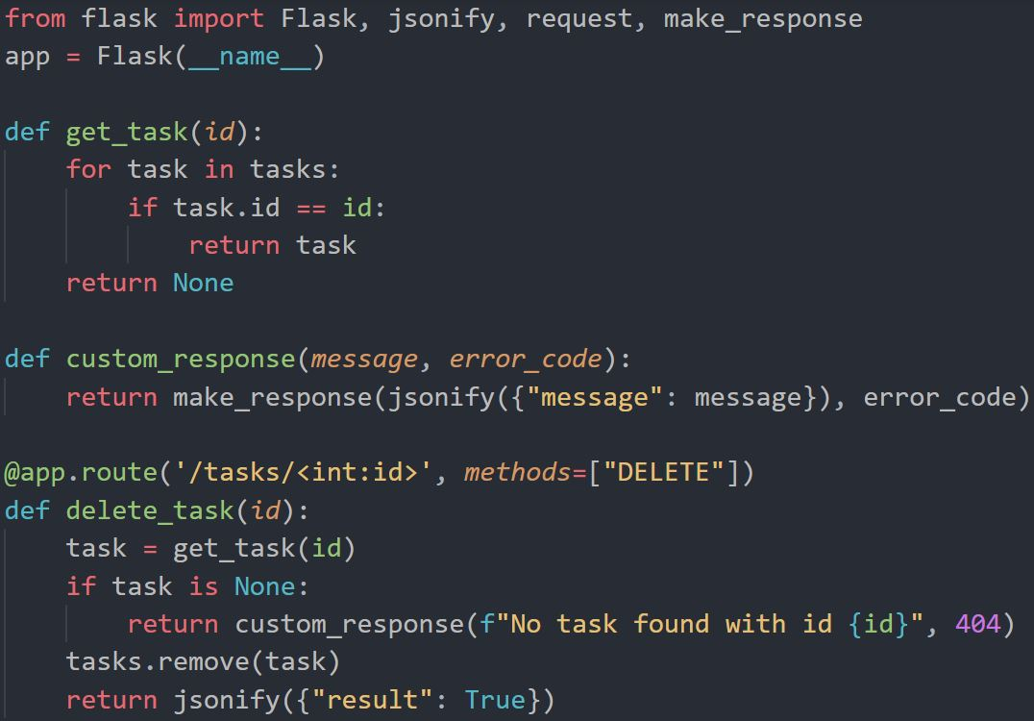
DELETE in Flask
DELETE should be done by finding the task and deleting it
DELETE should probably not ever be able to delete collection resources
When a DELETE is completed a 200-http code should be returned
For the To-Do API we should be able to DELETE a task

Slide 15
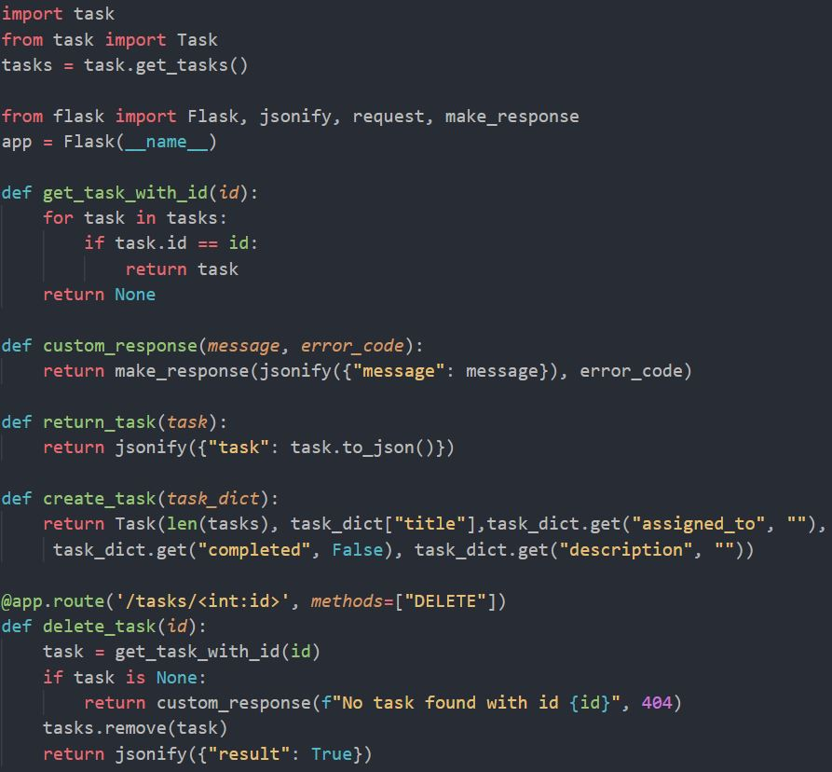
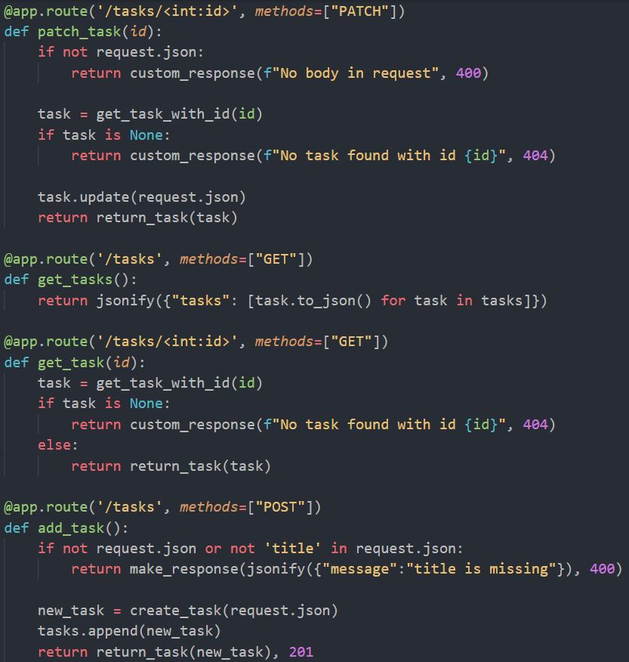

Slide 16
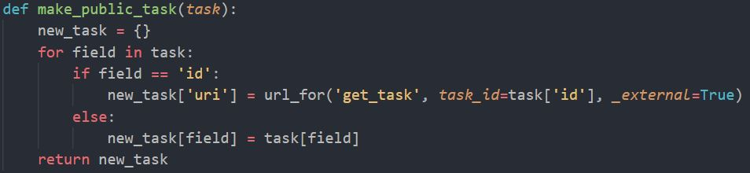
To adhere to HATEOAS
Instead of returning id with the task we should replace it with a url to the item instead
Using the module url_for allows us to dynamically create internal routes to our function with different id's

Slide 17
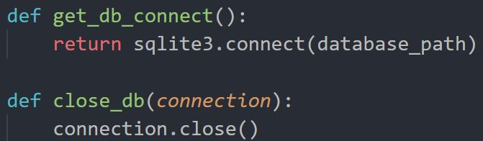
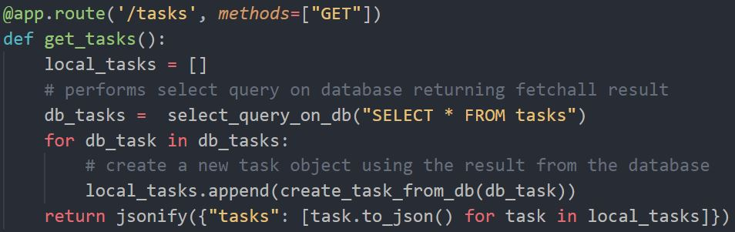
Connect to database
Because of how flask is started we should not use a relative path to our database instead we should ask the application where it is running using app.root_path
The correct way to handle this is using the g package to create a local instance of connection that can be reused and that is automtically closed when finished

Slide 18
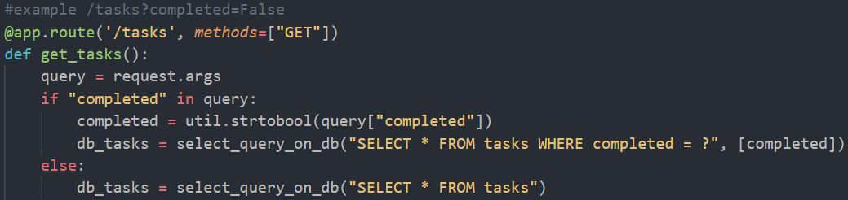
Using query parameters
To access query parameters use request.args
Request.args contains the query parameters in a dict and can be accessed using normal dict syntax
When sending a request with query parameters use the standard format i.e ?firstParam=firstValue&secondParam=secondValue

Slide 19
How could this API be improved ?
Security, version handling, following best pratice for Flask, logging/alerts

