Slide 1


Slide 2
This weeks agenda
Intro API
REST API
Postman
Flask
API examples

Slide 3
Object-oriented programming cont.
Beyond just using classes and objects. Object-oriented programming consists of a couple of concepts that serve different purposes such as reducing code duplication, hiding data, sharing behavior
These concepts are encapsulation, abstraction, inheritance, polymorphism and composition
Using these concepts is not required but gives us more tools when solving complex problem. Makes code more readable, easier to extend and maintain

Slide 4
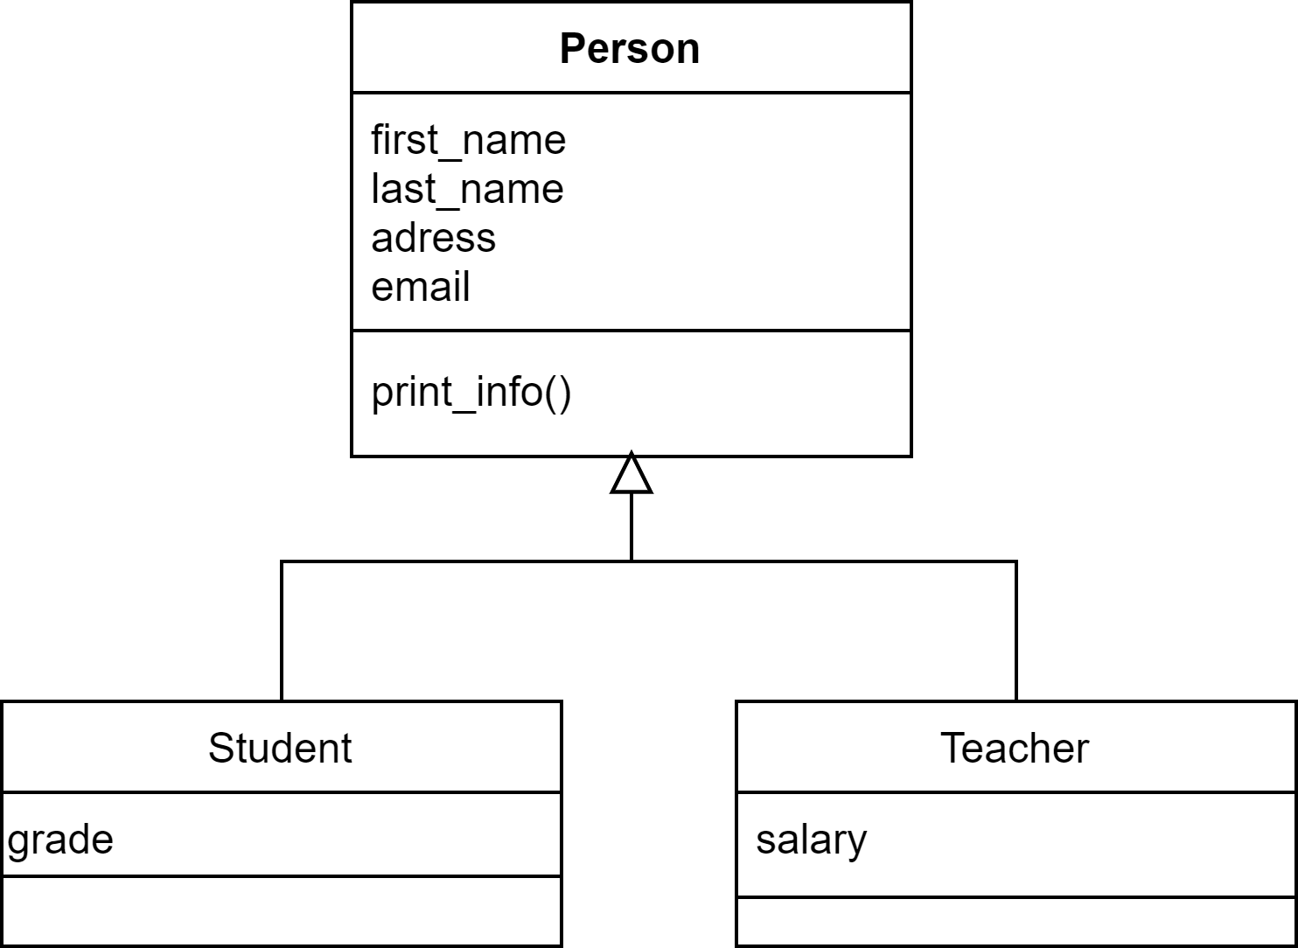
Inheritance
Inheritance is the mechanism of basing one class on another. This creates a hierarchy of classes that represents a "is-a" relationship, a student "is-a" person
All "child" classes of a "parent" class inherits all properties and behaviors of their parent. Except for constructors.
This allows us to share behavior between classes that are like each other and reduce code duplication. This also makes it easier to add more type of persons in the future.
Say we have the classes Student and Teacher that both have the properties first_name, last_name, address, email and the method print_info(). We create the parent or base class Person that contains the properties first_name, last_name, adress, email and method print_info(). This allows us to keep what is unique for a Student such as grade in the Student class which makes it easier to reason about.
If we want to customize the behavior of a base class property or method, we can overload it.

Slide 5
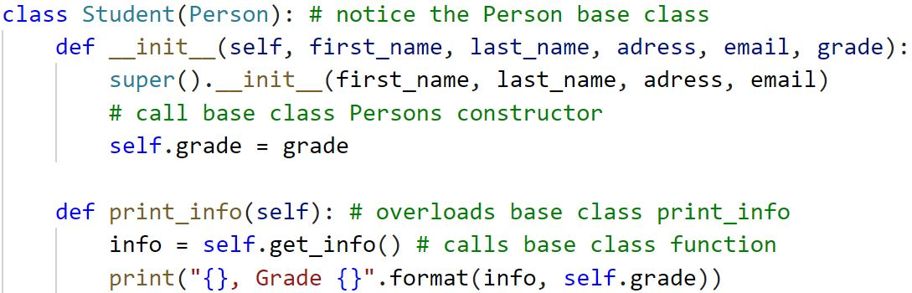
Inheritance in python
To setup inheritance you must pass the Base class to the super class you do this when creating the class like this class Student(Person):
To use overloading in python we only must defined a name in the super class that also exists in the base class. Note that this also applies to constructors
You can use the keyword super to reference the base class. This is often used to call the base class constructor (which should be done from the super class constructor) like this super().__init__(parameters)

Slide 6
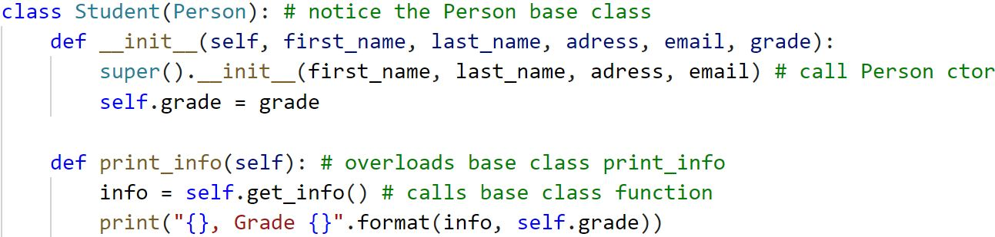
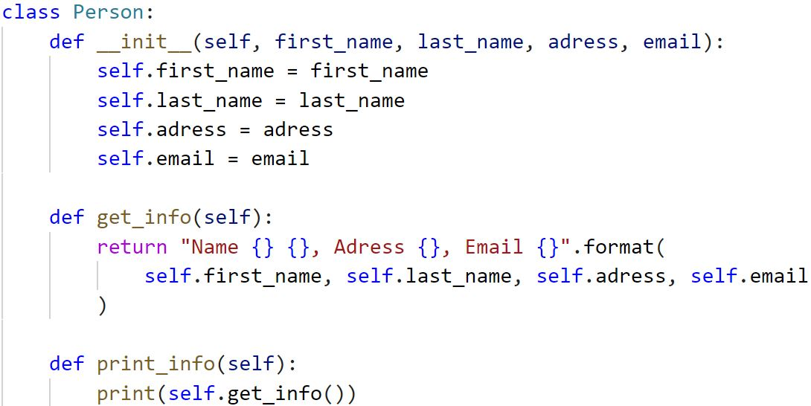
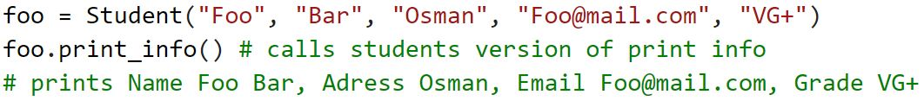

Slide 7
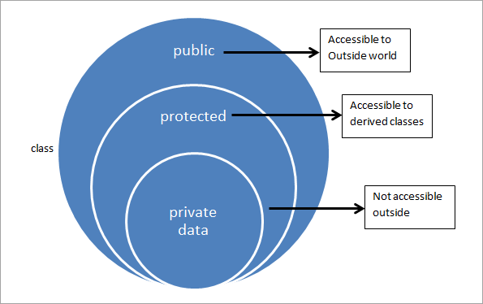
Encapsulation
Encapsulation revolves around the idea that the author of a class knows best how it should be used. To keep users from accessing properties or methods that should not be accessed OOP uses encapsulation
This is done by using access levels that defined from where you can access something. The most common levels are public, private and protected
Public is always accessible these can always be called or modified
Protected can be called from within the class or by subclasses that inherit the class
Private can only be accessed from within the class so only the class can call or modify
Better classes have fewer things that are public

Slide 8
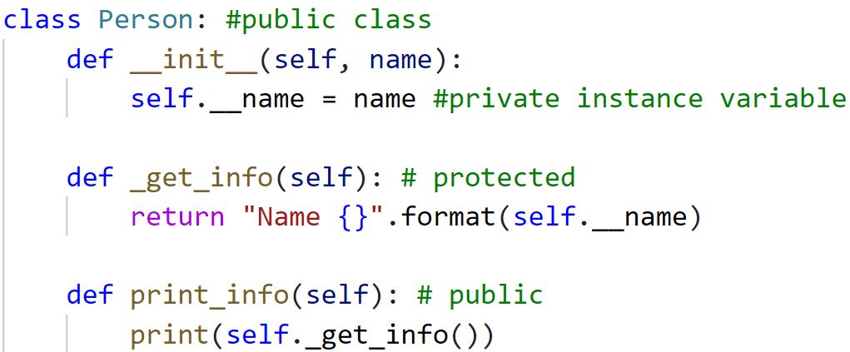
Encapsulation in python
Python does not have any way to enforce encapsulation you can always access private or protected names. But! you should never do this as it might have unintended behavior.
To indicate that something is intended to be protected we prefix it with a _ (single underscore)
To indicate that something is intended to be private we prefix it with a __(double underscore)
Everything else is public

Slide 9
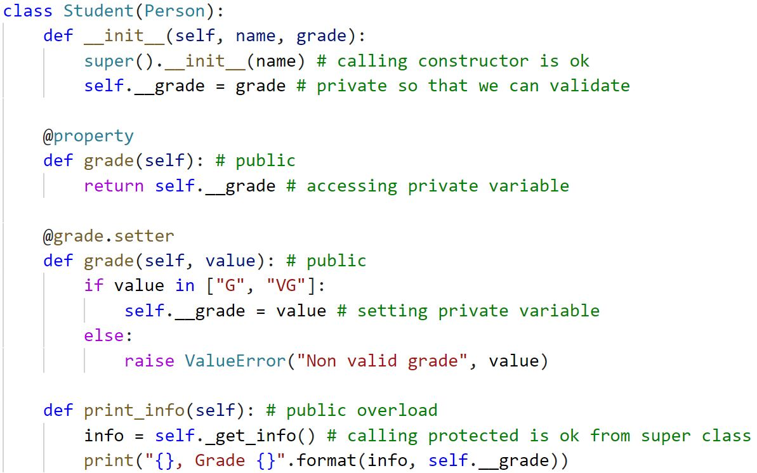
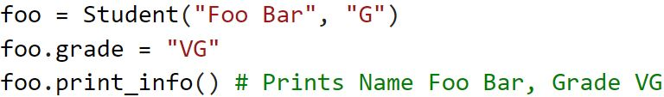

Slide 10
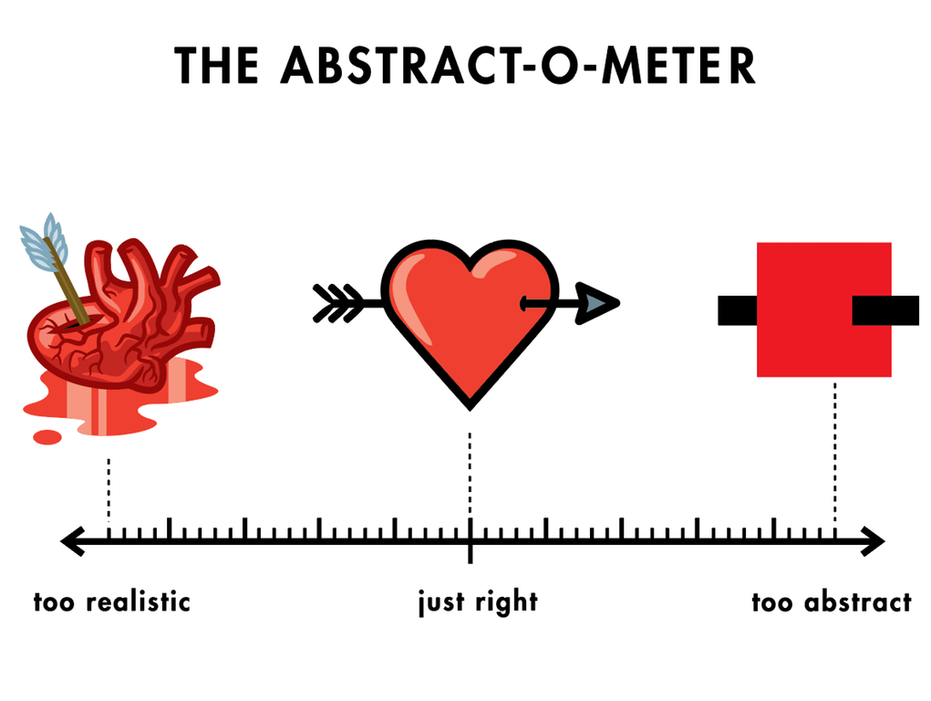
Abstraction
Abstraction is a key concept of OOP. The main idea is to handle complexity by hiding unnecessary details from the users. This should in theory allow users to implement advanced logic on top of other things without having to understand all the hidden complexity.
Abstraction is a very generic concept that can be found eveywhere. When you hit the start button on a coffe machine it boils water, grinds beans and starts warming the coffe pot. The on button abstracts away all these steps. If we wrote a coffe machine class, we could for example have a single method for make_coffe() this would be very abstract. Perhaps to abstract ? Abstraction is more art than science. How abstract something should be depends on the system it exists in.
Abstraction is a design concept that is achieved by using other OOP concepts. You think of abstraction when designing rather than implementing

Slide 11
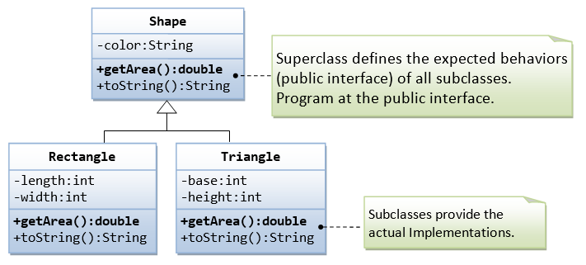
Polymorphism
Polymorphism is one of the most powerful concepts of OOP. It allows us to separate implementation and interfaces so that we can work directly against interfaces which is very important in complex system. It allows us to introduce new behavior by simply creating a new class for the behavior that implements the interface. It also creates an abstraction as we only need to know what the interface does
Suppose we have a program that calculates the area of different shapes. We could create an interface called Shape that has the method get_area() and implement this in the classes Triangle and Rectangle. Anything acting on these Shapes would use the interface instead of the classes. If we had not used an interface, we would have to create separate methods for Triangle, Rectangle and any other shape we added.

Slide 12
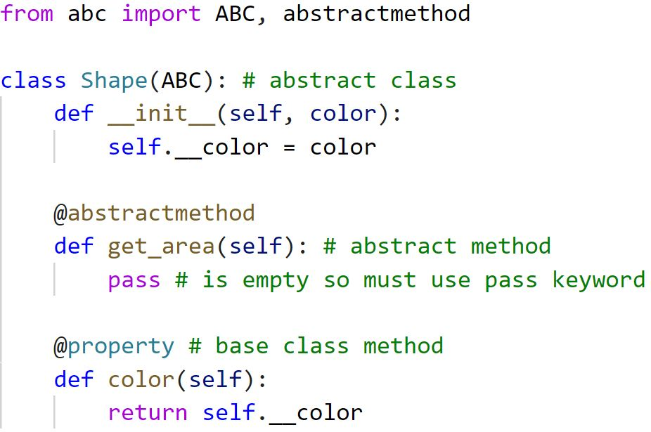
Abstract classes in python
An abstract class can be seen as a blueprint for other classes. It allows you to create a set of methods that must exists on any child classes implementing the abstract class. While still being able to have shared properties and methods. Abstract classes serves as pythons' version of interfaces
The abc class must be imported: from abc import ABC, abstractmethod to set a class to be abstract pass ABC when creating it for example class Person(ABC): would create the abstract class Person
Abstract methods are methods that classes inheriting an abstract class must implement. In python we use the decorator @abstractmethod to create an abstract method.
The pass keyword must be used when a method or class is empty

Slide 13
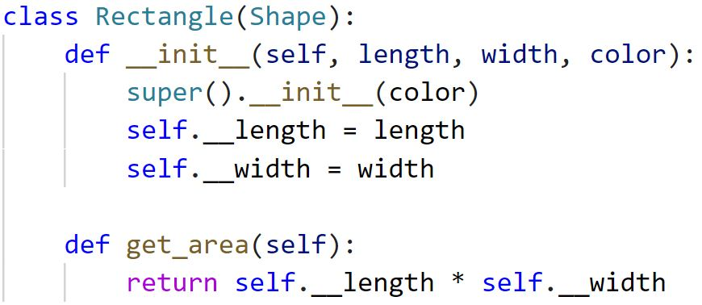
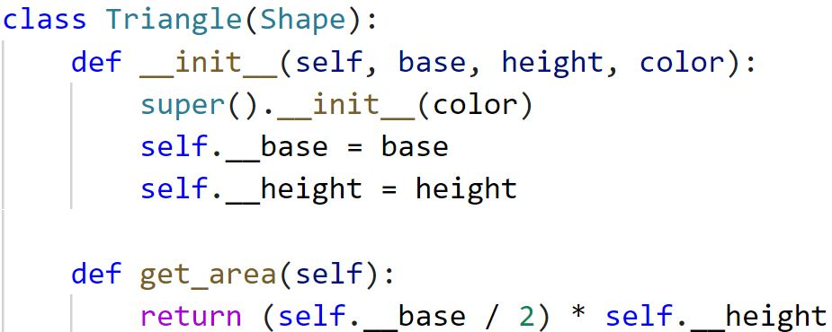
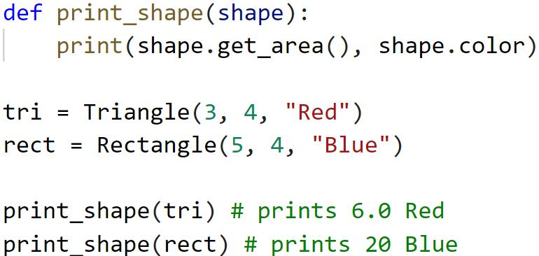

Slide 14
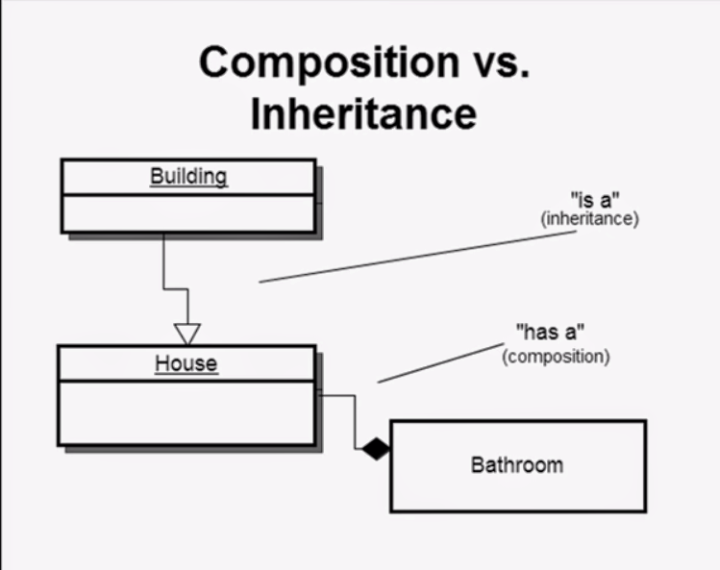
Composition
With composition we can model "has-a" relationships. By using composition we can easier and more clearly extend the behavior of our classes without it affecting any other part of our system. Changes to a class will always be contained within the class(if we do not change publics)
Inheritance and composition achieves the same principles such as polymorphic behavior and code reuse. By using different methods. In composition we pass other class instances to a class that implements the desired functionality instead of deriving it from a base class.
Using composition is especially important when using small contained classes which is a goal when design OO. Using a combination of composition and inheritance is very common

Slide 15
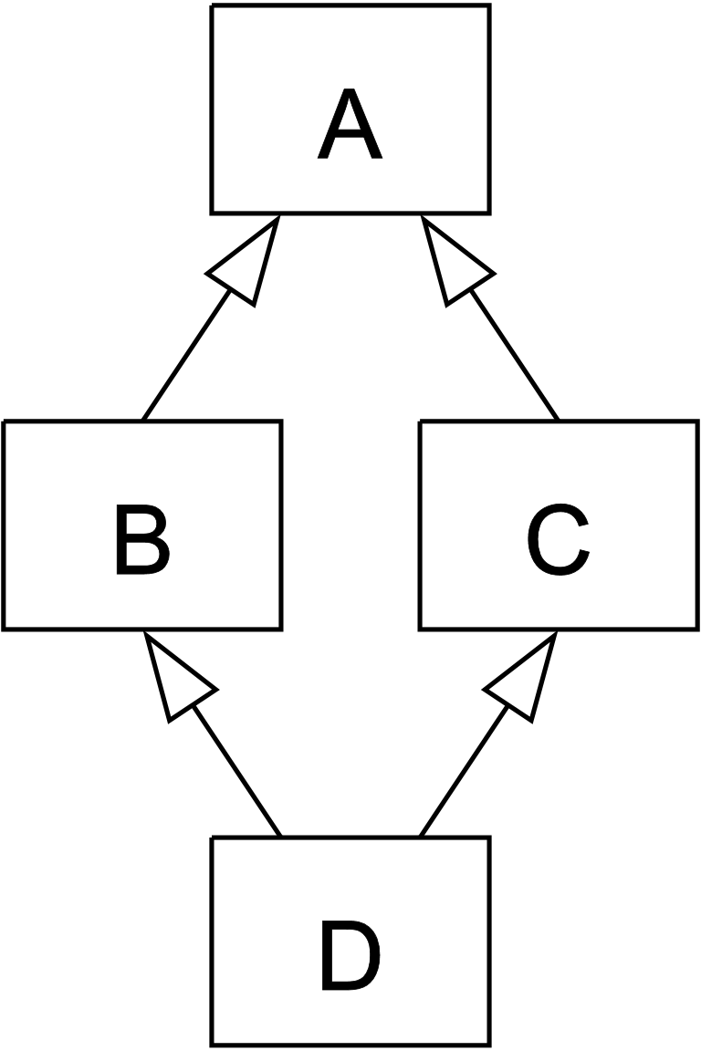
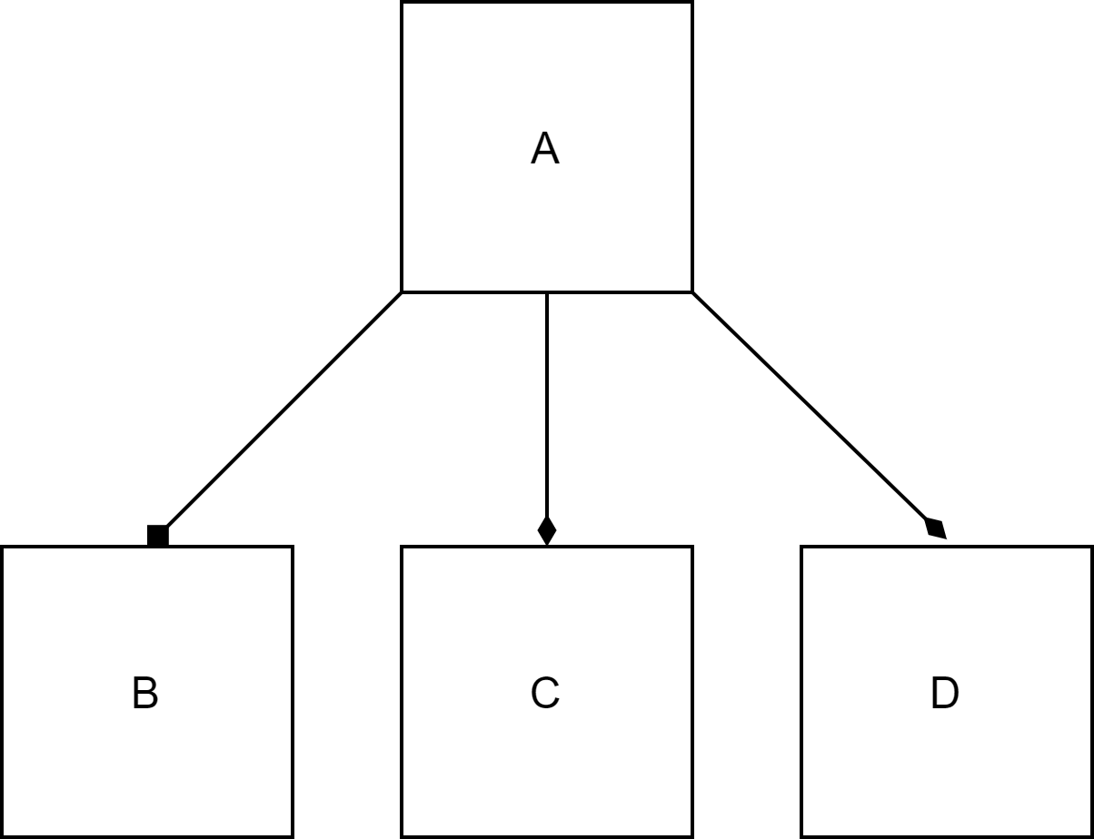
Composition over inheritance
When inheritance is used extensively you can sometimes encounter the diamond problem where a class derives from two classes that derives from the same base class. This must be avoided as it creates non-deterministic behavior
An easy way to spot when composition should be used is if you have these sort of names VisibleAndSolid, VisibleAndMovable, VisibleAndSolidAndMovable and so on. This indicates that you want to be able to combine behavior in classes but since you can only inherit from one class you have created all combinations of behavior as classes. What if we want to add another behavior. If we were to use composition, we would create the classes Visible, Solid, Movable and pass which should be used to the object when creating it.

Slide 16
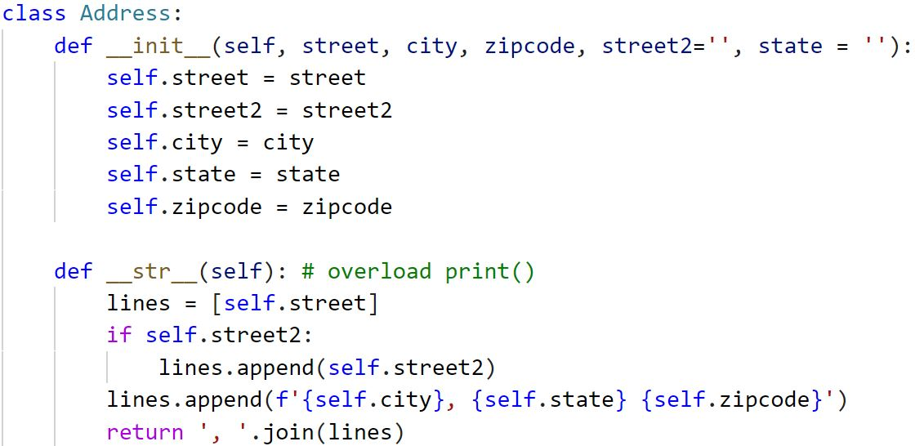
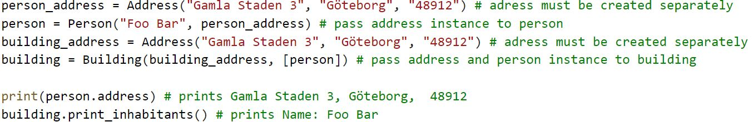
Composition in python
Python does not have any language constructs to facilitate composition.
In python we create instances of classes that should be used in a class and pass them in the constructor.

Slide 17
