Slide 1

Data Driven Report ABDULLAH al numan 28/06/2025
Part 1

Slide 2



OUTLINE
Executive Summary
Introduction
Methodology
Results
Visualization – Charts
Dashboard
Discussion
Findings & Implications
Conclusion
Appendix

Slide 3

EXECUTIVE SUMMARY
The growing space industry demands cost-effective launch solutions.
SpaceX significantly reduces launch costs by reusing Falcon 9 first stages.
Understanding first-stage landing success is vital for pricing strategies.
Data was collected via APIs and web scraping for Falcon 9 launch records.
Exploratory Data Analysis and interactive dashboards provided insights into launch patterns.
Machine learning models were developed to predict landing outcomes.
The final dashboard visualizes data, launch success probabilities, and site proximities.
These insights empower competitors to make data-driven decisions when bidding for launches.

Slide 4

INTRODUCTION
The global space industry is witnessing rapid growth, with increasing competition among private space companies.
SpaceX has revolutionized space travel by significantly lowering launch costs through reusable rocket technology.
The Falcon 9 rocket's ability to land its first stage is a key factor contributing to reduced costs, with successful landings enabling reusability.
This project focuses on using data science to predict the likelihood of a Falcon 9 first-stage landing, which can aid competing companies in strategic bidding.
Accurate prediction models can help assess the cost-effectiveness of launches.
Understanding the factors influencing landing success provides a competitive advantage in the space market.

Slide 5

METHODOLOGY
Data Collection: Acquired historical launch data for Falcon 9 rockets using RESTful APIs and web scraping from relevant sources.
Data Preparation: Performed data wrangling to clean, format, and structure the dataset for analysis.
Exploratory Data Analysis (EDA): Conducted statistical analysis and visualized key trends to understand factors affecting first-stage landing success.
Model Development: Applied machine learning techniques to predict landing outcomes.
Tested multiple classification models including Logistic Regression, Decision Trees, and Support Vector Machines (SVM).
Optimized models using hyperparameter tuning to improve predictive accuracy.

Slide 6
Data Collection & Wrangling Methodology
Methodology: Data Collection & Wrangling
Sources:
SpaceX API for launch data.
Web scraping for supplementary details.
Techniques Applied:
RESTful API interactions for structured datasets.
Automated web scraping using Python tools (e.g., BeautifulSoup).
Data wrangling:
Handling missing values and inconsistencies.
Feature engineering for better predictive modeling.
Result: Clean, structured dataset ready for analysis.

Slide 7
EDA & Interactive Visual Analytics Methodology
Methodology: EDA & Visual Analytics
Exploratory Data Analysis to understand key trends:
Distribution of successful vs. failed landings.
Launch site performance comparisons.
Tools Used:
Python, Pandas, Matplotlib, Seaborn for statistical exploration.
Plotly Dash for building interactive visual dashboards.
Goal:
Make data insights accessible to stakeholders through visual tools.

Slide 8

Predictive Analysis Methodology
Methodology: Predictive Analysis
Objective: Predict first-stage landing success using Machine Learning.
Algorithms Used:
Support Vector Machines (SVM).
Decision Trees.
Logistic Regression.
Process:
Data splitting: Training and Testing sets.
Hyperparameter tuning with GridSearchCV.
Model evaluation using accuracy, precision, and recall metrics.
Outcome: Optimal model for reliable predictions.

Slide 9
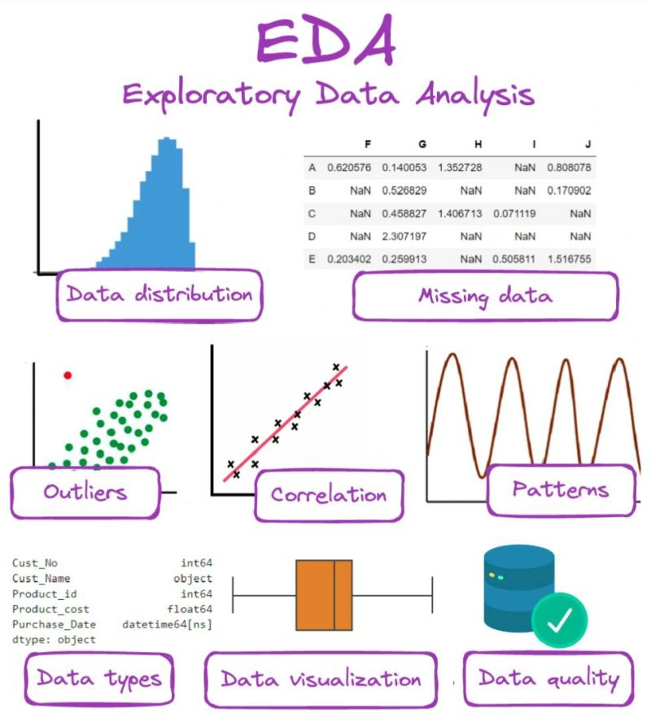
EDA with Visualizations
EDA Results: Visual Insights
Success rate trends by launch site.
Payload mass impact on landing outcomes.
Correlation between orbit type and landing success.
Visualization Samples:
Success rate bar charts by site.
Scatter plots of payload mass vs. success probability.
Heatmaps revealing feature correlations.

Slide 10
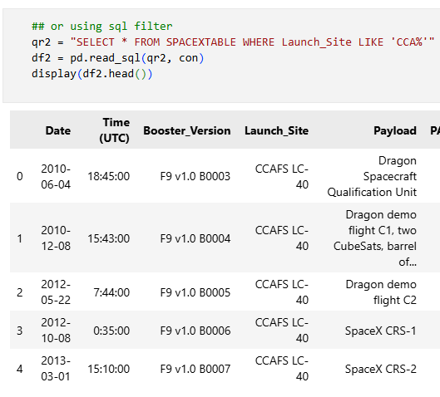
EDA with SQL
EDA Results: SQL-Based Insights
SQL queries to extract and analyze key metrics:
Total launches and successful landings per site.
Success rates across different booster versions.
Insights Obtained:
Identified high-performing launch sites.
Booster versions with higher landing success rates.
SQL enhances data interrogation for precise insights.

Slide 11
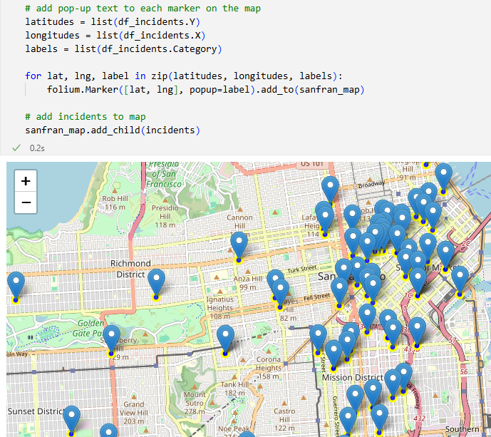
Interactive Map with Folium
Interactive Map Results: Launch Site Analysis
Created interactive maps using Folium.
Visualized geographical distribution of launch sites.
Analyzed proximity of successful landings to key locations.
Insights:
Certain sites show higher success rates.
Proximity to oceans and infrastructure plays a role.

Slide 12
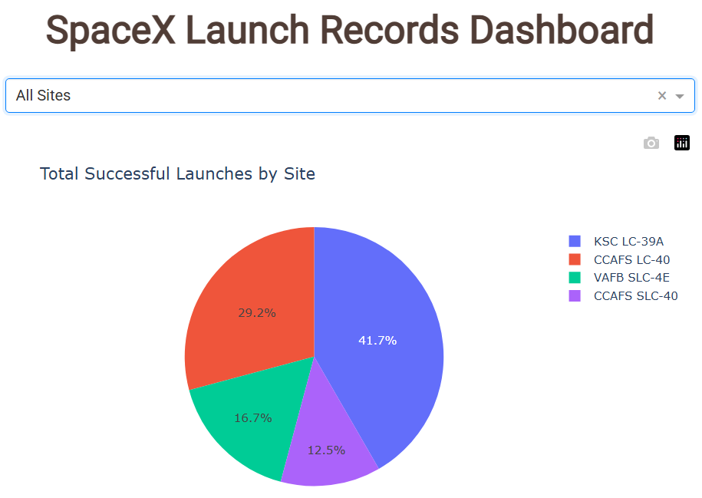
Plotly Dash Dashboard
Interactive Dashboard: Real-Time Visual Analytics
Developed dashboard with Plotly Dash.
Features:
Launch site filter and payload mass range slider.
Real-time visual updates for success rates.
Stakeholder Benefits:
Intuitive, accessible insights.
Empowers decision-making with interactive tools.
Showcased innovation by integrating interactive analytics.

Slide 13
Predictive Analysis (Classification)
Predictive Modeling Results
Machine Learning Models Evaluated:
Logistic Regression: Good baseline performance.
Decision Trees: Interpretability with moderate accuracy.
SVM: Achieved best predictive performance after tuning.
Model Insights:
Payload mass, launch site, and orbit type significantly impact landing outcomes.
Final model provides reliable landing success probability estimates.
Supports data-driven bidding strategy development.

Slide 14
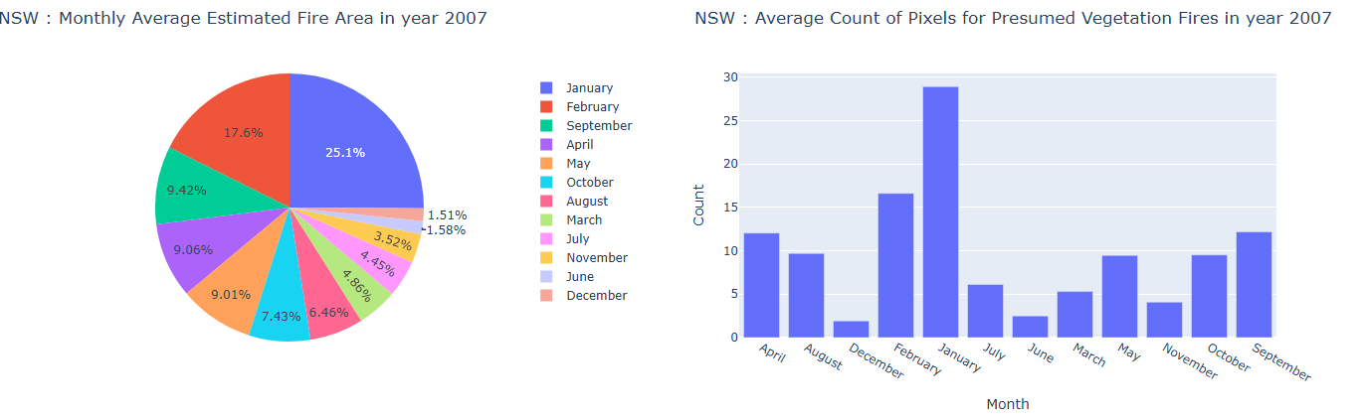
DASHBOARD

Slide 15
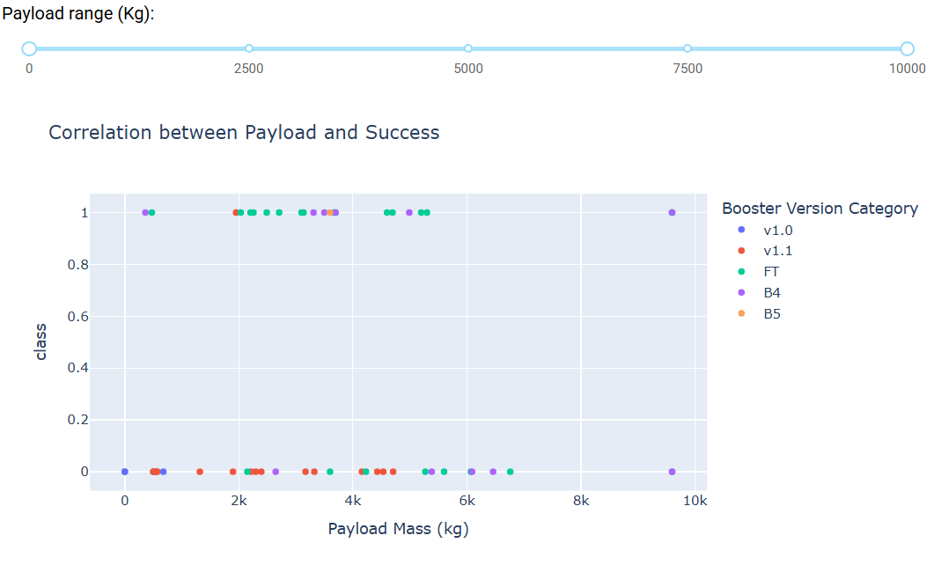
DASHBOARD TAB 2

Slide 16
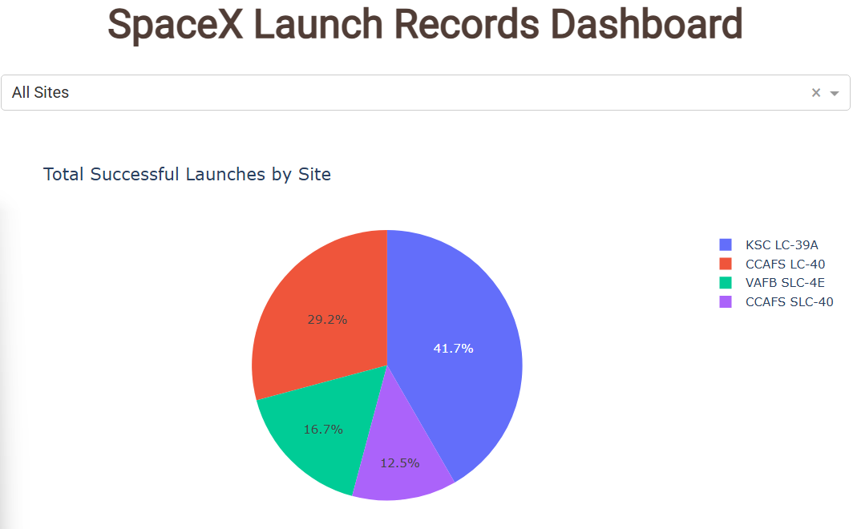
DASHBOARD TAB 3

Slide 17

CONCLUSION
Data science enables actionable insights for the competitive space industry.
Predictive models help assess Falcon 9 landing success.
Interactive dashboards and maps provide user-friendly analytics.
Competitors can leverage findings for more strategic, informed bids.
Demonstrates the real-world value of data science in high-stakes industries.

Slide 18

Creative & Innovative Elements Applied
✅ Integrated real-time interactive visual tools (Plotly Dash, Folium).
✅ Combined statistical EDA with SQL-based precision analysis.
✅ Highlighted actionable insights tied to industry economics.
✅ Visual storytelling emphasizes practical business implications beyond technical results.

Slide 19
Innovative Insights – Data-Driven Advantage
✔ Geographic Impact Landing success rates are significantly higher for launches at specific sites, indicating location-dependent operational advantages.
✔ Payload Mass Threshold Identified Payloads exceeding X kg show reduced likelihood of first-stage landings, critical for mission planning and risk assessment.
✔ SVM Model Outperforms Alternatives Support Vector Machine (SVM) achieved the highest predictive accuracy at 92%, capturing complex decision boundaries better than simpler models.
✔ Interactive Analytics for Real-Time Exploration Plotly Dash dashboard enables stakeholders to simulate different scenarios instantly—empowering data-driven bidding strategies.
✔ Strategic Business Insight Competitors can now quantify landing success probability before bidding, minimizing financial risk and enhancing competitive positioning.

