Slide 1

Specification 26 JUNE 2014

Slide 2
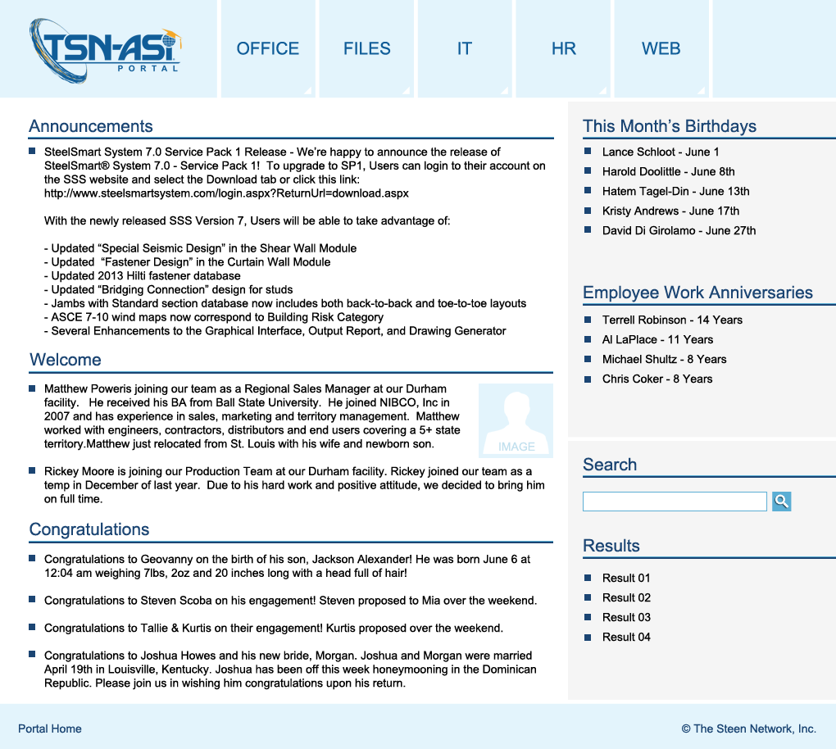
TSN-ASI Portal
This is the new TSN-ASI Portal site. It’s purpose is to expedite the flow of information within TSN and ASI by giving employees a direct connection to the applications, documents, and information they require most.
Almost all portal content is editable by administrators via an administrative dashboard.

Slide 3
Sections & Responsive Design

Slide 4
TSN-ASI Portal Sections
Logo
Main Menu
Sidebar
Page Content
Search Sidebar
Footer

Slide 5
TSN-ASI Portal Sections - Responsive
The TSN-ASI Portal is intended to be the homepage for TSN and ASI browsers viewable on multiple platforms. To this end, the Portal has been designed to be responsive to both desktop and mobile/tablet viewing. The Portal’s sections dynamically adjust to fit the space provided by the user’s display settings.
Desktop
Tablet
Mobile

Slide 6
Main Dropdown Menu

Slide 7
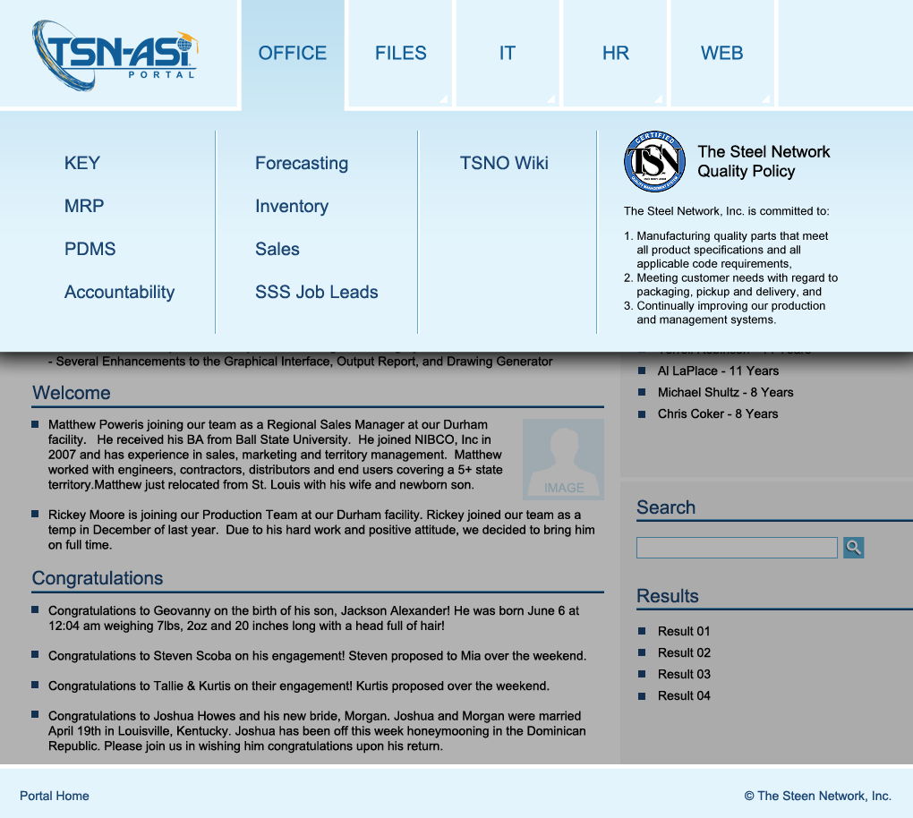
Main Menu
A central feature of the TSN-ASI Portal site is the Main Menu. It is designed to offer employees the most direct route to the tools and documents they require.
The buttons are large to accommodate touch screens used with tablet and mobile devices. Clicking or touching the main menu buttons triggers the dropdown menu that displays the most popular content. This content is managed by the administrative dashboard.
Since content and tools are updated frequently, administrators have the ability to modify the button text and the hyperlink associated with it.
Logo
- Links to Homepage
Main Menu Buttons
- Opens Dropdown Menus
Flex
- Space for Additional Buttons
Dropdown Menus
- Contains text or links to URL’s, files, or Portal pages
The areas beneath the dropdown menu becomes shaded when the dropdown menu is enabled.

Slide 8
TSN-ASI Portal Main Dropdown Menu
Portal PAGE
Intranet APP
Network FOLDER
URL
FILE
Portal Homepage
Office
Files
IT
HR
WEB
Main Dropdown Menu
Key
TSN Lists
Report IT Issue
Paychex.com
steelnetwork.com
MRP
ASI Lists
Phone Functions
uhc.com
appliedscienceint.com
PDMS
TSN Projects
TSN Web Mail
Office Supply Request
extremeloading.com
Accountability
ASI Projects
AnyMeeting Web Conferencing
Company Calendar
steelsmartsystem.com
Forecasting
TSN Publications
AnyMeeting System Test
structuralnews.com
Inventory
ASI Publications
Holiday Schedule
appliedelementmethod.com
Sales
TSN Presentations
AnyMeeting Support
Working Hours Policy
specialtyengineers.com
SSS Job Leads
ASI Presentations
Phone List
Time Off Policy
lifespandeck.com
TSNO Wiki
Product Information Bank
Quality Control Manual
Time Off Request Form
TSN / ASI/ Lifespan Deck
Social Media Links
Company Photos
Customer Complaint Form
PTO Supplement Form
Linked In
Logos & Letterhead
You Tube
Mileage Expense Form
Facebook
Expense Report
Google+
Although the content that appears in the main menu dropdown is managed by the administrative dashboard, the chart shown here depicts what the initial content will be. The buttons link to an assortment of content including pages, apps, network folders, files, and external websites.
Clicking, or touching in the case of a mobile device or tablet, the main menu buttons triggers the dropdown menu to appear which displays the content listed here.
PayChex Employee Instructions
Pinterest
Twitter
Employee Discount – Verizon Wireless
RSS Feed

Slide 9
Office Dropdown
Portal PAGE
Intranet APP
Network FOLDER
URL
FILE
Office
Key
MRP
PDMS
Accountability
Forecasting
Inventory
Sales
SSS Job Leads
TSNO Wiki
The Office dropdown menu contains links to the majority of TSN and ASI’s management information system applications, as well as a link to the TSN Office Wiki, which will be a section within the portal where employees will find answers to common questions surrounding the various applications. The TSN Quality Policy is also displayed on this dropdown the remind employees of TSN’s commitment to quality standards and products.

Slide 10
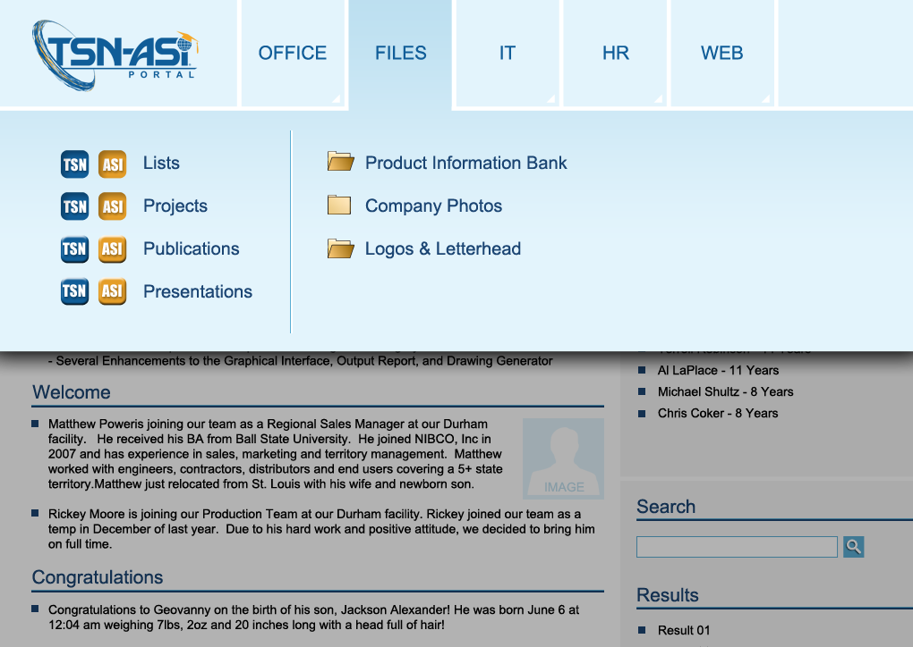
Files Dropdown
Portal PAGE
Intranet APP
Network FOLDER
URL
FILE
Files
TSN Lists
ASI Lists
TSN Projects
ASI Projects
TSN Publications
ASI Publications
TSN Presentations
ASI Presentations
Product Information Bank
Company Photos
Logos & Letterhead
The Files dropdown menu contains links to a variety of TSN and ASI documents and resources. The Portal pages these menu items link to are largely lists that allow employees to directly access approved files. Links to a few network folders located on TSN’s LAN are also provided which contain large quantities of current and archived files that are useful.

Slide 11
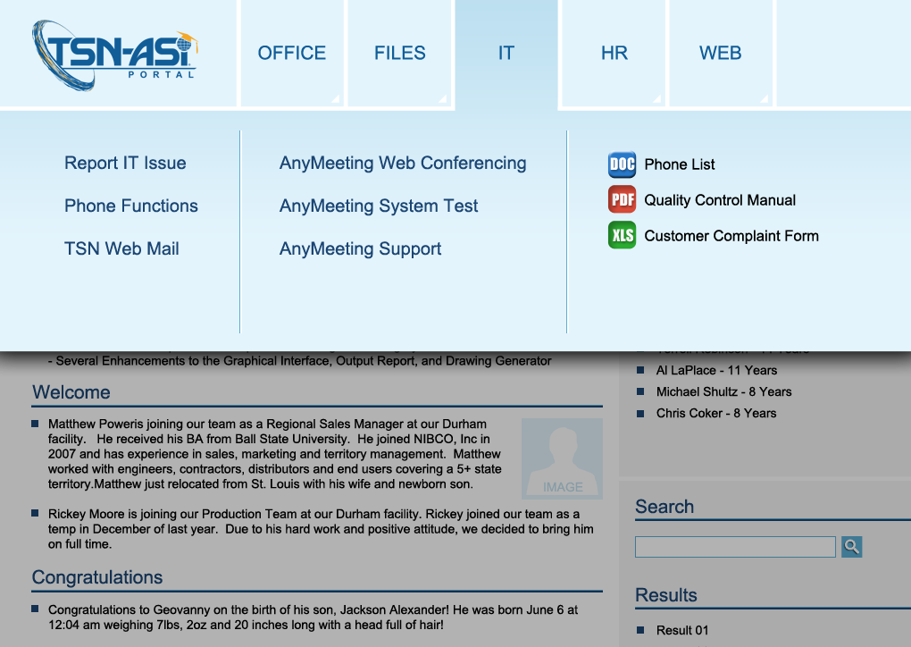
IT Dropdown
Portal PAGE
Intranet APP
Network FOLDER
URL
FILE
IT
Report IT Issue
Phone Functions
TSN Web Mail
AnyMeeting Web Conferencing
AnyMeeting System Test
AnyMeeting Support
Phone List
Quality Control Manual
Customer Complaint Form
The Information Technology dropdown menu contains links to a resources related to phone, web conferencing, and email functionality. There is also a link to a page dedicated to reporting IT issues. A few IT-related documents are provided here as well.

Slide 12
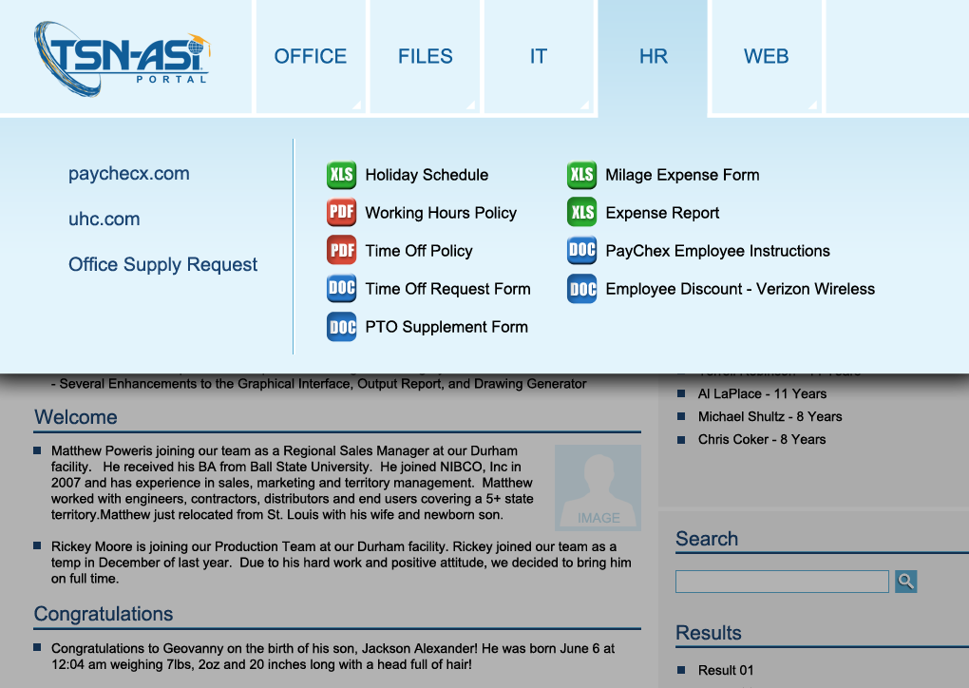
HR Dropdown
Portal PAGE
Intranet APP
Network FOLDER
URL
FILE
HR
Paychex.com
uhc.com
Office Supply Request
Company Calendar
Holiday Schedule
Working Hours Policy
Time Off Policy
Time Off Request Form
PTO Supplement Form
Mileage Expense Form
Expense Report
PayChex Employee Instructions
The Human Resources dropdown menu gives TSN and ASI employees links to benefits and payment resources. Additionally, a host of documents commonly related to working policies and time-off procedures are directly accessed here.
Employee Discount – Verizon Wireless

Slide 13
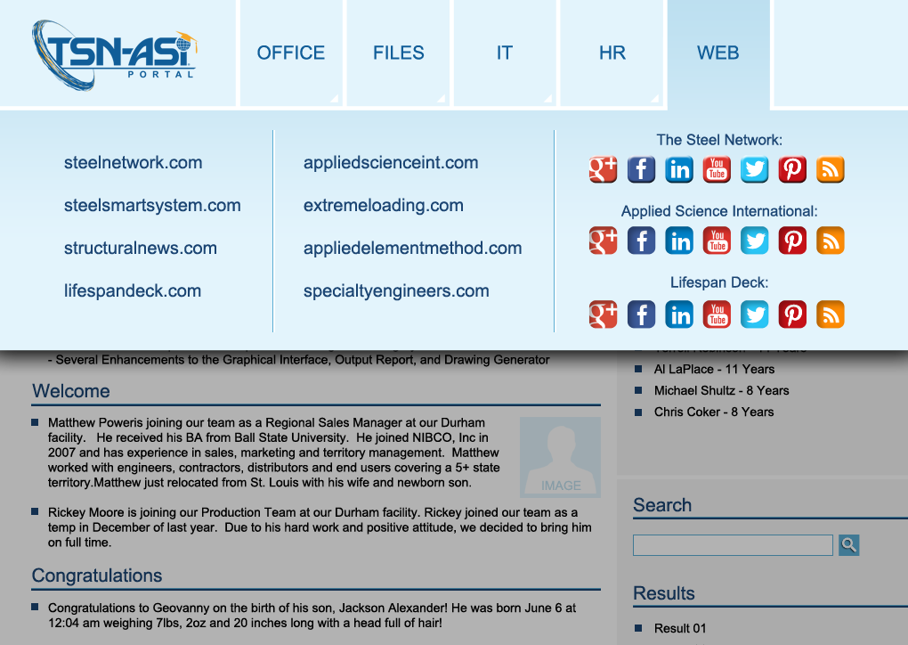
Web Dropdown
Portal PAGE
Intranet APP
Network FOLDER
URL
FILE
WEB
steelnetwork.com
appliedscienceint.com
extremeloading.com
steelsmartsystem.com
structuralnews.com
appliedelementmethod.com
specialtyengineers.com
lifespandeck.com
TSN / ASI/ Lifespan Deck
Social Media Links
Linked In
You Tube
Facebook
Google+
Pinterest
Twitter
RSS Feed
The Web dropdown menu displays a multitude of links connecting to TSN and ASI web properties and social media accounts.

Slide 14
Sidebar & Search

Slide 15
Sidebar & Search
Portal Administrators can add units to the Sidebar and Items are listed within these Units. Items can be simple text or links to files and other resources.
Sidebar
Unit
Item
Sidebar
Unit Title
Items
Unit Title
Items
Search Sidebar
This is a special unit that allows employees to search for a specific document or tool.
Search Sidebar Results
The results appear below the Search Field and extend the sidebar downward.

Slide 16
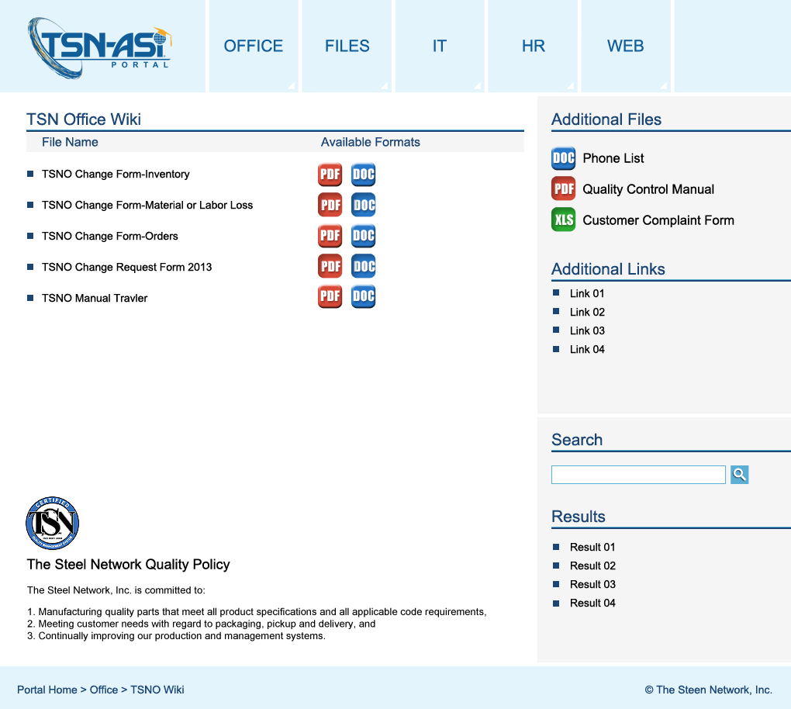
Sidebar Administration
Add Section
Unit Title
Text Field
Add Item
Item Name
Text Field
Item Type
Text
File - DOC
The above example shows a list of simple text items that are not linked.
File - PPT
File - XLS
File - PDF
File - JPG
File - PNG
File - PSD
File - AI
File - EPS
File - MP4
Selecting the item type associated will a specific file type will assign the graphic button associated with that file type on the front end. The button will be linked to the uploaded file.
Link
Item URL
If “Link” is selected.
Upload a File
If “File” is selected.
Browse

Slide 17
Portal Pages

Slide 18
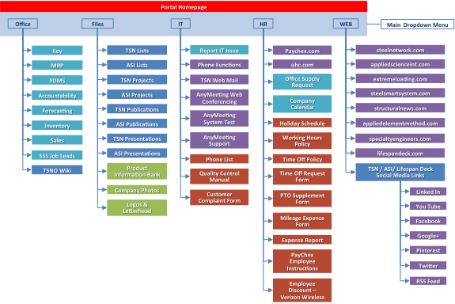
TSN-ASI Portal Homepage
The main purpose of the TSN-ASI Portal is to link to various files and apps that are helpful to employees. Many of those items are directly linked from the dropdown menus, however there is also the need to have specialized pages for the dissemination of grouped resources. As a result, most of the portal pages are organized lists of files that employees can download.
The homepage shown here is mainly informational in nature. However all pages should have the ability to host a list of files for download if needs be.
The following slides show a variety of portal pages and their most likely content.

Slide 19
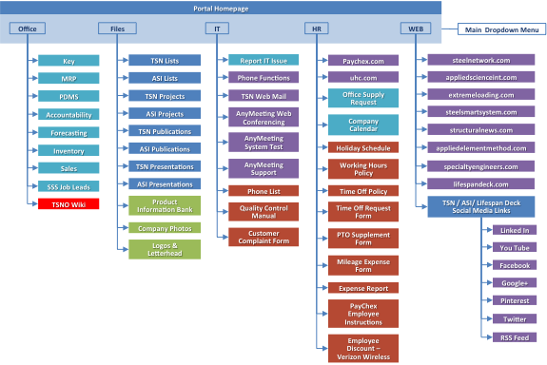
TSN Office Wiki Page
The TSN Office Wiki is a page within the portal where employees will find answers to common questions surrounding the various applications, as well as useful documents for doing tasks offline.

Slide 20
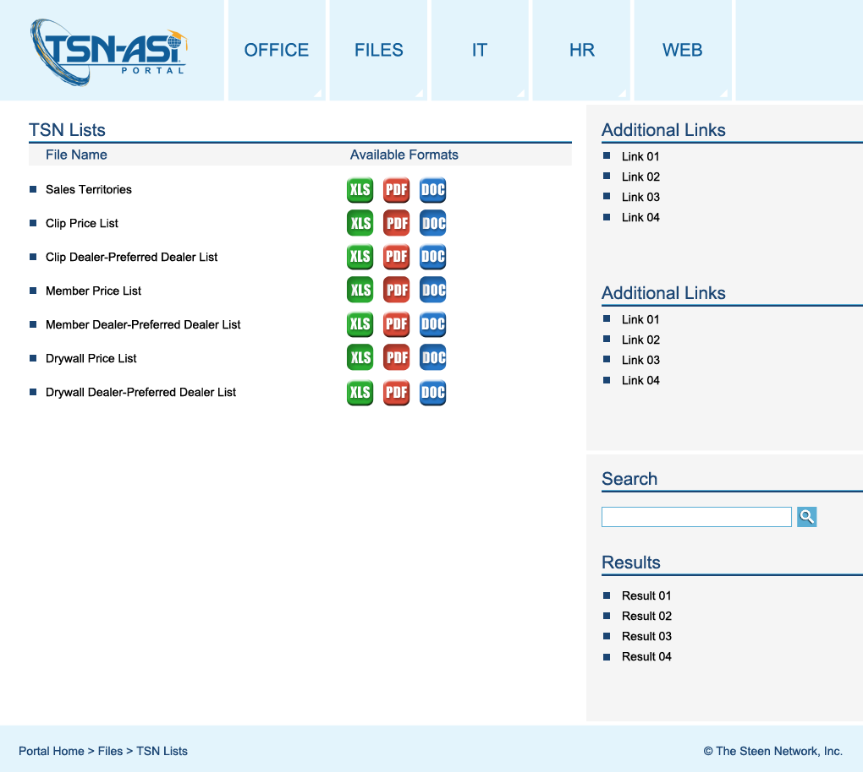
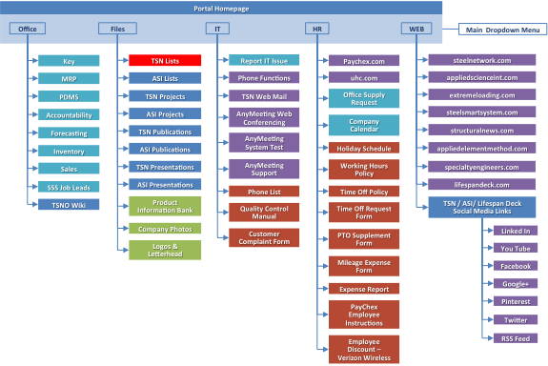
TSN Lists Page
Most of the Portal Pages a itemized lists of related files. The page shown here represents the TSN LISTS Page.

Slide 21
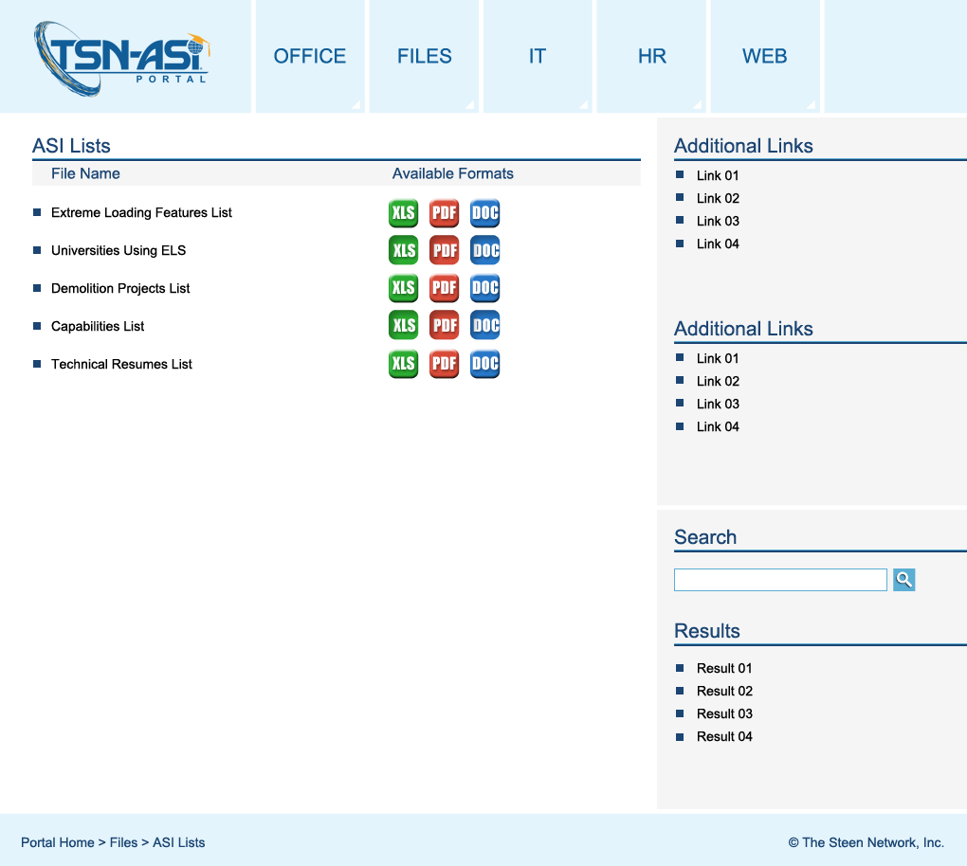
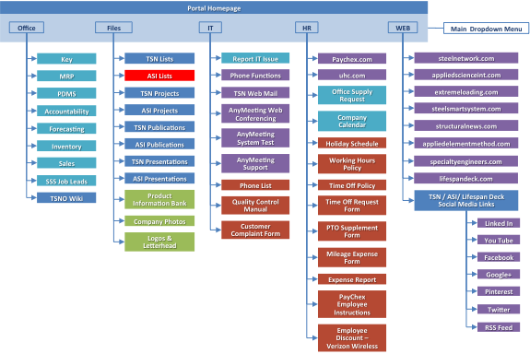
ASI Lists Page
Most of the Portal Pages a itemized lists of related files. The page shown here represents the ASI LISTS Page.

Slide 22
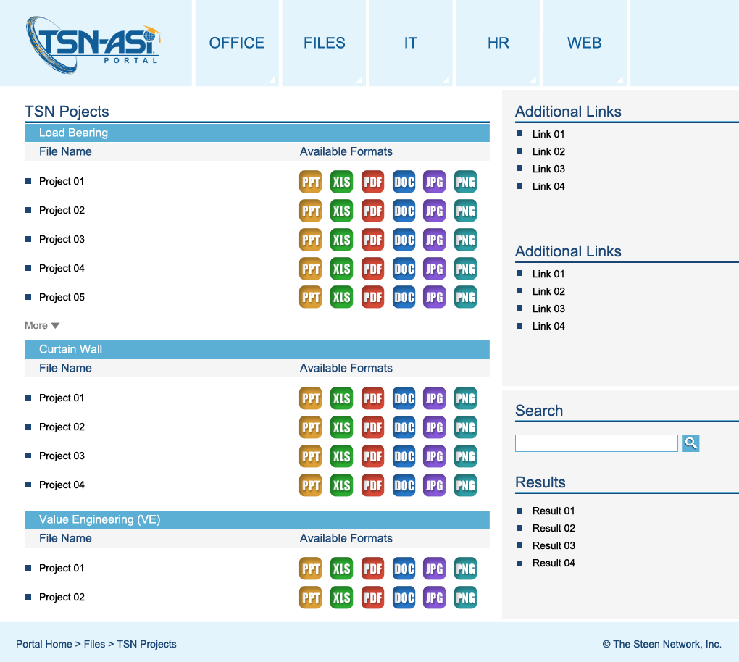
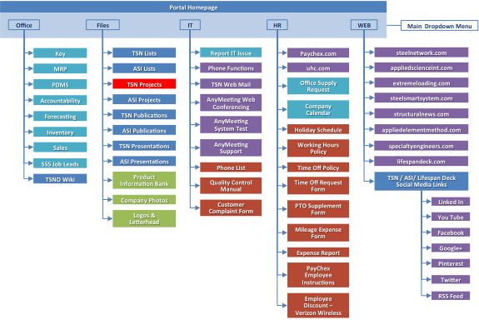
TSN Projects Page
Most of the Portal Pages a itemized lists of related files. The page shown here represents the TSN PROJECTS Page.

Slide 23
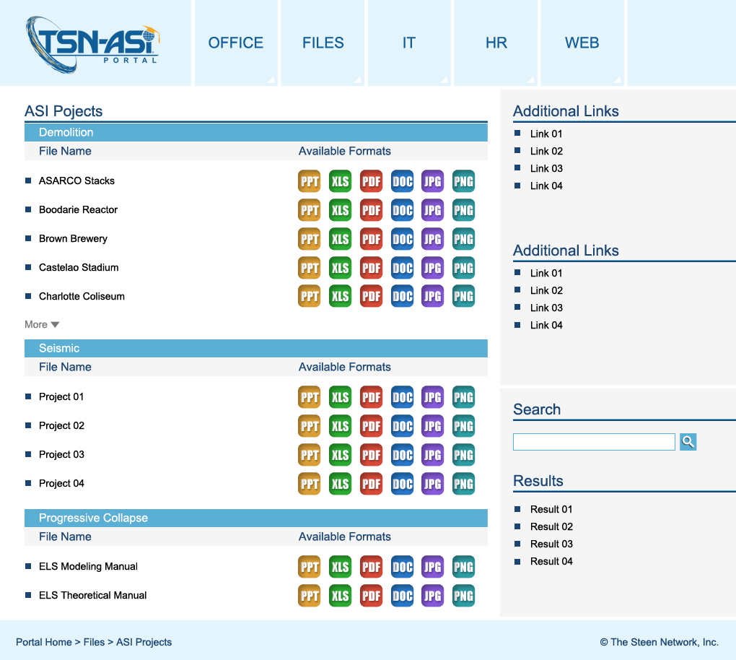

ASI Projects Page
Most of the Portal Pages a itemized lists of related files. The page shown here represents the ASI PROJECTS Page.

Slide 24
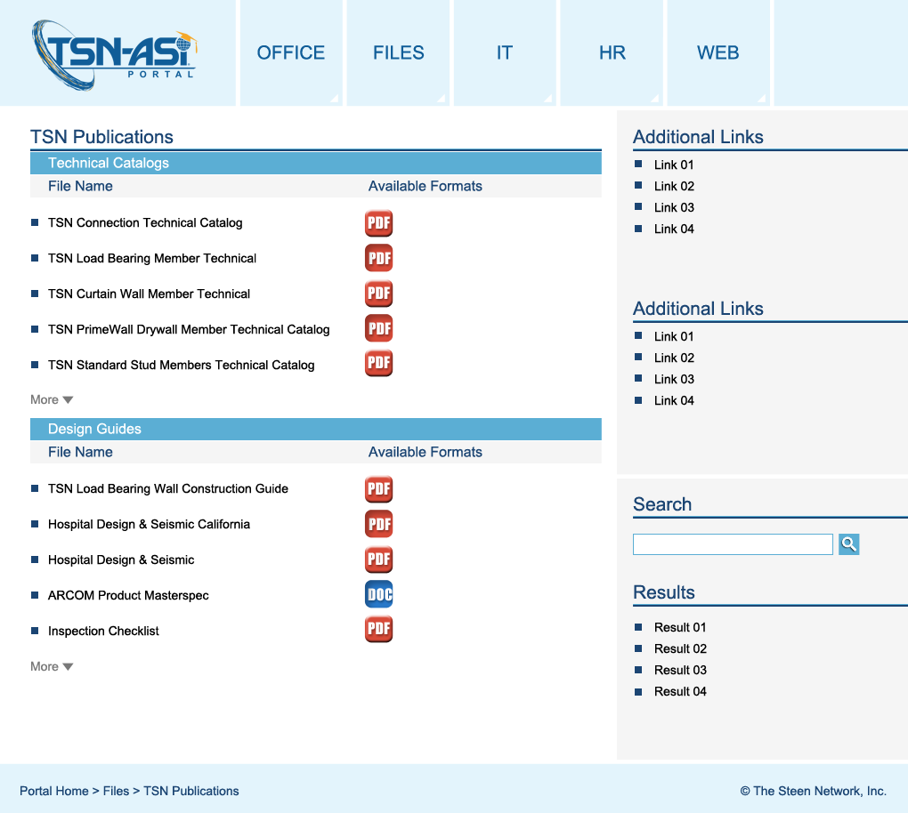

TSN Publications Page
Most of the Portal Pages a itemized lists of related files. The page shown here represents the TSN PUBLICATIONS Page.

Slide 25
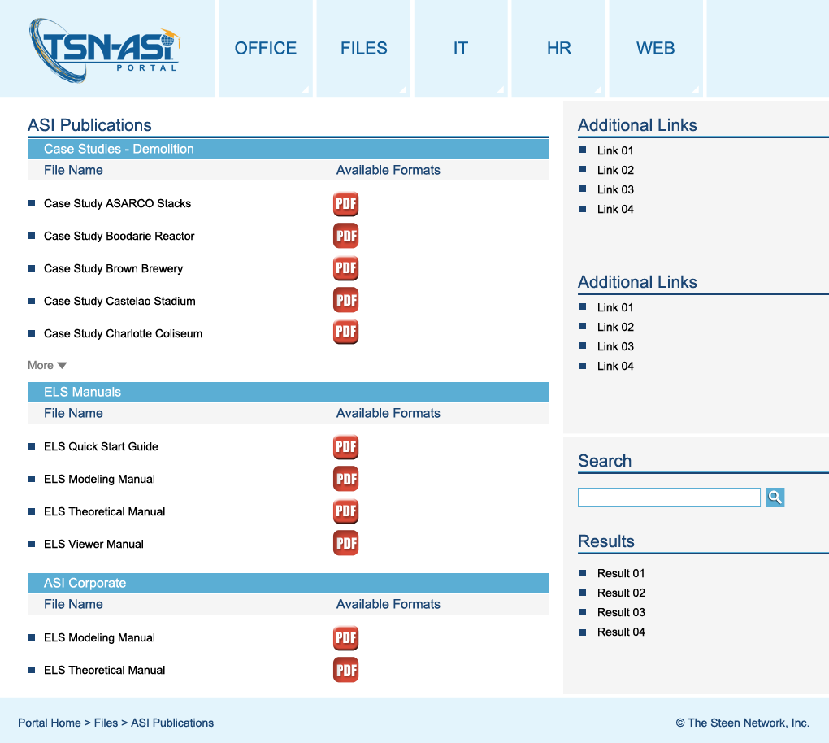

ASI Publications Page
Most of the Portal Pages a itemized lists of related files. The page shown here represents the ASI PUBLICATIONS Page.

Slide 26
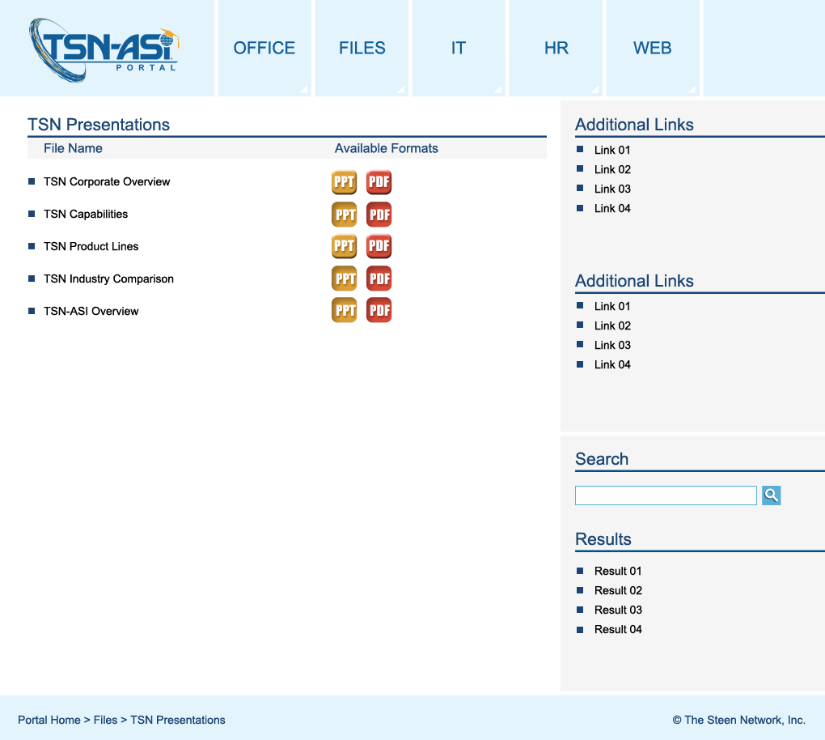

TSN Presentations Page
Most of the Portal Pages a itemized lists of related files. The page shown here represents the TSN PRESENTATIONS Page.

Slide 27
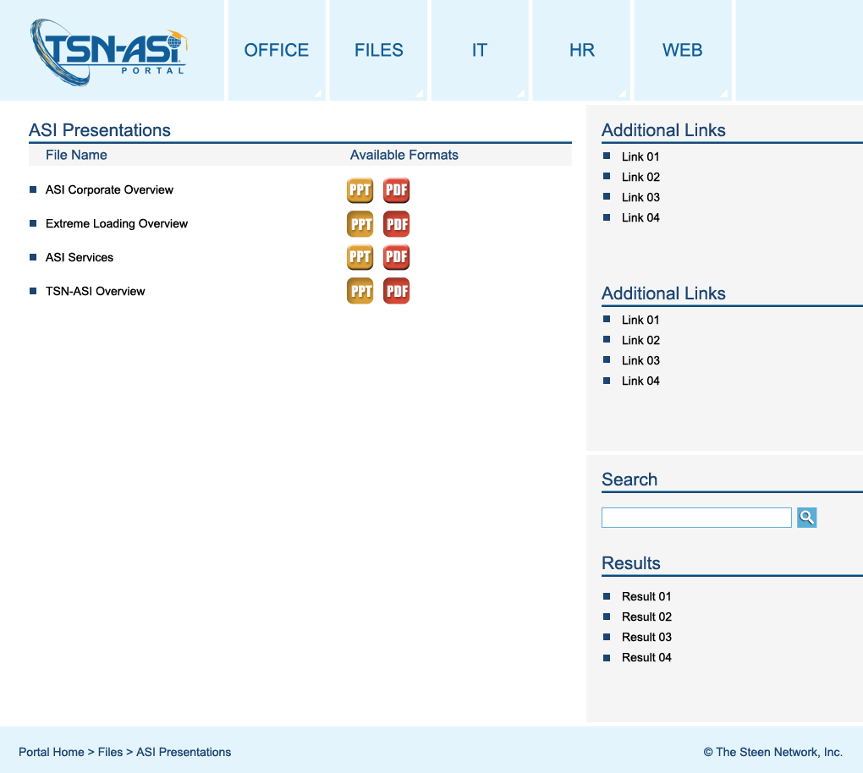
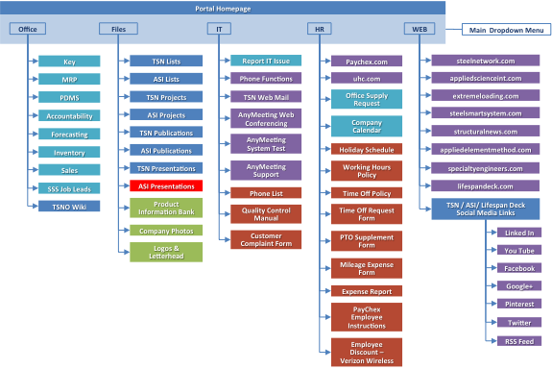
ASI Presentations Page
Most of the Portal Pages a itemized lists of related files. The page shown here represents the ASI PRESENTATIONS Page.

Slide 28
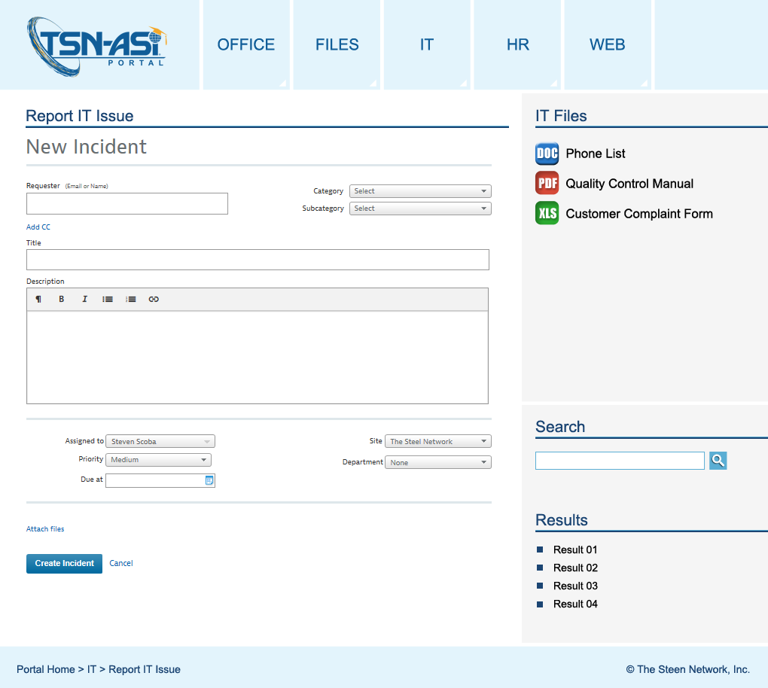

Report IT Issue Page
The “Report IT Issue” page has the Samanage App incident report embedded in it. This report is currently used by IT to field issues reported by employees.
There is space for additional helpful IT-related files in the sidebar.
The search feature (and results) remain on the bottom of the sidebar.

