Slide 1
AI key terms and concepts

Slide 2
Tokens
Step1: What is a Token?
LLMs do not read your text word by word. Instead, your text is first broken into small chunks called tokens before the model processes it. A token can be a whole word, part of a word, a punctuation mark, or even a space. For example, "cat" is 1 token, but "unbelievable" becomes 3 tokens — un + believ + able. A rough rule of thumb is that 1 token ≈ 0.75 words in English.
How is Text Broken into Tokens?
Before a model is ever used, it is trained on a massive amount of text. During that training, it builds a vocabulary — a fixed lookup table of common chunks. When you send a message, your text is matched against this vocabulary from left to right. If a whole word exists in the vocabulary, it becomes 1 token. If it does not, it gets split into smaller pieces that do exist. This is why common words cost fewer tokens, and rare, long, or made-up words cost more
Why Not Split into Single Letters? — The Longest Match Rule
The vocabulary is built by scanning huge amounts of text and asking: which combinations appear together so frequently that they deserve their own chunk? Frequent pairs get merged into a single token — for example, "PT" appears often enough in words like "option" and "opted" to earn its own slot. Longer matches are preferred because they carry more meaning — "playing" as one token tells the model more than "p" + "l" + "a" + "y" + "i" + "n" + "g" as seven separate pieces. Just like how reading the word "running" whole is faster and more meaningful than sounding out each letter individually. So the tokenizer always picks the longest possible match first, and only falls back to shorter pieces if nothing longer exists. Think of it like abbreviations — we write "don't" instead of "do not" because it is common enough to deserve a shortcut.

Slide 3
Step 2: What is a Context Window?
Every conversation you have with an LLM has a limit — the model can only "see" a certain amount of text at one time. That limit is measured in tokens, and it is called the context window.
Everything counts toward this limit:
Your instructions to the model
The entire conversation history
The model's own responses
Once the limit is hit, the model cannot see what came before. It is not that it "forgets" — it literally never had access to that earlier text in the first place.
Step 3: Why Does the Context Window Fill Up Faster Than You Think?
Here is something that surprises most people. Every time you send a new message, the entire conversation — from the very beginning — is resent to the model. The model does not "remember" previous messages on its own. It gets the full history handed to it fresh each time.
So imagine a 10-message conversation:
Message 1 sends 1 message worth of tokens
Message 2 sends 2 messages worth of tokens
Message 3 sends 3 messages worth of tokens
... and so on
By message 10, you are sending all 10 messages every single time. The context window fills up much faster than it seems from the outside.

Slide 4
Step 4: Why Does This Matter — Cost and Limits
Now that you know tokens are the unit the model reads and writes in, and that the full history is resent every time — this directly affects two things: cost and limits.
LLM APIs charge per token — separately for input tokens (what you send in) and output tokens (what the model writes back). Output is typically 3–5× more expensive than input because generating text is harder for the model than just reading it. Every model also has a maximum context window — once you hit it, old messages get silently dropped or the API throws an error, which is why very long conversations can feel like the model forgot something you said early on.
When a developer builds an app — like a customer support chatbot — that app is sending thousands of messages to the LLM every day on behalf of its users. Because they are using it at scale, the company charges them based on exactly how much they consumed, and tokens are the unit of measurement for that. Think of it like a utility bill — you do not pay a flat fee for electricity, you pay based on exactly how many units you consumed that month. Regular users on Claude.ai or ChatGPT pay a flat monthly subscription instead, with token costs baked in behind the scenes.
Step 5: Practical Implications — What Does This Mean in Real Life?
Now that you understand tokens, context windows, and cost — here is how all of that actually shows up in the real world when people build or use LLM-powered tools.
If you have a very long document — say a 100-page report — you cannot just paste the whole thing into a model and ask questions. It would exceed the context window. So developers build systems that chop the document into smaller chunks, search for the most relevant chunk, and only send that piece to the model. This is called RAG — Retrieval Augmented Generation.
Another implication is prompt design. Every word in your instructions to the model costs tokens. A bloated, repetitive system prompt eats into your usable context and inflates your bill on every single API call.
Code and structured data like JSON also tokenize inefficiently — repeated keys, brackets, and formatting characters all add up. So the same information written as clean prose can cost fewer tokens than the equivalent JSON.

Slide 5
Step 6: How Do Different Models Compare?
Now that you understand what a context window is and why it matters — it is worth knowing that different models have very different limits. This is often one of the first things developers look at when choosing which model to use for a task.
Here are some real numbers:
GPT-4o — 128,000 tokens
Claude Sonnet — 200,000 tokens
Gemini 1.5 Pro — 1,000,000 tokens
To put that in perspective — 200,000 tokens is roughly 150,000 words, which is about the length of two full novels. So Claude could theoretically hold that entire conversation in one go.
But a larger context window does not automatically mean better. A bigger window costs more per call, and models can sometimes lose focus on details buried deep inside a very long context. This is called the lost in the middle problem — where the model pays more attention to the beginning and end of the context, and less to what is in the middle.
Step 7: Putting It All Together
Let us now connect everything we have covered from the very beginning into one clear picture.
When you type a message to an LLM, your text is first broken into tokens — small chunks matched against a vocabulary built during training. The tokenizer always picks the longest possible match first, because longer chunks carry more meaning. Those tokens are then fed into the model.
Every token in the conversation — your instructions, the full history, and the model's replies — counts toward the context window. And because the full history is resent every single time you send a message, the window fills up faster than it seems. Once it hits the limit, earlier content falls out.
All of this has a direct cost. Developers pay per token — input and output separately — like a utility bill. Output costs more because generating is harder than reading. Regular users see this hidden inside a flat monthly subscription instead.
And finally, the size of the context window varies by model — bigger windows allow longer conversations and larger documents, but cost more and can suffer from the lost in the middle problem where details buried deep get less attention.

Slide 6
MapleVitals Explain

Slide 7
UNDERSTANDING CODE IN DEPTH: How??
From "I typed it out" to "I own it"
Why: transcribing trains recognition. A job needs generation + adaptation.
EXPLAIN IT BLIND: File closed, narrate question → answer in plain English.
Your vague spots = your study list.
2. TRACE BY HAND: Write what the messages list holds after each loop step: question → tool call + code → result → final answer.
3. BREAK & PREDICT: Change one thing, predict the outcome, run, reconcile. (max_turns = 1 · delete the column list · force an error)
4. INTERROGATE DECISIONS: Ask "why this, not that?" of every line. (why return the error string? why range() not while True?)
5. REBUILD BLANK: Rewrite the agent loop from memory, then diff against the original. The differences are what you hadn't really learned.
6. ADAPT IT: Add a 2nd tool, or a guardrail the walkthrough never showed you. Memorizing doesn't transfer — adapting does. → Go deepest on the agent loop + guardrails. That's your moat. Skim the pandas / Streamlit plumbing.

Slide 8
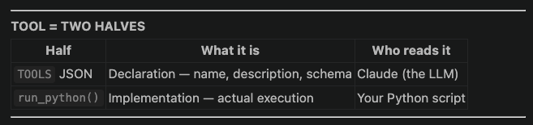
MapleVitals Agent — Part 1 & 2 Summary
SETUP (lines 1–14)
Loads libraries: pandas, matplotlib, anthropic SDK
matplotlib.use("Agg") — saves charts to file, no popup window
load_dotenv() — reads API key from .env
client — authenticated connection to Claude API
df — entire health CSV loaded into memory at startup
Nothing is sent to Claude yet — this is just preparation
WHAT IS A TOOL?
A capability you give the LLM to do something instead of just say something
Claude lives on Anthropic's servers — it cannot run Python, access your files, or execute anything
You define a tool → Claude decides to use it → your app executes it → result sent back to Claude

Slide 9
TOOL DEFINITION — 3 REQUIRED FIELDS
name → identifier Claude uses to call the tool
Description →Claude reads this to decide when/how to use the tool (most imp for customization)
input_schema → shape of arguments Claude must provide (JSON Schema format)
Optional 4th field: cache_control (advanced, for prompt caching)
INPUT SCHEMA — WHAT IT MEANS
"type": "object" → Claude's response will be a dictionary
"properties" → lists every argument the tool accepts
"type": "string" → that argument must be a string
"description" → tells Claude what to write in that argument
"required": ["code"] → Claude must always provide this field
input_schema is always required — even if your tool takes no arguments
Without it, Claude doesn't know what shape its response should be
TWO DESCRIPTIONS — WHY SEPARATE?
Outer (tool-level) → what the tool is, when to call it
Inner (property-level) → what to write inside each argument
For simple tools with one argument, both locations work
Separation becomes important as tools grow more complex
TOOL FORMAT IS PROVIDER-SPECIFIC
Anthropic (Claude) → uses "input_schema"
OpenAI (GPT) → uses "parameters"
Google (Gemini) → uses "parameters" with slightly different structure
Concept is identical across all — only the key names differ

Slide 10
TOOLS IS JUST A VARIABLE NAME
Could be named anything: tools_list, capabilities, etc.
What matters is passing it to the API: client.messages.create(..., tools=TOOLS)
All-caps convention = constant that doesn't change during the program
MapleVitals Agent — run_python() Function Summary
run_python() — HOW IT WORKS
buffer = io.StringIO() → fake text file in memory to capture print() output
scope = {"df": df, "pd": pd, ...} → restricted environment: Claude's code can only see these 3 variables
exec(code, scope) → runs Claude's code string as actual Python
redirect_stdout(buffer) → captures print() output instead of showing in terminal
return buffer.getvalue() → sends printed output back to caller except
Exception as e → if code crashes, returns error string so Claude can fix it
FUNCTION SIGNATURE
def run_python(code: str) -> str:
code: str → accepts Claude's generated Python code as a string
-> str → always returns a string (result or error) back to Claude
Name must match "name" field in TOOLS JSON — that's how your code knows which function to call
Everything is strings because Claude communicates only in text
buffer = io.StringIO()
Creates an in-memory fake terminal — no file created on disk
Captures everything that print() would normally send to the screen
Just a variable name — could be called anything (output, captured, etc.)
Without it: print() → screen → lost forever
With it: print() → buffer → readable → sendable back to Claude

Slide 11
scope = {"df": df, "pd": pd, "plt": plt}
A dictionary defining what variables Claude's code is allowed to see
Without scope: exec gives Claude access to everything — API keys, client object, all internals (security risk)
With scope: Claude's code can only touch these 3 things — nothing else exists
Must match what you told Claude in the tool description — if they don't match, Claude writes code using a variable that doesn't exist and errors
with contextlib.redirect_stdout(buffer):
Temporarily points all print() output at buffer instead of the screen
with = context manager: applies the rule inside the block, restores to normal after
Guarantees stdout is restored even if Claude's code crashes mid-execution
Without with: a crash could leave your terminal permanently broken
exec(code, scope)
Built-in Python function that takes a string and runs it as actual Python code
Skips the .py file — executes code at runtime directly
scope argument restricts what variables the code can access
Powerful: Claude can write any valid Python and your program executes it
Dangerous: runs whatever string it receives, no questions asked — safe only for local, trusted use
return buffer.getvalue() or "(code ran, no printed output)"
buffer.getvalue() → reads all collected print() output from exec
Fallback string → if Claude's code ran but printed nothing (e.g. only made a chart), returns this instead of empty string
Empty string back to Claude = Claude thinks tool failed → fallback prevents confusion

Slide 12
except Exception as e: return f"Error:{type(e).__name__}:{e}"
Catches any crash from exec — KeyError, NameError, SyntaxError, anything
Formats it as a readable string e.g. Error:KeyError:'Province_Name'
Returns error string instead of crashing your program
Claude receives this as the tool result → reads it → fixes its code → tries again (the retry loop)
FULL run_python() FLOW
Claude's code string arrives
↓
exec runs it inside restricted scope (df, pd, plt only)
↓
┌─ success? → buffer.getvalue() → returned to Claude as result
└─ error? → error string → returned to Claude to fix
KEY INSIGHT
run_python() never knows what question was asked or what Claude is thinking
It only does one thing: run a string of code and return what happened
All the intelligence (writing the code, fixing errors, interpreting results) stays with Claude
All the execution (actually running Python) stays with your app

Slide 13
How Claude Decides & Thinks
HOW CLAUDE DECIDES WHETHER TO WRITE CODE
Three inputs weighed simultaneously:
System prompt → "When asked a question, call run_python" — strong bias toward tool use
Question itself → Claude classifies: does this need data? does it need df?
Tool description → Claude matches question against "analyze the dataframe df"
"Which province has the highest value?" → needs df → use tool → write code
"Tell me the time" → doesn't need df → answer directly → no code
THE DECISION FLOWCHART INSIDE CLAUDE
Read question
↓
Does this need data from df?
├─ YES → does run_python fit? → YES → write code → stop_reason = "tool_use"
└─ NO → can I answer directly? → YES → plain text → stop_reason = "end_turn"
HOW CLAUDE KNOWS WHAT CODE TO WRITE
Real column names from system prompt → f"Its columns are: {list(df.columns)}" → Claude knows exactly what to query, no guessing
The question itself → "highest value by province" maps to groupby + idxmax → Claude reads intent, not just keywords
Training data → Claude has seen billions of pandas examples → "highest value by group" → groupby + idxmax is a known pattern

Slide 14
CLAUDE'S INTERNAL THINKING (simplified)
Step 1 — Understand: "User wants max value grouped by province"
Step 2 — Check tools: "run_python can query df → this is a data question → use it"
Step 3 — Write code: "groupby GEO, get VALUE, idxmax. print() result. savefig() if chart."
Step 4 — Return: tool_use block with code filled in
IMPORTANT NUANCE
Claude is not deterministic — same question twice may produce different code
Different variable names, different pandas approach, same correct result
It's a language model making probabilistic decisions, not a compiler following rules
This is exactly why the retry loop exists — first attempt may be wrong, Claude reads the error and tries differently

Slide 15
Full Flow of the code: Agent.py
Before the loop — Setup
# Bottom of file triggers everything:
answer = ask("Which province has the highest value, and show it as a bar chart?")
ask() is called. Inside it:
system = "You are a data analyst... columns are: ['Province', 'Year', 'Value'...]"
messages = [ {"role": "user", "content": "Which province has the highest value?"} ]
Conversation history starts with just your question. Loop begins.

Slide 16
Iteration 1 — Claude writes code
Step 1: Your script calls Claude
response = client.messages.create( system=system, tools=TOOLS, messages=messages # just your question so far )
Step 2: Claude on Anthropic's servers:
reads your question
reads the system prompt (knows real column names)
reads TOOLS (knows run_python exists)
decides: "I need to query df to answer this"
writes Python code and returns it
Step 3: Response comes back
response.stop_reason = "tool_use"
response.content = [ tool_use block: { id: "tool_123", name: "run_python", input: {"code": "result = df.groupby('GEO')['VALUE'].mean().idxmax()\nprint(result)"} } ]
Step 4: Append to messages
messages = [ {"role": "user", "content": "Which province has the highest value?"}, {"role": "assistant", "content": [tool_use block]}, ← added ]
Step 5: Check stop_reason
if response.stop_reason != "tool_use": # False — it IS tool_use
Loop does NOT exit. Continues.
Step 6: Extract code and run it
block.input["code"] # → "result = df.groupby('GEO')['VALUE'].mean().idxmax()\nprint(result)"
result = run_python(block.input["code"]) # → exec runs it → print fires → buffer captures "Ontario" # → returns "Ontario"
Step 7: Package result and append
tool_results = [{ "type": "tool_result", "tool_use_id": "tool_123", ← matches Claude's tool call "content": "Ontario" }]
messages = [ {"role": "user", "content": "Which province has the highest value?"}, {"role": "assistant", "content": [tool_use block]}, {"role": "user", "content": [tool_result: "Ontario"]}, ← added ]
Loop goes back to the top. Iteration 2 begins.

Slide 17
Iteration 2 — Claude interprets the result
Step 1: Your script calls Claude again
response = client.messages.create( system=system, tools=TOOLS, messages=messages # now has full history — question + code + result )
Step 2: Claude on Anthropic's servers:
reads the full history
sees its own code from turn 1
sees the result "Ontario"
decides: "I have the answer, no more tool calls needed"
writes plain-English interpretation
Step 3: Response comes back
response.stop_reason = "end_turn" response.content = [ text block: "Ontario has the highest average value at 42.3, significantly above the national average..." ]
Step 4: Append to messages
messages = [ {"role": "user", "content": "Which province has the highest value?"}, {"role": "assistant", "content": [tool_use block]}, {"role": "user", "content": [tool_result: "Ontario"]}, {"role": "assistant", "content": "Ontario has the highest..."}, ← added ]
Step 5: Check stop_reason
if response.stop_reason != "tool_use": # True — it is "end_turn" return "Ontario has the highest average value at 42.3..."
Loop exits. Final answer returned.

Slide 18
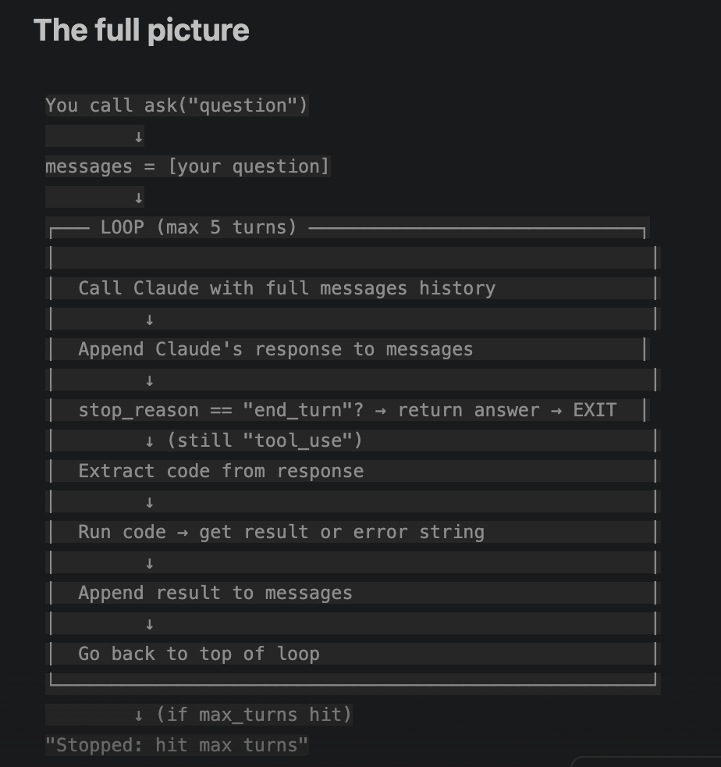
What if Claude's code errors?
Iteration 1 returns "Error:KeyError:'Province'" instead of "Ontario".
Messages becomes:
[ {"role": "user", "content": "Which province has the highest value?"}, {"role": "assistant", "content": [tool_use: bad code]}, {"role": "user", "content": [tool_result: "Error:KeyError:'Province'"]}, ]
Iteration 2: Claude sees its own error, writes fixed code → tool_use again.
Iteration 3: Fixed code runs → result → Claude interprets → end_turn → exits.

Slide 19
MapleVitals — RAG & Embeddings Foundation (Revision Notes)
1. Embedding = meaning as a position
An embedding converts text → a fixed list of numbers (384 for all-MiniLM-L6-v2).
Those numbers are an address in 384-D space. Similar meaning → nearby addresses.
Meaning becomes distance. This is the engine of RAG retrieval.
2. The 384 numbers
Plain decimals (positive/negative, no units), e.g. [0.043, -0.127, 0.981, ...].
No single number is human-readable (column 7 ≠ "diabetes-ness"). Only the whole pattern matters.
Analogy: like GPS — one coordinate alone means nothing; the full set points to a place.
3. Why 384
It's the model's width (hidden dimension) — a capacity vs. speed dial.
Too few = meanings blur; too many = slower, heavier, more data needed.
"Mini" = deliberately compact/fast. Bigger models use 1536 or 3072. 384 is plenty for a focused corpus.
4. Chunk vs. token (key distinction)
Chunk = a passage you pre-slice from your corpus and store. No stop-word removal.
Token = throwaway internal step (word-pieces) used inside the model, then discarded. Never stored, never searched.
5. How text becomes an embedding (inside the model)
text → tokens → starting vectors (lookup table; context-blind) → attention (words update by looking at neighbors → adds context) → pool (combine into one vector) → 384-number embedding.
Attention is the heart of the transformer (next topic).
6. The two-phase RAG pipeline
Phase A — Indexing (once): corpus → chunks → embed each → store in Chroma. Result: N × 384 matrix.
Phase B — Query (every question): question → embed with the same model → cosine similarity vs. all stored embeddings → return top-k closest chunks.
Key symmetry: question and chunks use the same embedding model → same space → fair comparison.

Slide 20
7. What's stored vs. computed
Stored once (in Chroma): the 384-number addresses (embeddings).
Computed fresh (per question): cosine similarity = distance between two addresses.
Addresses are permanent; distances are on-demand.
8. Three models/objects — keep distinct
Embedding model (all-MiniLM) = the "camera": text → vectors.
Chroma matrix (N × 384) = the "photos": stored chunk addresses.
LLM (Claude) = the "answer-writer": uses retrieved chunks to respond. Different, much bigger model.
9. top-k
k = how many closest chunks to return (a knob you set; 3 is a common default).
Retrieved chunks get pasted into Claude's prompt as grounding.
10. MapleVitals mapping
Corpus: ~15–30 hand-curated StatCan/CCHS definition docs (your epidemiology deliverable).
Indexing: embed each → Chroma PersistentClient (survives restarts) → ≈20 × 384.
Query: user question → embed → retrieve closest definition chunk → paste into Claude's prompt.
MOAT (citation-theater guardrail): cosine similarity always returns a closest chunk, even for uncovered terms ("closest" ≠ "relevant"). Guardrail rule: no definitional claim without genuine supporting retrieval → acknowledge the gap instead of faking a citation. Small curated corpus = retrieval quality is a design property, not luck.

Slide 21
Grounding the interpretation: look it up before you explain it
WHAT "EXPLAIN" MEANS
After computing a number, the agent writes what it means: "self-report, not a clinical diagnosis”; "E flag = use with caution”; "2024 not comparable to 2015"
TODAY those sentences come from model memory. Fluent, confident, unsourced, occasionally subtly wrong.
AFTER M2a: insert a lookup step before the paragraph is written. Search curated StatCan/CCHS corpus → top 3 excerpts → write from those excerpts → tag each claim with its doc_id. "Grounding" = words anchored to a retrievable source.
NUMBERS DO NOT CHANGE. Same run_python loop, same chart, same quality contract. M2a touches only the prose half.
"BUT TRAINING DATA IS ALSO A SOURCE"
True. The difference is not source vs. no source. It is:
ADDRESSABLE no doc_id in training memory; nothing to reread
RECONSTRUCTED, NOT RECALLED pattern-generated, can smooth several surveys into one plausible wrong definition
CURATED my corpus holds only text I trimmed from the real source; training data blends the real page with blogs and errors
LIVE StatCan revises; I edit a .md and re-run build_index.py
BOTTOM LINE
A reviewer can audit a citation.
A reviewer cannot audit "the model knew it."

