Slide 1
Online Retail Sales Performance Analysis
• Business Problem
• Understand overall sales and revenue performance.
• Identify high-performing products and countries.
• Analyze monthly sales and cancellation patterns.
• Goal: support better sales, inventory and customer decisions.

Slide 2
Data & Methodology
• Dataset: UCI Online Retail II
• 1,067,371 transaction records and 8 columns.
• Data processed using Python / Pandas.
• Removed exact duplicate records.
• Handled missing descriptions and identified missing Customer IDs.
• Created Sales Value = Quantity × Price and a cancellation flag.

Slide 3
Key Findings
• November was the strongest revenue month in both years.
• November 2010 revenue: £1.42M; November 2011: £1.46M.
• UK generated the highest revenue: £15.99M.
• Regency Cake Stand 3 Tier was the highest-revenue product: £314,045.
• Revenue is concentrated among a small number of high-value customers.
• Cancellation activity was also high in several peak periods.

Slide 4
Deep Dive: Trends & Performance
• Monthly trend: revenue repeatedly rises strongly in November.
• Product performance: a few products contribute substantially more revenue.
• Geography: UK revenue is far ahead of other countries.
• Customer performance: top customers contribute significant revenue.
• Cancellation pattern: November 2010 recorded 1,417 cancellation/return rows.
• December 2011 is only partially covered because the dataset ends on 09-Dec-2011.

Slide 5
Recommendations
• 1. Prepare inventory and marketing ahead of November.
• Owner: Sales & Inventory | Metric: November revenue and stockout rate.
• 2. Focus retention efforts on high-value customers.
• Owner: Sales / CRM | Metric: repeat purchase rate and high-value customer revenue.
• 3. Investigate products and periods with high cancellation activity.
• Owner: Operations / Product | Metric: cancellation/return rate.

Slide 6
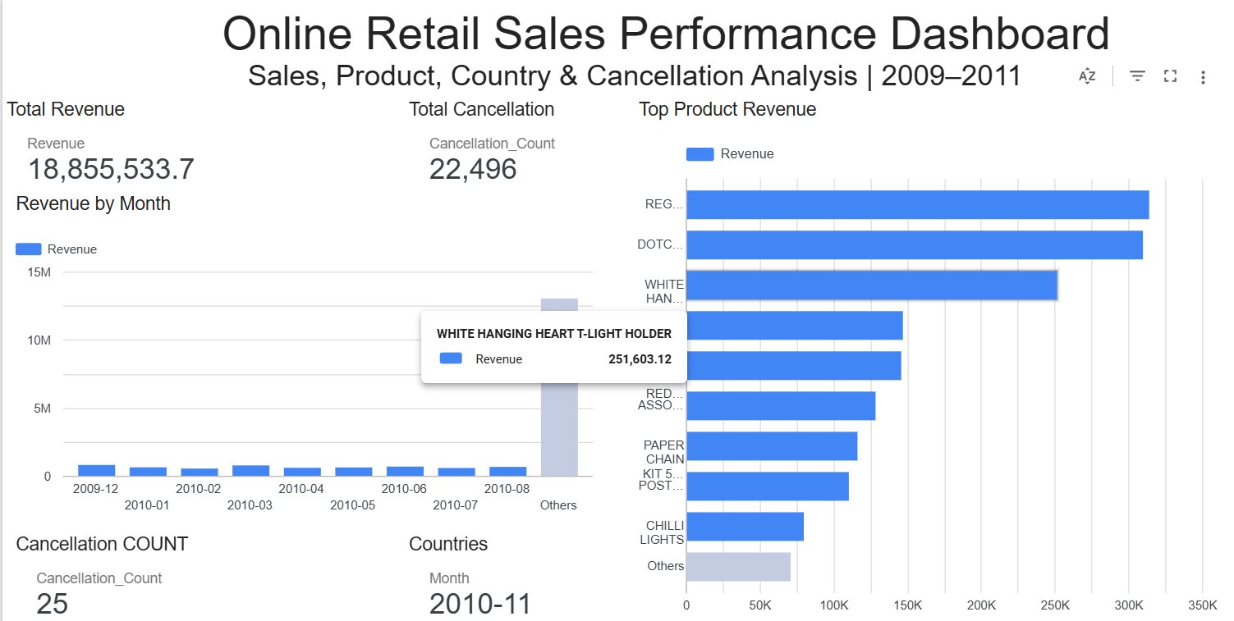
Expected Business Impact & Dashboard
Expected Business Impact
• Better inventory planning during peak demand periods.
• Higher revenue capture by prioritizing strong-performing products.
• Improved retention of high-value customers.
• Lower avoidable cancellations and returns.
• More focused management decisions using measurable KPIs.

Slide 7
Limitations & Next Steps
• Many transactions have missing Customer IDs, limiting customer-level analysis.
• Exact duplicates were removed, but other data-quality risks may remain.
• Negative-quantity transactions were separated from normal sales.
• December 2011 cannot be treated as a complete month.
• Next: investigate cancellation drivers, validate product patterns and monitor KPIs.
Dashboard Link: https://datastudio.google.com/s/gw2dubRLrcg

