Slide 1



pollutant_emissions
View in Power BI
Last data refresh:
3/17/2020 9:51:03 PM India Standard Time
Downloaded at:
3/17/2020 9:54:31 PM India Standard Time

Slide 2
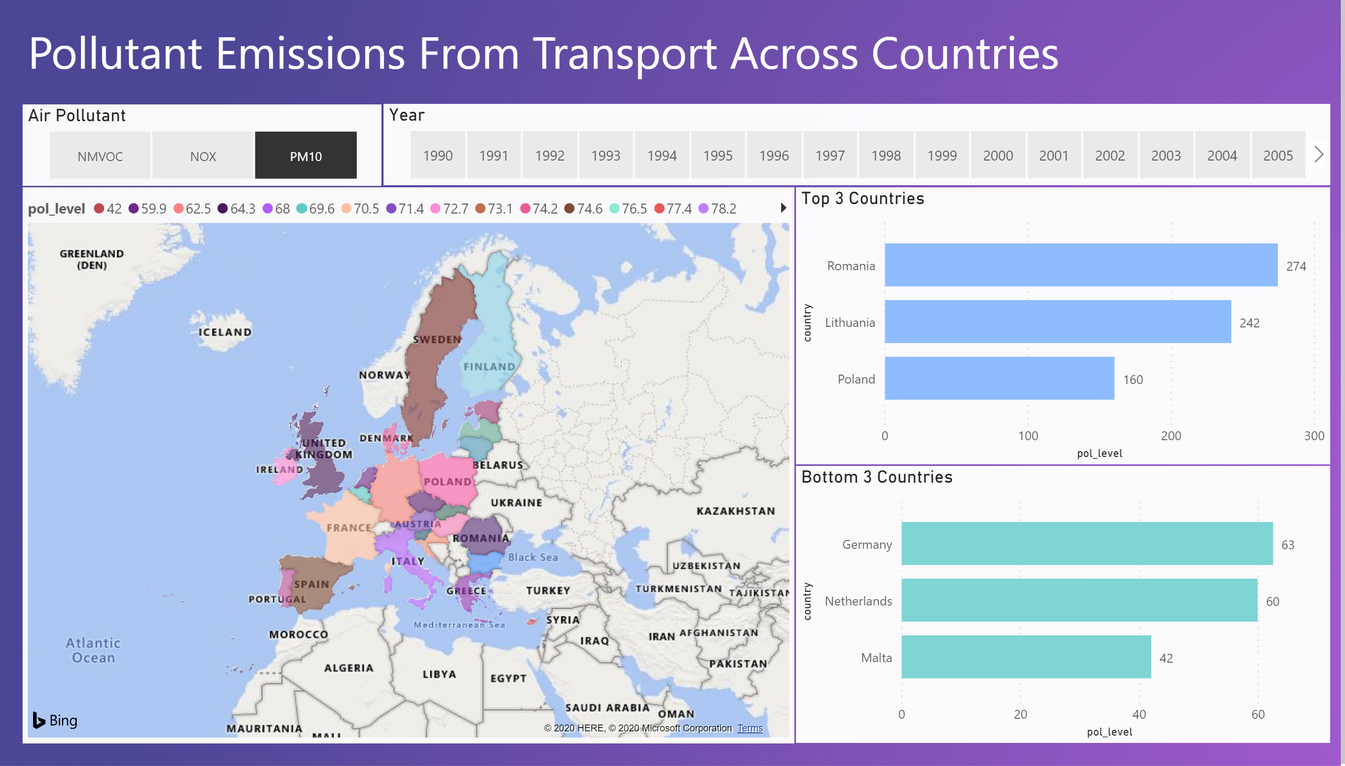

Slide 3
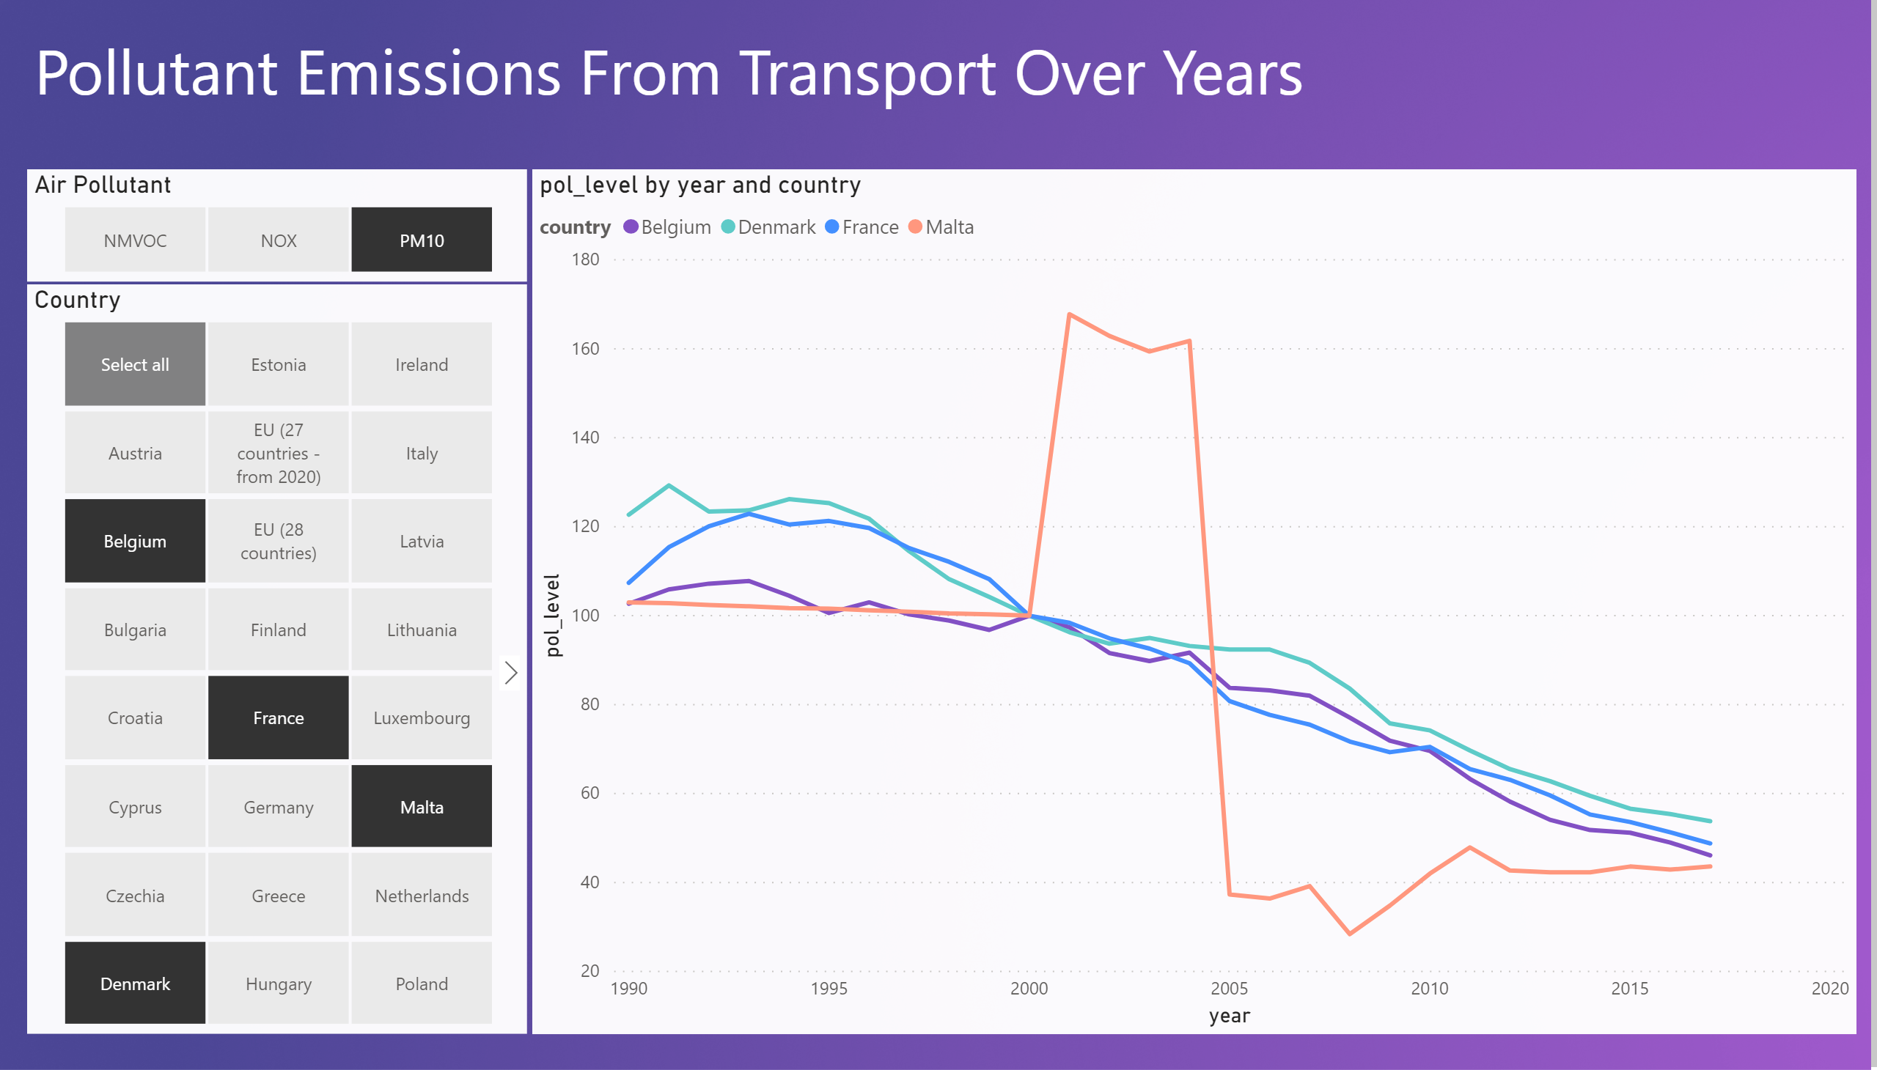

Slide 4
