Slide 1
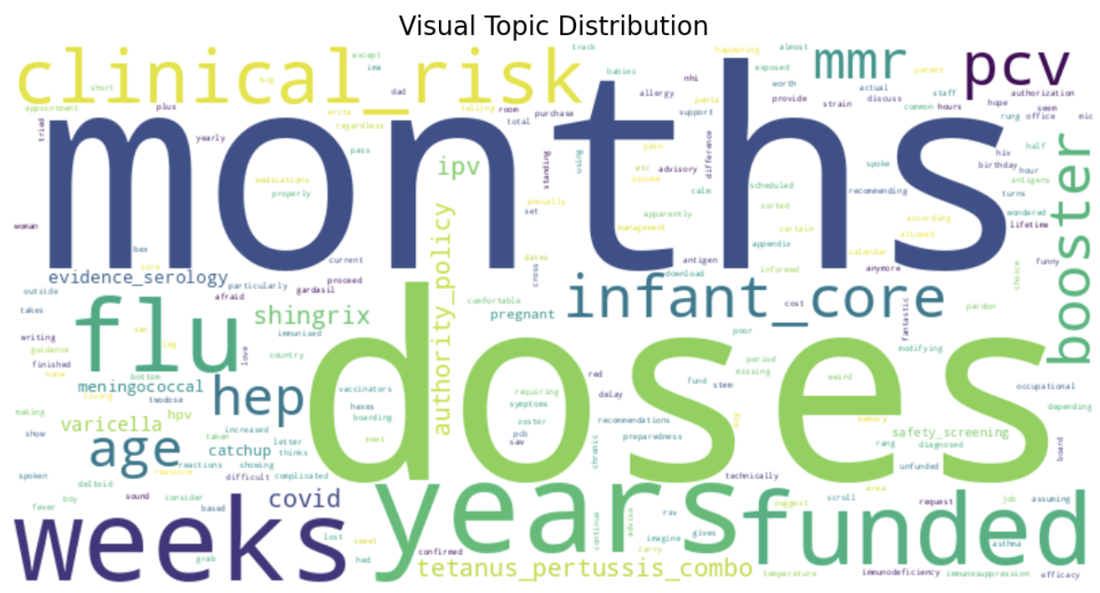
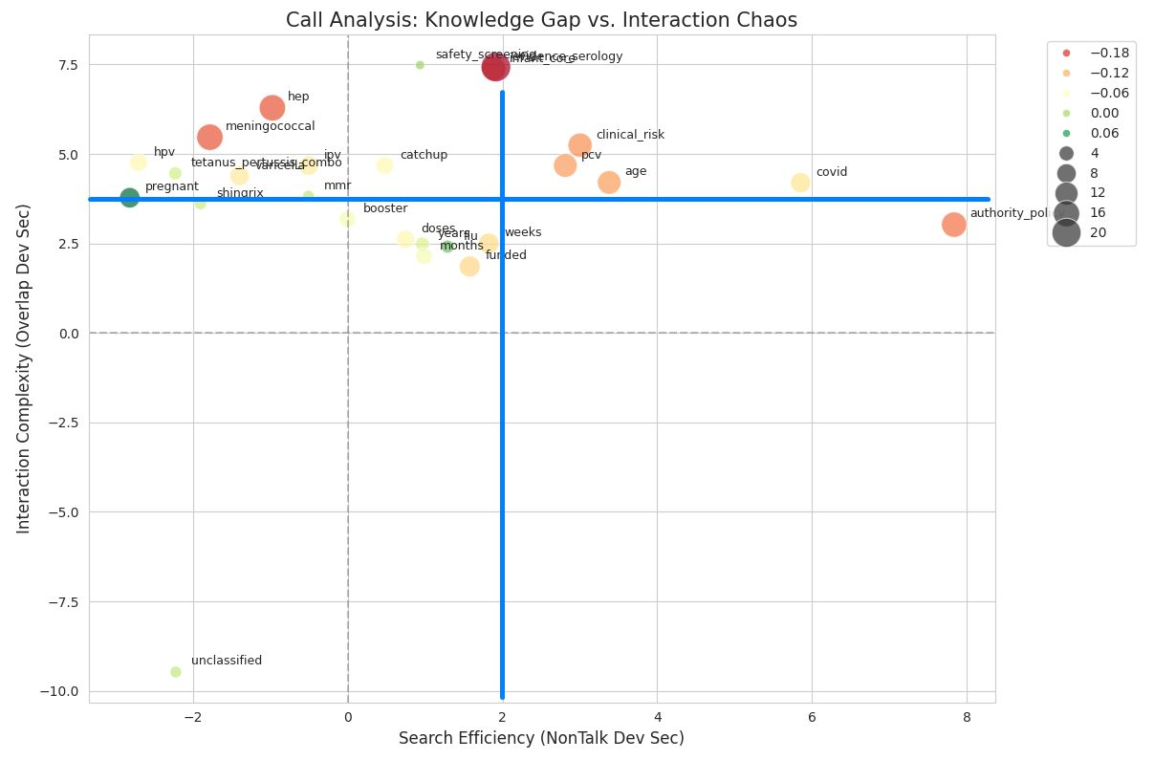
Transcript Classification and Build Test Set
is_slow = row['NonTalk_Dev_Sec'] > NONTALK_DEV_SEC_THRESHOLD
is_chaotic = row['Overlap_Dev_Sec'] > OVERLAP_DEV_SEC_THRESHOLD
is_stressed = row['Sentiment_Dev'] < SENTIMENT_DEV_THRESHOLD
“Q1_Extreme”: is_slow && is_chaotic
“Q2_Knowledge”: is_slow
"Q3_Interaction": is_chaotic
"Q4_Baseline": normal (Neither slow nor chaotic)
'funded': ['funded', 'funding', 'nonfunded', 'eligible', 'eligibility'],
'flu': ['flu', 'influenza', 'fluvax', 'influvac', 'quad', 'tetra'],
'catchup': ['catchup', 'ketchup'],

Slide 2
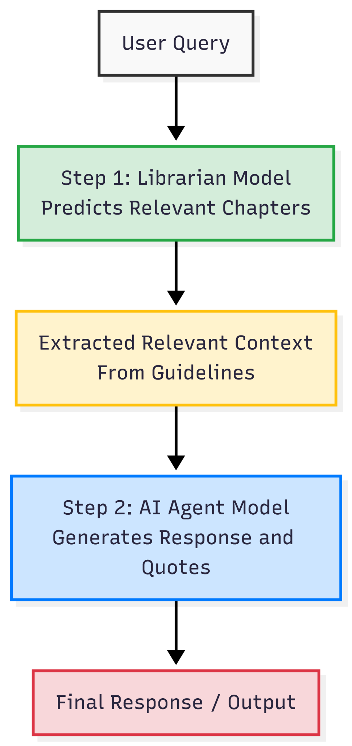
Evaluation Result on 100-Sample Test Set
Relevance: Feed Query and Response. "Did the AI response address the user's query?"
Groundedness: Feed Query, Response and Context. "Did the AI response stick strictly to our context?"
Use gpt-5-mini LLM as a judge. Score 1 to 5, over 4 is PASS.
Model | Relevance Pass Rate | Groundedness Pass Rate | Avg Time (sec) | Avg Tokens
gpt-5-mini => gpt-5-mini | 90.5% | 95% | 80.76 | 36325
gpt-4o-mini => gpt-4o-mini | 65.5% | 62.5% | 6.92 | 32193
gpt-4o-mini => gpt-5-mini | 85% | 95.5% | 66.32 | 37220
gpt-5-mini => gpt-4o-mini | 65.5% | 66% | 13.50 | 31425

