Slide 1

Analysis of Stocks IBM P&G and GE
DEEPTI GUPTA
ANLY515-2019/SUMMER: RISK MODELING AND ASSESSMENT
Harrisburg University of Science and Technology

Slide 2

OBJECTIVE
To improve the profitability of the trading models
To use statistical techniques to identify consistent behavior in assets which can be exploited to turn a profit.
Not to rely on "guesswork" or "hunches“ as financial industry doesn’t work that way

Slide 3
Methodology
Calculate best percentage of weights using Global Minimum Variance Portfolio (GMVP)
Method 1 will calculate VaR and ES using (Generalized Hyperbolic Distribution) GHYP distribution,
Method 2 will use ARMA and GARCH method
Method 3 will determine risk using copula-GARCH method

Slide 4
Data LOAD
Loaded from yahoo.finance.com for three major market players (IBM, GE and PG) in different sectors.
The assets are IBM from technology sector, General Electric from industrial sector and Proctor and Gamble from consumer’s market sector.
These assets have very long presence in consumer market as well as stock market, global presence and high brand value.
General Electric (GE) Company operates as a high-tech industrial company worldwide. It operates in Power, Renewable Energy, Aviation, Oil & Gas, Healthcare, Transportation, Lighting, and Capital segments.
IBM Corporation operates as an integrated technology and services company worldwide.
The Procter & Gamble (P&G) Company provides branded consumer packaged goods to consumers worldwide.
Loaded for a common period of Jan 1962 till Jul 2019 with a monthly frequency.
Considered the closing prices of IBM, GE and PG to perform the risk analysis.

Slide 5
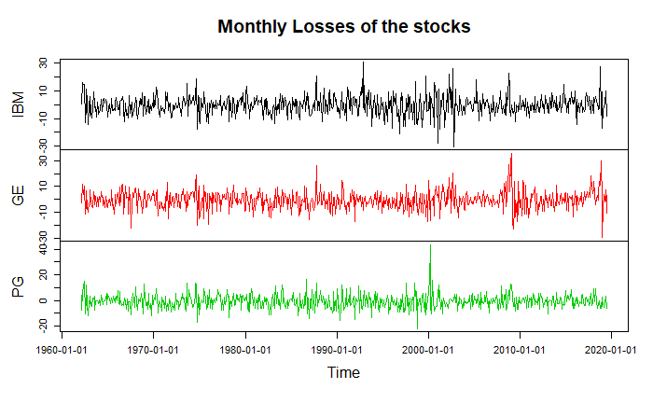
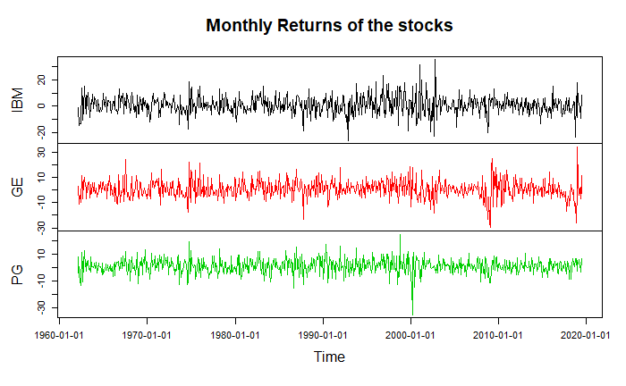
Data pre-processing
The plots on the monthly returns and monthly losses of the three assets
Using the rate of log return changes.
Observation
The mean is approximately stationary,
The variance is not stationery
Volatility is varying with time too.

Slide 6
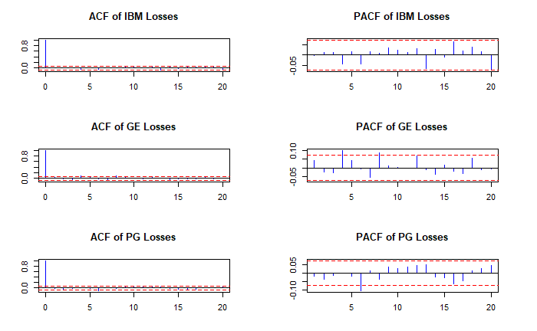
ACF and pacf

Slide 7
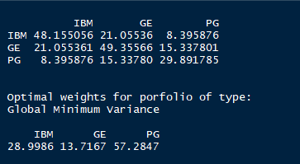
Covariance and portfolio
Covariance matrix using cov() function and "pairwise.complete.obs" specification
Found optimal weights of the assets using "global minimum variance portfolio"

Slide 8
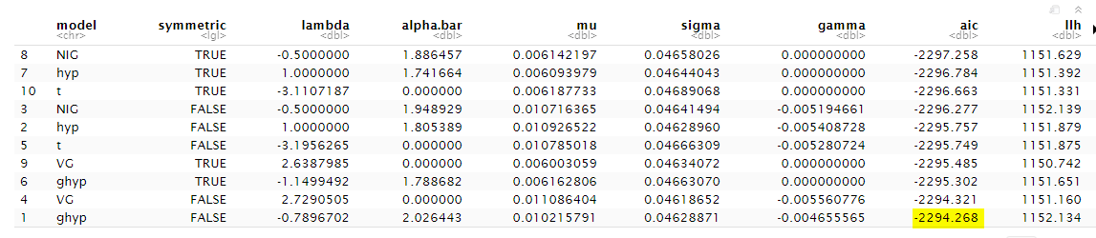
Method 1 : Generalized Hyperbolic Distribution
Assuming the time series data to be univariate, we assumed that returns are not independent and identically distributed (iid), time variant volatile and auto-correlated.
Using stepAIC(), performed a model selection in the scope of the GHYP distribution class based on the AIC to see which distribution has the closest fit to the actual distribution of returns.
GHYP with symmetric = FALSE seems to be the closest fit

Slide 9
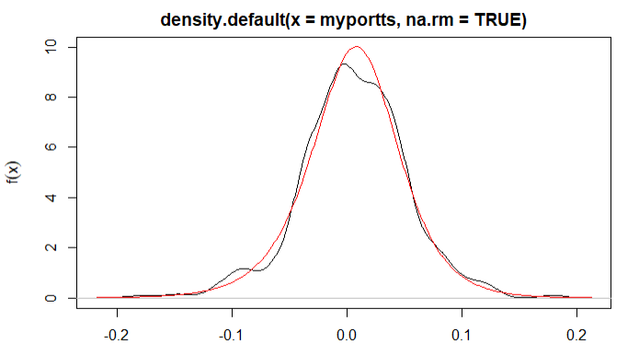
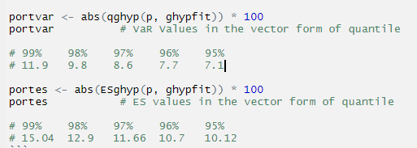
Method 1 : Generalized Hyperbolic Distribution (Cntd.)
Fitted the time series returns in GHYP distribution and calculated the density of it.
Plotting the ghyp density (red) over the empirical distribution (black) gives us the graph with close fit.
VaR at 95% confidence interval can be interpreted as 1 out of 1000 days (every 3 years), a loss of not greater than 7.1% should be expected.
ES at 95% confidence interval can be interpreted as 1 out of 1000 days (every 3 years), a shortfall of not greater than 10.12% should be expected.

Slide 10
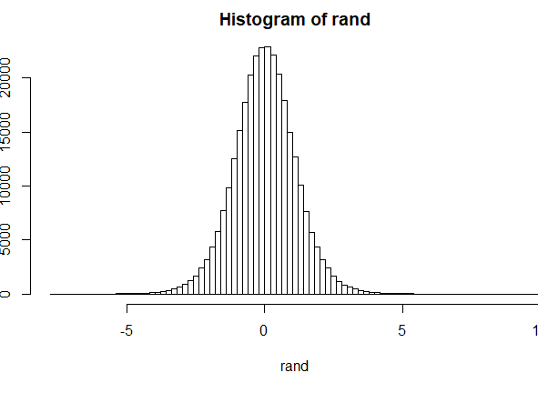
Method 2 : arma and garch
Estimated ARMA+GARCH model
Created one step ahead forecast of the standard deviation
Estimated distribution coefficients for the return series.
Simulated 100,000 random variables (returns) that follow the identified distribution with estimated parameters (refer the histogram)
Multiplied each simulated return by forecasted SD.
Sorted the product obtained from smallest to largest
Calculated VaR as the 5,000th largest loss (7.23)
ES as the median of 5,000 largest losses (8.78)

Slide 11
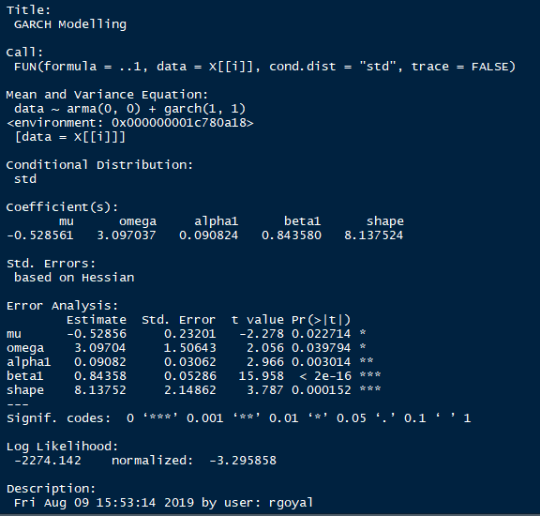
Method 3 : garch with copula
In order to consider both the univariate stylized fact such as volatility clustering and multivariate stylized facts such as time varying correlation into a model, we combined Garch model (which addresses univariate stylized facts) with copula (which addresses multivariate stylized facts) with the portfolio weights.
STEPS TO PROCEED WITH
Step 1 : Applied garchfit to the three assets with formula=~arma(0,0)+garch(1,1) and student t-distribution
Step 2 : Estimating the degrees of freedom parameter.
Step 3 : Calculated the residuals to apply Garch-copula model and standardized it by dividing it with conditional std. deviation.

Slide 12
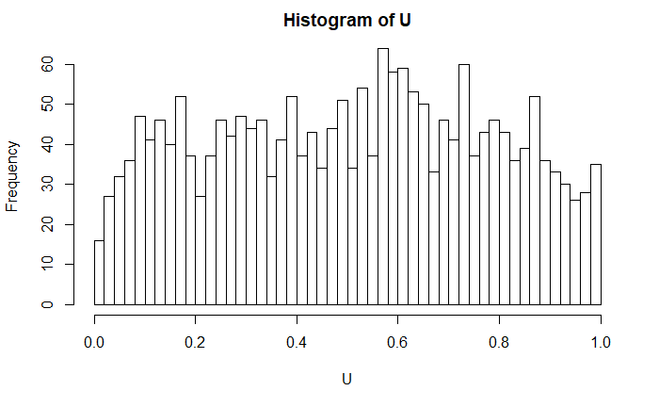
Method 3 : garch with copula (contd.)
Step 4 : The probabilities are calculated from pseudo-uniform variables for each risk from the standardized residuals. A copula model - Student's t copula is estimated based on Kendall's rank correlations.
Step 5: Simulate a100,000 random losses for each financial instrument and convert them back into quantiles
Step 6: The simulated portfolio losses are then determined as the outcome of the matrix-weight vector product by using weights from GMVP distribution.
Step 7: Sort the product obtained from smallest to largest
VaR is the 5,000th largest loss
ES is the median of 5,000 largest losses.
Histogram of Probabilities calculated from Pseudo Uniform Variables in Step 4

Slide 13
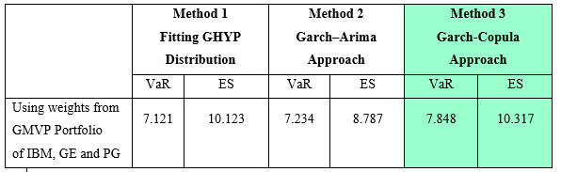
conclusion
Using Garch-Copula approach gives us a better and definite estimation

Slide 14

For a meaningful semester
Deepti Gupta

