Slide 1





US Crime Data Analysis
Presented by
- Deepti Gupta
- Madhu shri Rajagopalan
- Pallava ArAsu Pari
- Rahul
- Shriya

Slide 2
INTRODUCTION
Crime in the United States is a very important issue and as a data analyst, it is an interesting topic to analyze and find crime patterns and factors influencing crime
The data was collected by combining crime data from 1995 FBI UCR and the socio-economic data from 1990 census
In this project, we were interested in analyzing the factors namely, Education, Poverty, Ethnicity, Type of crime and their influence on crime rates
We will be using clustering methods to classify states based on the values of crime attributes.

Slide 3

STEPS IN ANALYSIS
1
2
Data Cleaning
3
Exploratory Data Analysis
4
5
Models/Methods
Evaluation
Preprocessing

Slide 4
Exploratory Data Analysis
Variables of Interest
Ethnicity
Poverty
Education
Type of Crime
Overall Violent Crimes

Slide 5
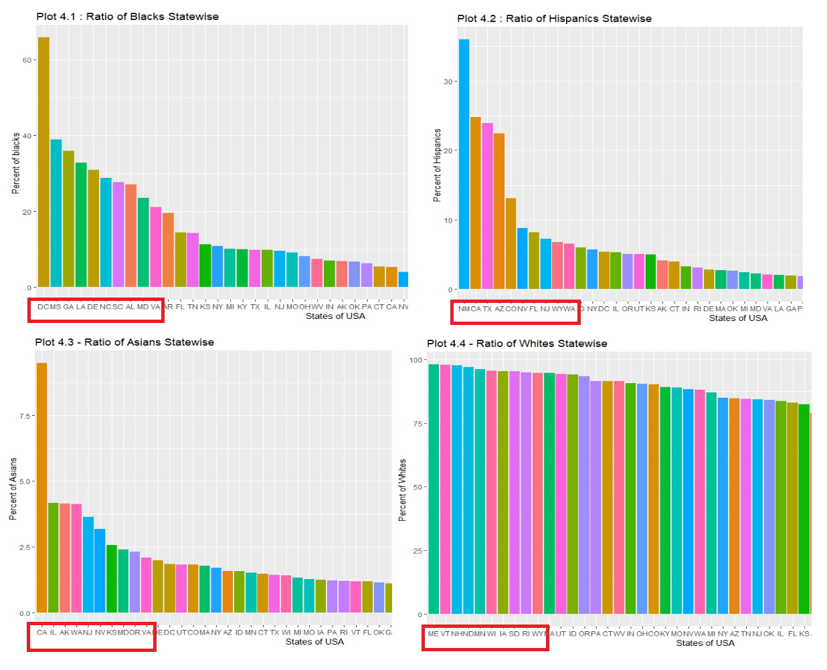
ETHNICITY AND THE TOP 10 STATES
Averaging the racial population of each state for the four major ethnicities separately
Ranking the states population-wise and deriving top 10 states for each ethnicity
Next step is to compare the crime rate of these states with national average of crime

Slide 6
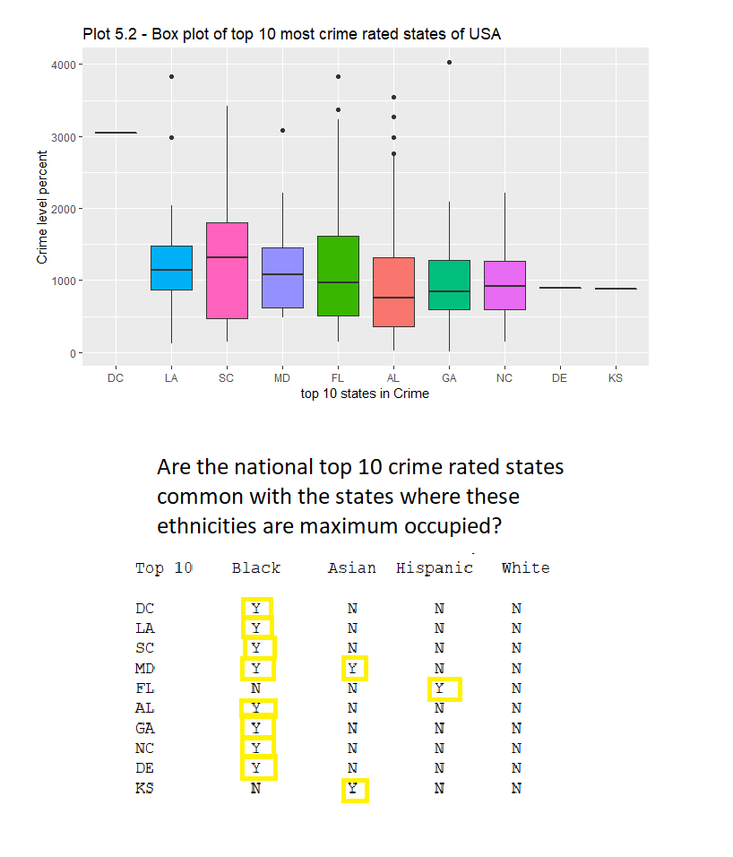
NATIONAL CRIME RATE
Comparing the national top 10 crime rated states with the ones where the four ethnicities are most populated
Results show that the state with maximum occupancy by Asians are only 2 in common with the national top 10
Next, studying the crime rate on the granular level by analyzing on the type of the crime for the top 10 racial states.

Slide 7
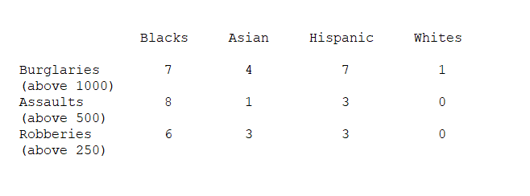
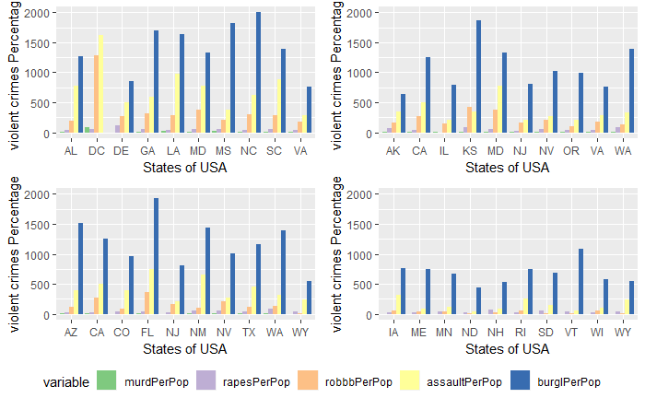
CRIME RATE AND TYPE OF CRIME
Comparing Crime rates based on the type of crime across different states in the US
Burglary is the top type of crime committed followed by assault and robberies in most of the states
Interestingly, same plot based on different ethnicity groups showed that’s crime rate of Asians were much lesser than other races.

Slide 8
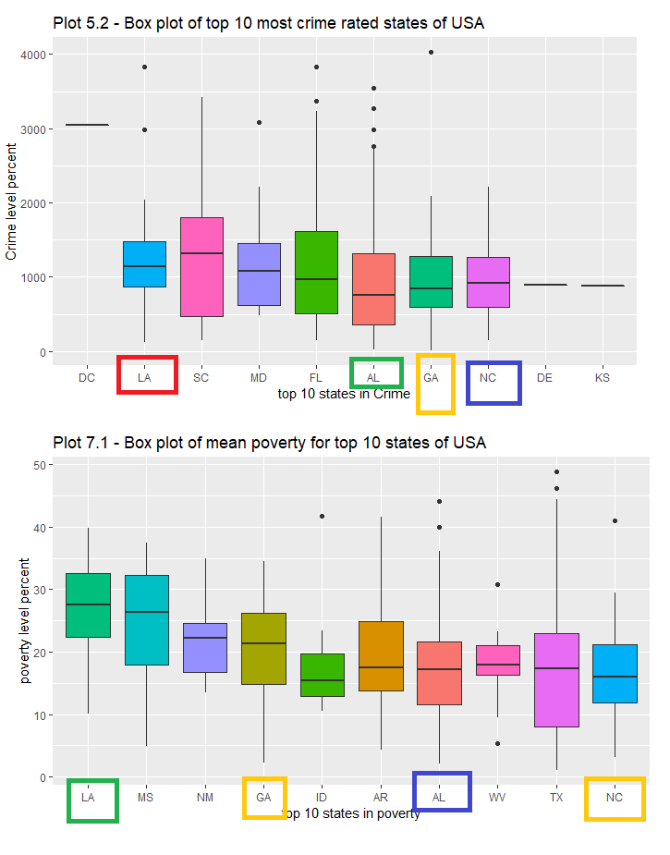
POVERTY AND CRIME RATE
Comparing top 10 states with highest crime rate with top ten states with highest level of poverty
Four states – LA, AL, GA and NC were common and had more crimes and higher poverty levels
Interestingly, the top 10 states with high level of poverty had less Asian population.

Slide 9
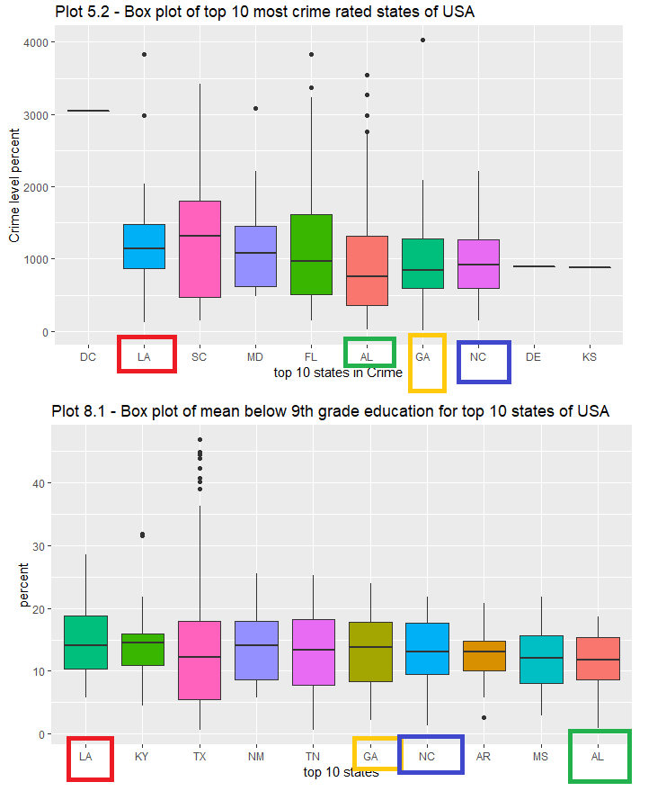
EDUCATION AND CRIME RATE
Comparing top 10 states with highest crime rate with top ten states with highest number of people with level of education below 9th grade
Four states – LA, AL, GA and NC were common and had more crimes and more less educated people
Interestingly, the top 10 states with more less educated people had less Asian population.

Slide 10
Method And Evaluation
K-means clustering
Population based Clustering Data Preparation
Variable Selection
Distance Matrix
Estimating number of Subgroups (k)
Cluster Plotting

Slide 11
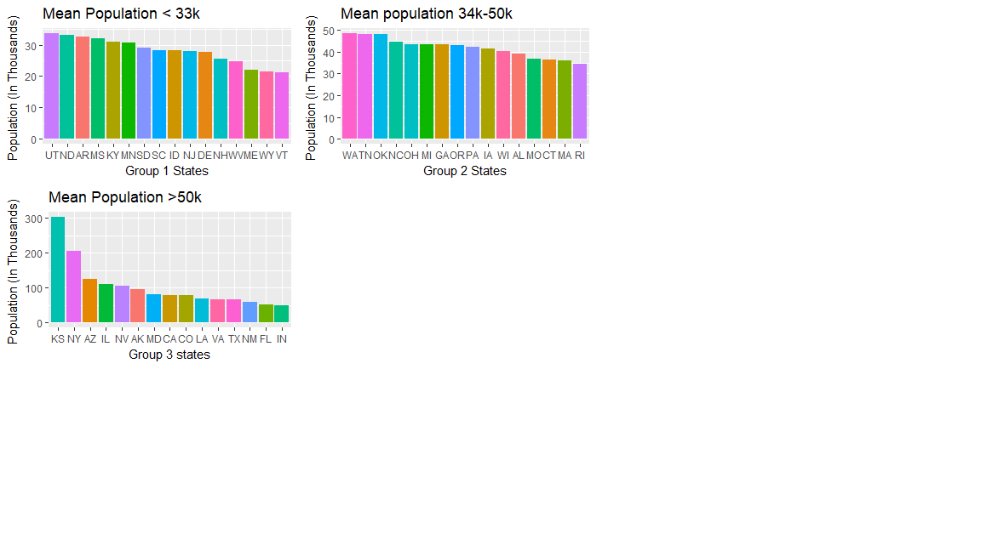
Clustering Data Preparation
Before performing k-means clustering on the entire data, for obtaining better clusters depending on our variables of interest, we grouped states into three based on mean population.
Group 1 – States that have a mean population of less than 33,000
Group 2 – States that have a mean population between 34,000 and 50,000
Group 3 – States that have a population greater than 50,000

Slide 12
K-means Clustering
Variable
Poverty
Education
Employment
Overall Crime rate
Group states based on level of poverty, number of high school and middle school dropouts, number unemployed and overall violent crime rate

Slide 13
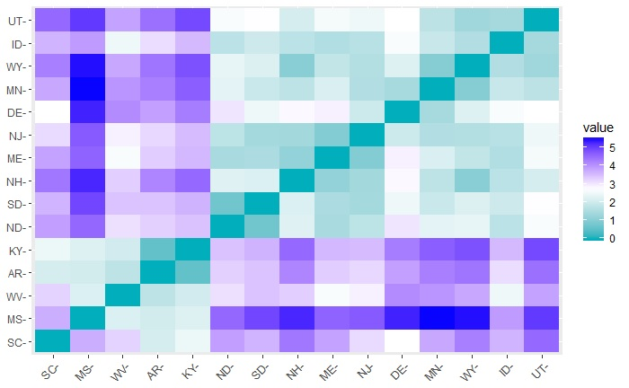
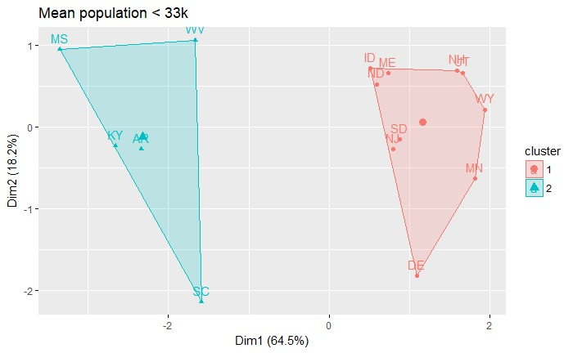
Clustering States with Mean Population < 33k
From the distance matrix, the gradient scale ranges with three different dominant colors, hence performing clustering with k=2/3 will group the states of similar characteristics together.
Cluster 1- States MS,WV,KY,AR, SC show similar trends
Cluster 2 – States ID,ME,ND,NJ,SD,MN,WY,NH,UT ,DE show similar trends

Slide 14
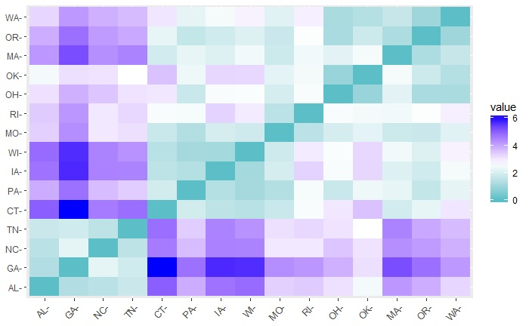
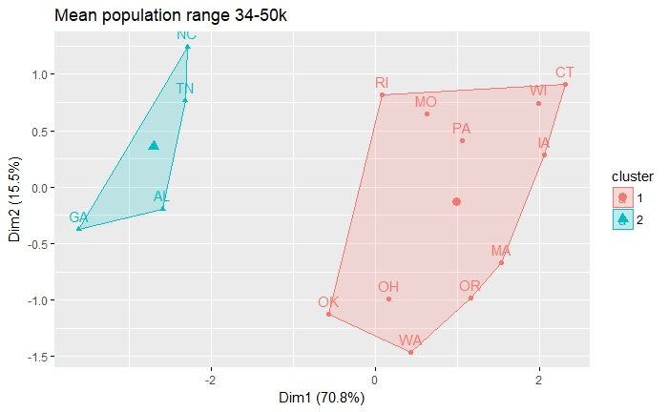
Clustering States with Mean Population between 33k-50k
From the distance matrix, the gradient scale ranges with three different dominant colors, hence performing clustering with k=2/3 will group the states of similar characteristics together.
Cluster 1- States GA,AL,TN,NC show similar trends
Cluster 2 – States RI,MO,PA,WI,CT,IA,MA,OR,WA,OH,OK show similar trends

Slide 15
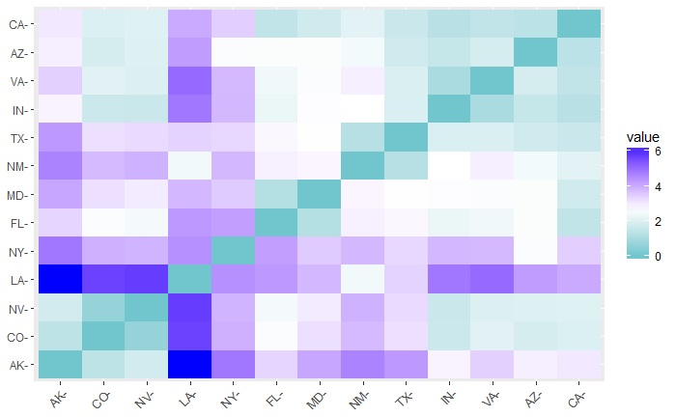
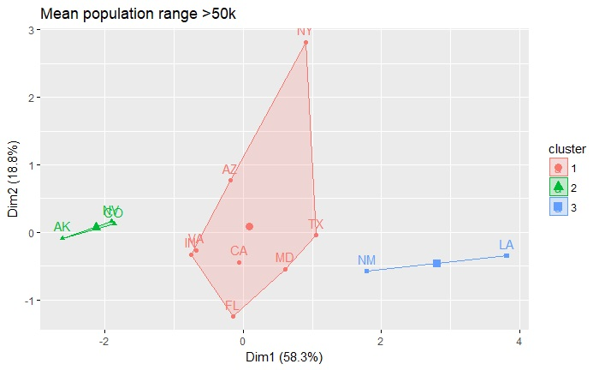
Clustering States with Mean Population between >50k
From the distance matrix, the gradient scale ranges with three different dominant colors, hence performing clustering with k=2/3 will group the states of similar characteristics together.
Cluster 1- States Ak, CO, NV show similar trends
Cluster 2 – States IN,VA,AZ,NY,CA,FL,MD,TX show similar trends
Cluster 3 – States NM,LA show similarities

Slide 16
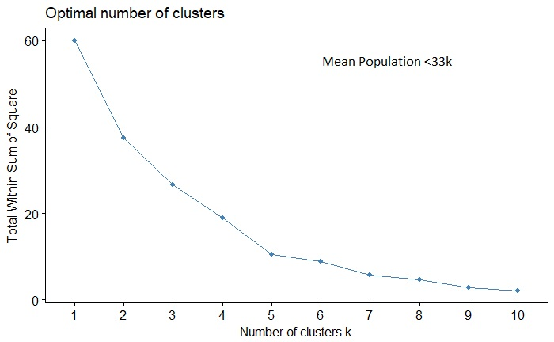
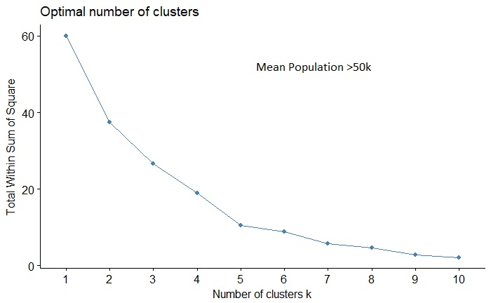
Evaluation
Using the elbow method for evaluating the optimal number of cluster, we can see that the optimal number of cluster is 5 for all the groups.

Slide 17
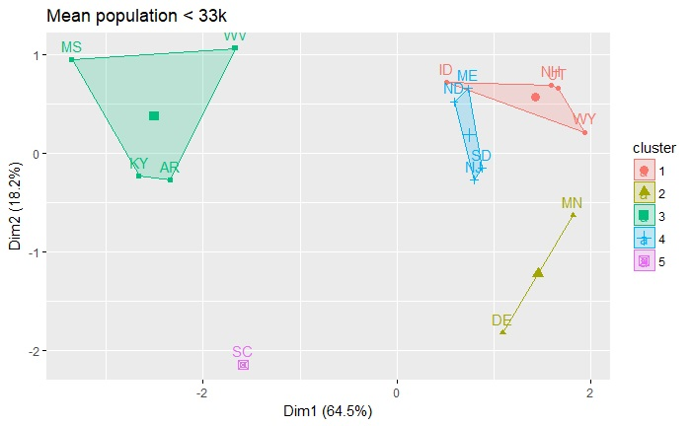
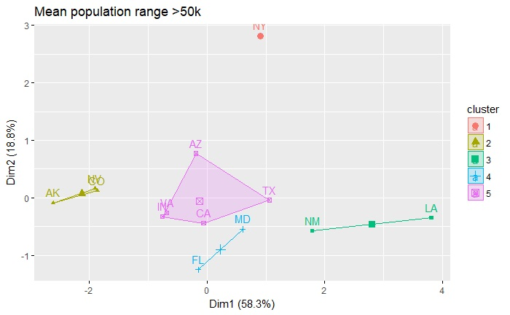
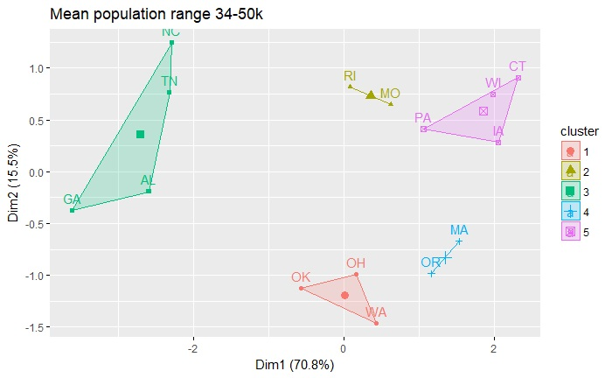
Updating K based on Optimal value
The states for all the groups are now clustered into 5
The updated clusters group will now have the sum of squared errors less than the previous clusters with k = 3

Slide 18
CONCLUSION
Ethnicity – From the top 10 states with highest crime rate, Asian population seems to be the least in those states when compared with other races
Type of Crime – Burglary is the most common crime committed in higher numbers followed by assault and robberies
Poverty – From the top ten states with high crime rate, four states -LA, AL, GA and NC were common with the states with high poverty levels
Education – Interestingly, like poverty, from the top ten states with high crime rate, four states -LA, AL, GA and NC were common with the states with low level of education
Addressing the issues like poverty and education might help in curbing the crimes

Slide 19


