Slide 1
Visual Data Analysis using ALTAIR

Slide 2
Presentation structure

Slide 3
Problem Statement and data at hand
Assumptions
Data Pre Processing
Task 1: Data exploration
Task 2: Data visualization
Dashboard
Conclusion

Slide 4
Problem Statement :
The city of Mistford and the Boonsong Lekagul Wildlife Preserve are facing a significant decline in the nesting pairs of the Rose-Crested Blue Pipit, a beloved local bird species. Previous investigations have suggested a potential link between the decline and activities at Kasios Office Furniture, a manufacturing firm in Mistford. However, no concrete evidence has been found to establish this link.
A detailed analysis of the water sensor readings from rivers and streams in the preserve needs to be carried out to identify any potential correlation between chemical measurements and decline in bird population

Slide 5
Data at hand:
Dataset : Tabular
Datatype : Items and attributes

Slide 6
Assumptions :
The wildlife preserve is located in the UK.
If the readings of a chemical are not available, we assume that reading was not taken.
Readings with value=0 were included in the analysis for in-depth trend analysis.
The sites on the same river routes were marked together. Post this selection we had 4 routes with the bifurcation as
Route 1: Boonsri, Kohsoom, Busarakhan, Chai, Kannika.
Route 2: Somchair, Achara, Sakda.
Route 3: Tansanee.
Route 4: Decha.
After the route marking and distance calculation, Route 1 was found nearest to the dumping site and route 4 is the farthest.Kohsoom is nearest to the dumping site with a distance of 1.55 units and Decha is the farthest with 8.21 units of distance.
Since the exact manufacturing process of the furniture manufacturing company ‘Kasios Office Furniture’ is unknown, therefore it is assumed that all the chemicals listed in the dataset are emitted as a byproduct of the manufacturing activities.

Slide 7
Data Pre Processing :
‘Sample date’ was converted to date type format.
Additional information on the sites’ coordinates and their distance from the dumping site was added in a separate dataset named ‘location_coordinates’. This helped in creating a dummy map for site locations.

Slide 8
Task 1 - Data Exploration

Slide 9
Visual 1 :
Aim : Discover trends, outliers, and missing data location-wise.
Key Findings:
Data for all locations of Route 1 were available from 1988 to 2016.
Data for only 2 Route 2 sites (Somchair, Sakda) available from 1998 to 2016.
Other sites on Route 2 (Achara), Tansanee (Route 3), and Decha (Route 4) had data available from 2009 to 2016 (8 years).
Kohsoom had highest measures in 2003.
Majority of sites in green to blue zones.
2003 saw high values, possibly due to heat wave.
Tansanee consistently in blue to purple zone.
Achara mostly in green zone, except in 2009.

Slide 10
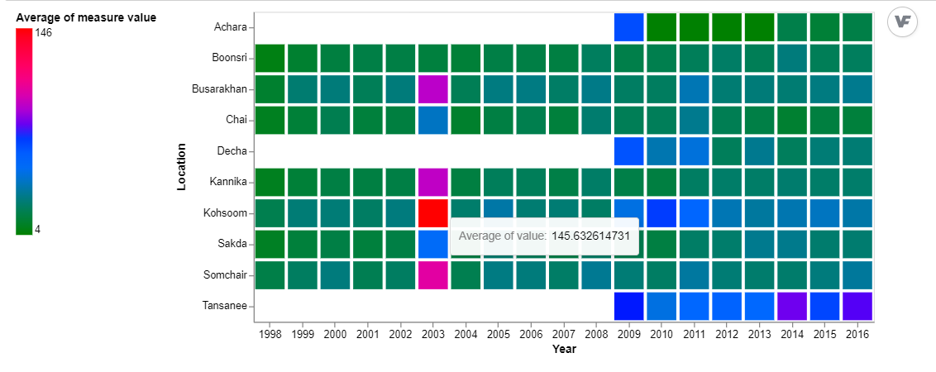
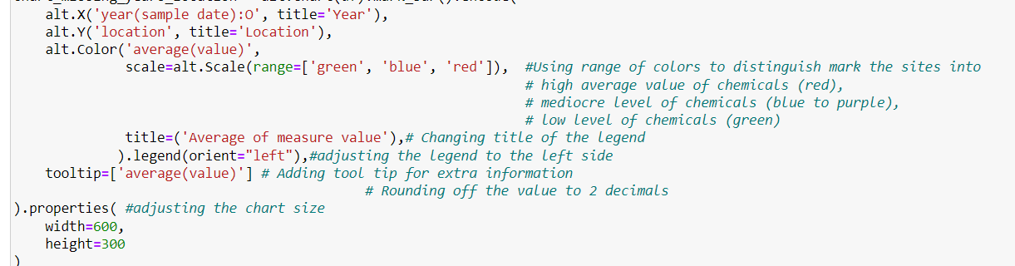

Slide 11
Visual 2
Aim : The goal was to identify data irregularities in chemical metrics across all locations.
Key Findings :
All average measures across locations fall within the green zone
Achara recorded 'Total coliforms' in the red zone.
Missing values are evident from white spaces, indicating no readings for a specific measure in 19 years.
Chemicals observed across all locations include 'Ammonium', 'Anionic active surfactants', 'Arsenic', 'Atrazine', 'Bicarbonates', 'Biochemical Oxygen', 'Cadmium', 'Calcium', 'Chemical Oxygen Demand (Cr)', 'Chemical Oxygen Demand (Mn)', 'Chlorides', 'Chromium', 'Copper', 'Dissolved oxygen', 'Dissolved silicates', 'Iron', 'Lead', 'Macrozoobenthos', 'Magnesium', 'Manganese', 'Mercury', 'Nickel', 'Nitrates', 'Nitrites', 'Orthophosphate-phosphorus', 'Oxygen saturation', 'Petroleum hydrocarbons', 'Potassium', 'Sodium', 'Sulphates', 'Total dissolved salts', 'Total hardness', 'Total nitrogen', 'Total phosphorus', 'Water temperature', 'Zinc', 'gamma-Hexachlorocyclohexane', 'p,p-DDT'.

Slide 12
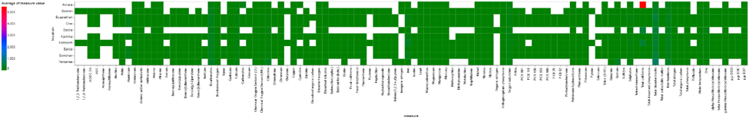
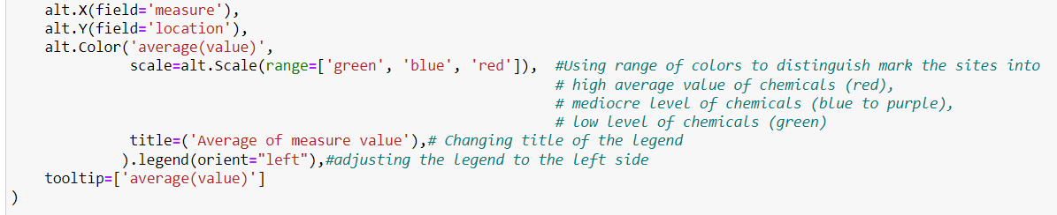

Slide 13
Visual 3
Aim : To find out the missing values, data irregularities of all chemical values throughout the time period 1998-2016 (19years).
Key findings:
Inconsistencies in data collection frequency observed; e.g., Beryllium, PCB 28, PCB 118, PAHs, Boron, Cesium, PCB 52, Trifluralin, Fluorene collected once from 1998 to 2016.
'Total dissolved salts' and 'bicarbonates' consistently in the blue zone, indicating mediocre average values.
Iron's average value was in the red zone in 2003.

Slide 14
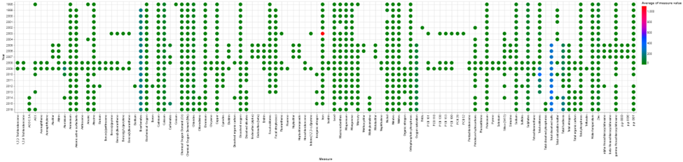
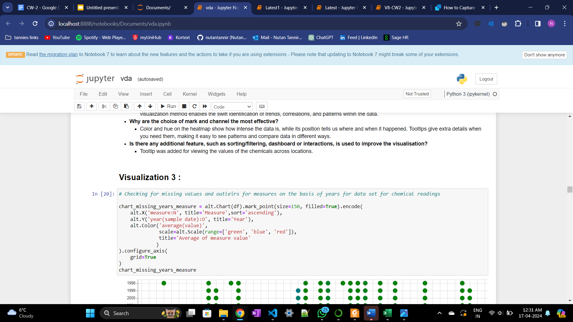


Slide 15
Visual 4
Aim : To observe and compare the total number of records collected for each location and chemical measures.
Key Findings :
Boonsri and Chai had the highest observations: Boonsri (31314) and Chai (31245).
Achara, Decha, and Tansanee had the fewest.
Water temperature was the most frequently recorded measure with 5031 records.

Slide 16
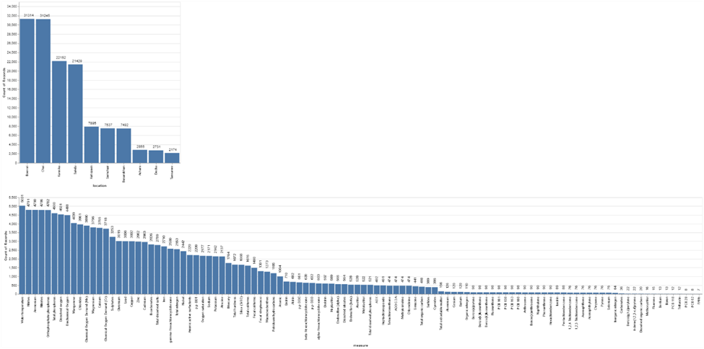


Slide 17
Visual 5
Aim : The aim was to see the trend of collection frequency over the span of 19 years.
Key Findings :
Boonsri and Chai had the highest observations: Boonsri (31314) and Chai (31245).
Achara, Decha, and Tansanee had the fewest.
Water temperature was the most frequently recorded measure with 5031 records.

Slide 18
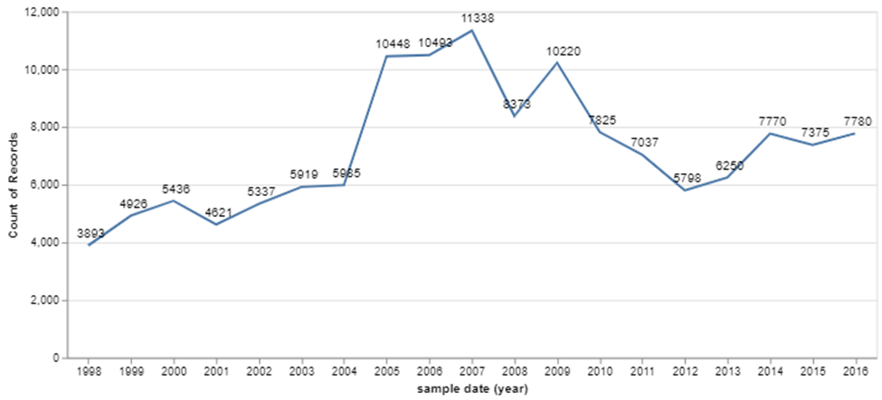

Slide 19
Task 2 - Data Visualization

Slide 20
Data considered
Following the observations from Task 1, for deeper analysis we consider:
Sites: Route 1 (Boonsri, Kohsoom, Busarakhan, Chai, Kannika) and Route 2 (Somchair, Sakda) were available from 1998 to 2016 as the data is available from 1998 to 2016.
Chemicals which were observed for all the locations from 1998 to 2016 are - 'Ammonium', 'Biochemical Oxygen', 'Cadmium', 'Calcium', 'Chemical Oxygen Demand (Cr)', 'Chemical Oxygen Demand (Mn)', 'Chlorides', 'Chromium', 'Copper', 'Dissolved oxygen', 'Lead', 'Magnesium', 'Nitrates', 'Nitrites', 'Orthophosphate-phosphorus', 'Potassium', 'Sodium', 'Sulphates', 'Total phosphorus', 'Water temperature'.

Slide 21
Visual 6
Aim : The visualization illustrates average measure values over time across multiple locations using faceted line charts.
Key Findings :
Across all locations, it has been noted that the average value of measures has exhibited a declining trend over a 19-year period, although the start was at high levels.

Slide 22
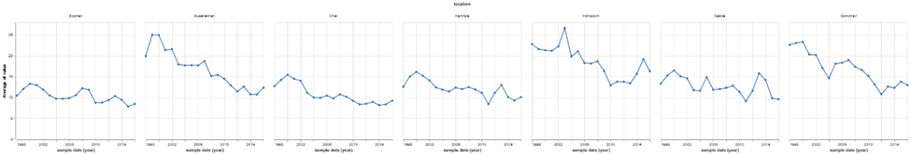
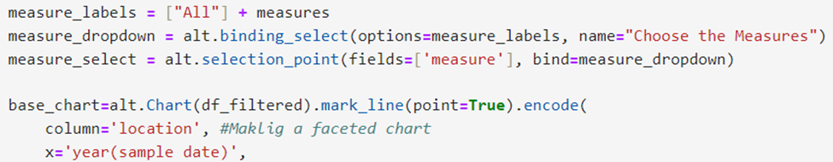
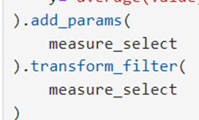

Slide 23
Visual 7
Aim : The visualization summarizes the cumulative value of various chemicals from 1998 to 2016, providing yearly averages and identifying predominant chemicals annually.
Key Findings :
During the course of the 19 years of monitoring, calcium, chlorides, and sulphates have continuously shown larger amounts than other chemicals.
Nitrate has consistently shown the lowest levels of all chemicals throughout the entire 19 years.

Slide 24
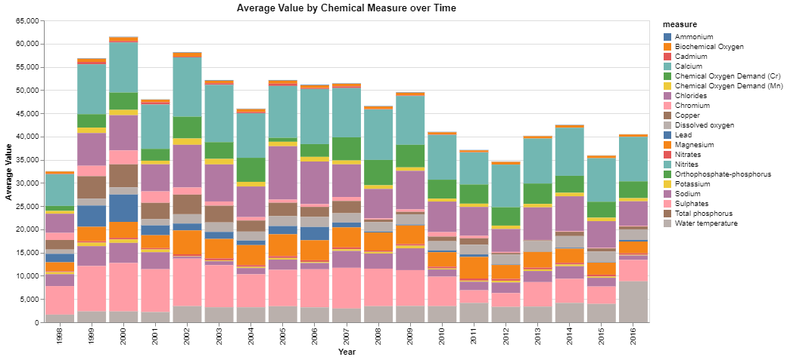
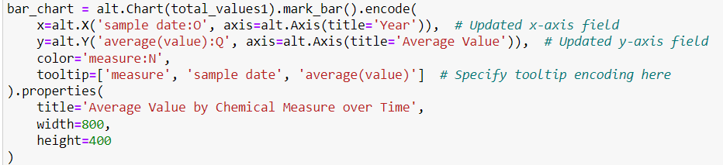

Slide 25
Dashboard

Slide 26
Dashboard :
Aim : The aim of this dashboard is to analyze and display the distribution of chemical values at various locations over time, separated by routes and distance from a dumping site. It aims to explain how different routes and distances from a central point affect the spatial and temporal patterns of chemical distribution.

Slide 27
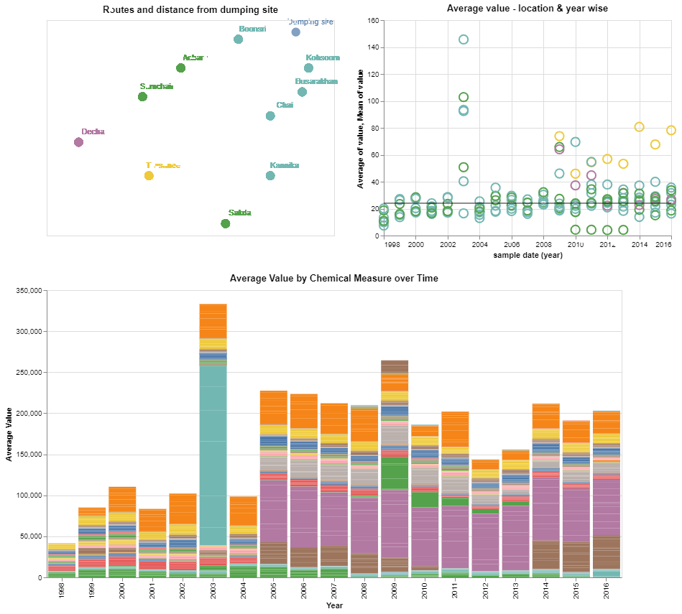

Slide 28
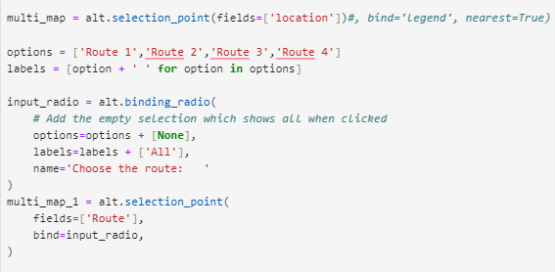
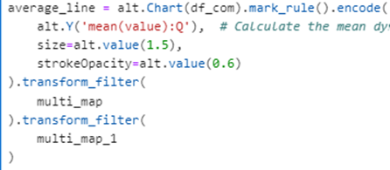


Slide 29
Conclusion

Slide 30
Based on the findings from Task 1 and Task 2, it is inferred that the bird population could potentially be affected by the concentration of chemicals in the various locations. However, a definitive conclusion can only be reached with additional information regarding factors such as the quantity of pollutants emitted by the furniture company, the establishment date of the company, acceptable thresholds for each chemical, and so forth.

Slide 31
Thank you

