Slide 1

Fundamentals of Lotus Notes
Opening Slide
1
Opening Slide with appropriate background music for 5 sec
The screen has active player triggers for moving to the next and previous screens.
After the music is over, the screen 1 accedes to screen 2.1
https://upload.wikimedia.org/wikipedia/commons/0/04/IBM_Notes_9_logo.png
https://www.chosic.com/download-audio/26019/
NA

Slide 2
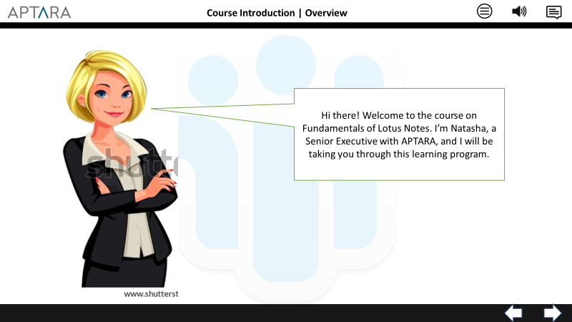
Fundamentals of Lotus Notes
Overview
2.1
On screen load, display the character and callout in sync with VO
After VO completes, move to screen 2.2
https://upload.wikimedia.org/wikipedia/commons/0/04/IBM_Notes_9_logo.png
https://www.shutterstock.com/image-vector/smart-blonde-business-women-vector-illustration-563998354
Hi there! Welcome to the course on Fundamentals of Lotus Notes. I’m Natasha, a Senior Executive with APTARA, and I will be taking you through this learning program.

Slide 3
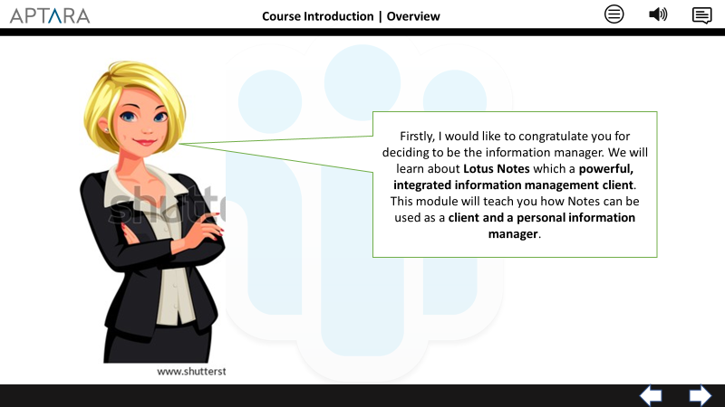
Fundamentals of Lotus Notes
Overview
2.2
On screen load, display the character and callout in sync with VO
After VO completes, move to screen 3
https://upload.wikimedia.org/wikipedia/commons/0/04/IBM_Notes_9_logo.png
https://www.shutterstock.com/image-vector/smart-blonde-business-women-vector-illustration-563998354
Firstly, I would like to congratulate you for deciding to be the information manager. We will learn about Lotus Notes which a powerful, integrated information management client.
This module will teach you how Notes can be used as a client and a personal information manager.

Slide 4
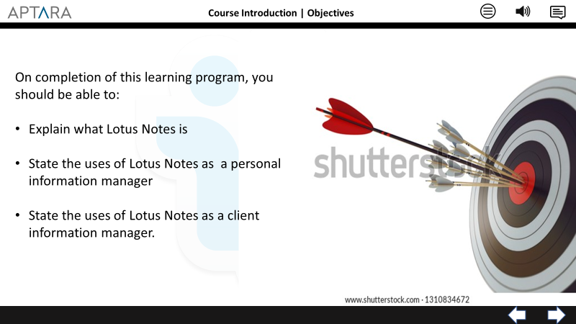
Fundamentals of Lotus Notes
Objectives
3
On screen text to be in sync with VO
After VO completes, move to screen 4
https://upload.wikimedia.org/wikipedia/commons/0/04/IBM_Notes_9_logo.png
https://www.shutterstock.com/image-illustration/arrow-hit-center-target-business-achievement-1310834672
On completion of this learning program, you should be able to:
Explain what Lotus Notes is
State the uses of Lotus Notes as a personal information manager
State the uses of Lotus Notes as a client information manager.

Slide 5
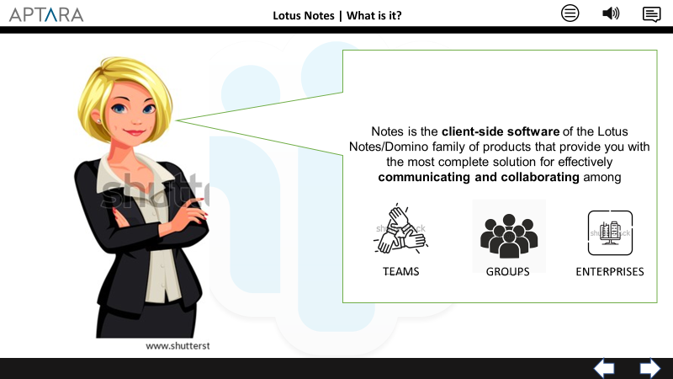
Fundamentals of Lotus Notes
Lotus Notes | What is it?
4
Call out and infographics to be in sync with VO
After VO completes, move to screen 5
https://upload.wikimedia.org/wikipedia/commons/0/04/IBM_Notes_9_logo.png
https://www.shutterstock.com/image-vector/three-hands-support-each-other-concept-1043518303
https://www.shutterstock.com/image-vector/six-man-team-black-color-icon-1008189019
https://www.shutterstock.com/image-vector/outline-enterprise-vector-icon-isolated-black-1493645030
Notes is the client-side software of the Lotus Notes/Domino family of products that provide you with the most complete solution for effectively communicating and collaborating among Teams, groups and entire enterprises

Slide 6
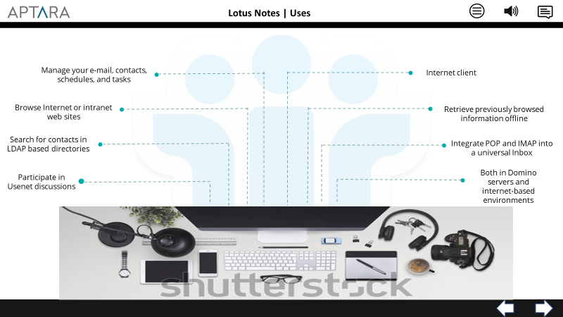
Fundamentals of Lotus Notes
Lotus Notes | Uses
5
Display this visual and text in sync with the VO
After VO completes, move to screen 6
https://upload.wikimedia.org/wikipedia/commons/0/04/IBM_Notes_9_logo.png
https://www.shutterstock.com/image-photo/top-view-office-694231765
Notes can help you manage your e-mail, contacts, schedules, and tasks. It can also act as an Internet client. With Release 5, you can browse Internet or intranet web sites while connected to the network, or retrieve previously browsed information offline. With Notes, you can search for contacts in Light Directory Access Protocol (LDAP)-based directories on the Internet, or your company’s intranet. Release 5 can integrate your Post Office Protocol (POP) and Internet Message Access Protocol (IMAP) mail accounts into a single, universal Inbox. It even allows you to participate in Usenet discussions on the Internet, online and offline. It has a consistent, integrated interface to manage all these functions. You can use Notes within environments that include Domino servers, or within environments entirely based on Internet-related services. These would include Hypertext Transfer Protocol (HTTP)/Hypertext Markup Language (HTML), LDAP, POP3/ /Simple Mail Transfer Protocol (SMTP), and Network News Transfer Protocol (NNTP).

Slide 7
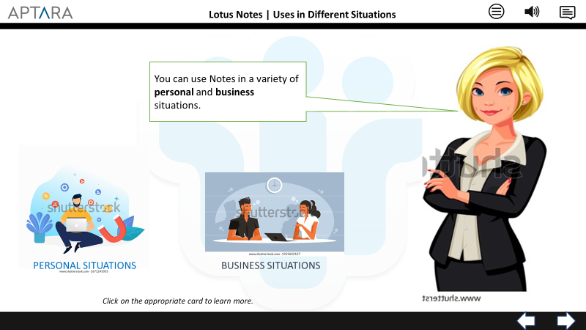
Fundamentals of Lotus Notes
Lotus Notes | Uses in Different Situations
6
Call out and infographics to be in sync with VO
If user click on “Personal Situations”, move to slide 8.1
Else if user clicks on “Business Situations”, move to slide 7.1
Set a variable for all the images to make sure that the user has visited all the relevant screens
Once the user has clicked on each of these cards – move to screen 9.1
https://upload.wikimedia.org/wikipedia/commons/0/04/IBM_Notes_9_logo.png
https://www.shutterstock.com/image-vector/interview-businessman-man-having-job-manager-1359622127
https://www.shutterstock.com/image-vector/smm-social-media-marketing-manager-sitting-1671245035
https://www.shutterstock.com/image-vector/smart-blonde-business-women-vector-illustration-563998354
You can use Notes in a variety of personal and business situations.
To learn more about each one of them, please click on the appropriate card.

Slide 8
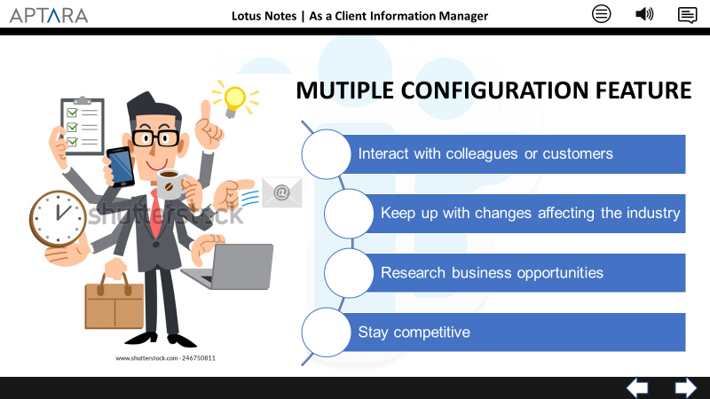
Fundamentals of Lotus Notes
Lotus Notes | As a Client Information Manager
7.1
Call out and infographics to be in sync with VO
After VO completes, move to screen 7.2
https://upload.wikimedia.org/wikipedia/commons/0/04/IBM_Notes_9_logo.png
https://www.shutterstock.com/image-vector/businessmen-do-multitasking-246750811
Notes is an effective tool for small businesses because of its feature of multiple configuration. It is because of this feature that Notes can be used with ISP account to interact with colleagues or customers, keep up with changes affecting the industry, research business opportunities, and stay competitive

Slide 9
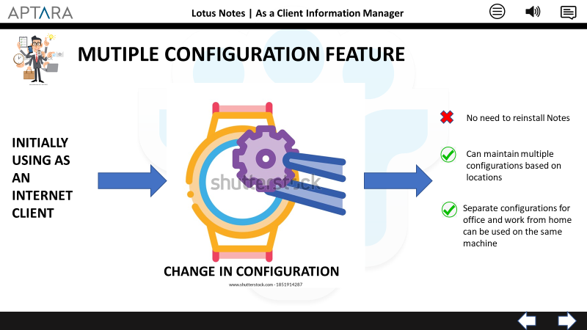
Fundamentals of Lotus Notes
Lotus Notes | As a Client Information Manager
7.2
Call out and infographics to be in sync with VO
After VO completes, move to screen 6
https://upload.wikimedia.org/wikipedia/commons/0/04/IBM_Notes_9_logo.png
https://www.shutterstock.com/image-vector/businessmen-do-multitasking-246750811
https://www.shutterstock.com/image-vector/watch-change-gear-icon-vector-sign-1851914287
Notes is installed on your computer in a way that enables you to start using it for one purpose and easily change the configuration as your needs change. For example, you can start using Notes exclusively as an Internet client. If you later encounter a situation that requires access to a Domino server, you only need to make a simple change in configuration. You will not need to reinstall Notes. Notes can maintain multiple configurations. These configurations based on location. Thus, you can use Notes with one configuration while you are in office, and another when you work from home, all on the same machine. With this feature, you can use Notes for a variety of purposes

Slide 10
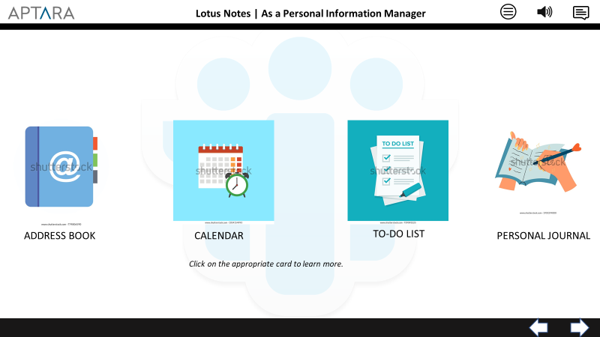
Fundamentals of Lotus Notes
Lotus Notes | As a Personal Information Manager
8.1
Call out and infographics to be in sync with VO
After VO completes, move to screen 8.2
If the user clicks on “Address Book” move to screen 8.2
If the user clicks on “Calendar” move to screen 8.3
If the user clicks on “To-do list” move to screen 8.4
If the user clicks on “Personal Journal” move to screen 8.5
Set a variable for all the images to make sure that the user has visited all the relevant screens
Once the user has clicked on each of these images – move to screen 6
https://upload.wikimedia.org/wikipedia/commons/0/04/IBM_Notes_9_logo.png
https://www.shutterstock.com/image-vector/woman-hands-notepad-diary-journal-writing-1903294000
https://www.shutterstock.com/image-vector/flat-vector-icon-design-address-book-774806590
https://www.shutterstock.com/image-vector/do-list-planning-icon-concept-all-739093225
https://www.shutterstock.com/image-vector/calendar-clock-icon-vector-illustration-1067096708
You can use Notes to record your personal information as well , such as contacts, agendas, personal tasks, and other data. Notes include core functionality that lets you store contact information, manage your schedule, control your tasks, and keep a personal journal.
Click on the appropriate card to learn more.

Slide 11
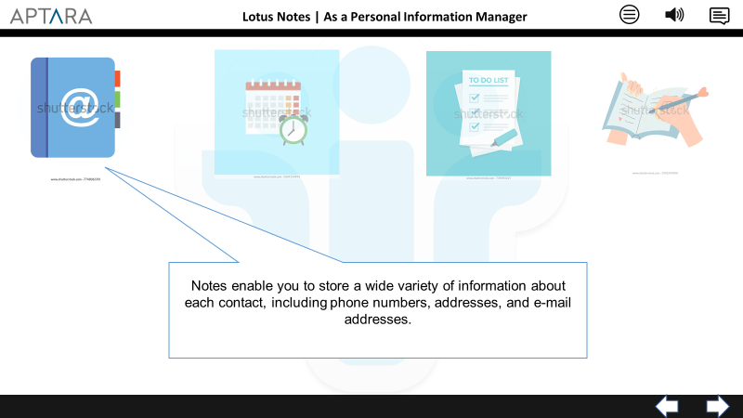
Fundamentals of Lotus Notes
Lotus Notes | As a Personal Information Manager
8.2
Call out and infographics to be in sync with VO
After VO completes, move to screen 8.1
https://upload.wikimedia.org/wikipedia/commons/0/04/IBM_Notes_9_logo.png
https://www.shutterstock.com/image-vector/woman-hands-notepad-diary-journal-writing-1903294000
https://www.shutterstock.com/image-vector/flat-vector-icon-design-address-book-774806590
https://www.shutterstock.com/image-vector/do-list-planning-icon-concept-all-739093225
https://www.shutterstock.com/image-vector/calendar-clock-icon-vector-illustration-1067096708
You can use Notes’s built-in Personal Address Book to store and manage your contact information. . Notes enable you to store a wide variety of information about each contact, including phone numbers, addresses, and e-mail addresses.

Slide 12
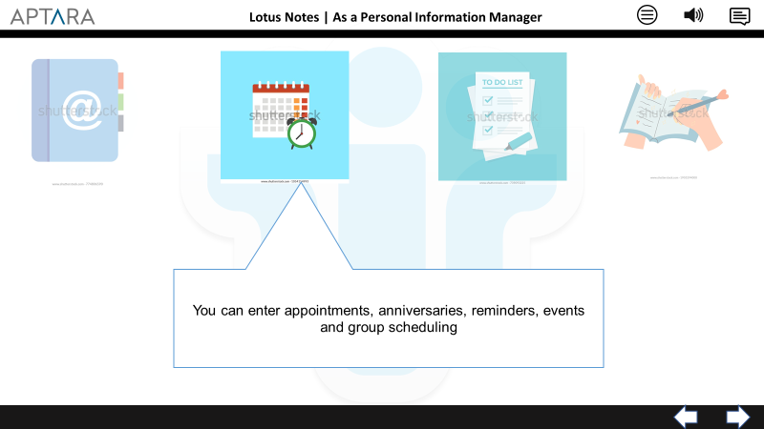
Fundamentals of Lotus Notes
Lotus Notes | As a Personal Information Manager
8.3
Call out and infographics to be in sync with VO
After VO completes, move to screen 8.1
https://upload.wikimedia.org/wikipedia/commons/0/04/IBM_Notes_9_logo.png
https://www.shutterstock.com/image-vector/woman-hands-notepad-diary-journal-writing-1903294000
https://www.shutterstock.com/image-vector/flat-vector-icon-design-address-book-774806590
https://www.shutterstock.com/image-vector/do-list-planning-icon-concept-all-739093225
https://www.shutterstock.com/image-vector/calendar-clock-icon-vector-illustration-1067096708
Notes includes a Calendar for you to keep track of your schedule. You can enter appointments, anniversaries, reminders, and events, just as you can on a paper calendar. You can also use the Calendar for group scheduling, if you are participating in a Domino-based collaboration environment

Slide 13
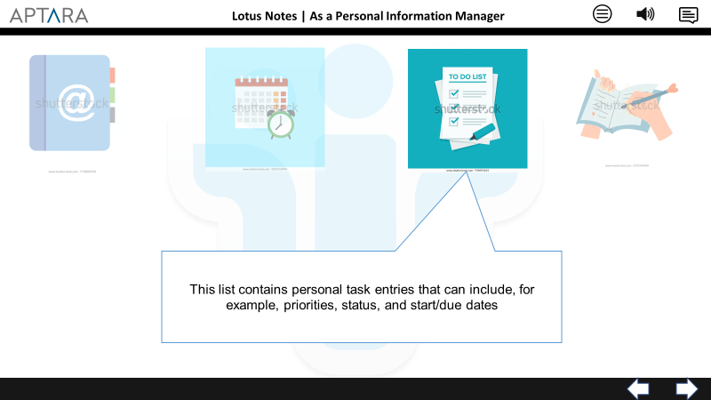
Fundamentals of Lotus Notes
Lotus Notes | As a Personal Information Manager
8.4
Call out and infographics to be in sync with VO
After VO completes, move to screen 8.1
https://upload.wikimedia.org/wikipedia/commons/0/04/IBM_Notes_9_logo.png
https://www.shutterstock.com/image-vector/woman-hands-notepad-diary-journal-writing-1903294000
https://www.shutterstock.com/image-vector/flat-vector-icon-design-address-book-774806590
https://www.shutterstock.com/image-vector/do-list-planning-icon-concept-all-739093225
https://www.shutterstock.com/image-vector/calendar-clock-icon-vector-illustration-1067096708
Notes feature a personal To Do list. This list contains personal task entries that can include, for example, priorities, status, and start/due dates. Your To Do list also contains group To Do items assigned to you if you are participating in a Domino-based collaboration environment.

Slide 14
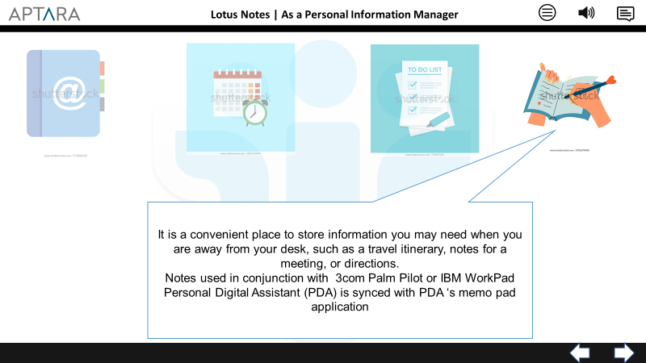
Fundamentals of Lotus Notes
Lotus Notes | As a Personal Information Manager
8.5
Call out and infographics to be in sync with VO
After VO completes, move to screen 8.1
https://upload.wikimedia.org/wikipedia/commons/0/04/IBM_Notes_9_logo.png
https://www.shutterstock.com/image-vector/woman-hands-notepad-diary-journal-writing-1903294000
https://www.shutterstock.com/image-vector/flat-vector-icon-design-address-book-774806590
https://www.shutterstock.com/image-vector/do-list-planning-icon-concept-all-739093225
https://www.shutterstock.com/image-vector/calendar-clock-icon-vector-illustration-1067096708
The Personal Journal is a convenient place to store information you may need when you are away from your desk, such as a travel itinerary, notes for a meeting, or directions. Notes used in conjunction with 3com Palm Pilot or IBM WorkPad Personal Digital Assistant (PDA) is synced with PDA ‘s memo pad application

Slide 15
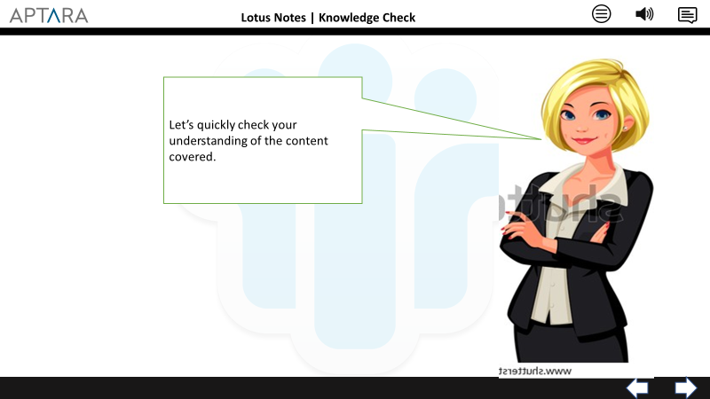
Fundamentals of Lotus Notes
Lotus Notes | Knowledge Check
9.1
Call out and infographics to be in sync with VO
After VO completes, move to screen 9.2
https://upload.wikimedia.org/wikipedia/commons/0/04/IBM_Notes_9_logo.png
https://www.shutterstock.com/image-vector/smart-blonde-business-women-vector-illustration-563998354
Let’s quickly check your understanding of the content covered.

Slide 16
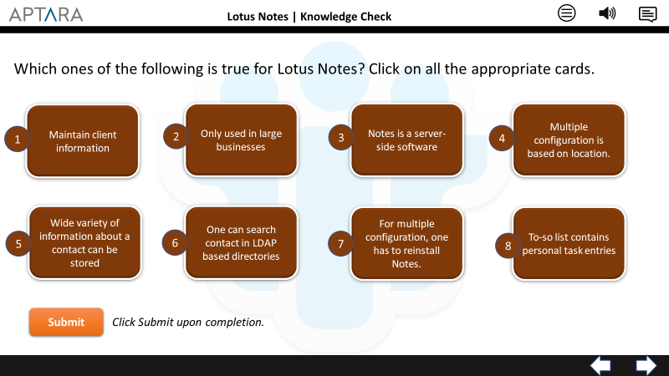
Fundamentals of Lotus Notes
Lotus Notes | Knowledge Check
9.2
This is a click interactivity. The learner should be able to click on the cards
The colour of card numbers 1,4,5,6,8 will change to green when user clicks on them. When all these cards are clicked, the learner will be navigated to screen 9.4
If the user clicks on card numbers 2,3,7 – he will be navigated to screen 9.3
https://upload.wikimedia.org/wikipedia/commons/0/04/IBM_Notes_9_logo.png
Which ones of the following is true for Lotus Notes? Click on all the appropriate cards.

Slide 17
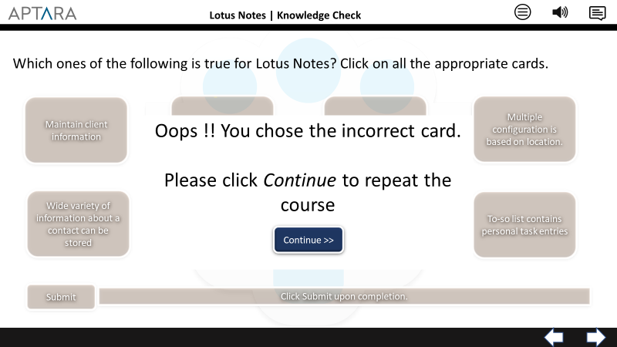
Fundamentals of Lotus Notes
Lotus Notes | Knowledge Check
9.3
Text in sync with VO
When user clicks on Continue, move to screen 4
https://upload.wikimedia.org/wikipedia/commons/0/04/IBM_Notes_9_logo.png
Oops !! You chose the incorrect card. Please click Continue to repeat the course.

Slide 18
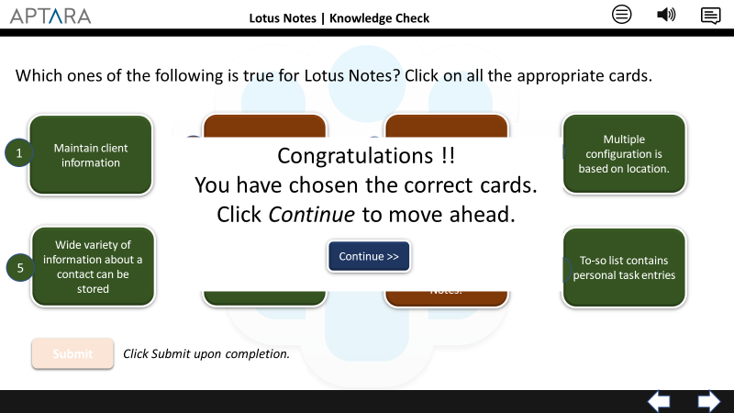
Fundamentals of Lotus Notes
Lotus Notes | Knowledge Check
9.4
Text in sync with VO
When user clicks on continue, move to screen 10.1
https://upload.wikimedia.org/wikipedia/commons/0/04/IBM_Notes_9_logo.png
Congratulations !! You have chosen the correct cards. Click Continue to move ahead.

Slide 19
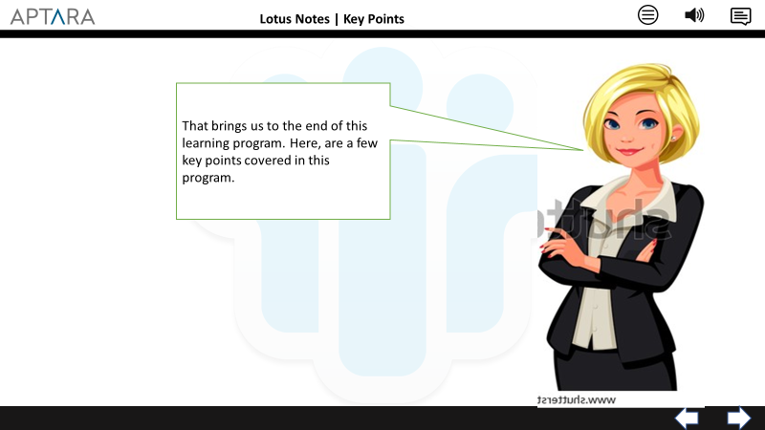
Fundamentals of Lotus Notes
Lotus Notes | Key Points
10.1
Call out and infographics to be in sync with VO
After VO completes, move to screen 10.2
https://upload.wikimedia.org/wikipedia/commons/0/04/IBM_Notes_9_logo.png
https://www.shutterstock.com/image-vector/smart-blonde-business-women-vector-illustration-563998354
That brings us to the end of this learning program. Here, are a few key points covered in this program.

Slide 20
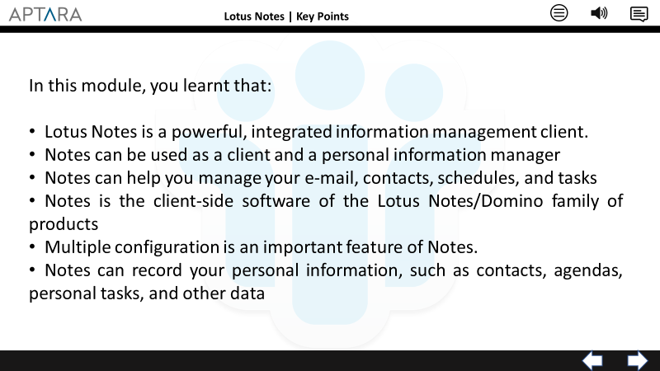
Fundamentals of Lotus Notes
Lotus Notes | Key Points
10.2
https://upload.wikimedia.org/wikipedia/commons/0/04/IBM_Notes_9_logo.png

