Slide 1
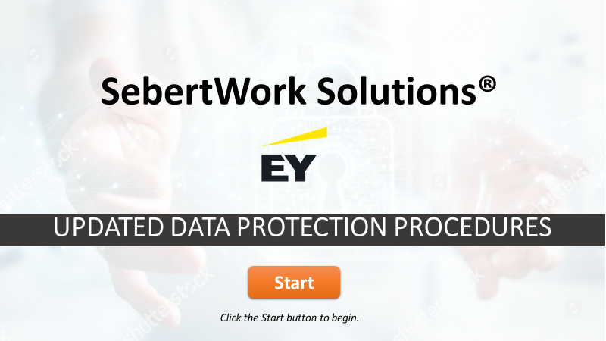
Updated Data Protection Procedures
Opening Slide
1
When user clicks on “Start”, move to screen 2.
https://www.shutterstock.com/image-photo/wood-letter-smart-word-hand-writing-336767873
Welcome to the course on Updated Data Protection Procedures. Click on start to begin

Slide 2
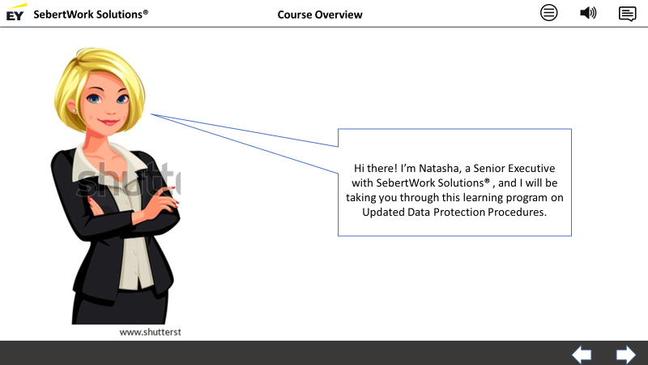
Updated Data Protection Procedures
Course Overview
2
Graphic and text to be in sync with VO
When user clicks on the right arrow at the bottom right corner, move to screen 3.
https://www.shutterstock.com/image-vector/smart-blonde-business-women-vector-illustration-563998354
Hi there! I’m Natasha, a Senior Executive with SebertWork Solutions® , and I will be taking you through this learning program on Updated Data Protection Procedures.

Slide 3
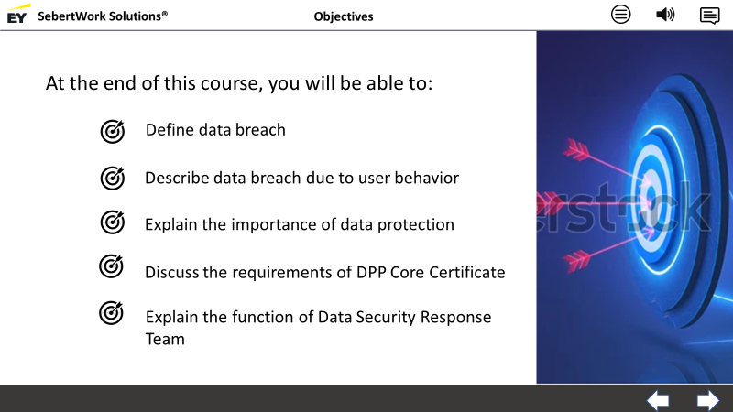
Updated Data Protection Procedures
Objectives
3
Text and graphics to be in sync with VO.
When user clicks on the right arrow at the bottom right corner of the screen, move to screen 4
When user clicks on the left arrow at the bottom right corner of the screen, move to screen 2
https://www.shutterstock.com/image-vector/darts-target-success-business-concept-hit-1767284747
https://www.shutterstock.com/image-vector/target-icon-successful-shot-darts-isolated-302025566
At the end of this course, you will be able to:
Define data breach
Describe data breach due to user behavior
Explain the importance of data protection
Discuss the requirements of DPP Core Certificate
Explain the function of Data Security Response Team

Slide 4
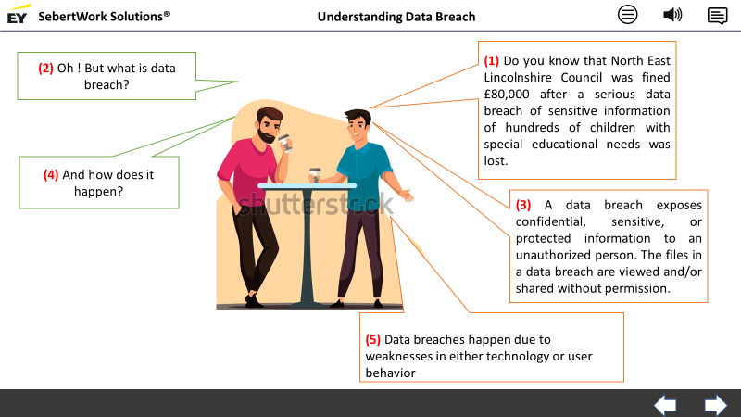
Updated Data Protection Procedures
Understanding Data Breach
4
Call out and text to be in sync with VO in sequence
When user clicks on the right arrow at the bottom right corner of the screen, move to screen 5
When user clicks on the left arrow at the bottom right corner of the screen, move to screen 3
https://www.shutterstock.com/image-vector/coffee-break-concept-two-men-stand-1734054809
Lets hear this small conversation between two colleagues.
(1) Do you know that North East Lincolnshire Council was fined £80,000 after a serious data breach of sensitive information of hundreds of children with special educational needs was lost.
(2) Oh ! But what is data breach?
(3) A data breach exposes confidential, sensitive, or protected information to an unauthorized person. The files in a data breach are viewed and/or shared without permission.
(4) And how does it happen?
(5) Data breaches happen due to weaknesses in either technology or user behavior

Slide 5
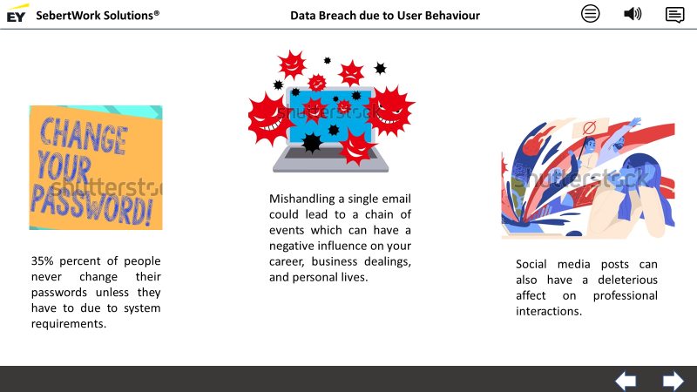
Updated Data Protection Procedures
Data Breach due to User Behaviour
5
Picture and text to be in sync with VO
When user clicks on the right arrow at the bottom right corner of the screen, move to screen 6
When user clicks on the left arrow at the bottom right corner of the screen, move to screen 4
https://www.shutterstock.com/image-illustration/text-sign-showing-change-your-password-1295924113
https://www.shutterstock.com/image-vector/computer-virus-color-287479460
https://www.shutterstock.com/image-vector/woman-suffering-panic-attack-after-reading-1705662640
Despite many cases of data breach, a recent survey in PCMag of 2,500 US consumers, conducted between June 30 and July 12th 2018, found that 35% percent of people never change their passwords unless they have to due to system requirements.
If you mishandle a single email communication or open just one virus-carrying file, you could set into action a chain of events that can influence your career, business dealings, and personal lives in a negative way.
Social media posts can also have a deleterious affect on professional interactions. So can mistakes in email, such as Reply All on a sensitive communication or making a company-damaging Social media post. You don’t want these things to happen! This can damage SebertWorks Solutions relationships with key clients and your standing among your colleagues.

Slide 6
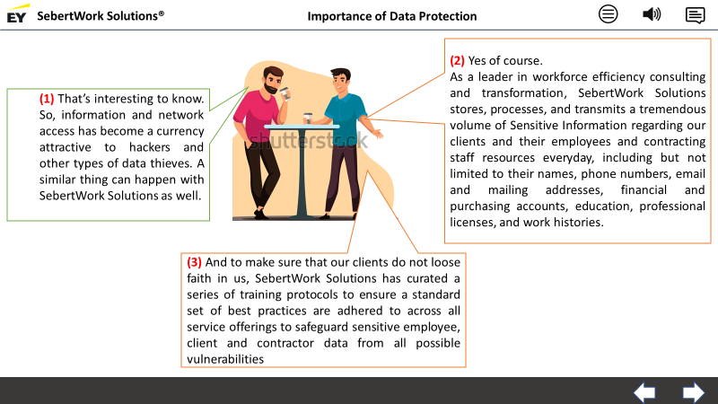
Updated Data Protection Procedures
Importance of Data Protection
6
Call out and text to be in sync with VO in sequence
When user clicks on the right arrow at the bottom right corner of the screen, move to screen 7.1
When user clicks on the left arrow at the bottom right corner of the screen, move to screen 5
https://www.shutterstock.com/image-vector/coffee-break-concept-two-men-stand-1734054809
(1) That’s interesting to know. So, information and network access has become a currency attractive to hackers and other types of data thieves. A similar thing can happen with SebertWork Solutions as well.
(2) Yes of course.
As a leader in workforce efficiency consulting and transformation, SebertWork Solutions stores, processes, and transmits a tremendous volume of Sensitive Information regarding our clients and their employees and contracting staff resources everyday, including but not limited to their names, phone numbers, email and mailing addresses, financial and purchasing accounts, education, professional licenses, and work histories.
(3) And to make sure that our clients do not loose faith in us, SebertWork Solutions has come up with a series of training protocols to ensure a standard set of best practices are adhered to across all service offerings to safeguard sensitive employee, client and contractor data from all possible vulnerabilities

Slide 7
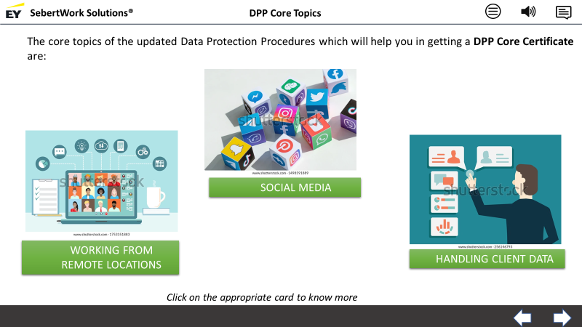
Updated Data Protection Procedures
DPP Core Topics
7.1
Image and text to be in sync with VO
When user clicks on the right arrow at the bottom right corner of the screen, move to screen 8
When user clicks on the left arrow at the bottom right corner of the screen, move to screen 6.
When user clicks on “Social Media” , move to screen 7.2
When the user clicks on “Working from Remote Location”, move to screen 7.3
When the user clicks on “Handing Client Data”, move to screen 7.4
https://www.shutterstock.com/image-photo/kyiv-ukraine-september-5-2019-paper-1498591889
https://www.shutterstock.com/image-vector/business-team-conference-video-call-studying-1753351883
https://www.shutterstock.com/image-vector/customer-relationship-management-vector-illustration-256146793
The core topics of the updated Data Protection Procedures which will help you in getting a DPP Core Certificate are: : Social Media, Working from Remote locations, and handling client data. Click on the appropriate card to know more

Slide 8
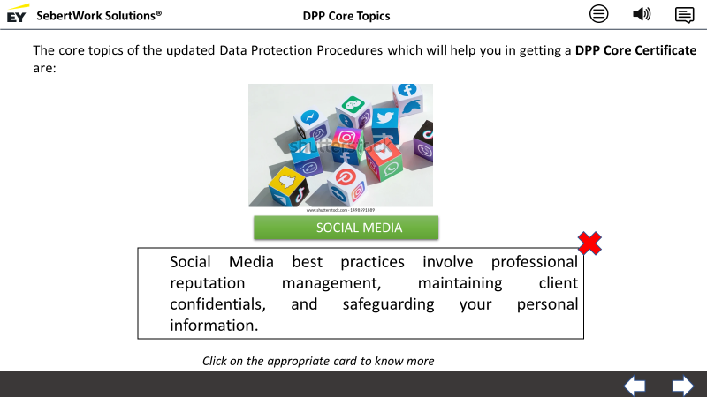
Updated Data Protection Procedures
DPP Core Topics
7.2
Image and text to be in sync with VO
When user clicks on the right arrow at the bottom right corner of the screen, move to screen 8
When user clicks on the left arrow at the bottom right corner of the screen, move to screen 6.
When user clicks on the “Red Cross”, move to screen 7.1
https://www.shutterstock.com/image-photo/kyiv-ukraine-september-5-2019-paper-1498591889
Social Media best practices involve professional reputation management, maintaining client confidentials, and safeguarding your personal information.

Slide 9
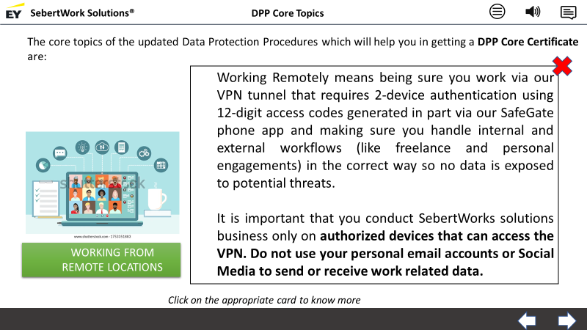
Updated Data Protection Procedures
DPP Core Topics
7.3
Image and text to be in sync with VO
When user clicks on the right arrow at the bottom right corner of the screen, move to screen 8
When user clicks on the left arrow at the bottom right corner of the screen, move to screen 6.
When user clicks on the “Red Cross”, move to screen 7.1
https://www.shutterstock.com/image-vector/business-team-conference-video-call-studying-1753351883
Working Remotely means being sure you work via our VPN tunnel that requires 2-device authentication using 12-digit access codes generated in part via our SafeGate phone app and making sure you handle internal and external workflows (like freelance and personal engagements) in the correct way so no data is exposed to potential threats.
It is important that you conduct SebertWorks solutions business only on authorized devices that can access the VPN. Do not use your personal email accounts or Social Media to send or receive work related data.

Slide 10
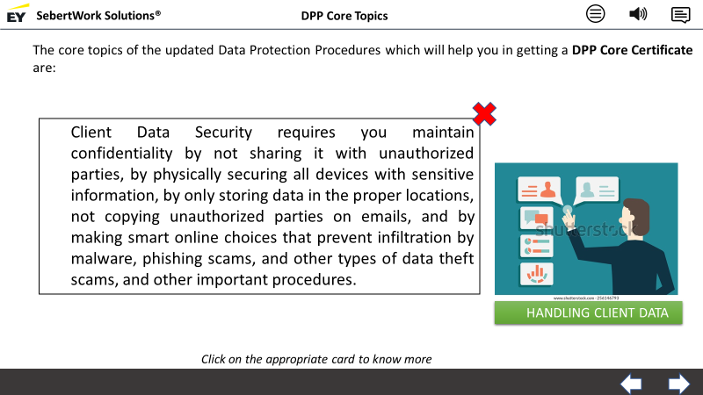
Updated Data Protection Procedures
DPP Core Topics
7.4
Image and text to be in sync with VO
When user clicks on the right arrow at the bottom right corner of the screen, move to screen 8
When user clicks on the left arrow at the bottom right corner of the screen, move to screen 6.
When user clicks on the “Red Cross”, move to screen 7.1
https://www.shutterstock.com/image-vector/customer-relationship-management-vector-illustration-256146793
Client Data Security requires you maintain confidentiality by not sharing it with unauthorized parties, by physically securing all devices with sensitive information, by only storing data in the proper locations, not copying unauthorized parties on emails, and by making smart online choices that prevent infiltration by malware, phishing scams, and other types of data theft scams, and other important procedures.

Slide 11
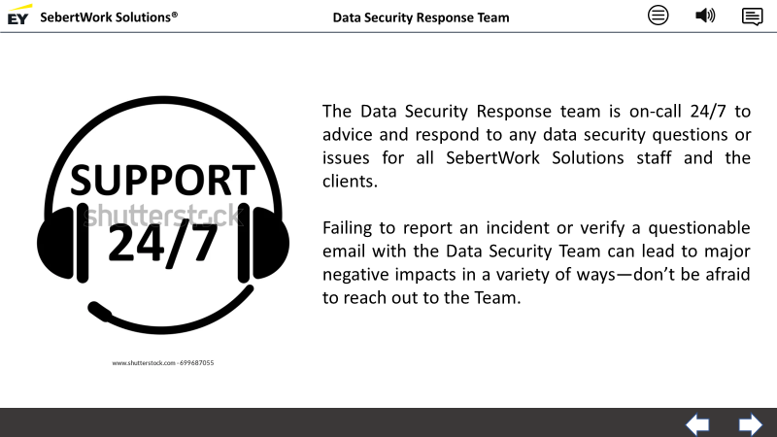
Updated Data Protection Procedures
Data Security Response Team
8
Text to be in sync with VO
When user clicks on the right arrow at the bottom right corner of the screen, move to screen 9.1
When user clicks on the left arrow at the bottom right corner of the screen, move to screen 7.1.
https://www.shutterstock.com/image-vector/support-24-hours-flat-icon-isolated-699687055
The Data Security Response team is on-call 24/7 to advice and respond to any data security questions or issues for all SebertWork Solutions staff and the clients.
Failing to report an incident or verify a questionable email with the Data Security Team can lead to major negative impacts in a variety of ways—don’t be afraid to reach out to the Team.
We will also cover how to properly report security concerns that you experience and also the ways you can alert our SebertWork Solutions’ Data Security Response Team in the event of a possible data breach to minimize impacts and identify security gaps so that the team can close them.

Slide 12
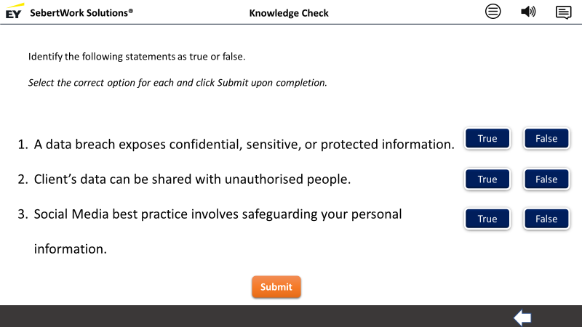
Updated Data Protection Procedures
Knowledge Check
9.1
This is a true/false activity
Provide clickable tabs for True and False next to each statement
The learner needs to be able to select one option for each statement
On clicking the Submit button, evaluation needs to happen, as shown in the screen 9.2
Play appropriate feedback
When user clicks on the left arrow at the bottom right corner of the screen, move to screen 8
Identify the following statements as true or false.
Select the correct option for each and click Submit upon completion.

Slide 13
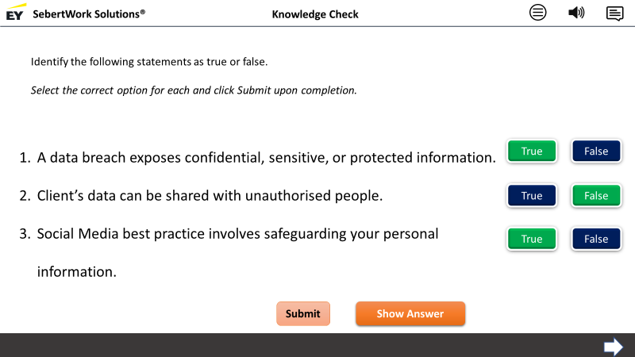
Updated Data Protection Procedures
Knowledge Check
9.2
If the learner does not get the answer right, provide a Show Answer button, clicking which, the correct answers need to be shown
When user clicks on the right arrow at the bottom right corner of the screen, move to screen 10
Correct answer feedback:
That’s correct!
Incorrect answer feedback:
That’s not quite right. Click the Show Answer button for the correct answers.

Slide 14
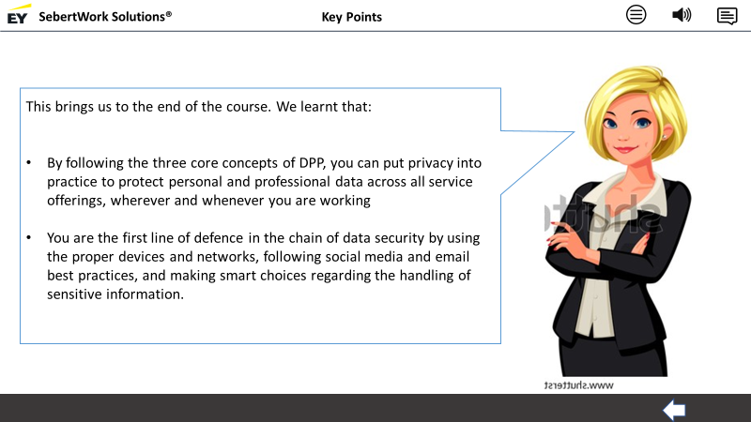
Updated Data Protection Procedures
Key Points
10
Text to be in sync with VO
When user clicks on the left arrow at the bottom right corner of the screen, move to screen 9.1
https://www.shutterstock.com/image-vector/smart-blonde-business-women-vector-illustration-563998354
This brings us to the end of the course. We learnt that:
By following the three core concepts of DPP, you can put privacy into practice to protect personal and professional data across all service offerings, wherever and whenever you are working
You are the first line of defence in the chain of data security by using the proper devices and networks, following social media and email best practices, and making smart choices regarding the handling of sensitive information.

