Slide 1

Monetisation Strategy and AI-Driven Financial Solutions for FilmFusion

Slide 2
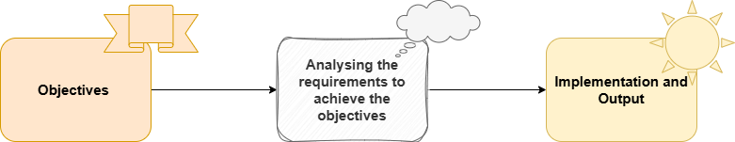
Approach

Slide 3
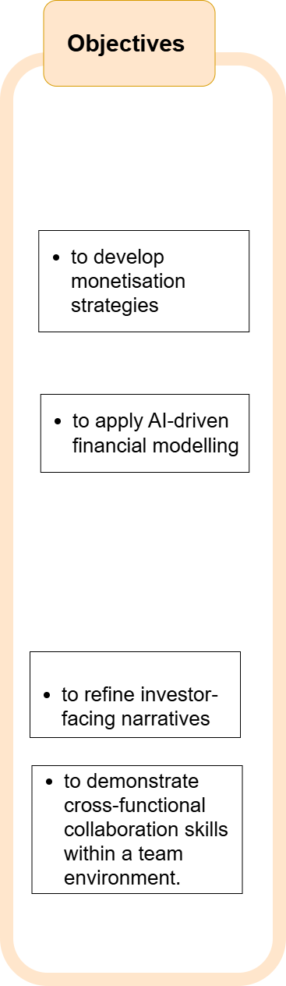

Slide 4
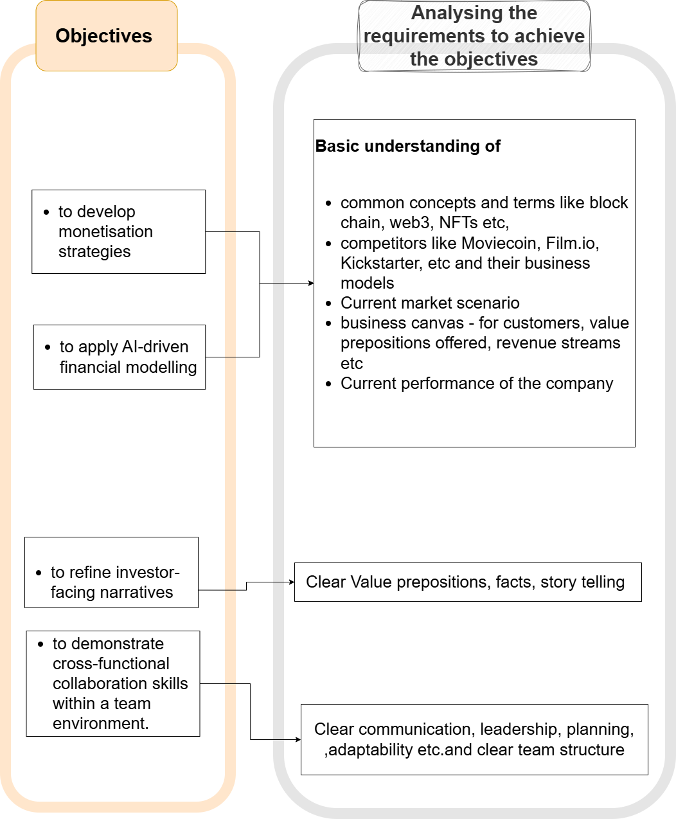

Slide 5
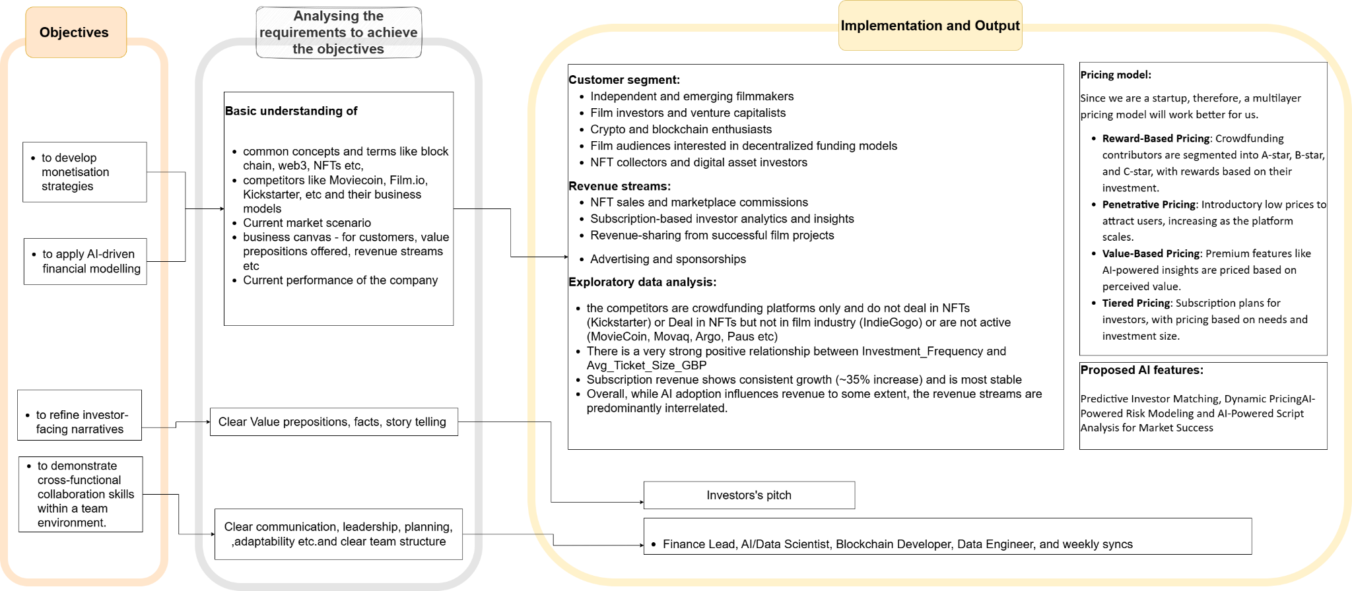

Slide 6

Questions

