Slide 1
Bank Marketing Data Analysis Iti shri Kotiyal

Slide 2
AGENDA
PROBLEM STATEMENT
GOALS
DATA PREPROCESSING
DATA ANALYSIS AND VISUALIZATIONS
CURRENT MODEL EVALUATION
PROPOSING NEW MODEL
RECOMMENDATIONS

Slide 3
PROBLEM STATEMENT
The dataset is related to the marketing campaign of a banking institution. The bank wants to make their campaign successful by determining in advance the clients who will be more receptive to it and subscribe to the term deposit offered by the bank
The dataset contains 41188 records with 20 inputs

Slide 4
GOALS
Find meaningful insights to help the banking institution identify the profile of a customer, who is more likely to subscribe to the term deposit and develop a highly targeted marketing campaign
Evaluate the performance of current predictive model
Suggest a new model with improved performance

Slide 5
DATA PREPROCESSING
There were no null values
Removed 12 duplicate rows
Converted object variables to categorical variables
Performed one-hot encoding to convert categorical values to 0 and 1 for machine learning

Slide 6
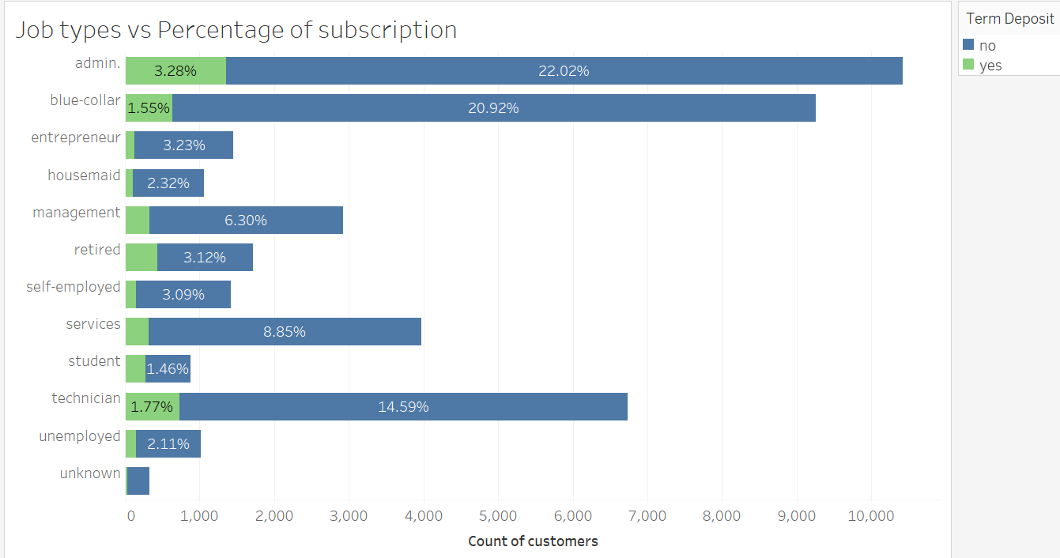
DATA ANALYSIS AND VISUALIZATION

Slide 7
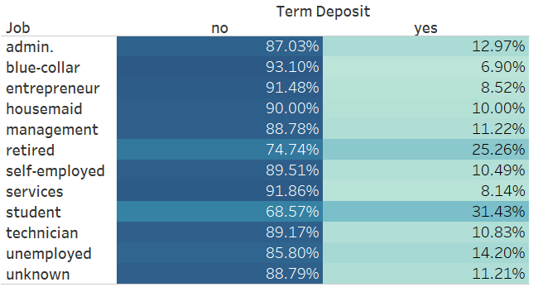
DATA ANALYSIS AND VISUALIZATION
INSIGHTS:
Highest success rate is observed in retired people and students
Lowest success rate is for blue collar and service jobs

Slide 8
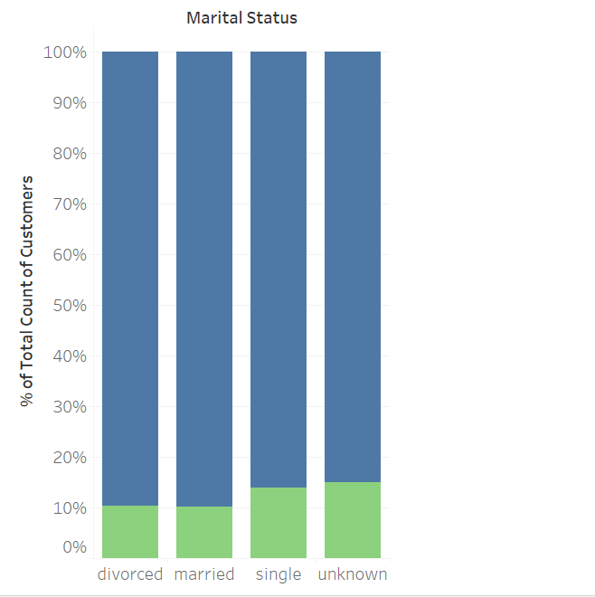
DATA ANALYSIS AND VISUALIZATION
INSIGHTS:
Highest success rate is observed in singles as compared to divorced and married customers
Lowest success rate is for divorced individuals

Slide 9
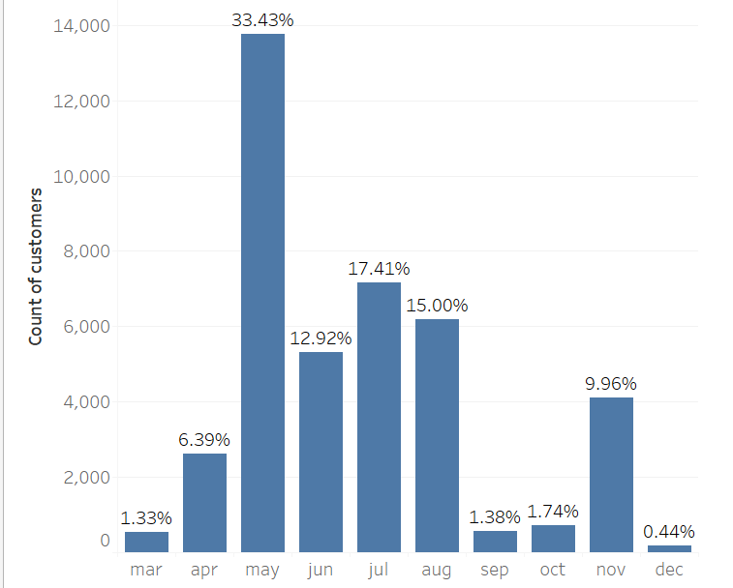
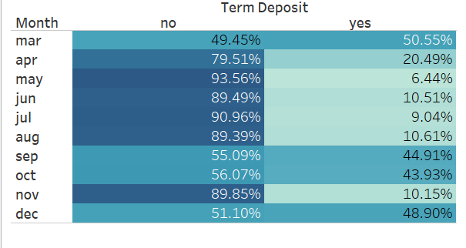
DATA ANALYSIS AND VISUALIZATION

Slide 10
DATA ANALYSIS AND VISUALIZATION
INSIGHTS:
Highest percentage of calls are being made in the month of May, whereas it is not the month with the highest success rate
Months with significantly high success rates are March, September and December
Lowest success rate is for month of May

Slide 11
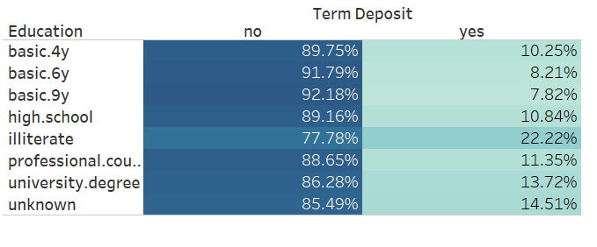
DATA ANALYSIS AND VISUALIZATION
INSIGHTS:
Highest success rate is observed in people with no formal education

Slide 12
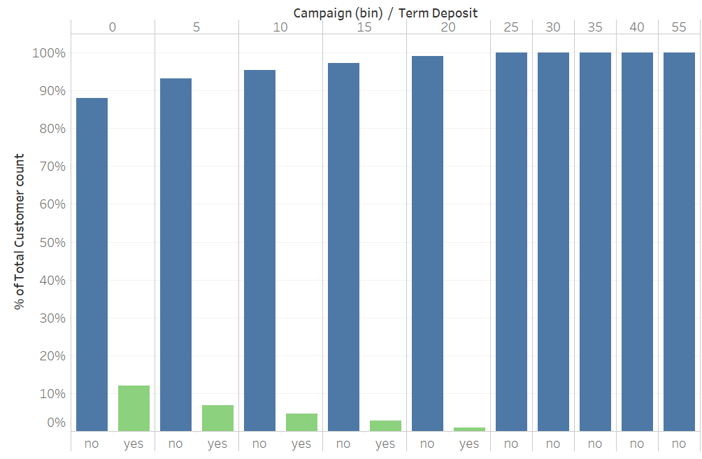
DATA ANALYSIS AND VISUALIZATION
INSIGHTS:
Campaigns (number of contacts or calls made during the current campaign) are lower for customers who bought the term deposit
For number of calls greater than 25 there is a zero success rate

Slide 13
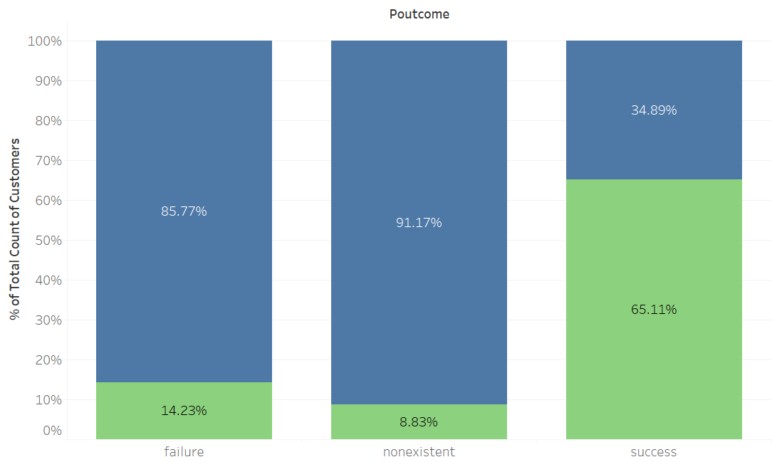
DATA ANALYSIS AND VISUALIZATION
INSIGHTS:
The success rate of the current campaign is highest for individuals who had a successful previous campaign

Slide 14
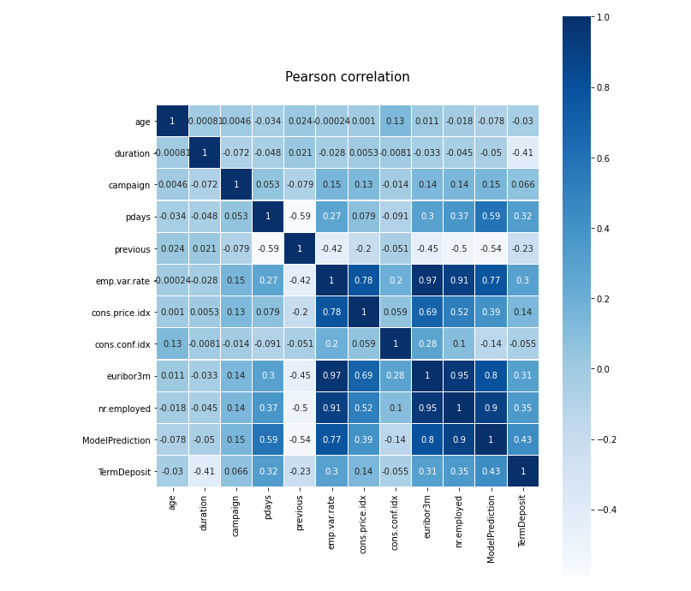
DATA ANALYSIS AND VISUALIZATION
INSIGHTS:
Pearson correlation matrix shows that the attributes with a high correlation to target variable are:
- nr.employed
- euribor3m
- emp.var.rate
- pdays

Slide 15
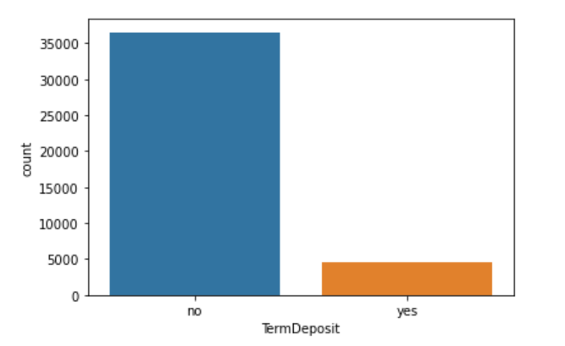
CURRENT MODEL EVALUATION
Data is imabalanced so accuracy would not be a good measure of model perfromance.
The performance matrix used will be the AUC ROC score (Area Under the Receiver Operating Characteristics)
AUC handles data imbalance issue by measuring both the True positive rate (TPR) and False positive rate (FPR).
A good AUC score is achieved only if both the TPR and FPR are well above the random line in the ROC curve

Slide 16
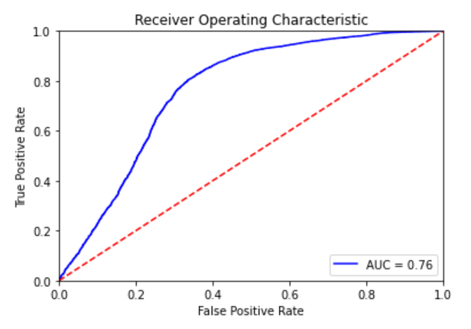
CURRENT MODEL EVALUATION
Current predictive model has a AUC score of 0.76
The greater the AUC score the greater is the ability of predict success values correctly
To improve the model performance we will try few other modeling techniques

Slide 17
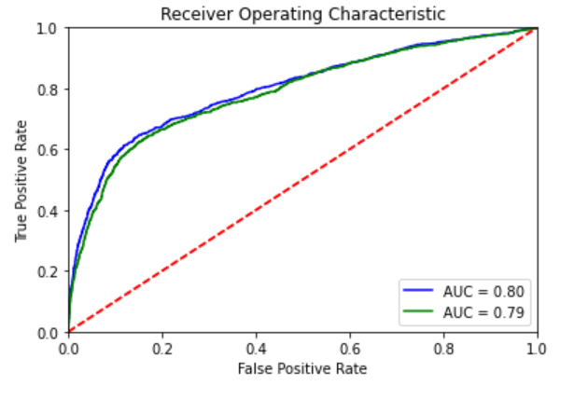
NEW MODEL FOR IMROVED PERFORMANCE
Logistic regression
AUC score = 0.79
Gradient Booster
AUC score = 0.80

Slide 18
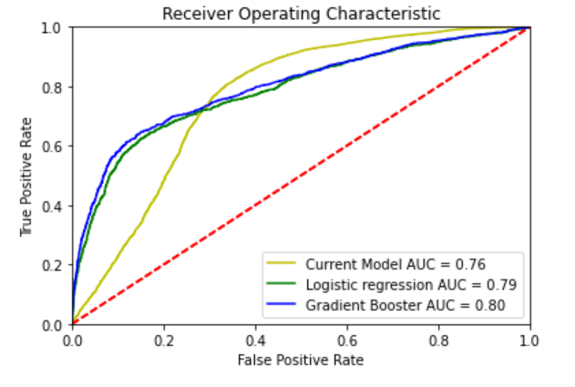
MODEL COMPARISON

Slide 19
RECOMMENDATIONS
19
Target higher number of students and retired customers for higher success rate
Number of calls being made to a customer should not exceed 25 calls
Increase the number of calls being made in the month of March, September and December
Logistic regression and gradient booster algorithms are better choices for predictive modeling

Slide 20
THANK YOU

