Slide 1



DBS Hack2Hire02
Aditi Raghuvanshi
Manoj Kumar
Prathap Joshi
Ashwin Nair

Slide 2



Slide 3
Technologies Used
Framework | Languages | Web API | Platforms
Yii | PHP | Google maps | Amazon AWS
 | Java |  | Amazon RDS
 | Python
 | SQL

Slide 4
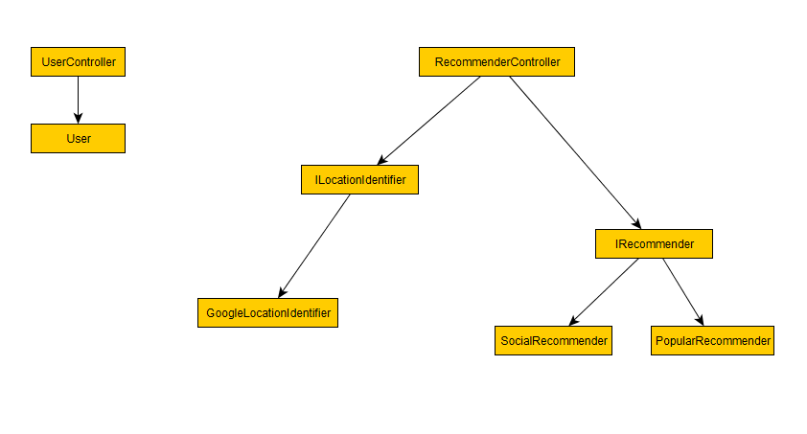
Initial Design

Slide 5
Initial Plan
User Management
User login
User logout
Registration
Recommendation System
Filtering criteria
Place Type
Rating
Choice – popular/social
Radius
Client
Bot
Web App

Slide 6
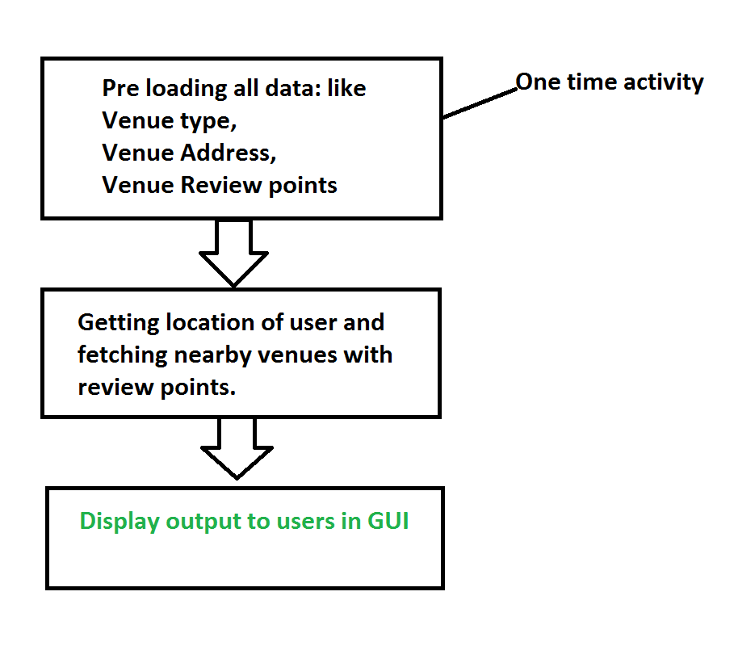

Workflow

Slide 7
Uses
It will help user know nearby places of his interest like park, movies, etc.
It will check if user’s friends have visited the place and shows that as output.
It will also give the review points for each nearby place.

Slide 8
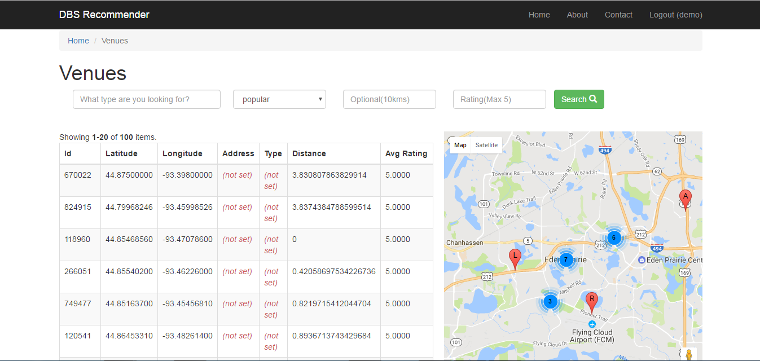
Show Time!
Demo Url :
http://sample-env.ymg5mpbr6i.ap-south-1.elasticbeanstalk.com/web/venue/index

Slide 9





Architecture
Interest
Request
Location
Processed Data
Amazon AWS
Amazon RDS – Database Server

Slide 10
Future Scope
Use Map/Reduce framework for doing collaborative filtering and for scalability.
Extend it as Mobile Application.
Navigate user based on choice of selection
Invite friends and send notification to group of close friends.

Slide 11

Questions, Answers and Feedback!

Slide 12

Thank You! ☺

