Slide 1
Classification

Slide 2
What is a Classification Problem?
We identify problem as classification problem when independent variables are continuous in nature and dependent variable is in categorical form
i.e. in classes like positive class and negative class

Slide 3
Examples
The real life example of classification example would be,
to categorize the mail as spam or not spam,
to categorize the tumor as malignant or benign
to categorize the transaction as fraudulent or genuine.
All these problem’s answers are in categorical form i.e. Yes or No. and that is why they are two class classification problems.

Slide 4
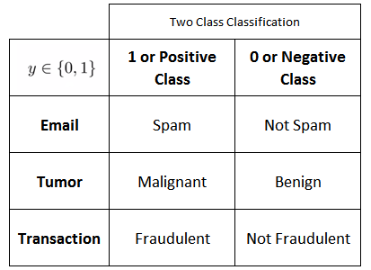
Example

Slide 5
Multi class classification
We come across more than 2 classes and still it is a classification problem.
These types of problems are known as multi class classification problems.

Slide 6
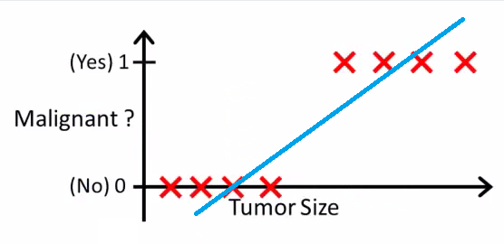
Why not use Linear Regression?

Slide 7
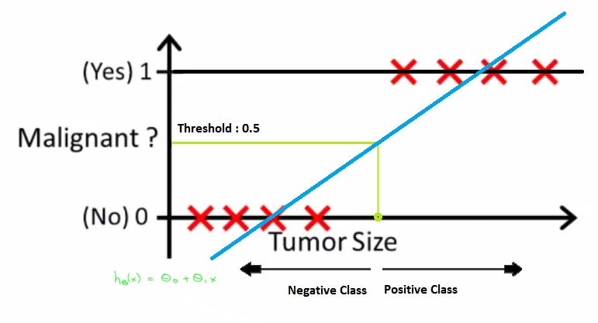
Classification

Slide 8
Logistic Regression

Slide 9

Logit function

Slide 10
What is Decision Boundary?
Decision boundary helps to differentiate probabilities into positive class and negative class.
Linear Decision Boundary
Non Linear Decision Boundary

Slide 11
Support Vector Machines

Slide 12
Hyper plane
The objective of the support vector machine algorithm is to find a hyperplane in an N-dimensional space(N — the number of features) that distinctly classifies the data points.

Slide 13
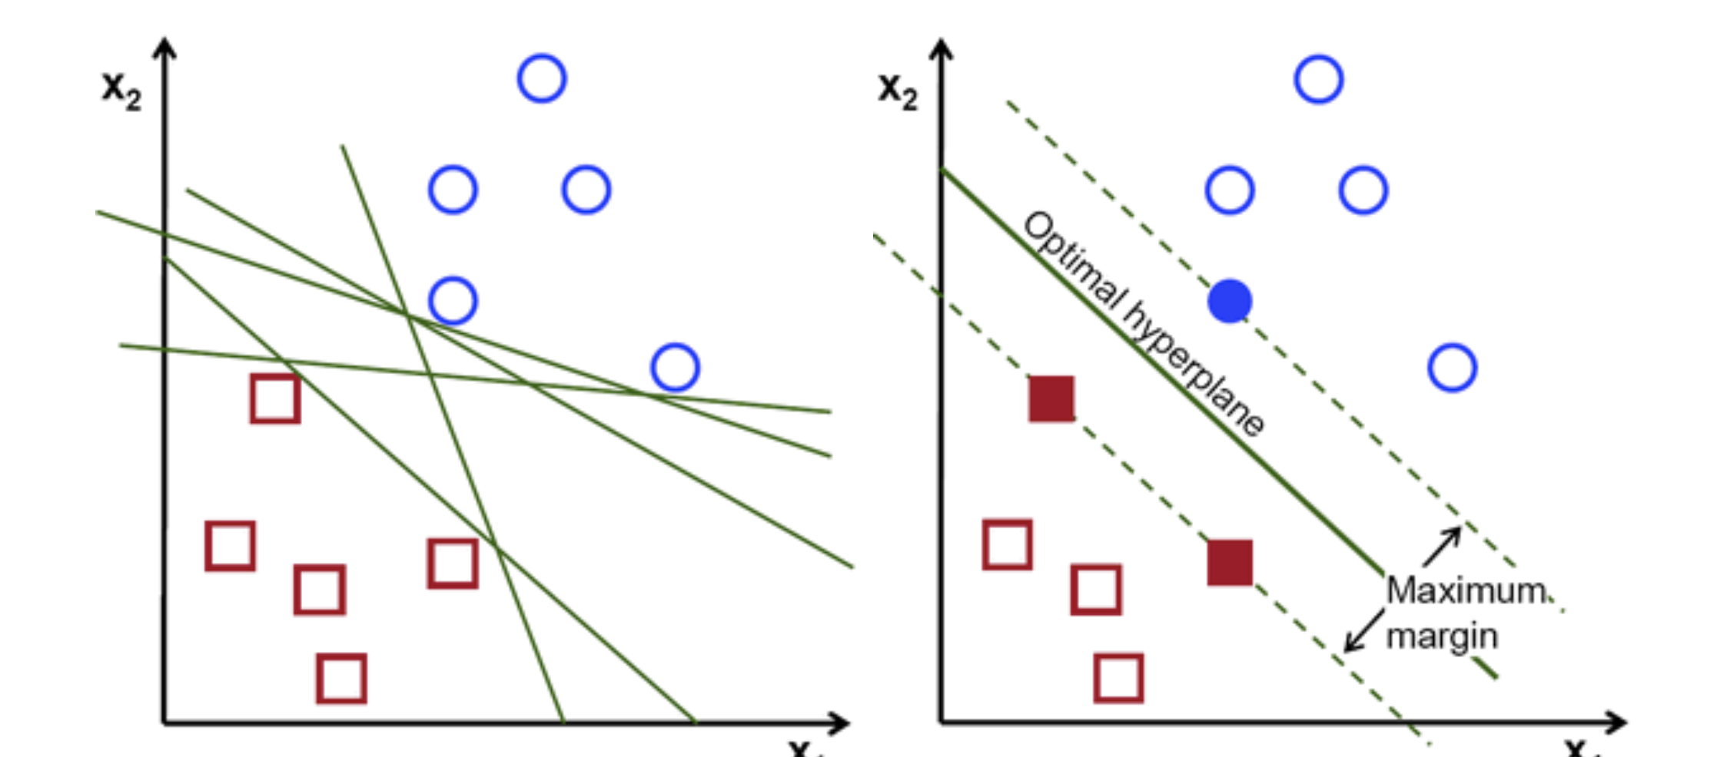
Hyper plane

