Slide 1
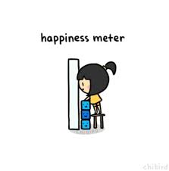
Happiness Meter
Meghna Mane
Health Data Science

Slide 2
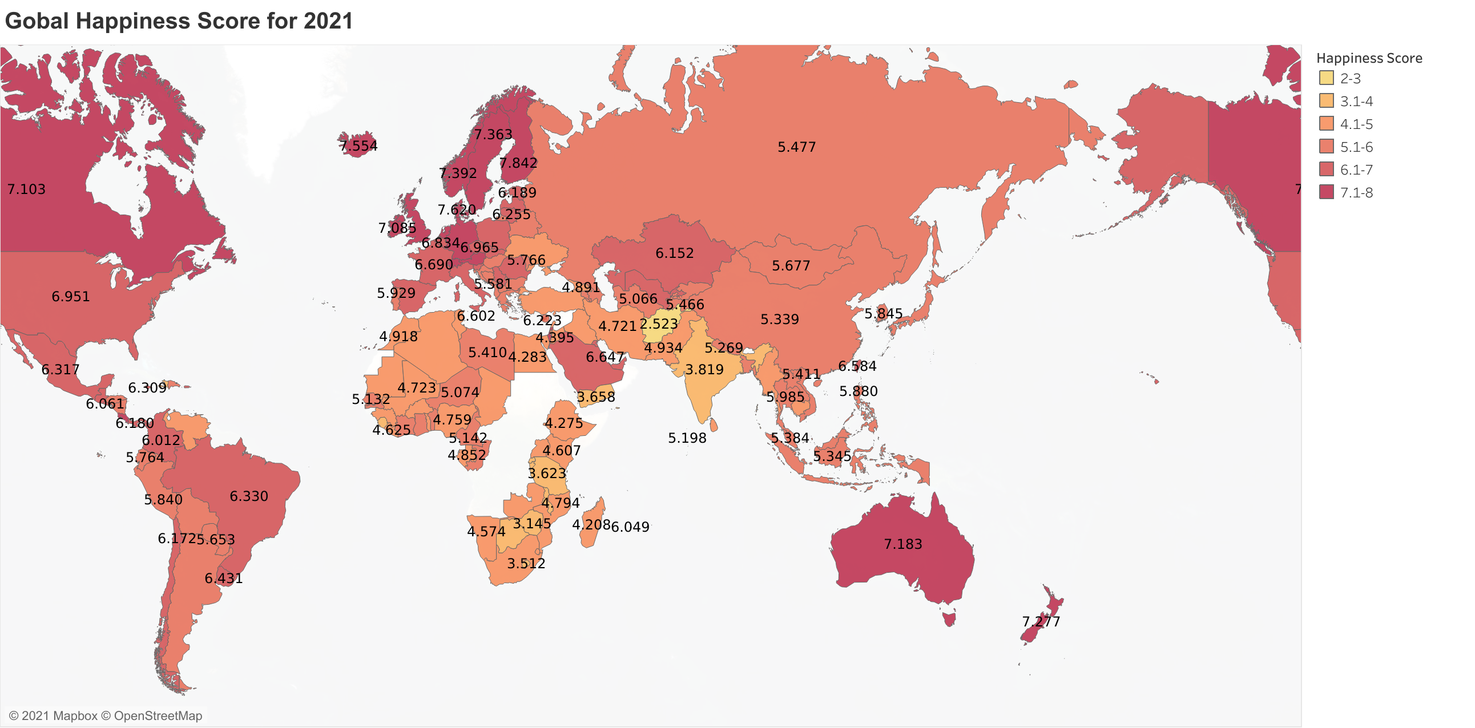
Happiness index for the countries which participated in the year 2021.
1. This sourse of data is been collected from kaggle , Gallup world poll.
2.Below link is a story how it all started.
https://www.gallup.com/analytics/247355/gallup-world-happiness-report.aspx
3.Depending on the
degree of happiness index,
the intensity of the colour is
increased

Slide 3
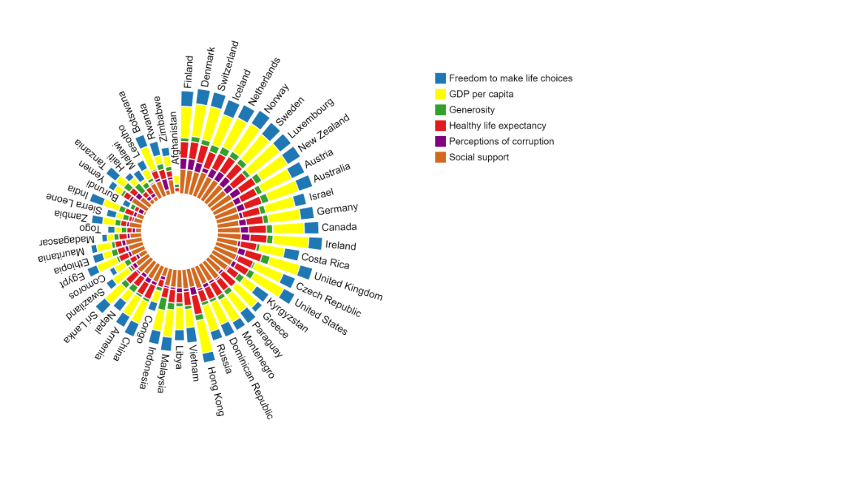
Elements of Happiness
Green for Generosity: It is the traditional color of peace, harmony, comfortable nurturing, support and well paced energy.
Blue for freedom and and/or patriotism.
Purple for Anti corruption
Red for Health: Induces vitality and stimulates energy, induces adrenaline
Yellow for GDP : Yellow for gold and its for money
Brown for social support: Ground root

Slide 4
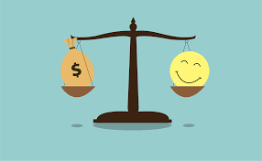
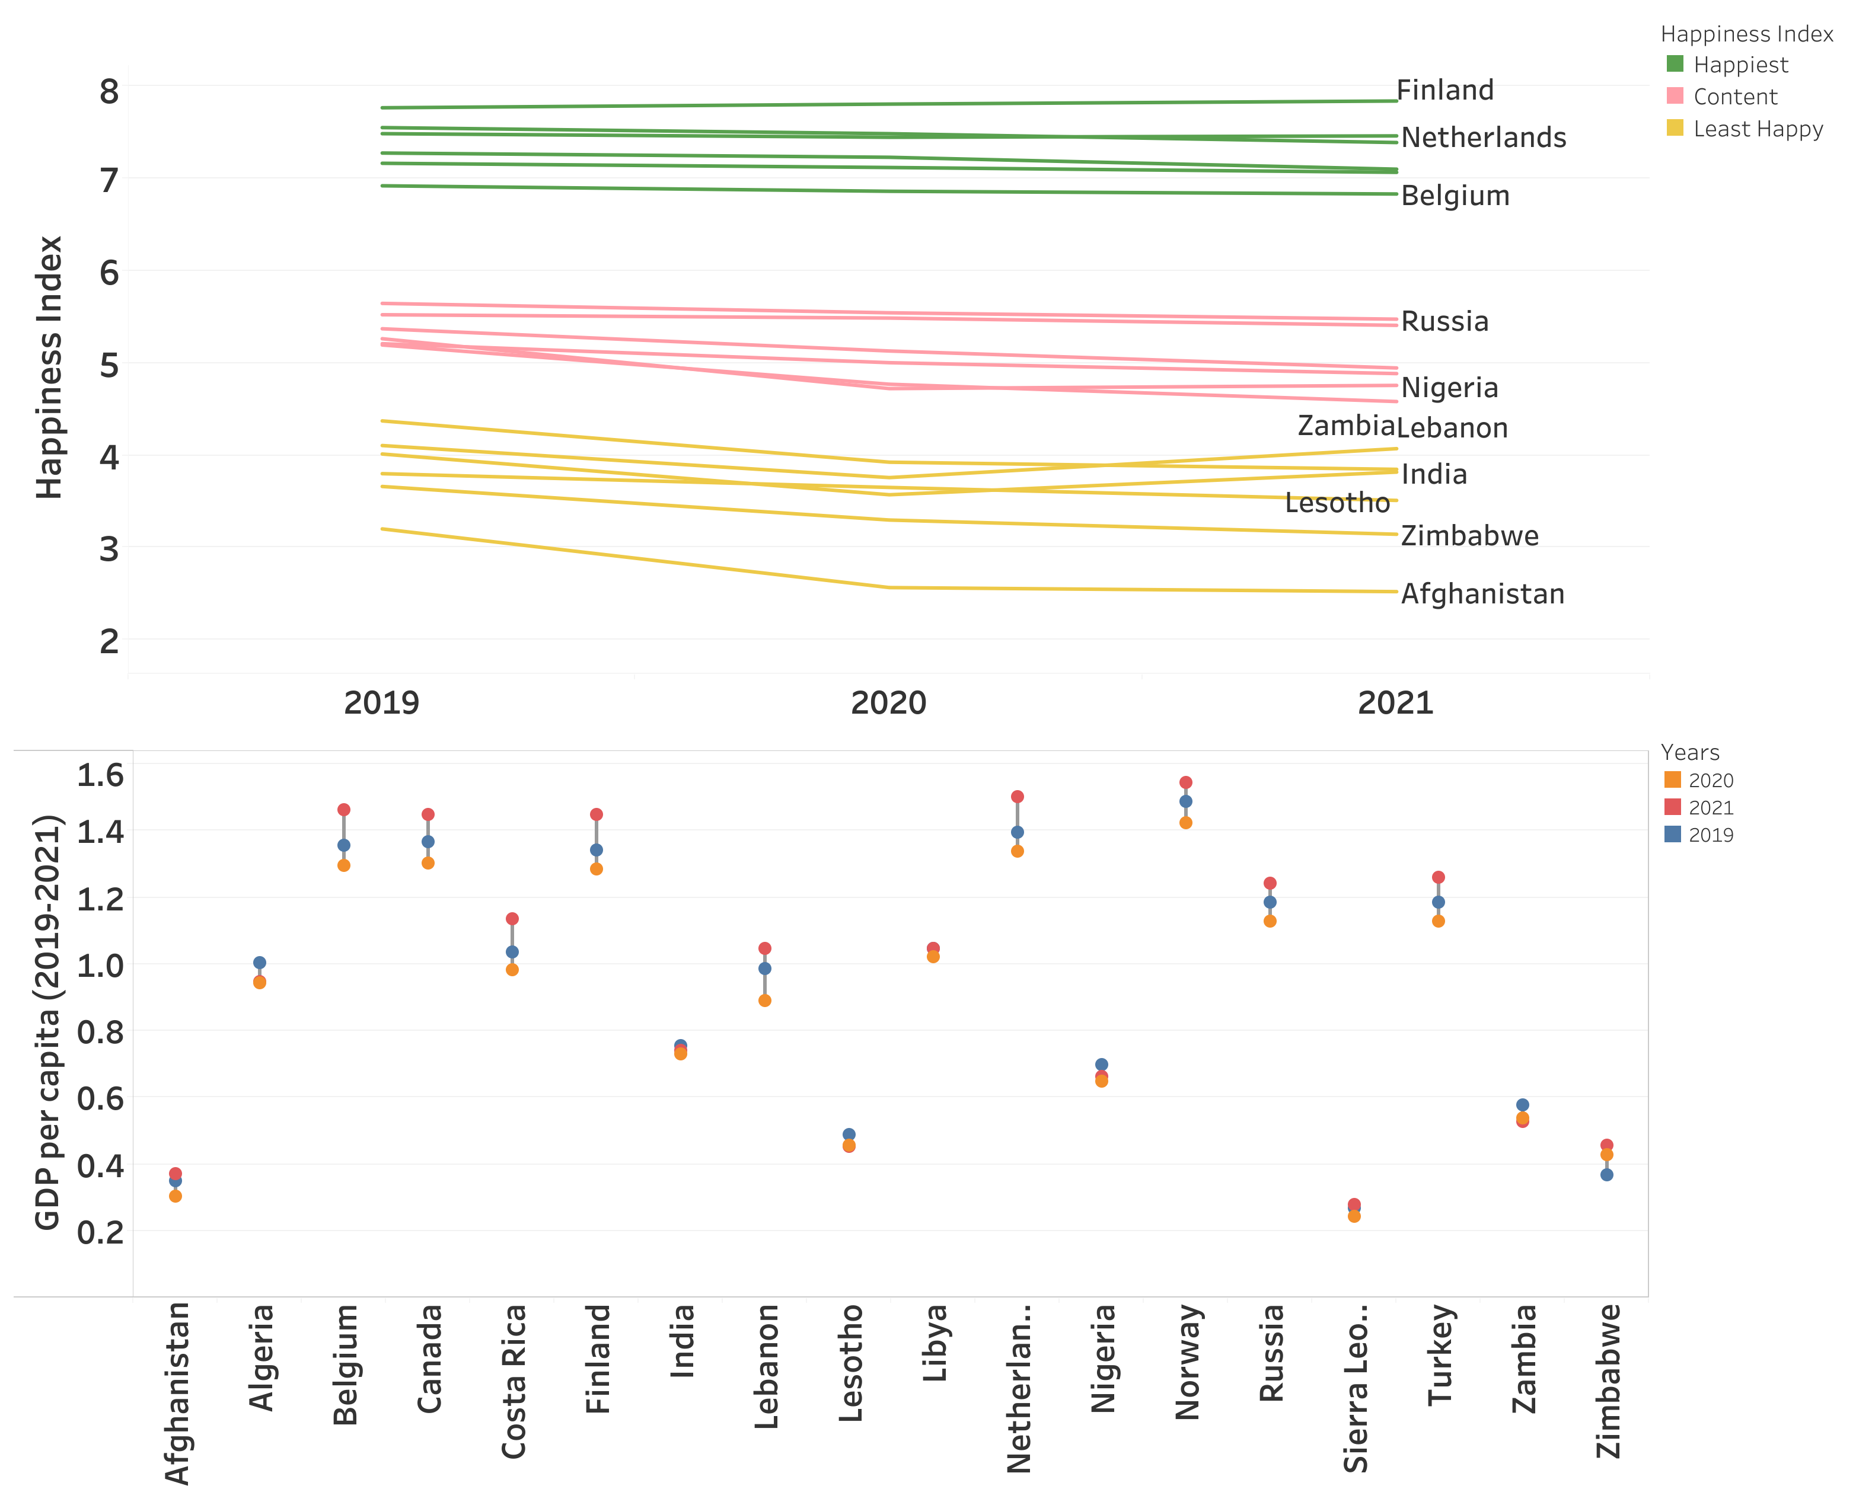
Change in Happiness from 2019 to 2021 and the Money
Comapring Happiness from 2019 to 2021, its been observed that countries have maintained their happiness value as we can compare countries have invested their economy in conserving the harmony of the country as GDP have decreased from 2019 to 2020 then increased in 2021.

Slide 5
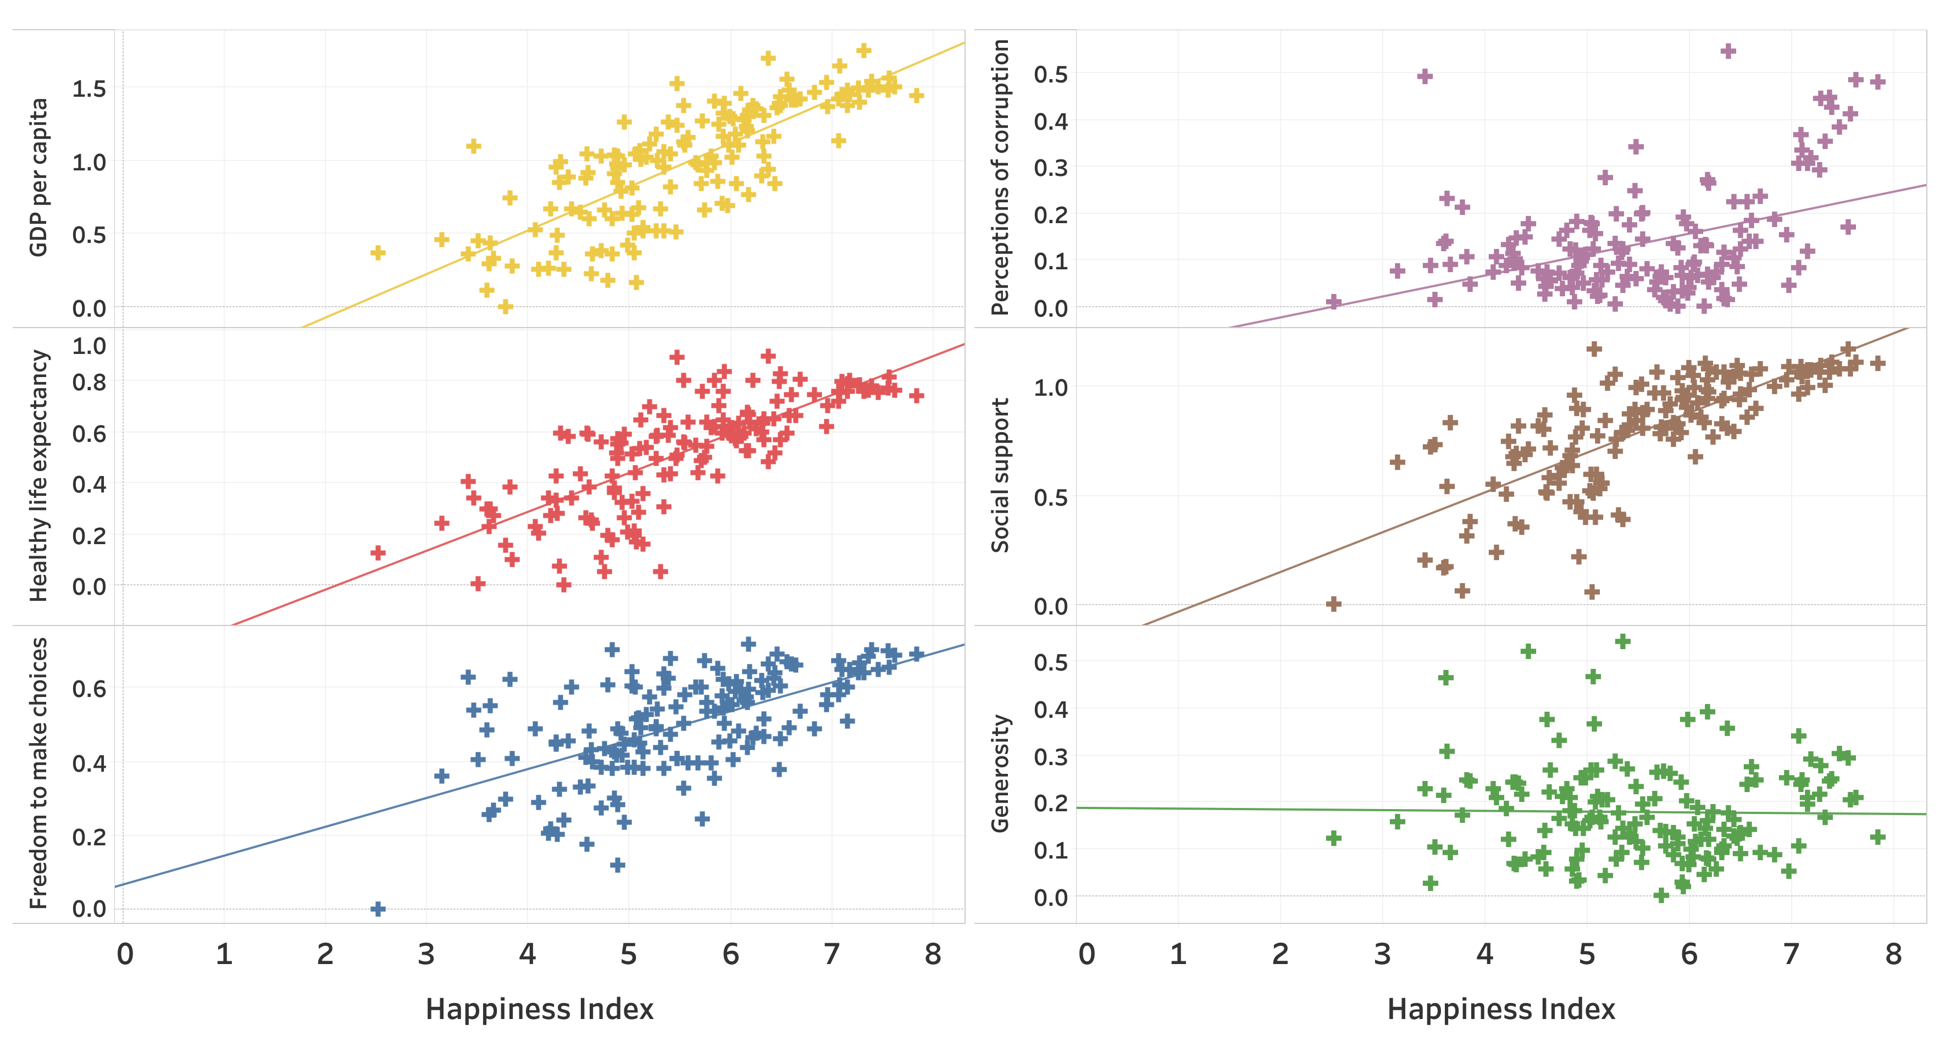
Correlation of Happiness with elements
Happiness is
in direct assocaition with
GDP, Healthy life expectancy,Freedom to make choice,Perception of corruption and social support.

Slide 6
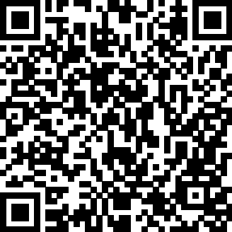
Link for refernce
https://docs.google.com/document/d/1cQt7ISm2sqSfYzK8h8gFJ5T35G1HAHCYCYLGJwEvhlw/edit
Any Questions???

Slide 7
Thank you

