Slide 1

Food Trend Analysis
Submitted by : Iti Tiwari

Slide 2
Objective of the project
Understand customer food preferences
Identify popular cuisines and food apps
Analyze online vs offline behavior
Assess sustainability awareness
Support strategic decisions for restaurants

Slide 3
The Need for BI
Manual data extraction is time-consuming and requires extensive cleaning across multiple sources
Reports take days or weeks, causing insights to become outdated
Human errors in formulas and merging can invalidate analyses
Lack of standardized metrics leads to inconsistent reports and reduced trust

Slide 4
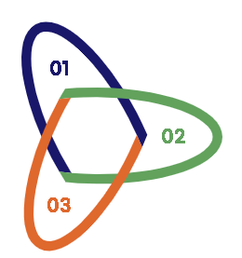
Business Intelligence Architecture
Data Sources Layer :This layer is the foundation, establishing the connection to the raw data that feeds the dashboard.
Data Processing Layer:This layer focuses on cleaning, transforming, and enriching the raw data using Power Query (ETL) and DAX formulas for accurate and meaningful analysis.
Business Intelligence Layer:This is the visualization and interaction layer, delivering insights through the interactive dashboard.

Slide 5
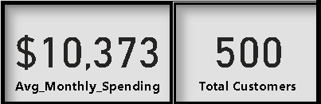
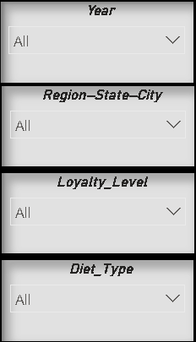
Dashboard Overview
Core KPIs :
Avg. Monthly Spending: $10,373
Total Customers: 500
Dynamic Data Filters (Slicers):
The dashboard allows dynamic analysis by Year, Region-State-City, Loyalty Level, and Diet Type, enabling users to drill down into specific consumer segments.

Slide 6
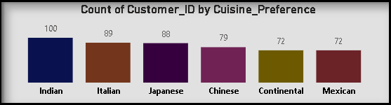
Dominant Customer Preference
The data clearly indicates that Indian cuisine holds the largest share of customer preference. This highlights a primary market opportunity for authentic and diverse Indian menu items.
Italian and Japanese follow as strong secondary preferences, suggesting demand for variety and high-quality international dining experiences.

Slide 7
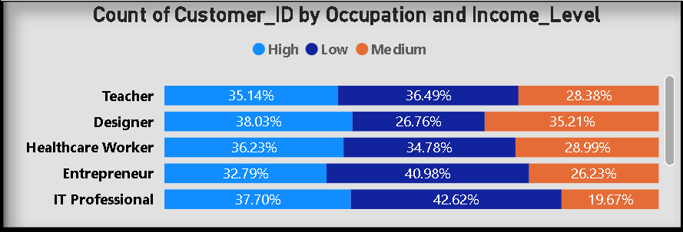
Target Audience Segmentation by Income&Occupation
Occupation | Primary Income Group | Marketing Focus
Designer | High & Medium | Premium & Quality (Highest High-Income %.)
IT Professional | Low | Value & Volume (Highest Low-Income %.)
Entrepreneur | Low | Value & Convenience (Second Highest Low-Income %.)

Slide 8
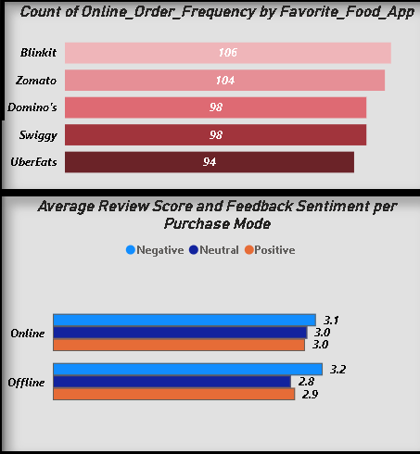
Online Order Behavior& Sentiment
Online Order Leaders: Blinkit (106 orders) and Zomato (104 orders) lead in order frequency, followed by Domino's and Swiggy (98 each).
Sentiment: Online purchases have a higher average review score (3.0 Positive) than Offline purchases (2.9 Positive), suggesting a generally positive experience with online service.

Slide 9
Advanced Features and Security
Integrate sentiment analysis using natural language processing to reveal customer emotions and pain points
Enable real-time API integrations for live data feeds, supporting zero-latency reporting and proactive alerts
Implement a robust user role and access control system to ensure data security and governance across analyst, manager, and administrator roles

Slide 10
Thank You!

