Slide 1
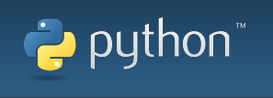
Introduction to Python
By Ivan Martinez
Coding Club

Slide 2
What is Python?
Python is an interpreted, object-oriented, high-level programming language with dynamic semantics.
Its high-level built in data structures, combined with dynamic typing and dynamic binding, make it very attractive for Rapid Application Development, as well as for use as a scripting or glue language to connect existing components together.

Slide 3
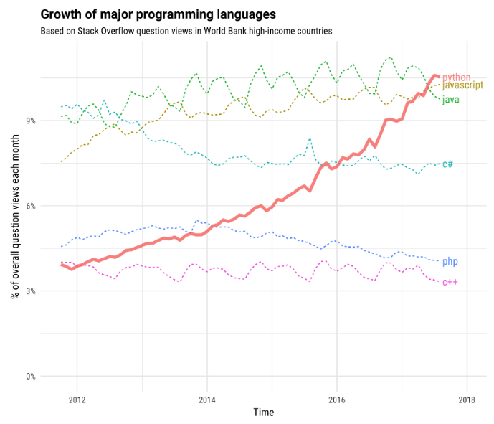
Why Learn Python?
Growth of Python compared to
other major programming
languages.

Slide 4
Why Learn Python?
Python Fast Facts
Average Salary: $107 000
Top Job Locations: New York City, Mountain View, San Francisco
Top Employees of Python Programmers: Intel, Amazon, Dell
Python was used to build: Instagram, YouTube, Spotify

Slide 5
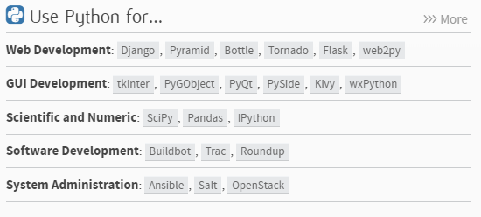
You can use Python for:

Slide 6
Installing Python
Python comes pre-installed on Mac and Linux
Windows installer https://www.python.org/

Slide 7
Basics
Whitespace is meaningful in Python: especially indentation and placement of newlines.
• Use a newline to end a line of code. • Use \ when must go to next line prematurely.
• No braces { } to mark blocks of code in Python… Use consistent indentation instead.
• The first line with less indentation is outside of the block.
• The first line with more indentation starts a nested block
• Often a colon appears at the start of a new block. (E.g. for function and class definitions.)

Slide 8
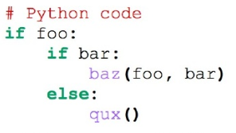
Indentation

Slide 9
Strings
Example 1
mystring = “Hello”
mystring = mystring + “ World”
Print(mystring)
Example 2
mystring2 = “Hello”
mystring2 += “ World”
Print(mystring)
Example 3
mystring3 += mystring+ mystring2
Print(mystring)

Slide 10
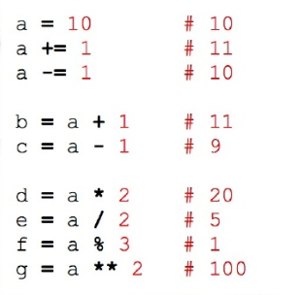
Arithmetic operators

Slide 11
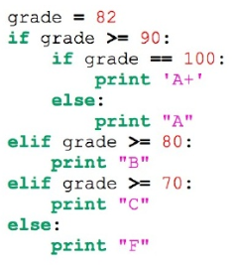
Conditionals

Slide 12

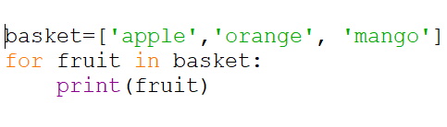
For Loop

Slide 13
Imports
Allows code isolation and re-use
Adds references to variables, classes, functions, etc. into current namespace

Slide 14
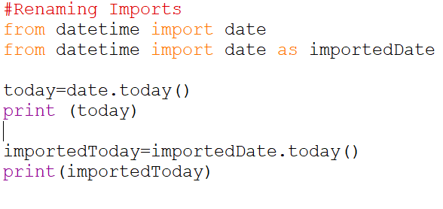
Imports

Slide 15
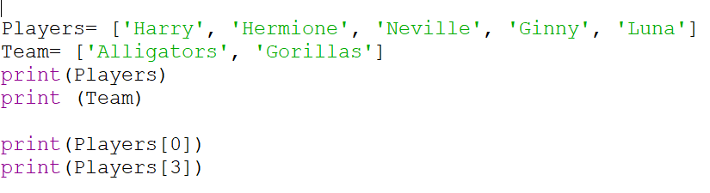
Python at work

Slide 16
Python at work

Slide 17
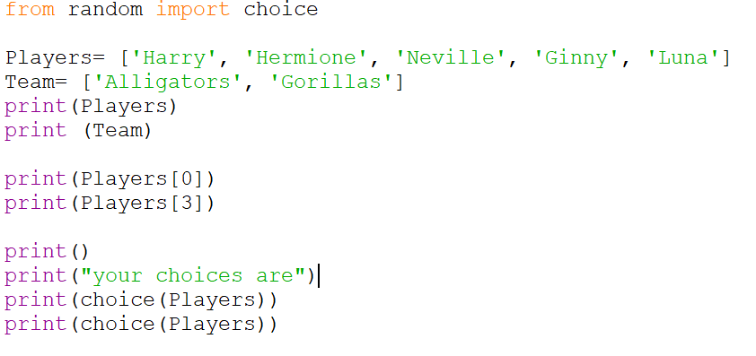
Python at work

Slide 18
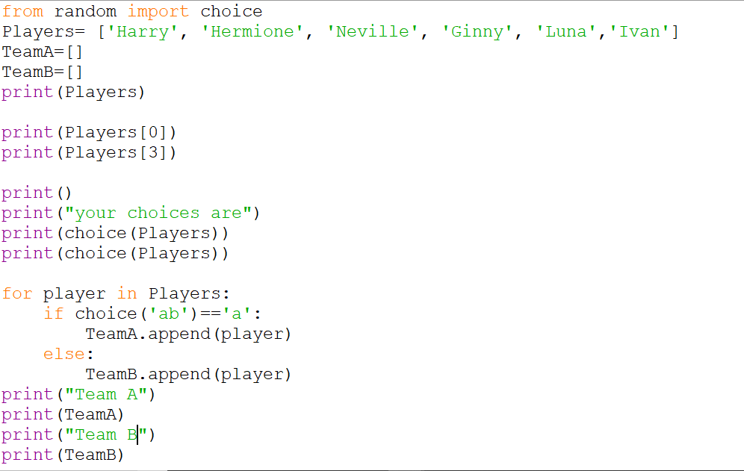
Python at work

