Slide 1
Snakes and ladders game
ESFP-II

Slide 2
OUR AIM FOR THE PROJECT→
OUR AIM TO BUILD THIS PROJECT IS TO Make a basic two player snakes and ladders game. With a dice function which gives random number between 1 to 6.

Slide 3
THE FUNCTIONS IN THE WHOLE PROject ARE→ 1) registername:- registers the name of two players. 2) snllocation:- this function takes the current score as argument and uses the snakes and ladders dynamics to give back the score. 3) playgame:- this function has the roll dice program and then add it to the current score and pass it to snllocation function. 4) main function:- to initialize objects and call these functions.

Slide 4
HEADER FILES USED IN THE PROJECT→
#include<iostream>
#include<stdlib.h>
#include<string>
#include<conio.h>
#include<time.h>
#include<iomanip>

Slide 5
CONCEPTS of c++ language used
1. Class and Objects.
2. Arrays.
3. Functions.
4. Switch case.
5. Random function.
6. Static variables.
7. Manipulators.

Slide 6
BELOW IS THE EXECUTION OF THE PROGRAM AND FLOW OF THE PROGRAM →
1) AT THE START THE PROGRAM IT WILL TELL US TO ENTER THE NAMES OF THE TWO PLAYERS. THEN THE GAME WILL START.
2) IT WILL ASK TO PRESS “ENTER” TO ROLL THE DICE FOR BOTH PLAYERS AND DISPLAY THEIR CURRENT SCORES AND IF THEY HAVE ENCOUNTERED A SNAKE OR A LADDER.
3) THIS WILL CONTINUE TILL ONE OF THE PLAYER REACHES A SCORE OF 100 AND THEN DISPLAY THE WINNER.

Slide 7
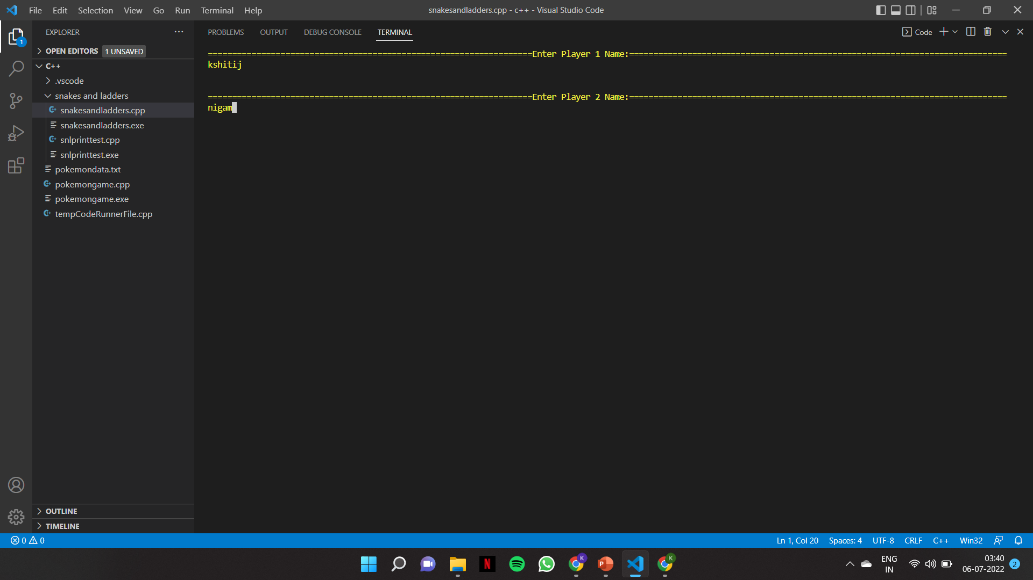

Slide 8
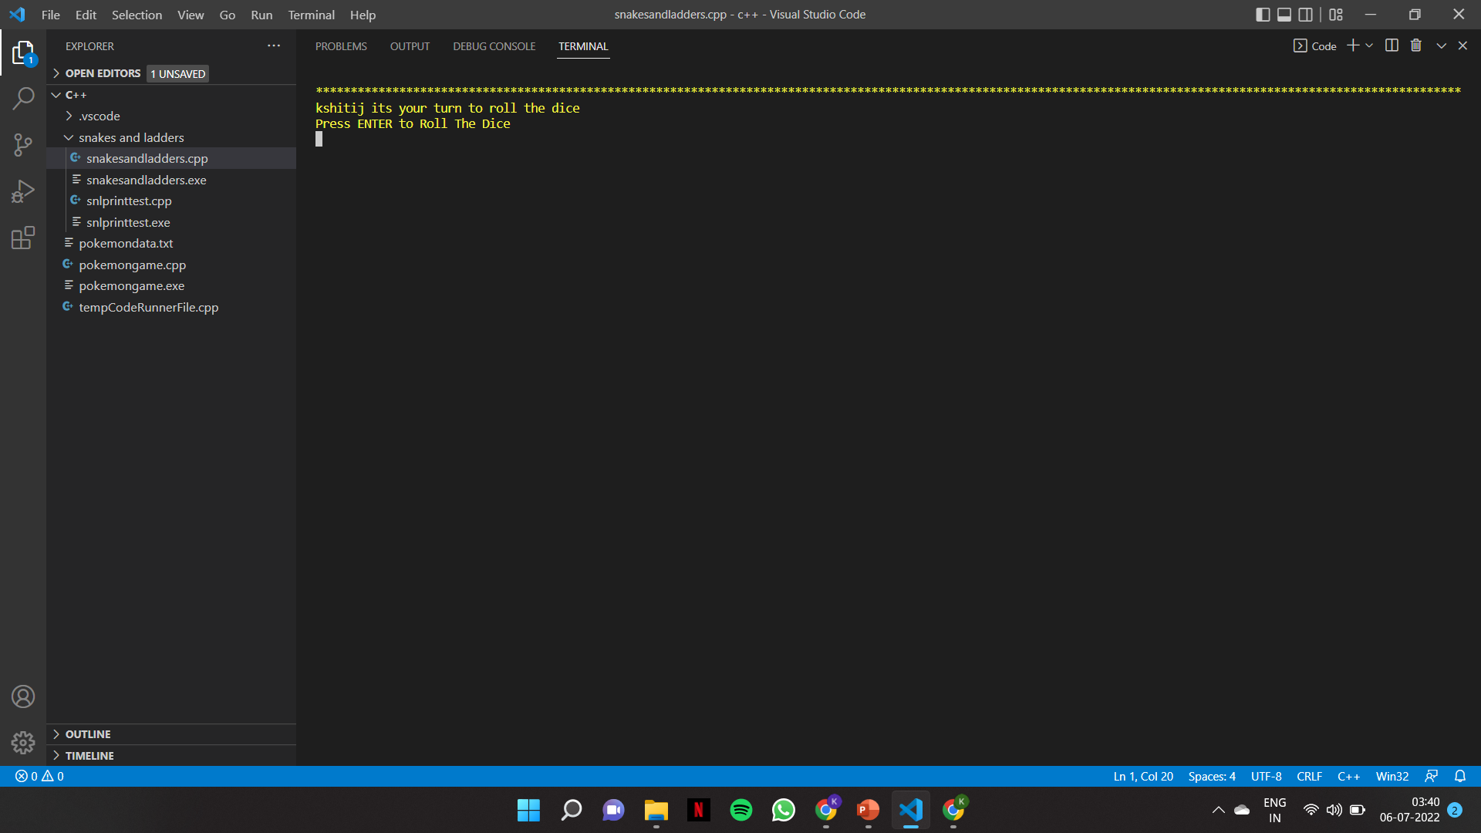

Slide 9
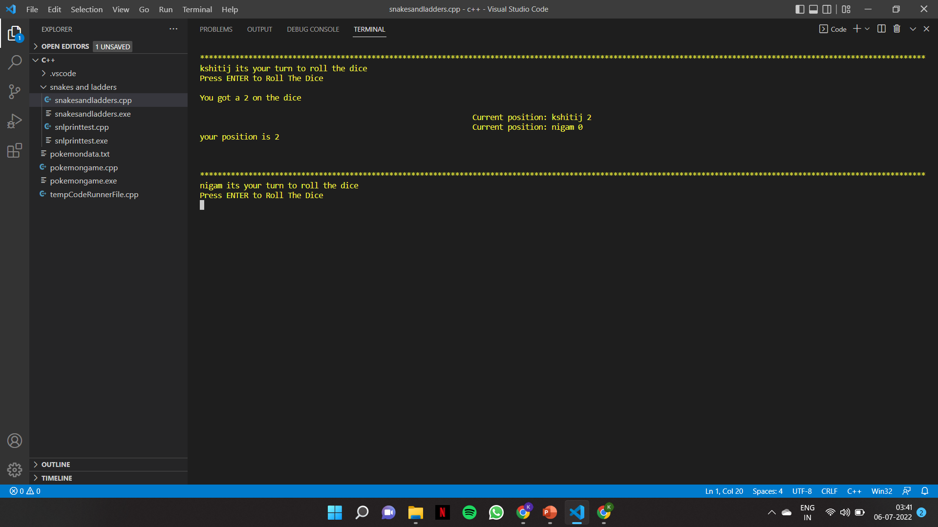

Slide 10
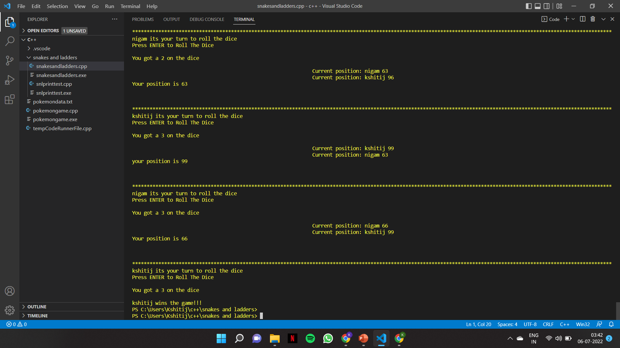

Slide 11
THANK YOU
-KSHITIJ NIGAM
ENROLLMENT NO. → 21162121012

