Slide 1

Tableau
Portfolio
Ivan Tkachenko

Slide 2



Slide 3
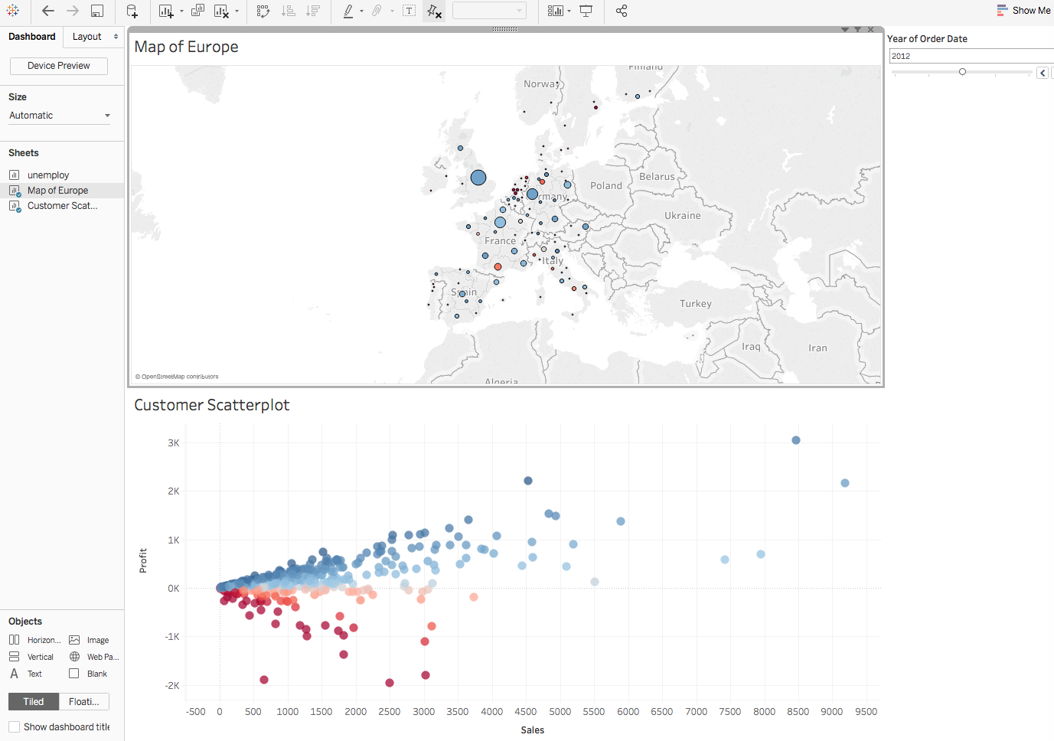
1. Maps
2. Scatterplots
3. Filters

Slide 4
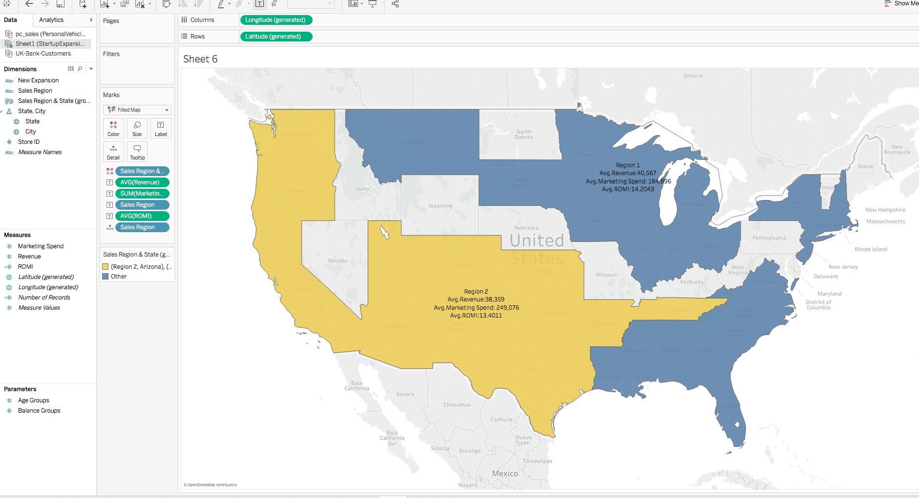
Customize territory via groups

Slide 5
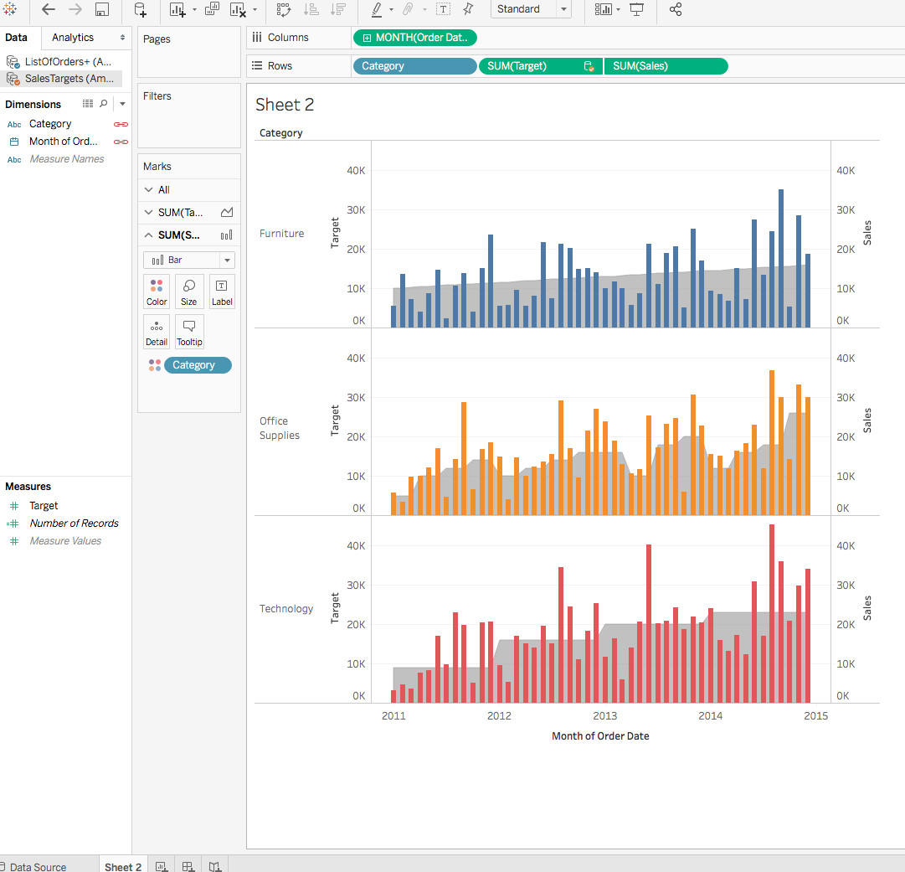
Dual Axis Chart
Creating calculation in the blend

Slide 6
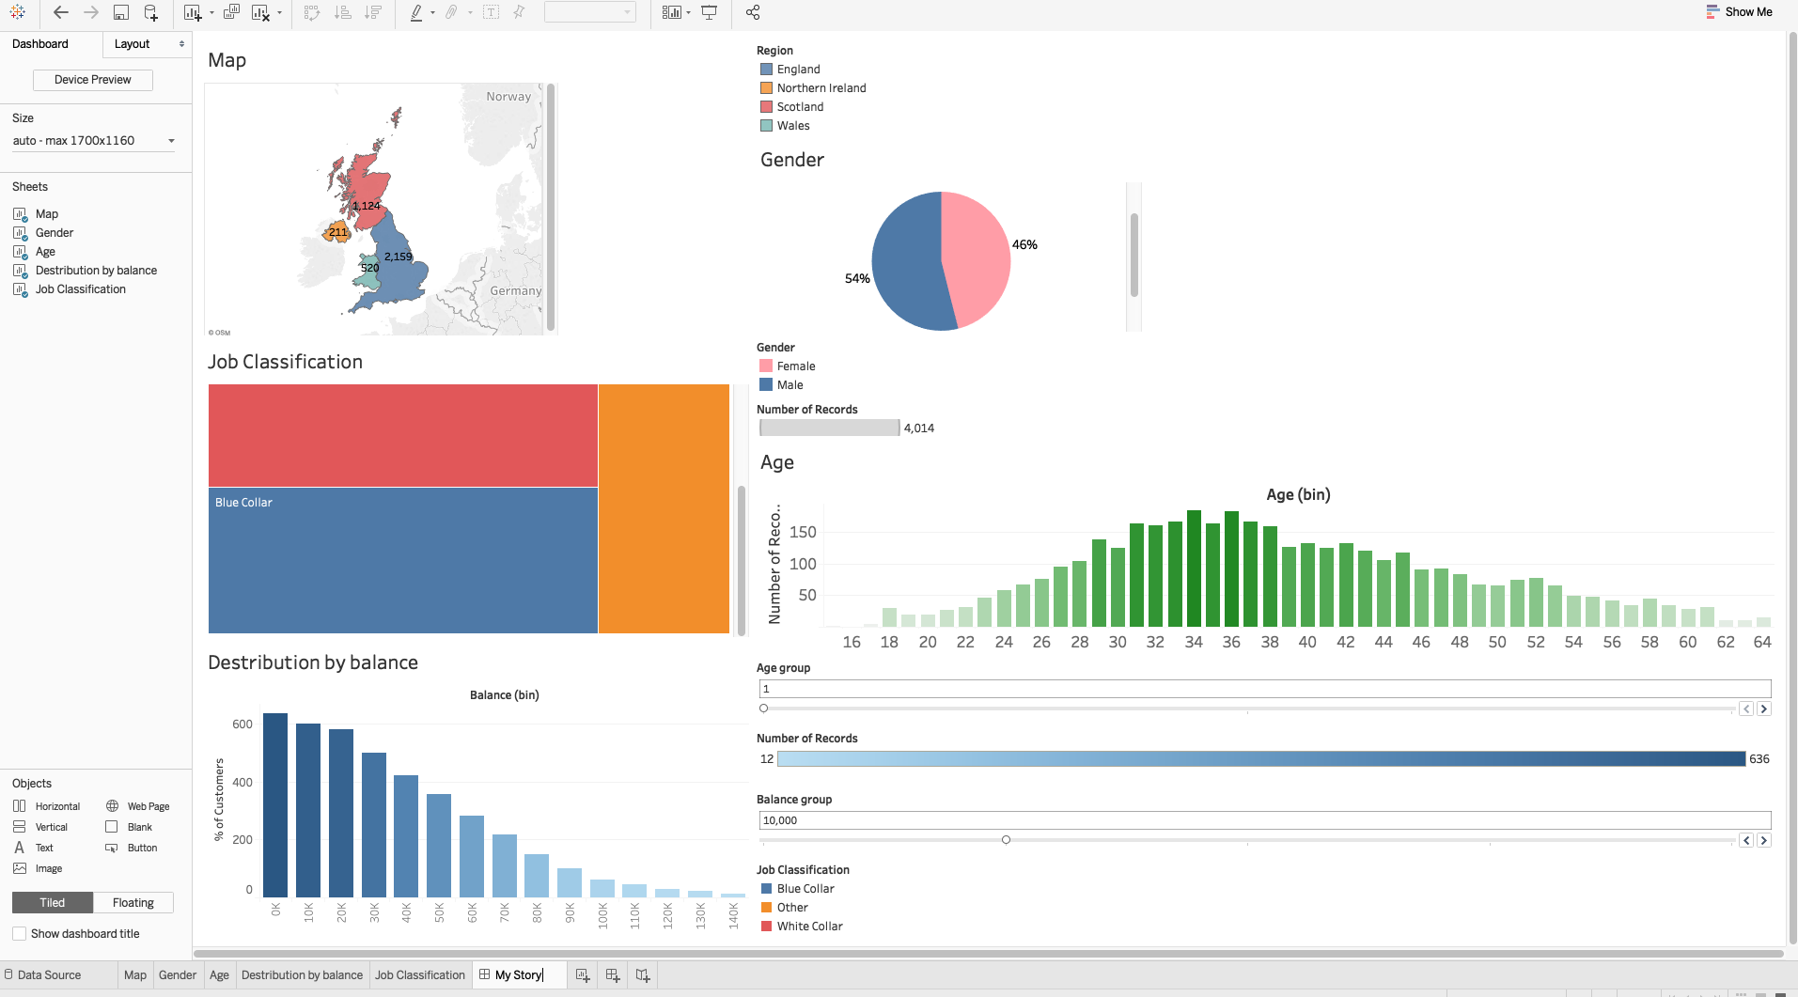
Mapping
Geographical role
Gender Pie chart (Calculation)
Tree map chart
Creating bins and distribution by age
Customer segmentation dashboard

