Slide 1
Introduction
Appium is an open source tool to automate native, hybrid and mobile web applications …

Slide 2

Introduction
Appium is an open source tool to automate native, hybrid and mobile web applications …

Slide 3
Appium is an open source tool to automate native, hybrid and mobile web applications …

Slide 4




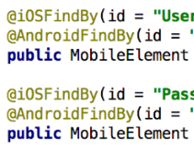

iOS
Windows
No Changes!!!

Slide 6







Slide 7
Let us have a look at few more advantages …
Supports physical device as well as an Android emulator or an iOS Simulator
Don't have to recompile or modify the app for automation
Appium is now being developed and supported by Sauce Labs
Good community support

Slide 8
Let us compare …
Appium
XCTest
Robotium
UI
Automator
Expresso
Platform
iOS/Android
iOS
Android
Android
Android
Unit Testing
No
Yes
No
No
Yes
Functional Testing
Yes
Yes
Yes
Yes
No
Language
Objective C or Swift
Java
Java or Kotlin
Java or Kotlin
Multiple

Slide 9
Let us have a look at few limitations …
iOS automation with local Appium server requires a Mac
Maintaining local Appium server lab requires additional resources
Documentation is limited or some times too technical
Changes to XCTest framework often breaks Appium

Slide 10
Architecture
Appium uses Selenium’s WebDriver API

Slide 11
Architecture
Appium uses Selenium’s WebDriver API
WebDriver API is based on
JSON Wire Protocol

Slide 12
Appium uses Selenium’s WebDriver API
WebDriver API is based on
JSON Wire Protocol

Slide 13
WebDriver API is based on
JSON Wire Protocol
What is JSON Wire Protocol?
XML
JSON
etc.
HTTP Request
Client
Server
HTTP Response

Slide 14

Appium developed Client libraries that implements JSON Wire Protocol for Mobile …
java-client

Slide 15

Appium developed Client libraries that implements JSON Wire Protocol for Mobile …
java-client

Slide 16

MobileElement el = driver.findElementByAccessibilityId("SomeId"); el.click();
java-client
HTTP API: POST /session/:session_id/element/:element_id/click

Slide 17
MobileElement el = driver.findElementByAccessibilityId("SomeId"); el.click();
HTTP API: POST /session/:session_id/element/:element_id/click
java-client

Slide 18



UIAutomator2
JSON
HTTP Request
java-client
Appium Server
HTTP Response
XCUITest

Slide 19
Let’s get bit technical …
Appium is a node.js HTTP server that exposes a REST API
Client initiates session using the Desired Capabilities
Drives Android session using the UiAutomator2 driver
Drives iOS session using the XCUITest driver
Uses WebDriverAgent server to interact with Apple’s XCTest native framework
Uses “Appium Settings” companion app on Android

Slide 20

#Native
Native
Application
Different Types of Mobile Apps
Java or Swift
Platform SDKs

Slide 21
Different Types of Mobile Apps
#Native
Native
Application
Java or Swift
Platform SDKs

Slide 22
Longer development cycle
Native
Application
Native apps are fast
Provides rich user experience
Java or Swift
Easy to automate
Platform SDKs
Easy to inspect UI elements

Slide 23


#Hybrid
Native
Container
(WebView)

Slide 24
Shorter development cycle
Native
Container
Hybrid apps are comparatively slow
Provides poor user experience
(WebView)
Tricky to automate
Need to enable debug mode in the Android app
Tricky to inspect WebView elements

Slide 25
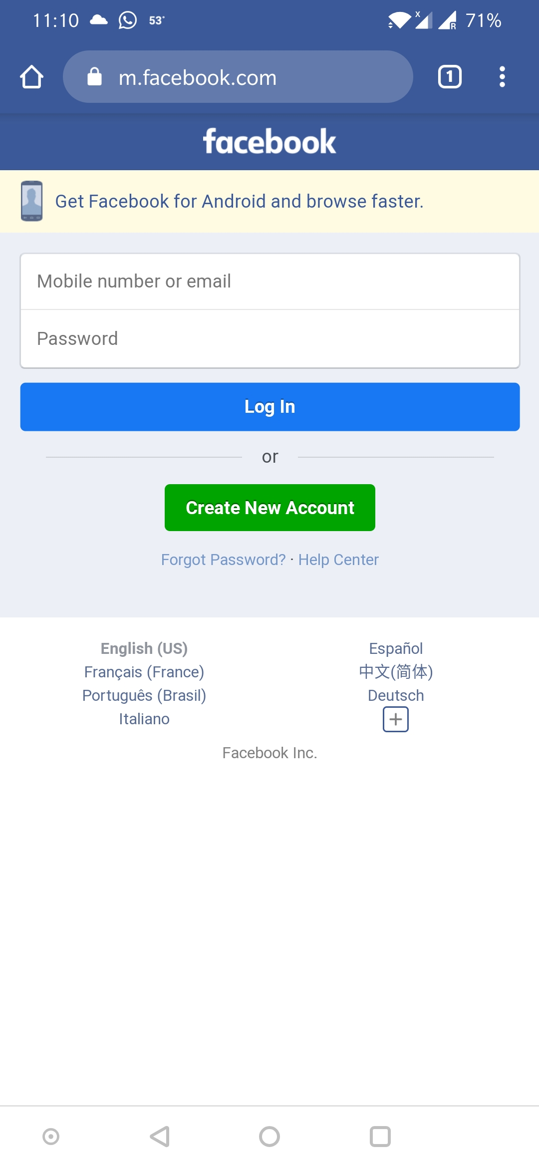
#Mobile Web

Slide 26
Shorter development cycle
Web apps are comparatively slower
Provides poor user experience
Easy to automate
Easy to inspect UI elements

Slide 27

Setup possibilities …
Appium on
Appium on

Slide 28
Let us start the amazing journey …

