Slide 1
What is an API?

Slide 2
Application Programming Interface
Notes:
It is an interface that allows two applications to talk to each other. Now the two applications can be two different servers or a client and a server.
Let us first take the example of client server.
So let us say, you open a browser on your laptop, then you type facebook.com and then hit enter.
The browser then sends a request to a server, the server interprets and processes the request, then sends the response back to the browser, the browser then interprets and processes the response and shows the web page. How does this happens?

Slide 3



Application Programming Interface
Server
Client
API

Slide 4
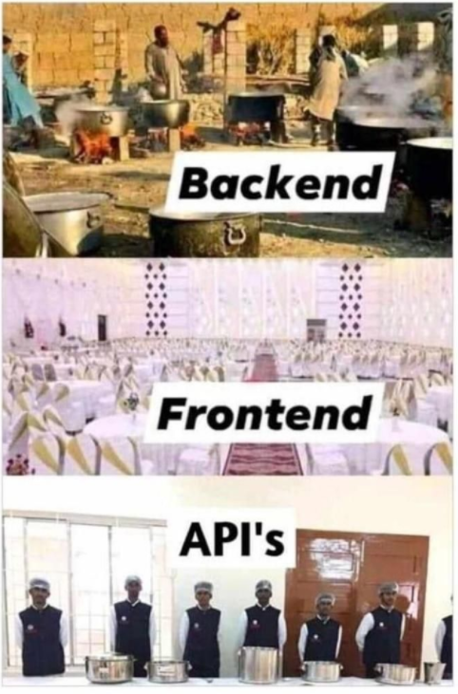

Slide 5
Application Programming Interface
Server
Client
API
HTML
CSS
JavaScript
Java
Python
PHP

Slide 6
Application Programming Interface
British Airways
Expedia
API
Expedia.com
API
API
Delta

Slide 7
Social Login

Slide 8
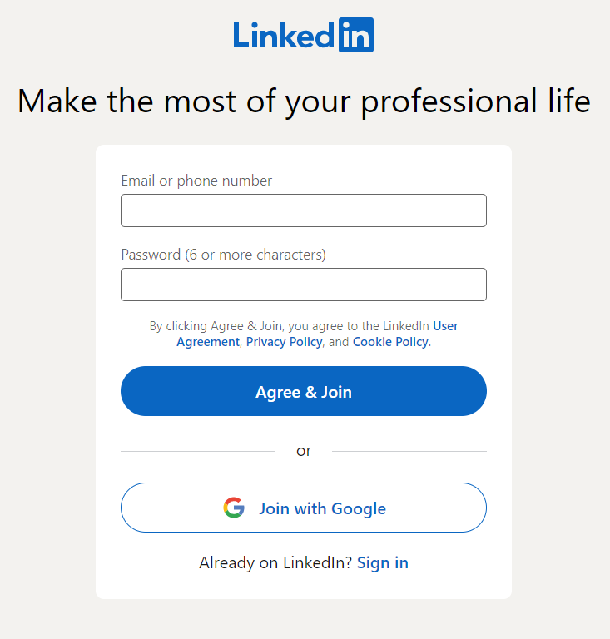
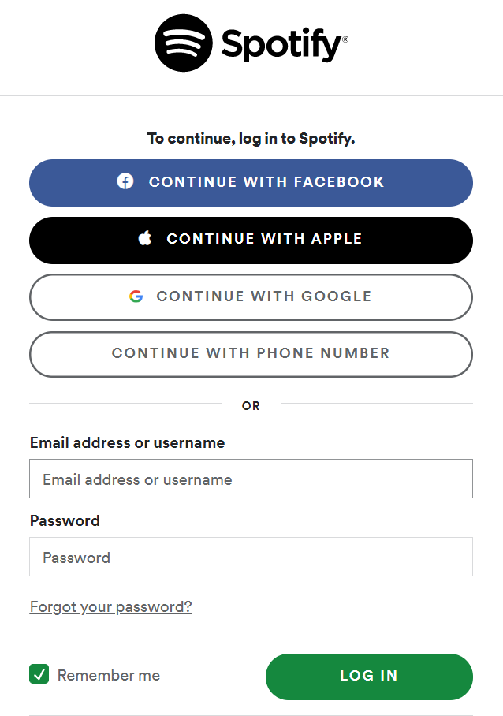
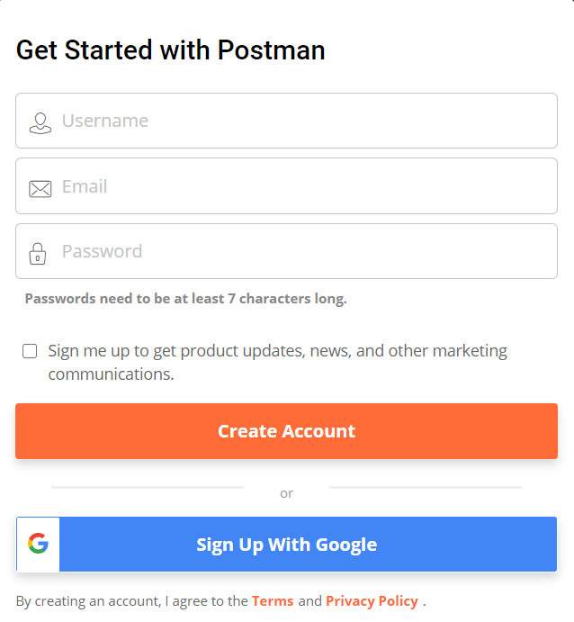
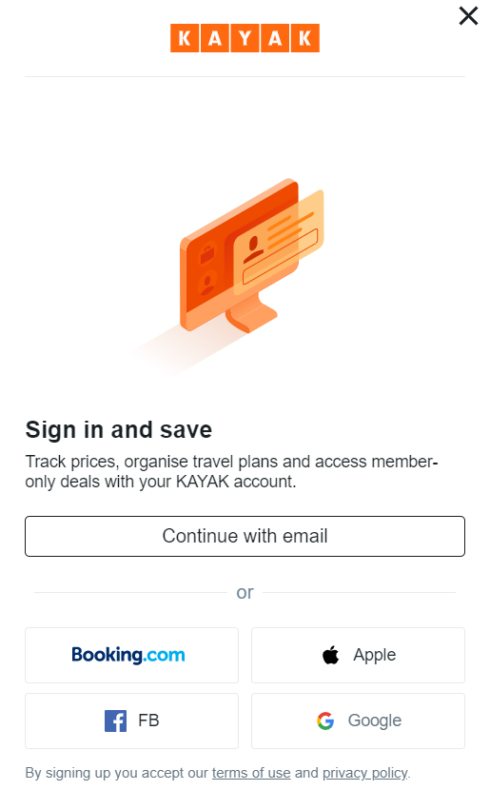
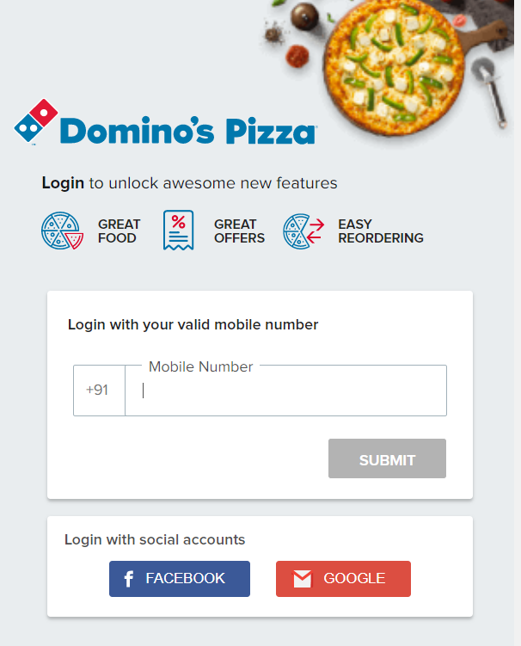

Slide 9
What is REST API?

Slide 10
Representational State Transfer

Slide 11
REST Constraints
Client Server
Stateless
Cache
Uniform Interface
Layered System
Code on Demand

Slide 12
What is JSON?

Slide 13
JSON
JavaScript Object Notation
Lightweight
Human Readable
Easy to understand
Key – Value pairs

Slide 14
JSON
{
"id": "1",
"firstName": "Omprakash",
"lastName": "Chavan",
"email": "askomdch@gmail.com"
}

Slide 15
JSON
Server
Client
GET /user/1
Java
Python
PHP
HTML
CSS
JavaScript
{
"id": "1",
"firstName": "Omprakash",
"lastName": "Chavan",
"email": "askomdch@gmail.com"
}

Slide 16
HTTP Vs REST

Slide 17
Hypertext Transfer Protocol

Slide 18
Client Server Architecture
Server
Client
HTTP Request
HTTP Response

Slide 19

Rest API Request
GET https://api.getpostman.com/workspaces/id
HTTP Method
Base URL
End
Point
Path
Param

Slide 20
HTTP Methods – RFC 7231/RFC 5789
Method | Description | Request body | Response body | Safe | Idempotent | Cacheable
GET | Transfer a current representation of the target resource | No | Yes | Yes | Yes | Yes
HEAD | Same as GET, but only transfer the status line and header section | No | No | Yes | Yes | Yes
POST | Perform resource-specific processing on the request payload | Yes | Yes | No | No | In some cases
PUT | Replace all current representations of the target resource with the request payload | Yes | No | No | Yes | No
DELETE | Remove all current representations of the target resource | Optional | Optional | No | Yes | No
CONNECT | Establish a tunnel to the server identified by the target resource | No | Yes | No | No | No
OPTIONS | Describe the communication options for the target resource | No | Yes | Yes | Yes | No
TRACE | Perform a message loop-back test along the path to the target resource | No | No | Yes | Yes | No
PATCH | Perform partial modification of the target resource | Yes | Yes | No | No | No

Slide 21
HTTP Methods
GET
Retrieves data from a server at the specified resource
Often the default method for HTTP Clients
Safe and Idempotent
Cacheable

Slide 22
HTTP Methods
HEAD
Gets the resource but without the response body
Useful to verify resource availability before making a GET request
Useful for testing API availability
Safe and Idempotent
Cacheable

Slide 23
HTTP Methods
POST
Sends data to a server to create or update a resource
Unsafe and Non-idempotent

Slide 24
HTTP Methods
PUT
Sends data to a server to overwrite or create a resource
Unsafe and Idempotent

Slide 25
HTTP Methods
PATCH
Sends data to a server to partially modify a resource
Unsafe and Non-idempotent

Slide 26
HTTP Methods
DELETE
Sends data to a server to delete a resource
Unsafe and Idempotent

Slide 27
HTTP Methods
OPTIONS
Returns the HTTP methods supported by a server for a given URL
Safe and Idempotent

Slide 28




Serialization and Deserialization in Java
Serialization
De-serialization
File
Java Object
Byte Stream
Byte Stream
Java Object
DB
Memory

Slide 29
Serialization and Deserialization in Rest Assured
Object Mapping
POJO/Map/List
Serialize
HTTP Request
Java Object
JSON/XML Object
Server
Deserialize
HTTP Response
Jackson/Gson/JAXB
Serializers

Slide 30
POJO
Plain Old Java Object

Slide 31
public class Workspace { private String name; private String type; public Workspace(String name, String type){ this.name = name; this.type = type; } public String getName() { return name; } public void setName(String name) { this.name = name; } public String getType() { return type; } public void setType(String type) { this.type = type; } }

Slide 32
Workspace teamWorkspace = new Workspace("MyTeam", "team"); Workspace personalWorkspace = new Workspace("MyPersonal", "personal");

Slide 33
POJO
Readability
Reusability
Easy access to data
Type Safety
Supports Serialization and Deserialization

Slide 34
POJO
Unnecessary code
Can be an overkill

Slide 35
Challenges
Different data type for “url” field in payload and response
Not asserting the “url” field

Slide 36
Request Payload
Response Payload
Base
Collection Root
Collection Root
Collection Root Base
Collection
Collection
Collection Base
Folder
Info
Folder
Info
Folder Base
Request Root
Request Root
Request Root Base
Request
Request
Request Base
Header
Body
Header
Body
URL

Slide 37
Authentication/Authorization
Authentication
Who you are.
Proves your identity.
Authorization
What you can do.
Proves your right to access.
Notes:
In this lecture, let us try to understand the fundamental difference between Authentication and Authorization.
This is important to know because many a times we get confused between the terms Authentication and Authorization.
So, what is Authentication?
Authentication proves that you are who you say you are.
In other words, It proves your identity.
For e.g. your social security number. You can use it almost anywhere in the US to prove your identity. Another example can be your driving license or any identity card issued by your state. The card will have a number using which the government can uniquely identify you. As simple as that.
So, now what is Authorization?
In simple words, authorization proves what actions or tasks you can do.
In other words, it proves your right to access.
With Authentication, you can prove your identity, but it is very much possible that you may or may not have right to perform certain tasks or access certain resources.
For e.g. You may get a driving license to drive a two wheeler and that can help you prove your identify. But with the same driving license, you may not be allowed to drive a four wheeler. Basically you may not be authorized to drive a four wheeler even though you proved your identity, right?
Another good example can be, let us say you are visiting a company. In this case, you will authenticate yourself using the visitor card to get inside the premises, but you may or may not be able to visit some restricted areas like the development center or the lab and so on …
So, in short,
Authentication refers to proving correct identity and Authorization refers to allowing certain tasks or actions.
So I hope with this, the concepts are clear. Thank you for watching this lecture.

Slide 38
HTTP Authentication Schemes
Basic
Bearer
Digest
OAuth
Notes:
There are different types of authentication schemes used in HTTP requests.
Here, I have listed the most popular ones.
The Basic, the Bearer, the Digest and the OAuth. In case of Oauth, there is Oauth 1.0 and OAuth2.0.
Oauth 2.0 is very popular and the most secure amongst all the authentication schemes. But Oauth is meant for Authorization and not authentication. This might sound confusing. We will have a look at that shortly.
Also for Oauth2.0, there are different flows based on the grant type. Among these, the Authorization grant type, the client credentials grant type and the implicit grant type flows are quite popular. We will have a look at each of these flows in separate lectures.
So in the next lecture, let us have a look at the Basic authentication scheme.

Slide 39
Basic
Base64 encoded username:password in the header
Base64 encoding is not secure
Example:

Slide 40

Bearer
Bearer token
Bearer is a person or an entity who holds a security token to get access to a certain resource
Cryptic: Generated by the server in response to login
Originally created as part of OAuth2.0 spec
Example:

Slide 41
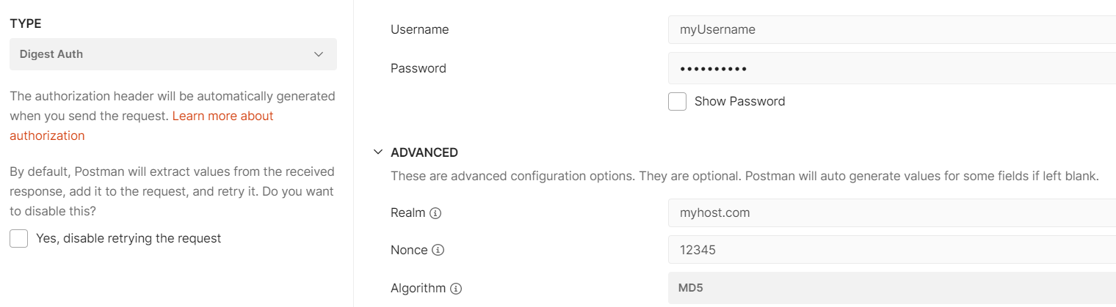
Digest
Challenge-response paradigm
Username and password is hashed using MD5 algorithm
Example:
Notes:
STEP 1 : a client sends a request to a server
STEP 2 : the server responds with a special code (called a nonce i.e. number used only once), another string representing the realm(a hash) and asks the client to authenticate
STEP 3 : the client responds with this nonce and an encrypted version of the username, password and realm (a hash)
STEP 4 : the server responds with the requested information if the client hash matches their own hash of the username, password and realm, or an error if not

Slide 42

API Key
Usually generated during first time login or during sign up
Used as a replacement for username and password
Usually fetched from account settings and often it is possible to delete, regenerate and create multiple API keys
Passed as a header or a query parameter or even in the request body.
Not secure
Example:
Notes:
STEP 1 : a client sends a request to a server
STEP 2 : the server responds with a special code (called a nonce i.e. number used only once), another string representing the realm(a hash) and asks the client to authenticate
STEP 3 : the client responds with this nonce and an encrypted version of the username, password and realm (a hash)
STEP 4 : the server responds with the requested information if the client hash matches their own hash of the username, password and realm, or an error if not

Slide 43
OAuth
Authentication
OpenID Connect
OAuth
Authorization
Notes:
STEP 1 : a client sends a request to a server
STEP 2 : the server responds with a special code (called a nonce i.e. number used only once), another string representing the realm(a hash) and asks the client to authenticate
STEP 3 : the client responds with this nonce and an encrypted version of the username, password and realm (a hash)
STEP 4 : the server responds with the requested information if the client hash matches their own hash of the username, password and realm, or an error if not

Slide 44
OAuth
Why do we need OAuth?
Notes:
STEP 1 : a client sends a request to a server
STEP 2 : the server responds with a special code (called a nonce i.e. number used only once), another string representing the realm(a hash) and asks the client to authenticate
STEP 3 : the client responds with this nonce and an encrypted version of the username, password and realm (a hash)
STEP 4 : the server responds with the requested information if the client hash matches their own hash of the username, password and realm, or an error if not

Slide 45
OAuth
Delegated Authorization
Notes:
STEP 1 : a client sends a request to a server
STEP 2 : the server responds with a special code (called a nonce i.e. number used only once), another string representing the realm(a hash) and asks the client to authenticate
STEP 3 : the client responds with this nonce and an encrypted version of the username, password and realm (a hash)
STEP 4 : the server responds with the requested information if the client hash matches their own hash of the username, password and realm, or an error if not

Slide 46
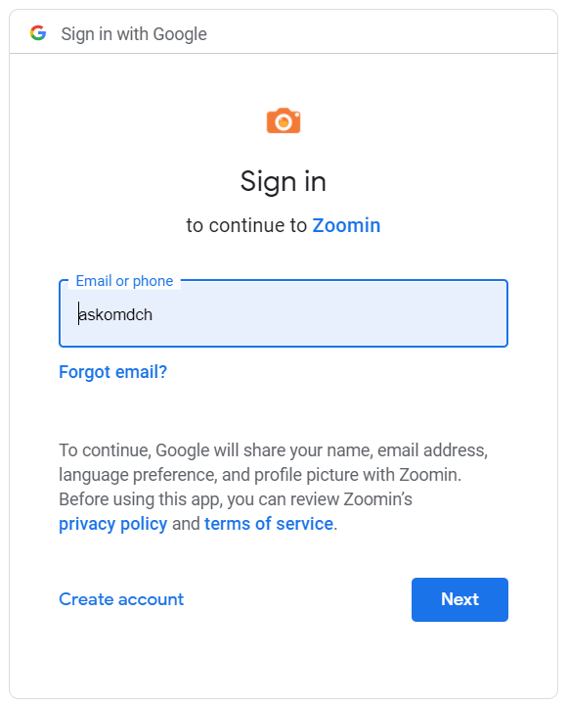
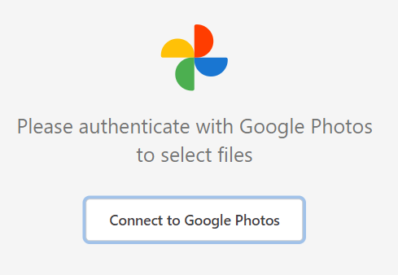


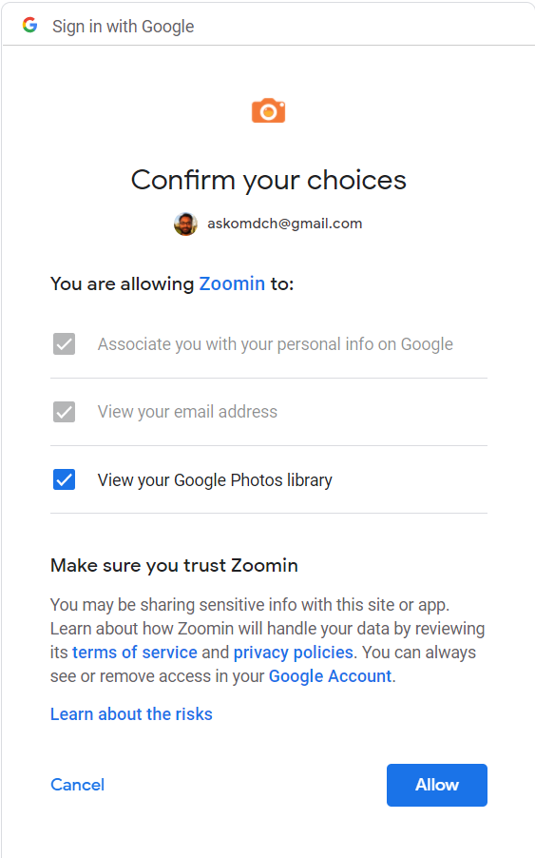
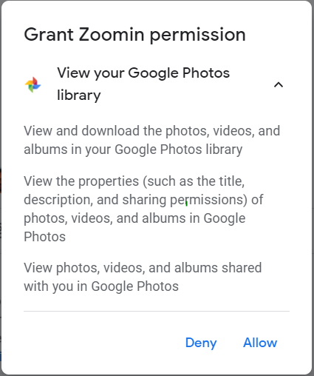
OAuth
Login
Add Photos
Allow
Login to Google
Notes:
STEP 1 : a client sends a request to a server
STEP 2 : the server responds with a special code (called a nonce i.e. number used only once), another string representing the realm(a hash) and asks the client to authenticate
STEP 3 : the client responds with this nonce and an encrypted version of the username, password and realm (a hash)
STEP 4 : the server responds with the requested information if the client hash matches their own hash of the username, password and realm, or an error if not

Slide 47
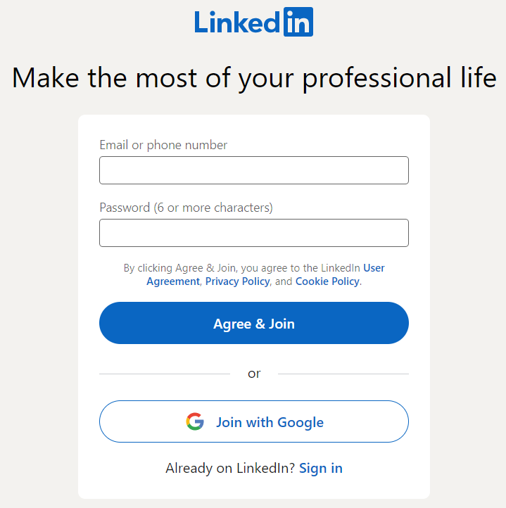
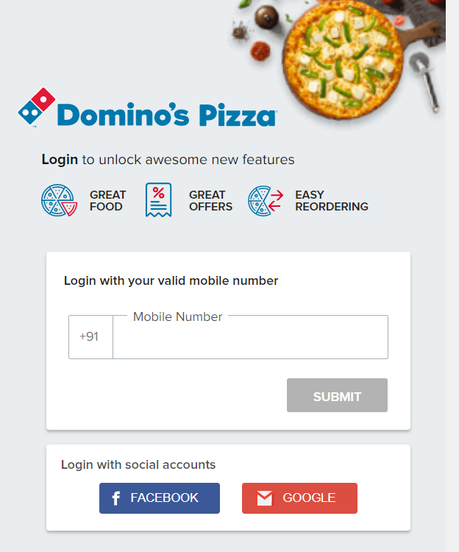
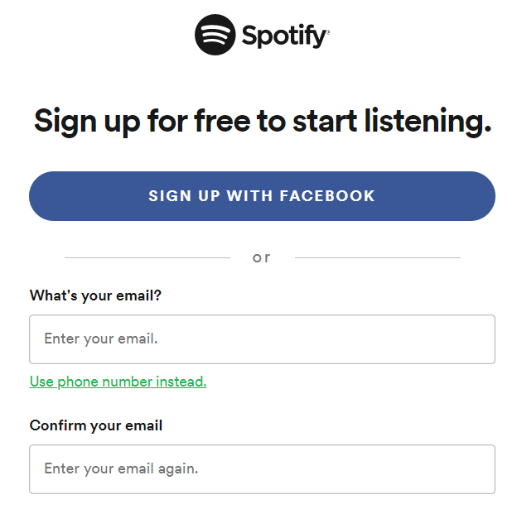
OpenID Connect + OAuth
Notes:
STEP 1 : a client sends a request to a server
STEP 2 : the server responds with a special code (called a nonce i.e. number used only once), another string representing the realm(a hash) and asks the client to authenticate
STEP 3 : the client responds with this nonce and an encrypted version of the username, password and realm (a hash)
STEP 4 : the server responds with the requested information if the client hash matches their own hash of the username, password and realm, or an error if not

Slide 48

OAuth Terminologies
#Client
#Resource Owner
#Authorization Server
#Resource
#Resource Server
Notes:
Resource: Protected resource. Something that is sought in the oauth flow. In this case, the thing that is being accessed is the photo which is present on the Google Photos. That’s the resource, the protected resource Not everyone has access to it. So the reason why we are having this Oauth flow is to allow access to this protected resource.
Resource Owner: Is the person who has access to the resource i.e. the user. In this case, the user has access to the photos on the Google Photos app. The person who can grant access to the resource to the ZoomIn app. The photo printing application.
Resource Server: holds the protected resource. Hosting. Google Photos.
Client: The photo printing app, the ZoomIn app. The client is that application which needs access to that protected resource. Making request for the protected resource on behalf of the resource owner and with the resource owner’s authorization.
Authorization server: Coupled with the resource server. Could be separate server or the same server. Issues access token to the client.

Slide 49
OAuth – Authorization Grant Flow
1
Auth Code
Refresh Token
2
Access Token
4
Photo
Access Token
Auth Code
5
6
#Authorization Server
API
3
Notes:
STEP 1 : a client sends a request to a server
STEP 2 : the server responds with a special code (called a nonce i.e. number used only once), another string representing the realm(a hash) and asks the client to authenticate
STEP 3 : the client responds with this nonce and an encrypted version of the username, password and realm (a hash)
STEP 4 : the server responds with the requested information if the client hash matches their own hash of the username, password and realm, or an error if not

Slide 50
OAuth – Implicit Grant Flow
1
2
Access Token
Photo
Access Token
4
5
#Authorization Server
API
3
Notes:
STEP 1 : a client sends a request to a server
STEP 2 : the server responds with a special code (called a nonce i.e. number used only once), another string representing the realm(a hash) and asks the client to authenticate
STEP 3 : the client responds with this nonce and an encrypted version of the username, password and realm (a hash)
STEP 4 : the server responds with the requested information if the client hash matches their own hash of the username, password and realm, or an error if not

Slide 51
OAuth – Client Credentials Flow
Client ID + Client Secret
#Authorization Server
Service2
Access Token
Access Token
Service1
Resource
Notes:
STEP 1 : a client sends a request to a server
STEP 2 : the server responds with a special code (called a nonce i.e. number used only once), another string representing the realm(a hash) and asks the client to authenticate
STEP 3 : the client responds with this nonce and an encrypted version of the username, password and realm (a hash)
STEP 4 : the server responds with the requested information if the client hash matches their own hash of the username, password and realm, or an error if not

Slide 52
Framework Goals:
Tools and Technologies
Scalable and extensible
Reusable Rest Assured specifications
Reusable Rest Assured API requests
Separation of API layer from test layer
POJOs for Serialization and Deserialization
Singleton Design Pattern
Lombok for reducing Boilerplate code
Builder pattern for Setter methods in POJOs
Robust reporting and logging using Allure
Automate positive and negative scenarios
Support parallel execution
Data driven using TestNG Data Provider
Automated access token renewal
Maven command line execution
Integration with Git
Integration with Jenkins
Rest Assured
TestNG
Java
Allure Reports
Hamcrest
Jackson API
Lombok

Slide 53
What are we automating?
Spotify Playlists API using the OAuth 2.0 flow [Authorization Code Grant Flow]
Create a Playlist
Get a Playlist
Change a Playlist’s Details
Test Cases:
shouldBeAbleToCreateAPlaylist
shouldNotBeAbleToCreateAPlaylistWithoutName
shouldNotBeAbleToCreateAPlaylistIfTokenIsExpired
shouldBeAbleToFetchAGivenPlaylist
shouldBeAbleToUpdateAGivenPlaylist

Slide 54
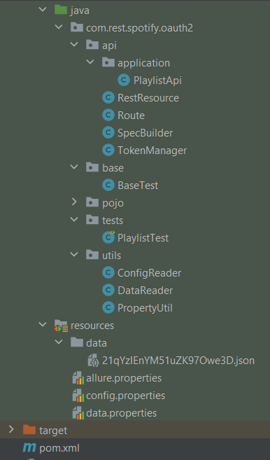
Playlist API reusable methods
Rest Assured API reusable methods
Playlist end points
Reusable request and response specifications
Access token expiry check and renewal
TestNG Base test
POJO classes
Test class
Singleton config.properties reader
Singleton data.properties reader
Common property loader
JSON data
Allure properties
Config properties
Data properties
Dependency management

Slide 55
Session based Authentication
Browser
Server
Post /signin
{username, password}
Server stores
the session
Cookie: Session ID
Get resource
Cookie: Session ID
Use cookie
to get user info
Resource
Notes:
Resource: Protected resource. Something that is sought in the oauth flow. In this case, the thing that is being accessed is the photo which is present on the Google Photos. That’s the resource, the protected resource Not everyone has access to it. So the reason why we are having this Oauth flow is to allow access to this protected resource.
Resource Owner: Is the person who has access to the resource i.e. the user. In this case, the user has access to the photos on the Google Photos app. The person who can grant access to the resource to the ZoomIn app. The photo printing application.
Resource Server: holds the protected resource. Hosting. Google Photos.
Client: The photo printing app, the ZoomIn app. The client is that application which needs access to that protected resource. Making request for the protected resource on behalf of the resource owner and with the resource owner’s authorization.
Authorization server: Coupled with the resource server. Could be separate server or the same server. Issues access token to the client.

Slide 56
HTTP Cookie
What is a Cookie?
Small piece of data stored in the
browser storage
Terminologies
- Session Cookie
- Persistent Cookie
- Secure Cookie
- http-only Cookie
- Same site Cookie
Designed to,
Authenticate the user – logged in or not?
Maintain the user session/state
Record user’s browsing activity
Remembering user information
Setting a Cookie
Used for,
Personalization
Session Management
Tracking
Sending a Cookie
Notes:
STEP 1 : a client sends a request to a server
STEP 2 : the server responds with a special code (called a nonce i.e. number used only once), another string representing the realm(a hash) and asks the client to authenticate
STEP 3 : the client responds with this nonce and an encrypted version of the username, password and realm (a hash)
STEP 4 : the server responds with the requested information if the client hash matches their own hash of the username, password and realm, or an error if not

