Slide 1

SAIRUS: LLM-BASED CLASSIFICATION AND SYNTHETIC RELATIONSHIP GENERATION
WALTER MANGIONE

Slide 2


OBJECTIVES
QUESTION 1
What are limitations of LLMs in classification?
How do the performances change with zero shot and few shot approach?
QUESTION 2
How can we generate synthetic relationships through an LLM?

Slide 3

Prompt Engineering phase
In prompt engineering phase, we leveraged:
Output priming
Special tokens
Temporal factor (for Few-Shot Learning)

Slide 4

ZERO-SHOT LEARNING
prompt_zero_shot = """
<|begin_of_text|><|start_header_id|>system<|end_header_id|>
You role is a sentiment analysis assistant. Analyze the sentiment of the provided tweet and respond with a JSON object containing the sentiment classification, where '1' represents negative sentiment and '0' represents positive sentiment.
<|start_header_id|>user<|end_header_id|>
Tweet: "{test_tweet}"
<|start_header_id|>assistant<|end_header_id|>
{{
"sentiment": """

Slide 5
FEW-SHOT LEARNING
EXAMPLE 1:
Tweet: “[tweet]”
<|start_header_id|>assistant<|end_header_id|>
{
"sentiment": 1
}
….
….
Now, analyze the following tweet:
Tweet: """
<|start_header_id|>assistant<|end_header_id|>
{
"sentiment":
"""
prompt_few_shot = """
<|begin_of_text|><|start_header_id|>system<|end_header_id|>
You are a sentiment analysis assistant. Analyze the sentiment of the provided tweet and respond with a JSON object containing the sentiment classification, where '1' represents negative sentiment and '0' represents positive sentiment.
Here are some improved few-shot examples to understand HOW to classify:

Slide 6
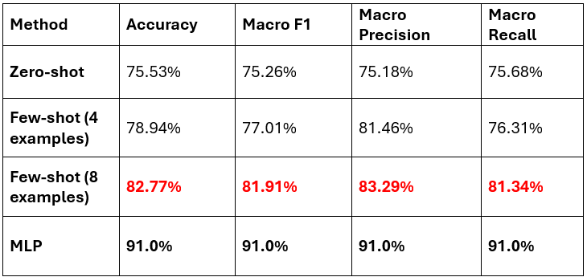
OVERALL RESULTS

Slide 7
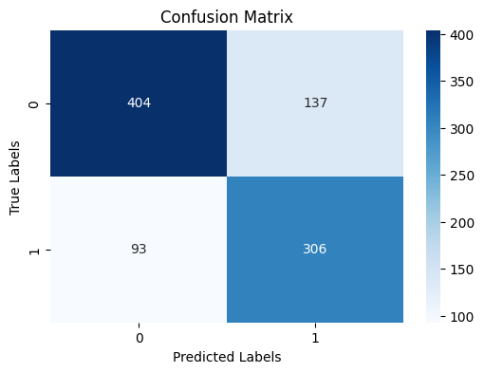
ZERO-SHOT LEARNING

Slide 8
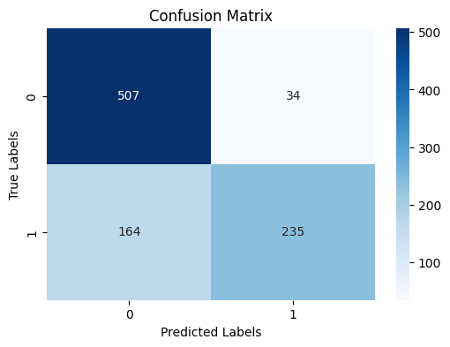
FEW-SHOT LEARNING - 4 EXAMPLES

Slide 9
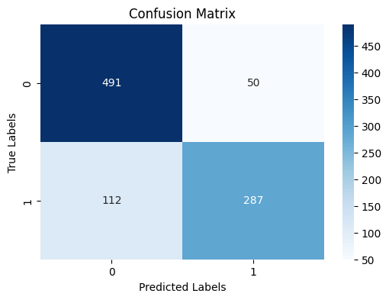
FEW-SHOT LEARNING - 8 EXAMPLES

Slide 10

CREATING CANDIDATE SYNTHETIC RELATIONSHIPS
IDEA: Treat the dataset as a user-item matrix and apply recommender system techniques.
Generate recommendations by leveraging content.
Query the LLM: "Given this user and this user (thought as item), would you recommend it?"

Slide 11
CREATING CANDIDATE SYNTHETIC RELATIONSHIPS
How to leverage content?
Discover hidden patterns;
Exploit synonymy;
Think step-by-step (chain-of-thought);
Few shot examples of recommendation (sampled by temporal sequences).

Slide 12
CREATING CANDIDATE SYNTHETIC RELATIONSHIPS
How do we want output?
We built following template:
<json>
{
"improved_chain_of_thought": char*,
"explanation": char*,
"similarity_score": int
}
</json>

Slide 13
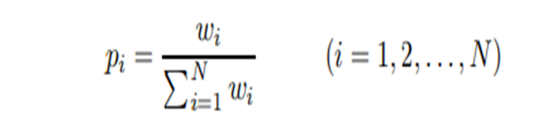
CREATING SYNTHETIC RELATIONSHIPS
We selected a restricted subset of relationships from the initial 12,410 (randomly selected) as follows:
1) We retained relationships with a similarity greater than 3, then sampled for each direction;
2) For each direction, we selected relationships based on a probability function of their similarity.
P.S. We introduced an alpha parameter to control the selection process!

Slide 14
CONCLUSIONS
We obtained a strong baseline using LLM classification;
We provide explainability for synthetic relationships;
We have started implementing the code for fine-tuning the relationship module;
We could leverage ensemble methods combining MLP and LLM;
We could refine prompt engineering to enhance LLM classification;
We could leverage a data-driven approach, especially for relationship generation.

Slide 15
Thank you

