Slide 1
Software Quality Assurance - Outline
What is Software Quality assurance(SQA)?
Quality Concepts.
Software Quality Assurance Activities.
Software Reviews and their importance
Statistical SQA.
Software Reliability
ISO 9000 approach to SQA
2

Slide 2
What is SQA?
Software Quality Assurance is an umbrella activity that is applied throughout the software process...
3

Slide 3
It encompasses..
A quality management approach
Effective software engineering technology
Formal technical reviews that are applied throughout the software process
A multitiered testing strategy
Control of software documentation and changes to it
A procedure to assure compliance with software development standards
Measurement and reporting techniques
4

Slide 4
Quality ???
Quality refers to any measurable characteristics such as correctness, maintainability, portability, testability, usability, reliability, efficiency, integrity, reusability and interoperability.
5

Slide 5
Quality Concepts
Quality of Design refers to the characteristics that designer’s specify for an item.
Quality of Conformance is the degree to which the design specifications are followed during manufacturing.
Quality Control is the series of inspections, reviews and tests used throughout the development cycle to ensure that each work product meets the requirements placed upon it.
6

Slide 6
(cont'd)...
Quality policy refers to the basic aims and objectives of an organization regarding quality as stipulated by the management.
Quality assurance consists of the auditing and reporting functions of management.
Cost of Quality includes all costs incurred in the pursuit of quality or in performing quality related activities such as appraisal costs, failure costs and external failure costs.
7

Slide 7
(cont'd)...
Quality planning is the process of assessing the requirements of the procedure and of the product and the context in which these must be observed.
Quality testing is assessment of the extent to which a test object meets given requirements
Quality assurance plan is the central aid for planning and checking the quality assurance.
Quality assurance system is the organizational structure, responsibilities, procedures, processes and resources for implementing quality management.
8

Slide 8
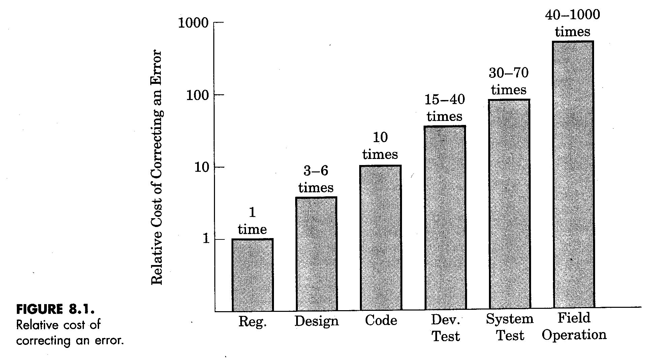
Relative cost of correcting an error
9

Slide 9
Defn. of Software Quality Assurance
Conformance to explicitly stated functional and performance requirements, explicitly documented development standards, and implicit characteristics that are expected of all professionally developed software.
10

Slide 10
SQA Group Plan
Evaluations to be performed
Audits and reviews to be performed
Standards that are applicable to the project
Procedures for error reporting and tracking
Documents to be produced by the SQA group
Amount of feedback provided to software project team
11

Slide 11
SQA Group Activities
Participates in the development of the projects software process description
Reviews software engineering activities to verify compliance with the defined software process.
Audits designated software work products to verify compliance with those defined as part of the software process.
12

Slide 12
(cont'd)...
Ensures that deviations in software work and work products are documented and handled according to a document procedure.
Records any non-compliance and reports to senior management.
13

Slide 13
Software Reviews
‘Filter’ for the software engineering process
‘Purify’ the software work products that occur as a result of analysis, design, and coding.
Achieve technical work of more uniform, greater and more predictable quality.
Detect errors and problems at the earliest possible time.
14

Slide 14
Formal Technical Reviews
To uncover errors in function, logic, or implementation for any representation of the software
To verify that software meets its requirements
To ensure that software representation meets predefined standards
To achieve software development in a uniform manner
To make projects more manageable
15

Slide 15
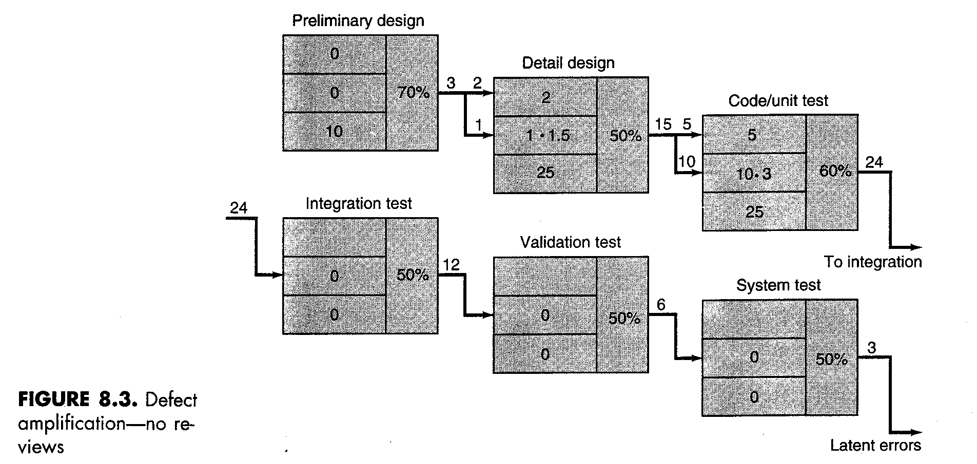
Defect Amplification Model

Slide 16
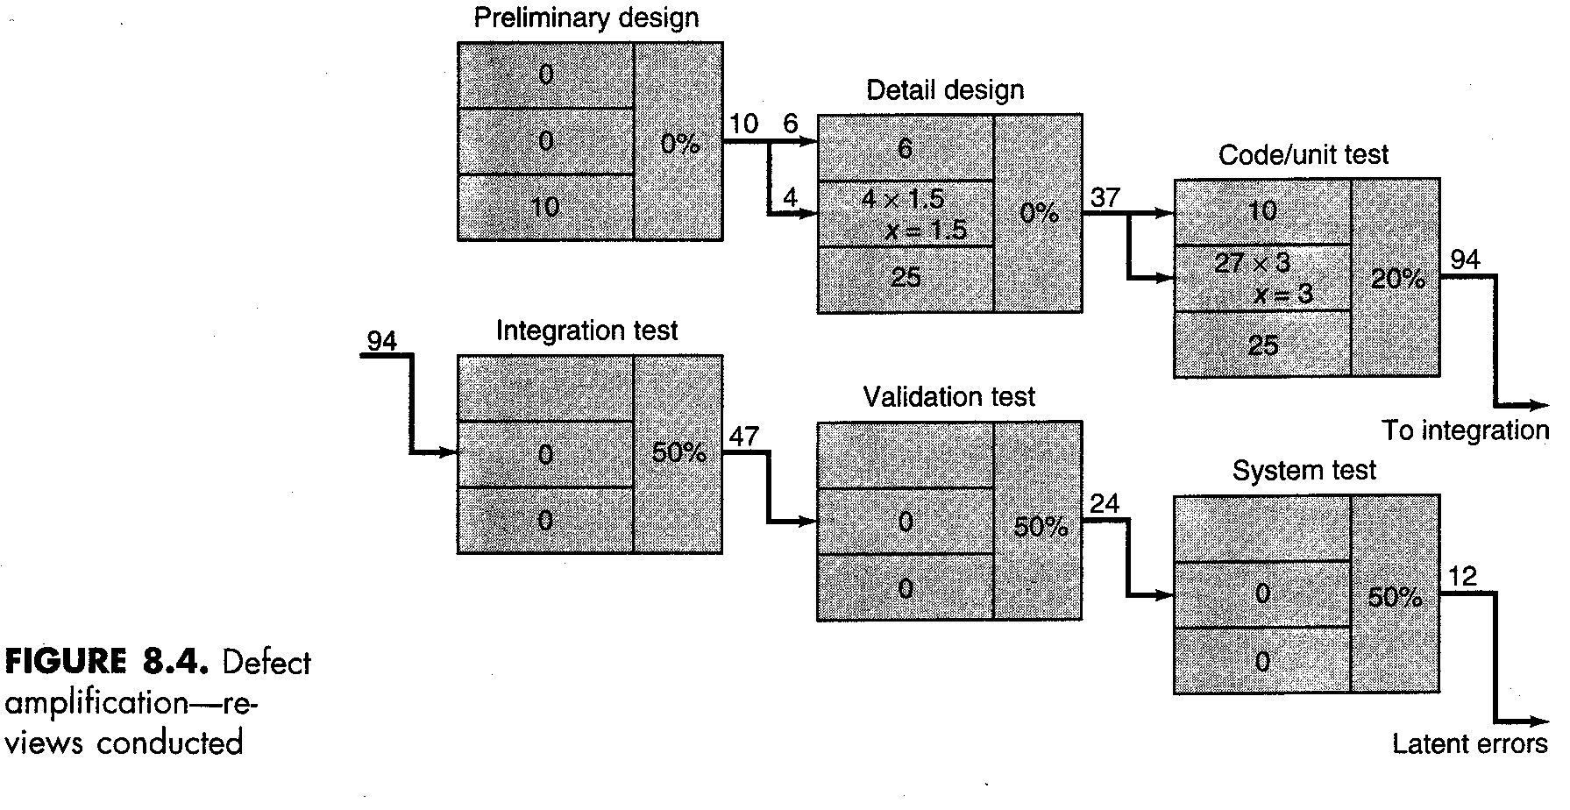
Defect Amplification with Reviews

Slide 17
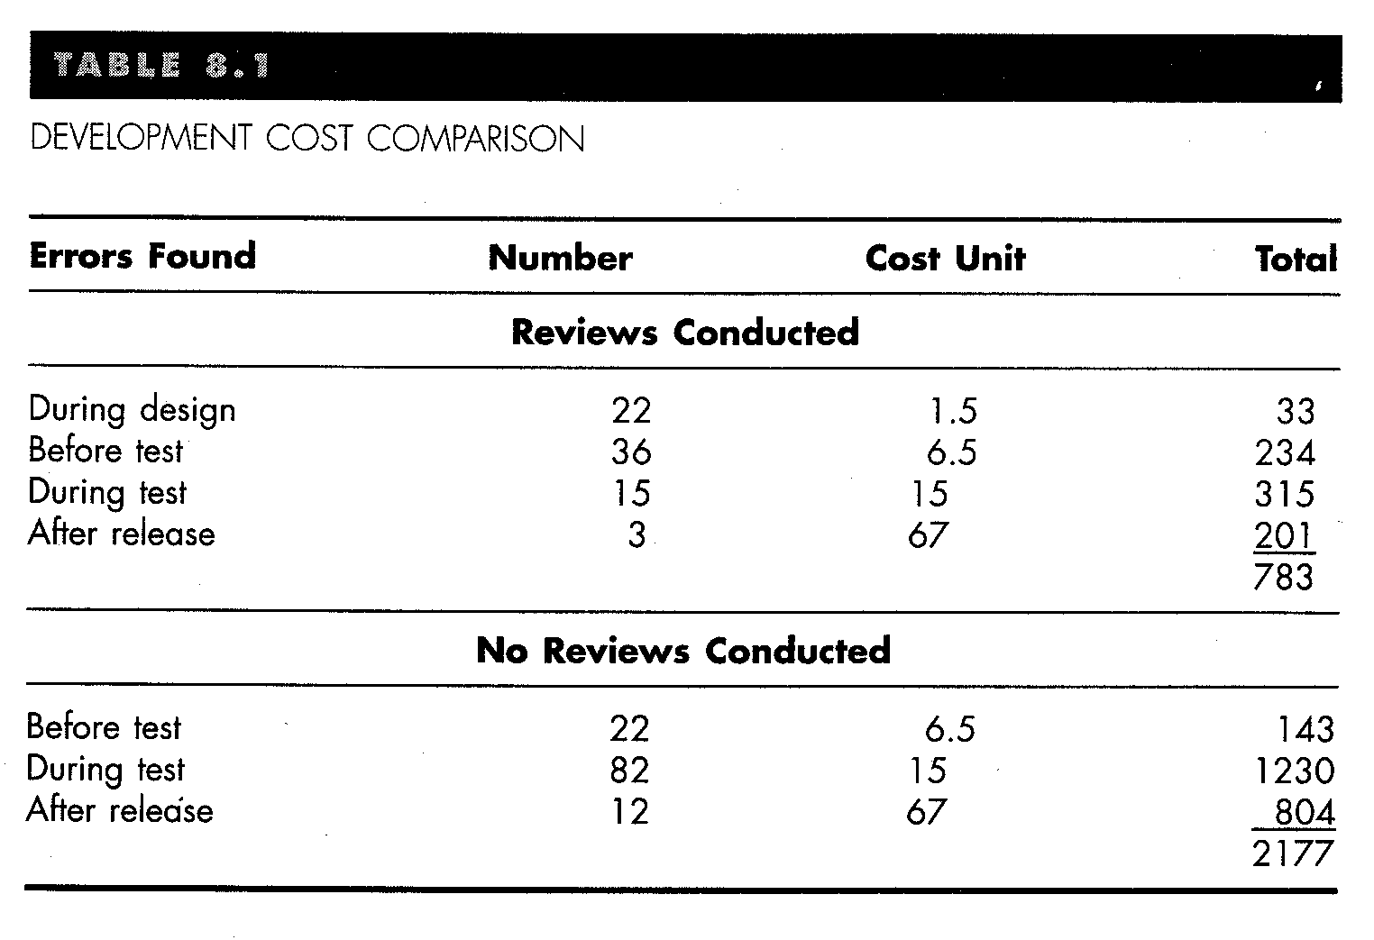
Cost Comparison of Error Repair

Slide 18
Review Guidelines..
Review the product, not producer
Set an agenda and maintain it
Limit the debate
Enunciate problem areas, not to solve every problem noted
Take written notes
Allocate resources and time schedule for FTR’s
Limit the number of participants and insist upon advance preparation
Develop a checklist for each work product to be reviewed
Training for all reviewer’s
Reviewing earlier reviews
16

Slide 19
Additional Structures
Requirements Control Board
  All requirement changes must be formally reviewed and approved
Software Control Board
  All design changes must be formally reviewed and approved
Interface Control Board

Slide 20
Statistical Quality Assurance
Implies information about software defects is collected and categorized
An attempt is made to trace each defect to its underlying cause
Isolate the vital few causes of the major source of all errors
Then move to correct the problems that have caused the defects
17

Slide 21
Categories of Errors
Incomplete or erroneous specification (IES)
Misinterpretation of customer comm (MCC)
Intentional deviation from specification (IDS)
Violation of programming standards (VPS)
Error in data representation (EDR)
Inconsistent module interface (IMI)
Error in design logic (EDL)

Slide 22
Categories of Errors (cont'd)
Incomplete or erroneous testing (IET)
Inaccurate or incomplete documentation (IID)
Error in programming lang. Translation (PLT)
Ambiguous or inconsistent human-computer interface (HCI)
Miscellaneous (MIS)
Most often IES, MCC and EDR are the vital few causes for majority of errors.

Slide 23
Definitions
E_{i} = the total number of errors uncovered during the ith step in the software engineering process
S_{i} = the number of serious errors
M_{i} = the number of moderate errors
T_{i} = the number of minor errors
PS = size of the product (LOC, design statements, pages of documentation)
18

Slide 24
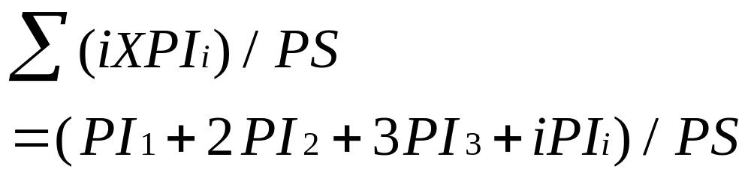
error index
Phase index for each step and then error index is calculated
PI_{i} = w_{s}(S_{i}/E_{i})+w_{m}(M_{i}/E_{i})+w_{t}(T_{i}/E_{i})
Formula:
19

Slide 25
Software Reliability
Defined as the probability of failure free operation of a computer program in a specified environment for a specified time.
It can measured, directed and estimated
A measure of software reliability is mean time between failures where
MTBF = MTTF + MTTR
MTTF = mean time to failure
MTTR = mean time to repair
20

Slide 26
Software Availability
Availability =MTTF/(MTTF + MTTR) * 100%
Software availability is the probability that a program is operating according to requirements at a given point in time
21

Slide 27
Software Safety
Processes that help reduce the probability that critical failures will occur due to SW
Hazard analyses
  Identify hazards that could call failure
  Develop fault tree
  Identify all possible causes of the hazard
  Formally review the remedy for each
Redundancy
Require a written software safety plan
Require independent verification & validation

Slide 28
Example Fault Tree -- Thermal
Loss of heat
...
Power failure
Computer failure
Incorrect
input
SW failed to throw switch
Computer failure
SW failed to throw switch
...
Logic reversed

Slide 29
Software Safety
Redundancy
  Replicated at the hardware level
  Similar vs.. dis-similar redundancy
Verification
  Assuring that the software specifications are met
Validation
  Assuring that the product functions as desired
Independence

Slide 30
Overview of SQA Plan
Purpose of Plan
References
Management
Documentation
Standards, Practices and Conventions
Reviews and Audits
Test
Problem Reporting and Corrective action
Tools, Techniques and Methodologies
Code Control
Media Control
Supplier control
Records Collection, Maintenance and Retention
Training
Risk Management
22

Slide 31
ISO 9000 Quality Standards
ISO 9000 describes quality assurance elements in generic terms that can be applied to any business.
It treats an enterprise as a network of interconnected processes.
To be ISO-complaint processes should adhere to the standards described.
Elements include organizational structure, procedures, processes and resources.
Ensures quality planning, quality control, quality assurance and quality improvement.
23

Slide 32
ISO 9001
An international standard which provides broad guidance to software developers on how to Implement, maintain and improve a quality software system capable of ensuring high quality software
Consists of 20 requirements...
Differs from country to country..
24

Slide 33
ISO 9001 (cont'd)..requirements
Management responsibility
Quality system
Contract review
Design Control
Document and data control
Purchasing
Control of customer supplied product
Product identification and traceability
Process control
Inspection and testing
Control of inspection, measuring and test equipment
25

Slide 34
ISO 9001 (cont'd)..
Inspection and test status
Control of non-confirming product
Corrective and preventive action
Handling, storage, packaging, preservation and delivery
Control of quality records
Internal quality audits
Training
Servicing
Statistical techniques
26

Slide 35
Summary-
SQA must be applied at each step
SQA might be complex
Software reviews are important SQA activities
Statistical SQA helps improve product quality and software process
Software Safety is essential for critical systems
ISO 9001 standardizes the SQA activities
27

