Slide 1
preparation for the course
basic development tools
create a directory C:/devel
open shared disk P:/mwa1 and copy content to C:/devel
install Git
install VSCode
launch itl-modern-examples1.bat
launch VSCode

Slide 2
e1 – web development preview
Pure html, css, js
install plugins auto-close-tag, auto-rename-tag on showing e01
show the plugin effect

Slide 3
e2 – web development preview
the help of libraries (JQUERY)

Slide 4
e3 – web development preview
Web Components with js
install plugins Vetur, Eslint and Prettier
show highlighted code

Slide 5
e4 – web development preview
Web Component with vue

Slide 6
e5 – web components libraries
puzzle an application together

Slide 7
e6 – …
…

Slide 8
e7 – …
…

Slide 9
e8 – …
…

Slide 10
e9 – …
…

Slide 11
e10 – …
…

Slide 12
e11 – …
…

Slide 13
e12 – VUE CLI & hand-on workshop
generate project Structure
install Node
show VSCode terminal
vue create project

Slide 14
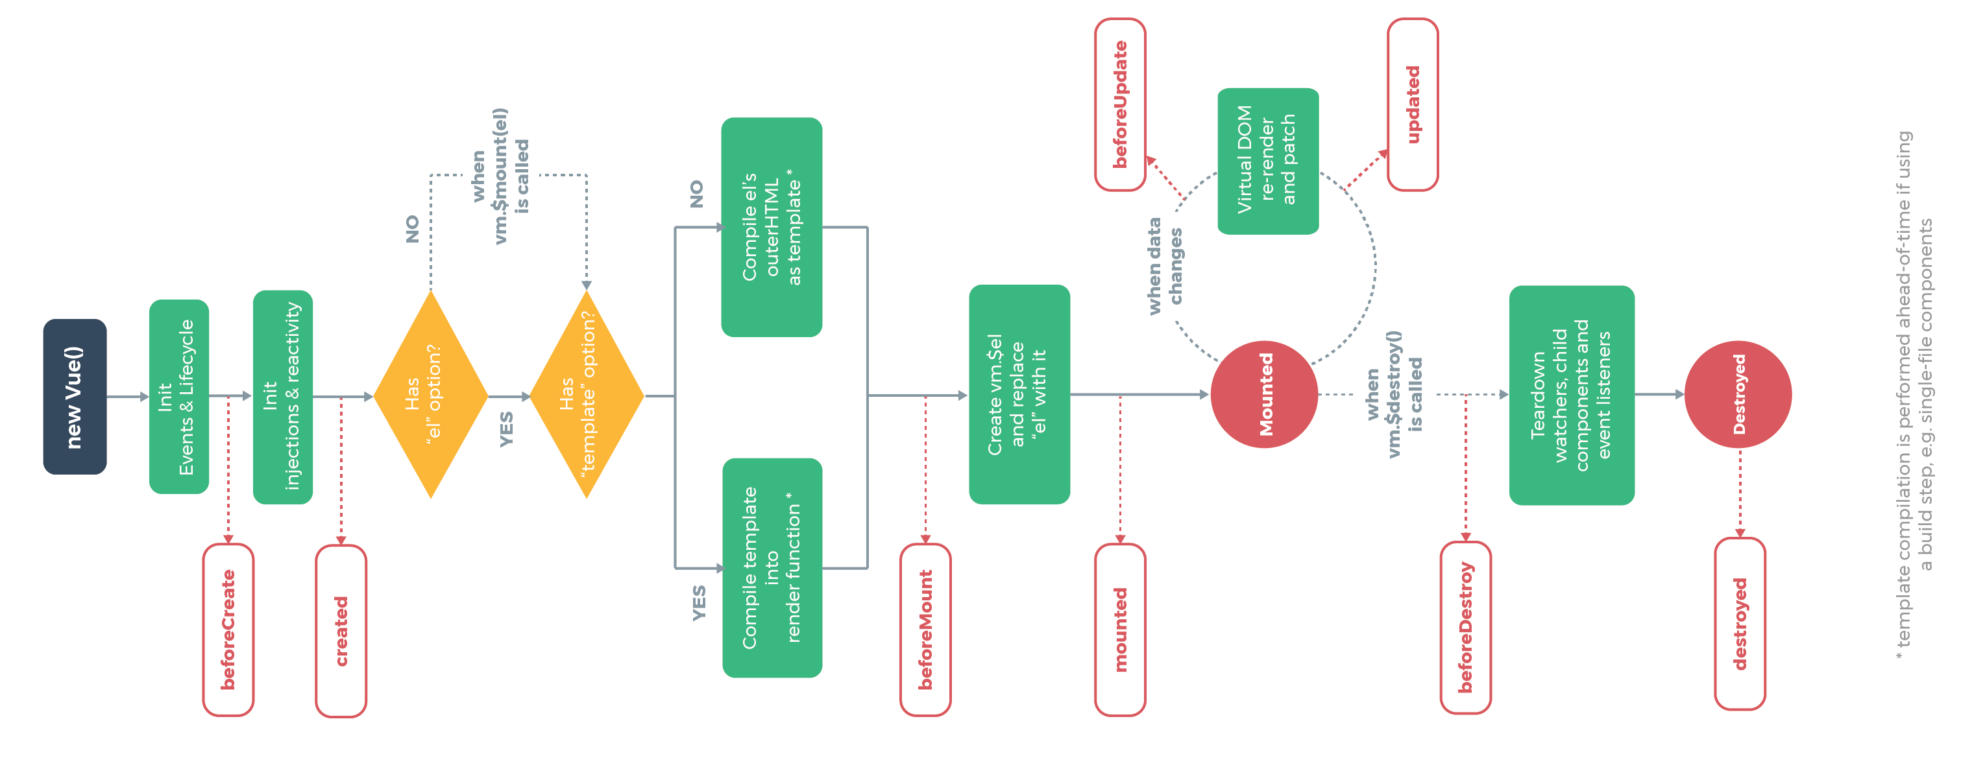
e13 – vue basics
VUE DOC & Vue INSTANCE
https://vuejs.org/v2/guide/

Slide 15
e13 – vue basics
variables & data
Show data variable reactivity
from VSCode
from browser console
in Vue browser plugin
For all next examples:
change directory to the current example
npm install
npm run serve

Slide 16
e13 – vue basics
CODE FORMATTING
show VSCode configuration
show settings.xml file
configure settings.xml by copying prepared configuration
show formatting and autosave
show upgrade of eslint 'plugin:vue/essential‘ to recommended
show autoformatting after the upgrade

Slide 17
e14 – vue basics
remember the layout

Slide 18
e15 – vue list rendering
v-for directive

Slide 19
e16 – vue conditional rendering
v-if, v-elseif, v-else directives

Slide 20
e17 – vue basics
event handling

Slide 21
e18 – vue basics
style binding

Slide 22
e19 – vue basics
class binding

Slide 23
e20 – vue basics
COMPUTED
Install Node

Slide 24
e21 – vue basics
components

Slide 25
e22 – vue basics
communicating events

Slide 26
e23 – vue basics
forms
Install Node

Slide 27
e24 – vue basics
tabs

Slide 28
e25 – practical vue
localization and i18n

Slide 29
e26 – practical vue
simple e-shop building

