Slide 1
Introduction to Flask Micro Framework
Mohammad Reza Kamalifard
@itmard

Slide 2
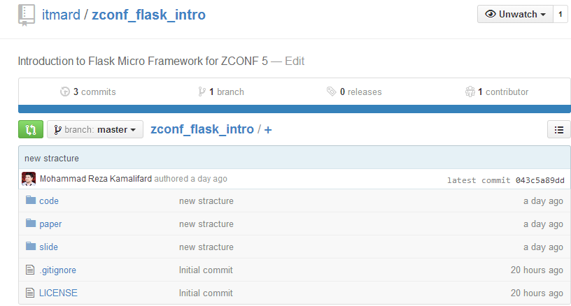
Codes
https://github.com/itmard/zconf_flask_intro

Slide 3
What is a Web Application Framework?

Slide 4
What is a Web Application Framework?
URL Routing

Slide 5
What is a Web Application Framework?
URL Routing
Request and Response Objects

Slide 6
What is a Web Application Framework?
URL Routing
Request and Response Objects
Template Engine

Slide 7
What is a Web Application Framework?
URL Routing
Request and Response Objects
Template Engine
Development Web Server

Slide 8
What is a Web Application Framework?
URL Routing
Request and Response Objects
Template Engine
Development Web Server
Database Object Relational Mapper

Slide 9
What is a Web Application Framework?
URL Routing
Request and Response Objects
Template Engine
Development Web Server
Database Object Relational Mapper
Form Validation

Slide 10
Python for web development

Slide 11
Why Python?
Python is an easy to learn
Powerful
Clean syntax and code readability
Open Source
Cross-platform
Rich set of libraries
Large Number of open source tools

Slide 12
Python web frameworks
Django
Flask
Werkzeug
Tornado
Pyramid
Bottle
…

Slide 13


Slide 14
Flask
Micro Framework

Slide 15
Flask
Micro Framework
Simple but extensible core

Slide 16
Flask
Micro Framework
Simple but extensible core
Werkzeug WSGI toolkit

Slide 17
Flask
Micro Framework
Simple but extensible core
Werkzeug WSGI toolkit
Jinja2 template engine

Slide 18
Flask
Micro Framework
Simple but extensible core
Werkzeug WSGI toolkit
Jinja2 template engine
Provides a simple template for web development

Slide 19
Flask
Micro Framework
Simple but extensible core
Werkzeug WSGI toolkit
Jinja2 template engine
Provides a simple template for web development
No ORM

Slide 20
Flask
Micro Framework
Simple but extensible core
Werkzeug WSGI toolkit
Jinja2 template engine
Provides a simple template for web development
No ORM
No Form validation

Slide 21
Flask
Micro Framework
Simple but extensible core
Werkzeug WSGI toolkit
Jinja2 template engine
Provides a simple template for web development
No ORM
No Form validation
Supports extensions

Slide 22
Simple Web Application with Flask
from flask import Flask
app = Flask(__name__)
@app.route("/")
def hello():
return "Welcome to ZCONF 5"
if __name__ == "__main__":
app.run()

Slide 23
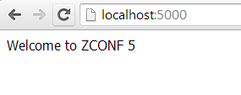
Simple Web Application with Flask
from flask import Flask
app = Flask(__name__)
@app.route("/")
def hello():
return "Welcome to ZCONF 5"
if __name__ == "__main__":
app.run()

Slide 24
Features
Built in development server and debugger
Integrated unit testing support
RESTful request dispatching
Uses Jinja2 templating
Support for secure cookies (client side sessions)
100% WSGI 1.0 compliant
Unicode based
Extensively documented

Slide 25
Flask Routing
Modern web applications have beautiful URLs
Routing using decorators
route( ) decorator is used to bind a function to a URL
Make certain parts of the URL dynamic
Attach multiple rules to a function

Slide 26
Flask Routing
Modern web applications have beautiful URLs
Routing using decorators
route( ) decorator is used to bind a function to a URL
Make certain parts of the URL dynamic
Attach multiple rules to a function
@app.route('/')
def index():
return 'Index Page'
@app.route('/hello/')
def hello():
return 'Hello World'

Slide 27
Variable Rules
<variable_name>
@app.route('/user/<username>')
def show_user_profile(username):
return 'User %s' % username
<converter:variable_name>
@app.route('/post/<int:post_id>')
def show_post(post_id):
return 'Post %d' % post_id

Slide 28
Request Object
Easy way to access request data
@app.route('/login', methods=['POST', 'GET'])
def login():
error = None
if request.method == 'POST':
if valid_login(request.form['username'],request.form['password']):
return log_the_user_in(request.form['username'])
else:
error = 'Invalid username/password'
return render_template(' login.html ', error=error)

Slide 29
Template Engine
Jinja2 (default)
from flask import render_template
@app.route(' /hello/ ')
@app.route(' /hello/<name> ')
def hello(name=None):
return render_template(' hello.html', name=name)

Slide 30
hello.html
<!doctype html>
<title>Hello from Flask</title>
{% if name %}
<h1>Hello {{ name }}!</h1>
{% else %}
<h1>Hello World!</h1>
{% endif %}

Slide 31
Development server and debugger
Easy to use local development server
Interactive Error page with debug mode

Slide 32
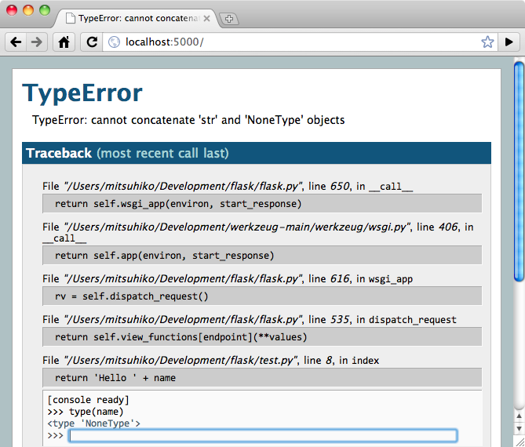

Slide 33
Database management
No ORM inside flask
Extensions:
SQLAlchemy
Peewee
Mongoengine
MongoKIT
PyMongo
MongoAlchemy
Flask-CouchDB
Flask-FluidDB
Flask-CouchDBKit
Flask-FluidDB

Slide 34
#sqlalchemy
from flask import Flask
from flask.ext.sqlalchemy import SQLAlchemy
app = Flask(__name__)
app.config['SQLALCHEMY_DATABASE_URI'] = 'sqlite:////tmp/test.db'
db = SQLAlchemy(app)
class User(db.Model):
id = db.Column(db.Integer, primary_key=True)
username = db.Column(db.String(80), unique=True)
email = db.Column(db.String(120), unique=True)
#peewee
import datetime
from peewee import *
class Note(db.Model):
message = TextField()
created = DateTimeField(default=datetime.datetime.now)

Slide 35
Form validation
Flask WTForm
#class based forms
from flask_wtf import Form
from wtforms import StringField
from wtforms.validators import DataRequired
class MyForm(Form):
name = StringField('name', validators=[DataRequired()])
#view
@app.route('/submit', methods=('GET', 'POST'))
def submit():
form = MyForm()
if form.validate_on_submit():
return redirect('/success')
return render_template('submit.html', form=form)

Slide 36
Architectural Pattern
Single file application
MVC , MV* patterns
project
–--apps
----------app1
----------------models.py
----------------views.py
---------------forms.py
---------------apis.py
–---statics
–---templates
-----models
-----views
-----forms
-----statics
-----templates

Slide 37
Mohammad Efazati
Mehdi Khoshnody
Reza Shalbafzadeh
K1 Hedayati
Thank you :)

Slide 38






Copyright 2014 Mohammad Reza Kamalifard
All rights reserved.
Introduction to Flask by Mohammad Reza Kamalifard is licensed under a
Creative Commons Attribution-NonCommercial-NoDerivatives 4.0 International License.
ZCONF 5

