Slide 1
Horse Race Prediction
Presented By:
Ramkumar. K

Slide 2
ESSENTIAL LIBRARIES:
Streamlit: Framework for building interactive web applications.
Pandas: Data manipulation and analysis library.
NumPy: Numerical computing library for mathematical operations on arrays.
Matplotlib: Plotting library for creating static, interactive, and animated visualizations.
Seaborn: Statistical data visualization library based on Matplotlib, for producing informative and attractive visualizations.
Scikit-learn: Machine learning library providing tools for data preprocessing, model building, evaluation, and optimization.
StandardScaler & LabelEncoder: Preprocessing tools for scaling and encoding data.
LogisticRegression: Library for building logistic regression models.
RandomForestClassifier: Library for building random forest models.
GradientBoostingClassifier: Library for building gradient boosting models.
MLPClassifier: Library for building multilayer perceptron (neural network) models.
Warnings: Library for managing warning messages.

Slide 3
ESSENTIAL LIBRARIES:
accuracy_score, precision_score, recall_score, f1_score, classification_report: Metrics for model evaluation.
cross_val_predict, cross_val_score: Tools for cross-validation.
StratifiedKFold: Cross-validation iterator to ensure stratified folds.
SMOTE, RandomUnderSampler: Techniques for handling imbalanced datasets.
class_weight='balanced': Technique to balance class weights during model training.
RFE: Recursive Feature Elimination for feature selection.
RandomizedSearchCV: Tool for hyperparameter tuning.
StratifiedKFold, cross_val_predict: Tools for creating stratified k-folds and predicting with cross-validation.

Slide 4
MAIN OBJECTIVE OF THE PROJECT:
To predict the outcomes of horse races using historical race data and machine learning techniques.
Develop models to accurately forecast which horses will win or place in a race.
Analyze and identify significant features influencing race outcomes.
Address the challenges of imbalanced data in race outcome prediction.
Enhance prediction accuracy through feature engineering and model optimization.

Slide 5
Developing Predictive Models for Classification
Data Preprocessing:
Handle missing values, outliers, and irrelevant data.
Encode categorical variables and transform skewed variables.
Exploratory Data Analysis:
Visualize data to gain insights into patterns and distributions.
Feature Engineering:
Create new features or modify existing ones to enhance model performance.
Model Building and Evaluation:
Train, evaluate, and optimize machine learning models for predicting race outcomes.
Use techniques like cross-validation and hyperparameter tuning to improve model accuracy.

Slide 6
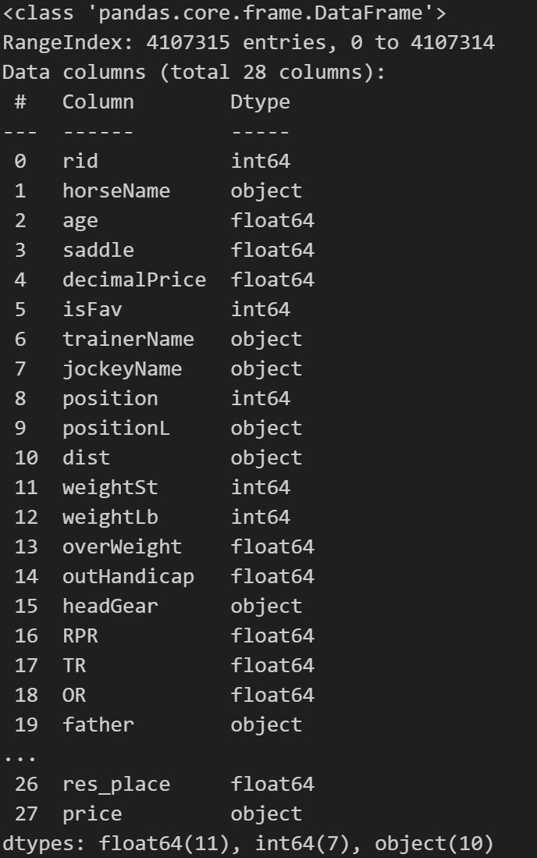
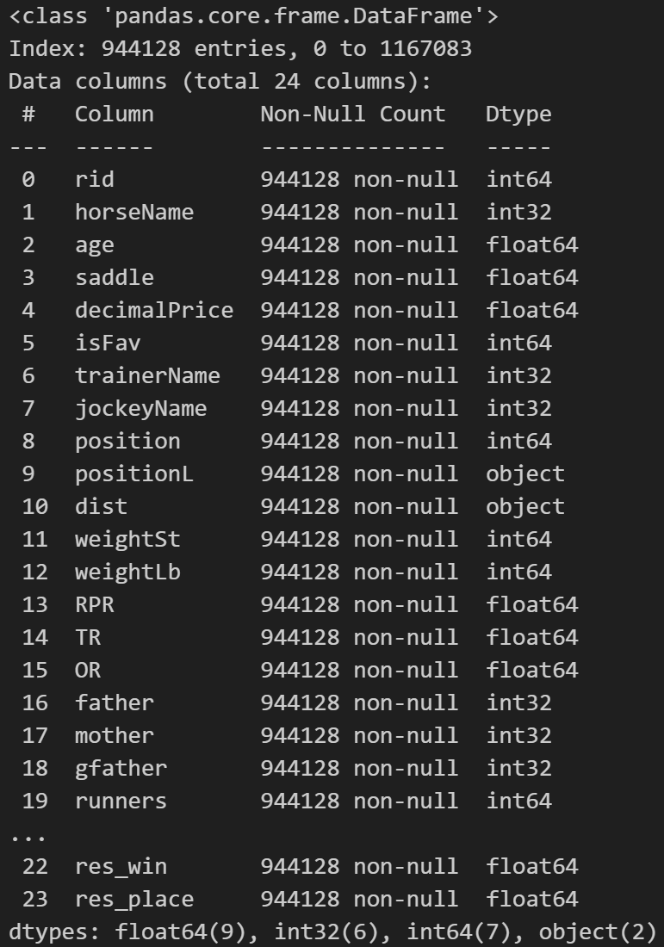
Horse data Before Preprocessing:
Horse data After Preprocessing:

Slide 7
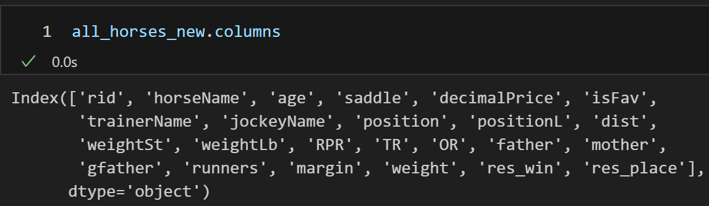
Step in preprocessing on Horse Data
Remove Column which as more null value and duplicate entry.
Explore available data to extract any feature.
Remove null value and reset the index
Using Sklearn preprocessing technique to encoder the data using label encoder.
Drop the unwanted string in columns present in columns of data.

Slide 8
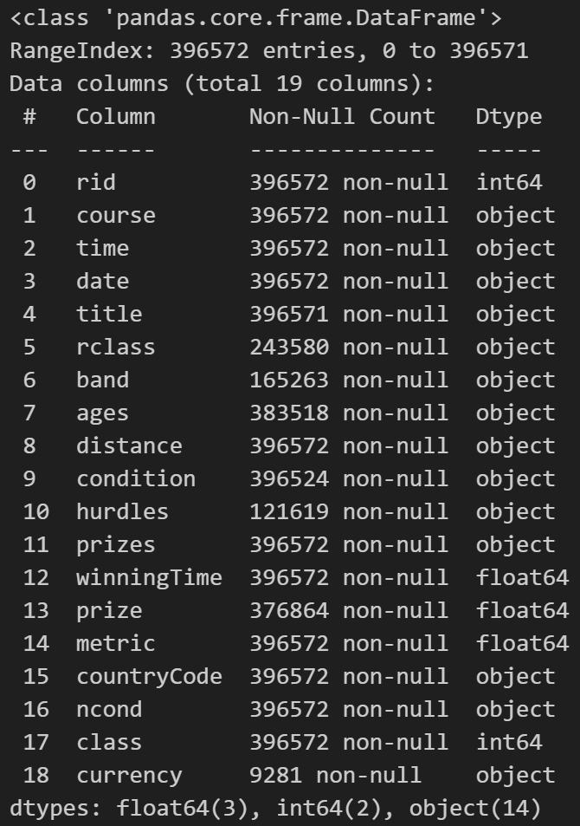
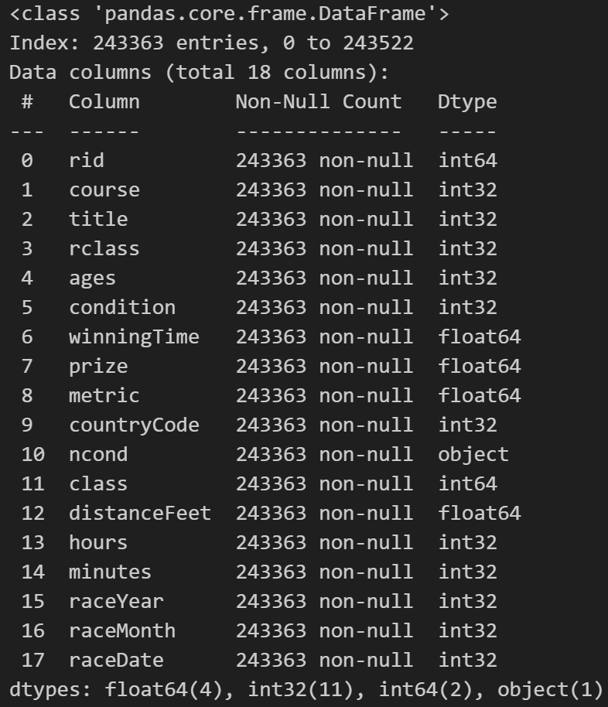
Race data Before Preprocessing:
Race data After Preprocessing:

Slide 9
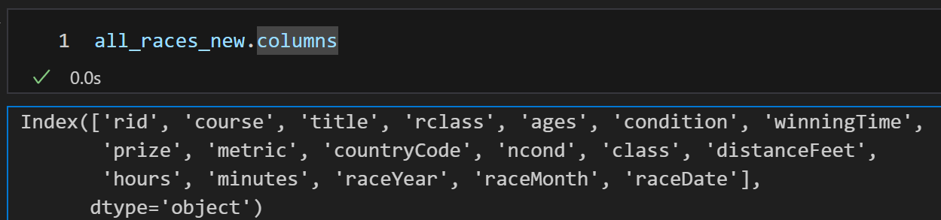
Step in preprocessing on Race Data
Remove Column which as more null value and duplicate entry.
Explore available data to extract any feature.
Extract distance metrics convert into feet.
Extract time convert into minutes and hours.
Extract date convert into year, month and date.
After drop unwanted columns.
Remove null value and reset the index
Using Sklearn preprocessing technique to encoder the data using label encoder.
Drop the unwanted string in columns present in columns of data.

Slide 10
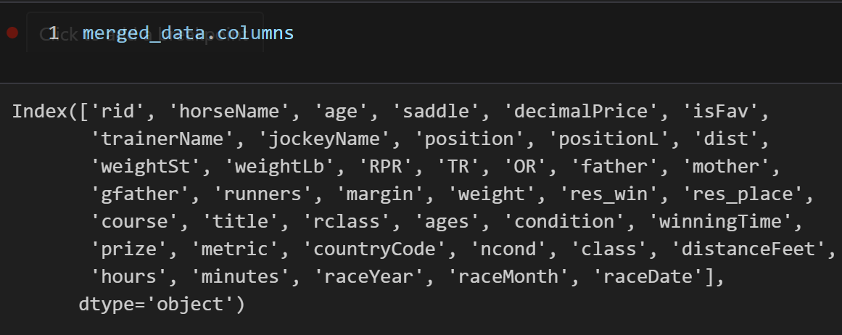
Merging the data:
After the converting we are merge both(horse and race) data based on common id.
Export into document as .csv.

Slide 11
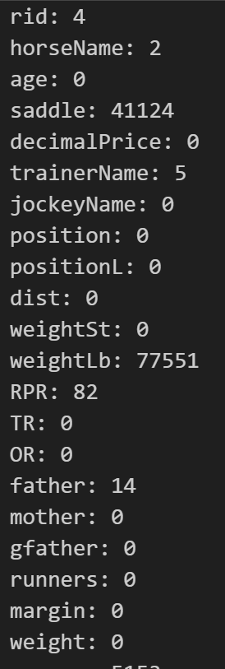
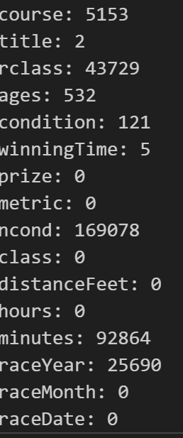
Remove value less than equal zero

Slide 12
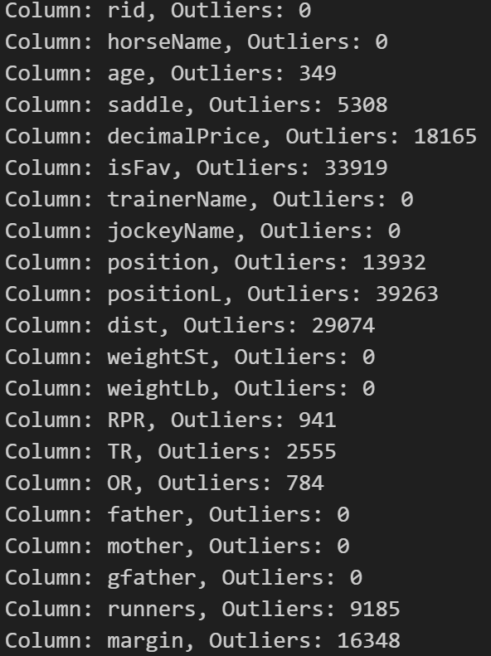
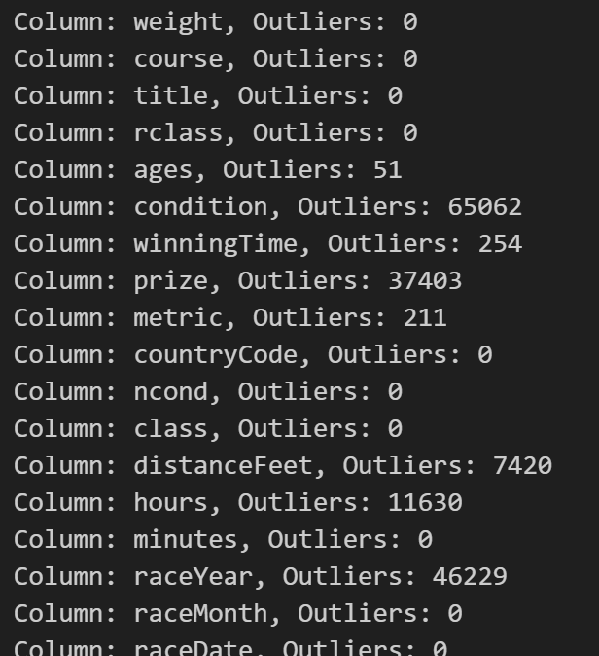
Remove Outliers:

Slide 13
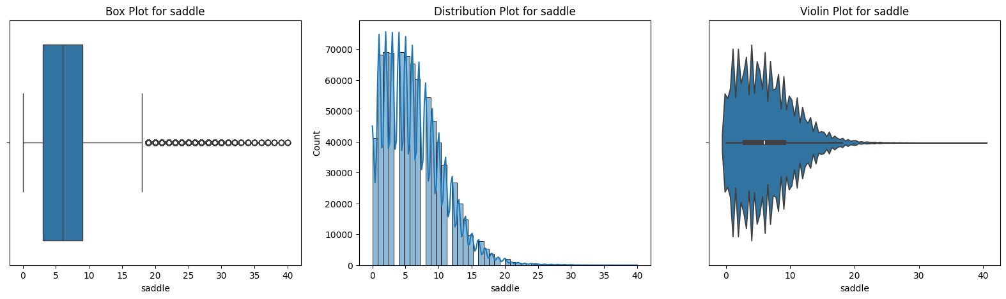
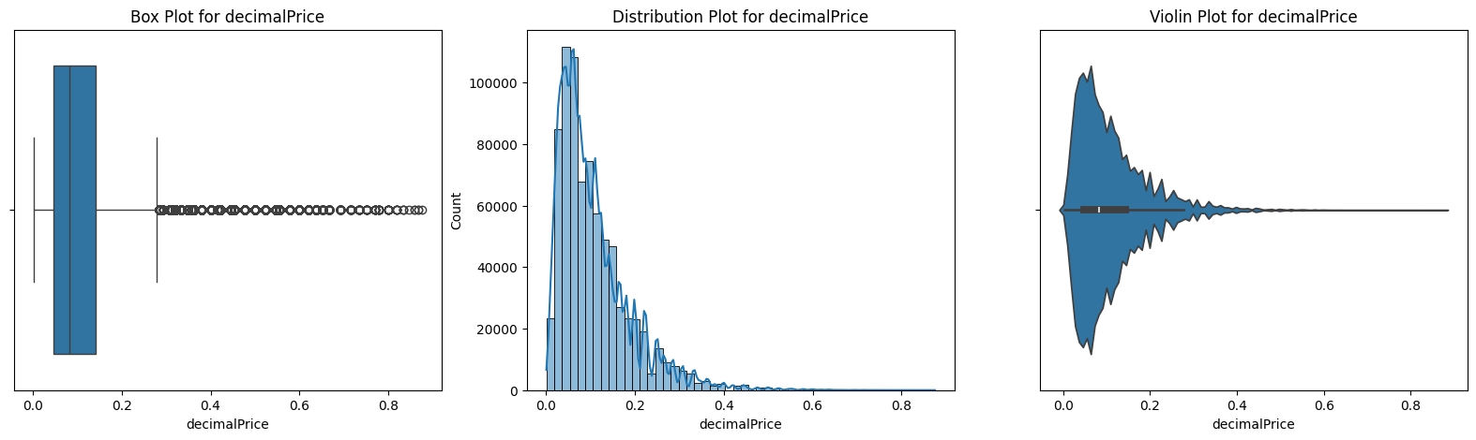
Before Remove Outlier and Null Value:

Slide 14
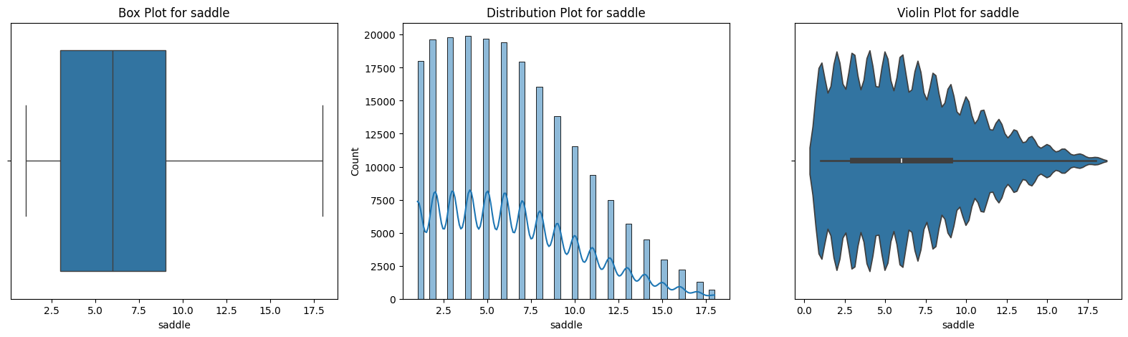
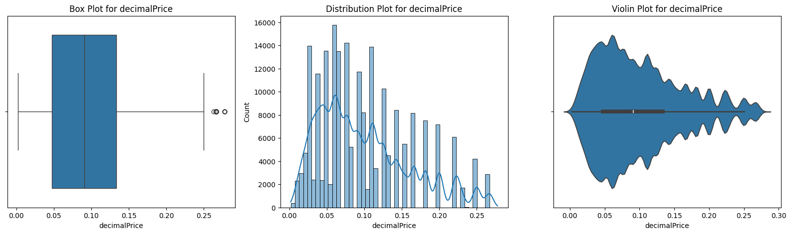
After Remove Outlier and Null Value:

Slide 15
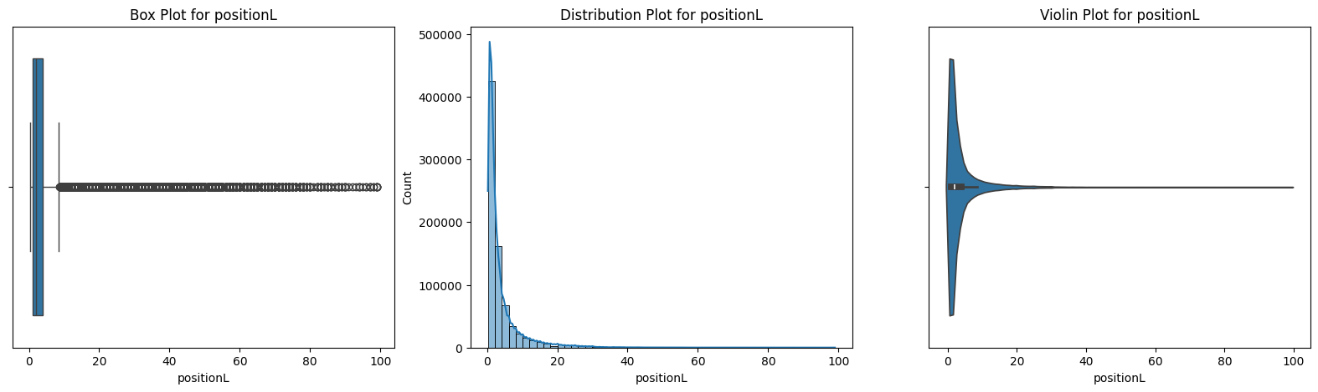
Before Remove Outlier and Null Value:

Slide 16
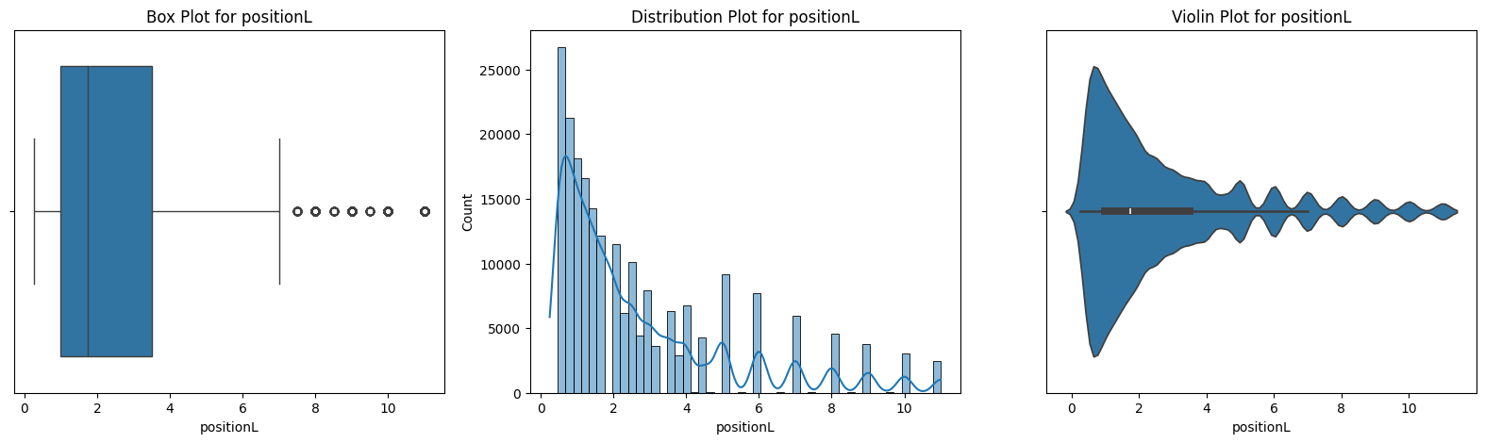
After Remove Outlier and Null Value:

Slide 17
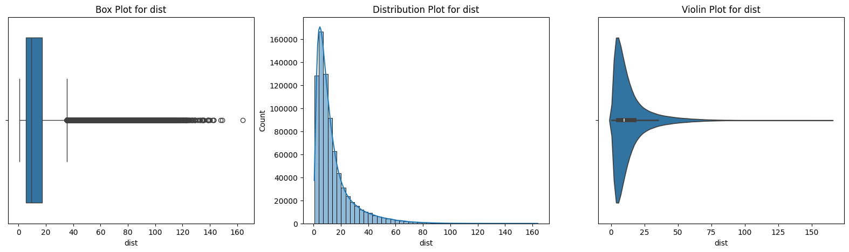
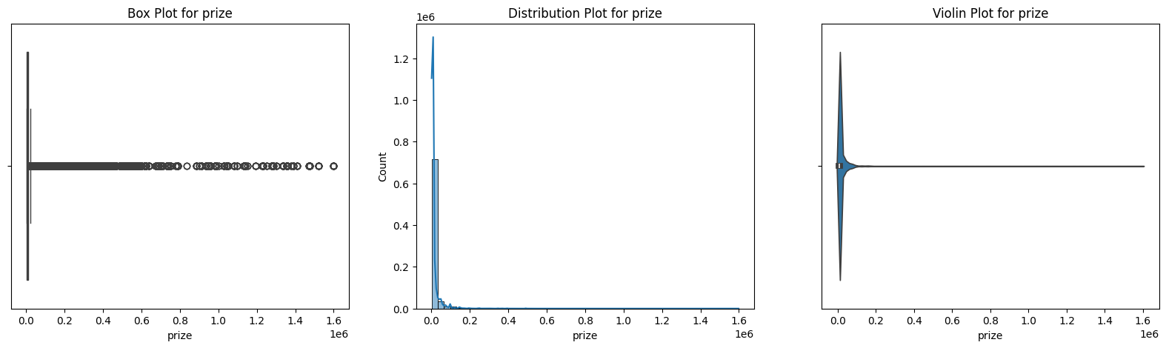
Before Remove Outlier and Null Value:

Slide 18
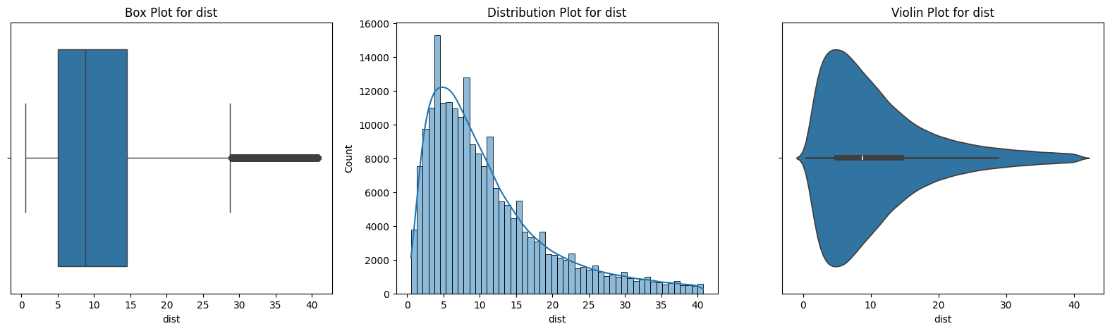
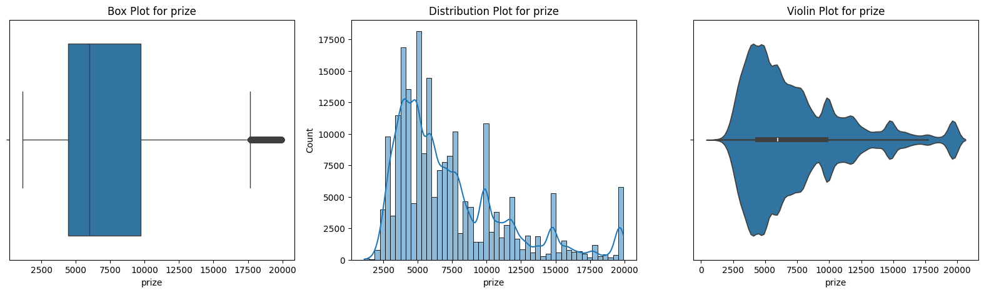
After Remove Outlier and Null Value:

Slide 19
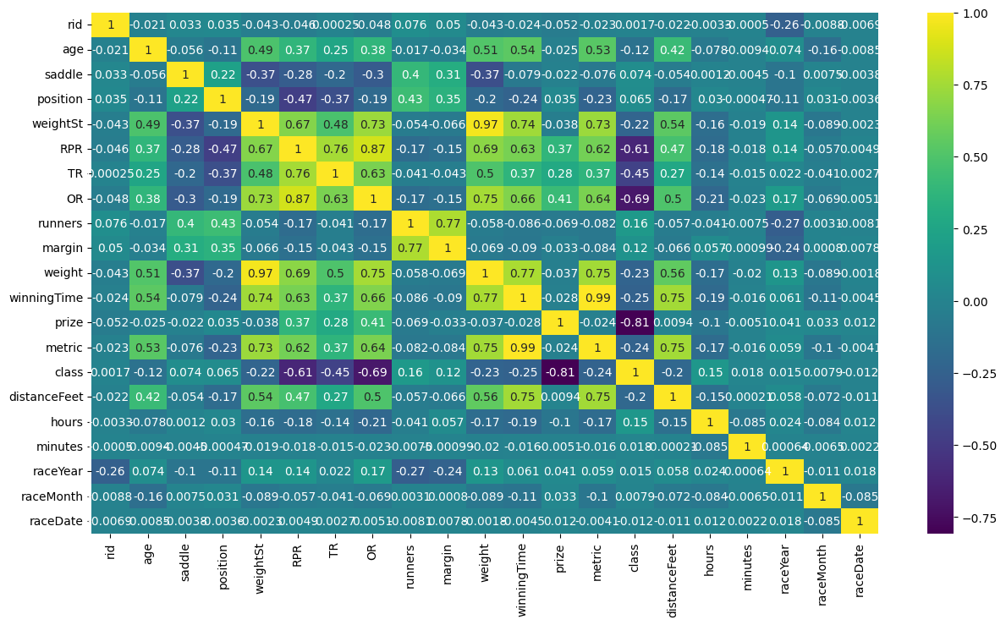
Correlation:

Slide 20
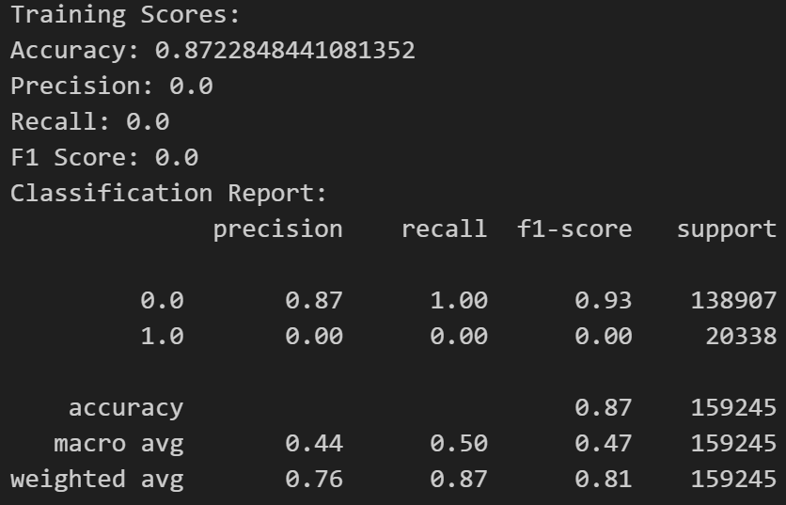
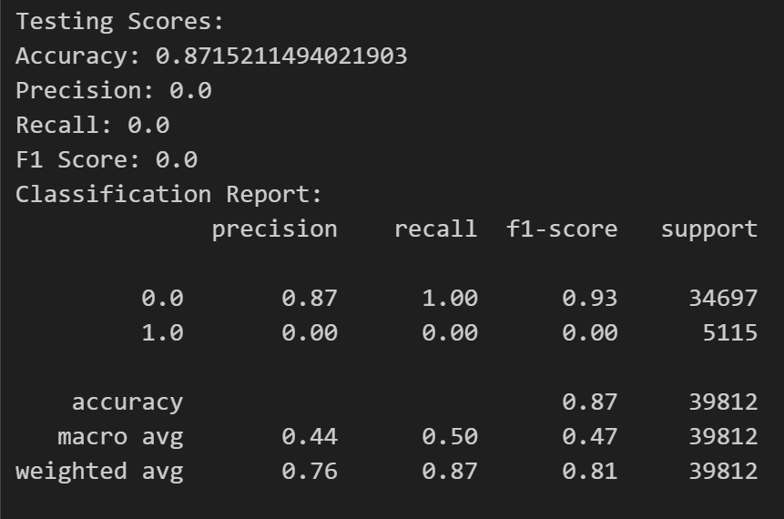
Normal Approach:
Evaluation Metrics of Logistic Regression:

Slide 21
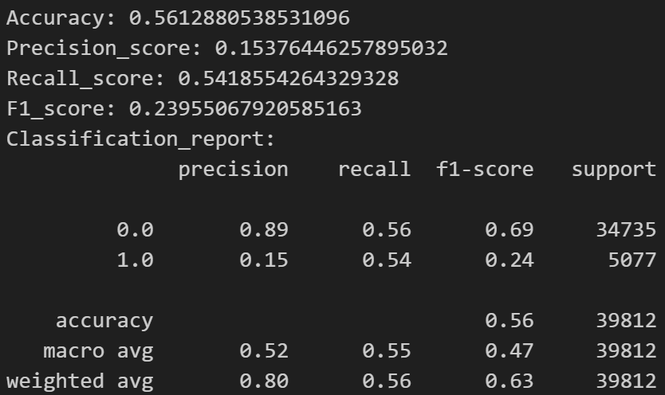
Cross Validation Approach for Accuracy:
Handling Imbalance Data using SMOTE:

Slide 22
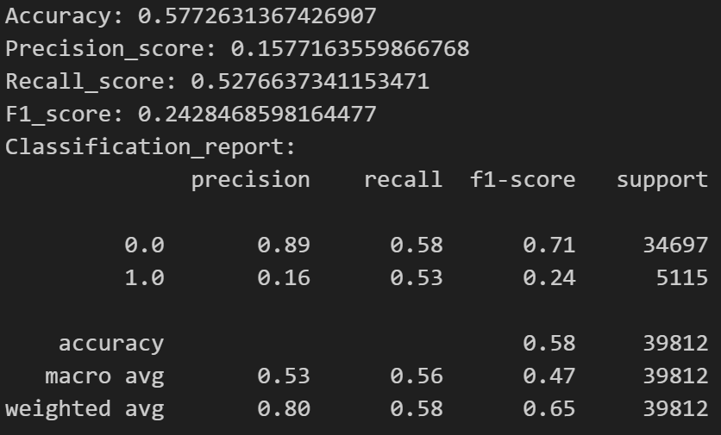
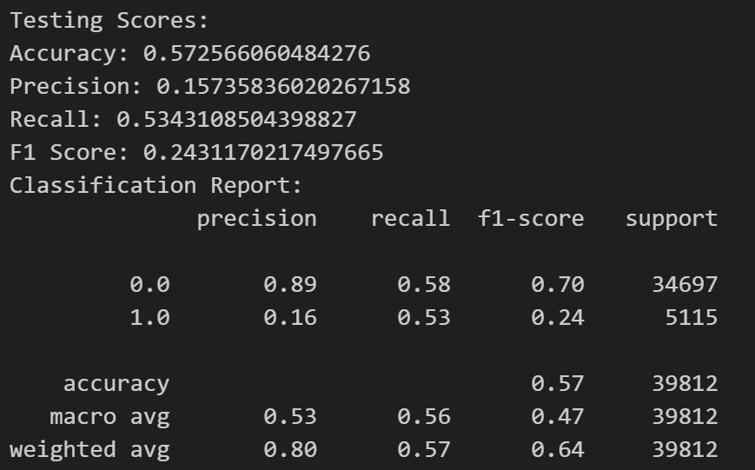
Handling Imbalance Data using Balanced:
Handling Imbalance Data using Under sampling:

Slide 23
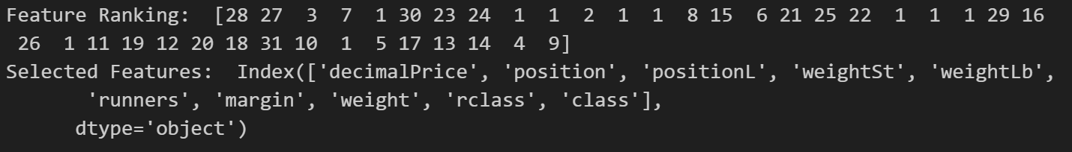
Recursive Features Elimination (RFE):

Slide 24
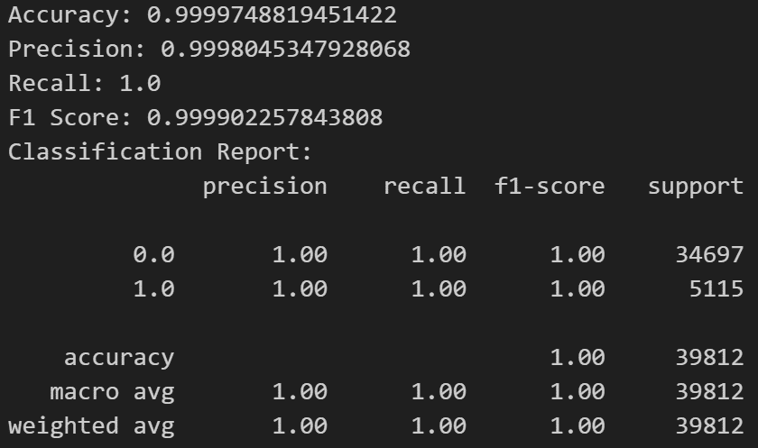
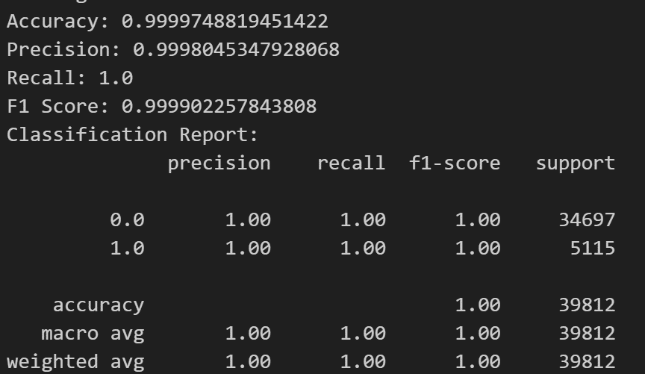
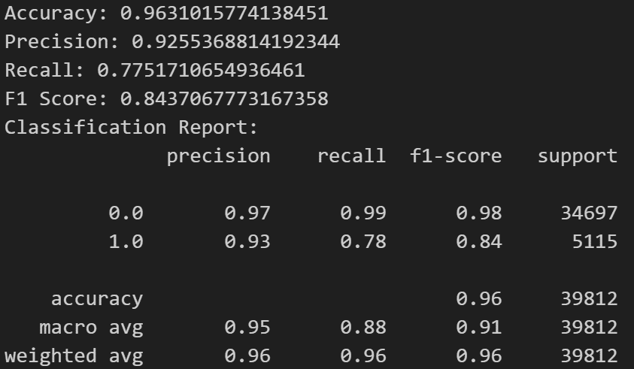
Regularization techniques to reduce model complexity and prevent overfitting:
L2 Regularization:
L1 Regularization:
Elastic Net Reg:

Slide 25
Grid Search:
Hyperparameter Tuning:
Random Search:

Slide 26
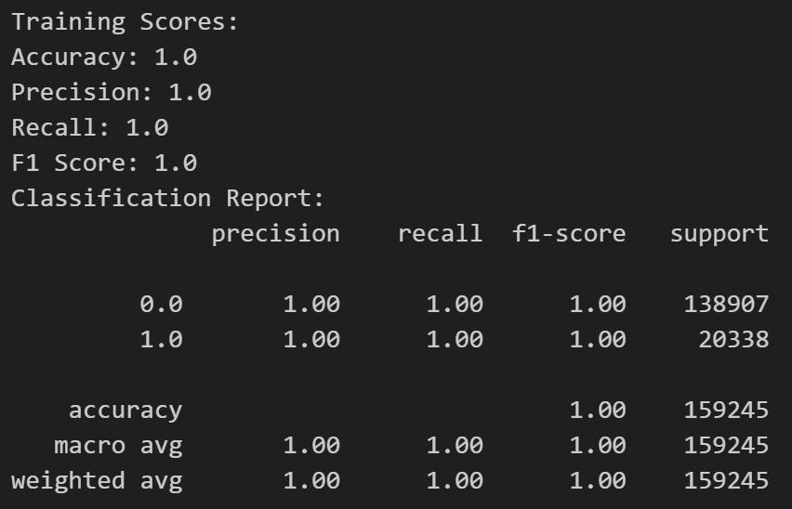
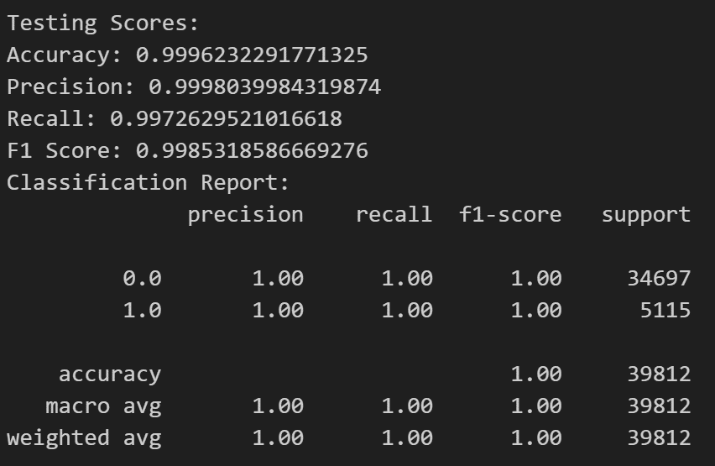
Normal Approach:
Evaluation Metrics of Random Forest:

Slide 27
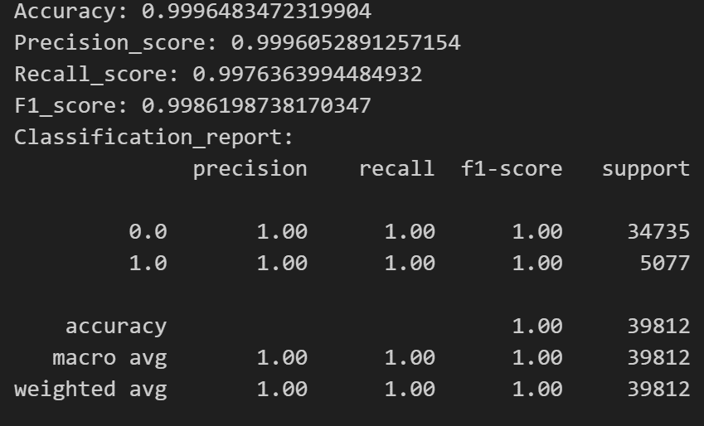
Cross Validation Approach for Accuracy:
Handling Imbalance Data using SMOTE:

Slide 28
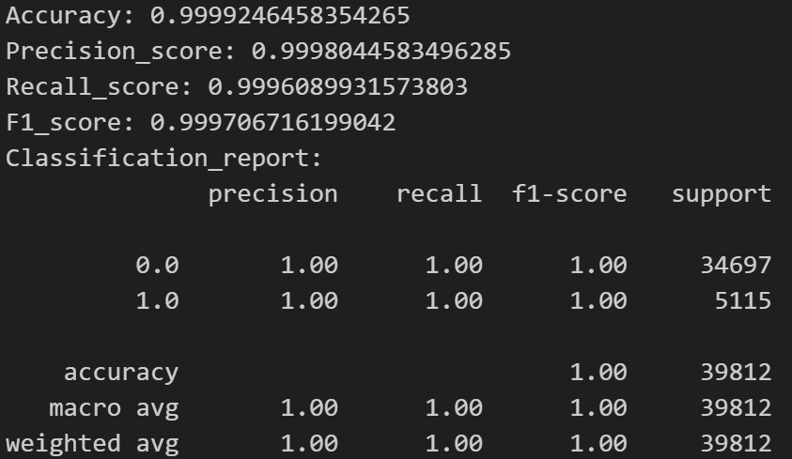
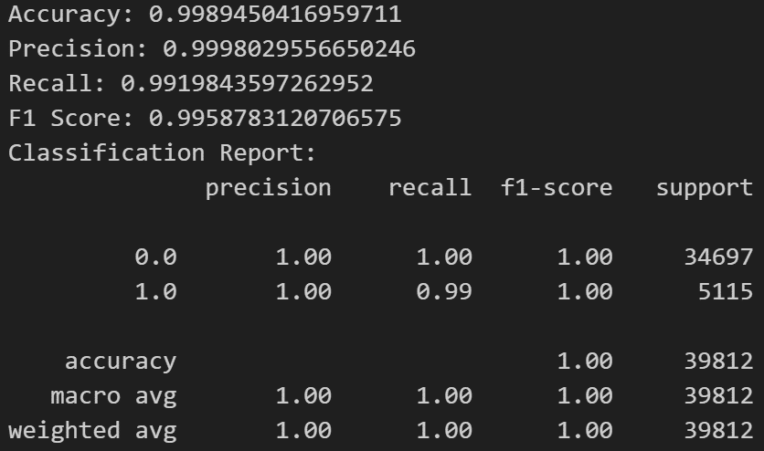
Handling Imbalance Data using Balanced:
Handling Imbalance Data using Under sampling:

Slide 29
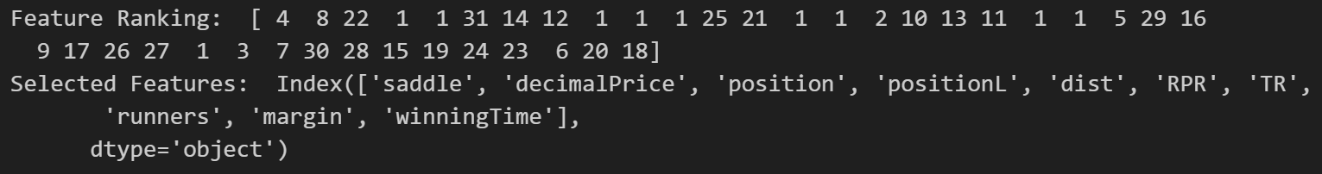
Recursive Features Elimination (RFE):

Slide 30
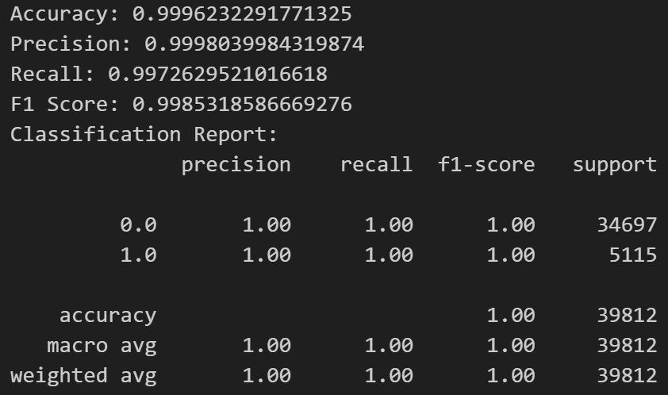
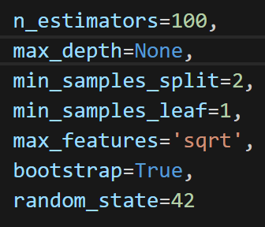
Regularization techniques to reduce model complexity and prevent overfitting:

Slide 31
Grid Search:
Hyperparameter Tuning:
Random Search:

Slide 32
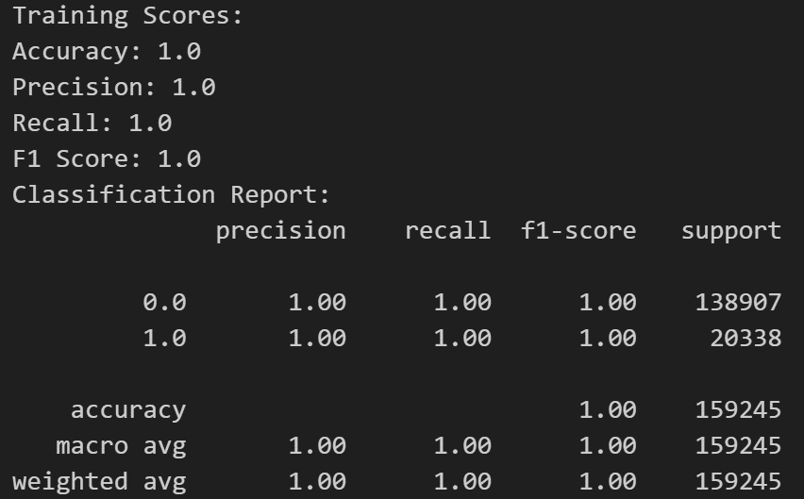
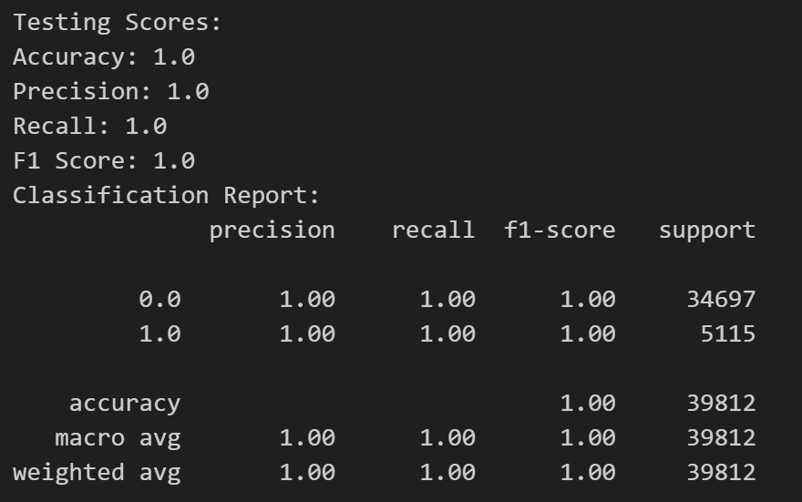
Normal Approach:
Evaluation Metrics of Gradient Boosting:

Slide 33
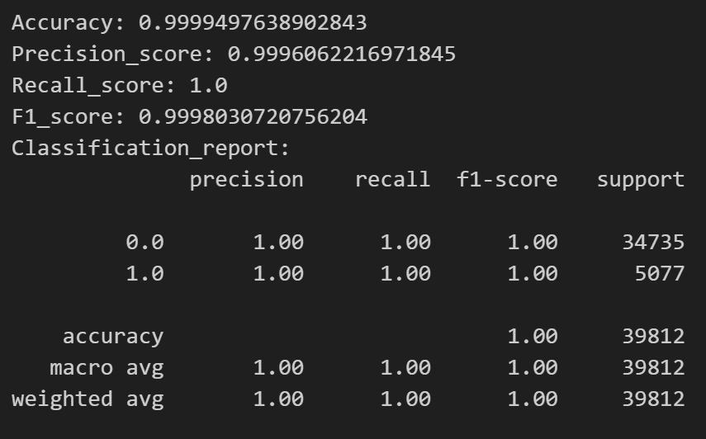
Cross Validation Approach for Accuracy:
Handling Imbalance Data using SMOTE:s

Slide 34
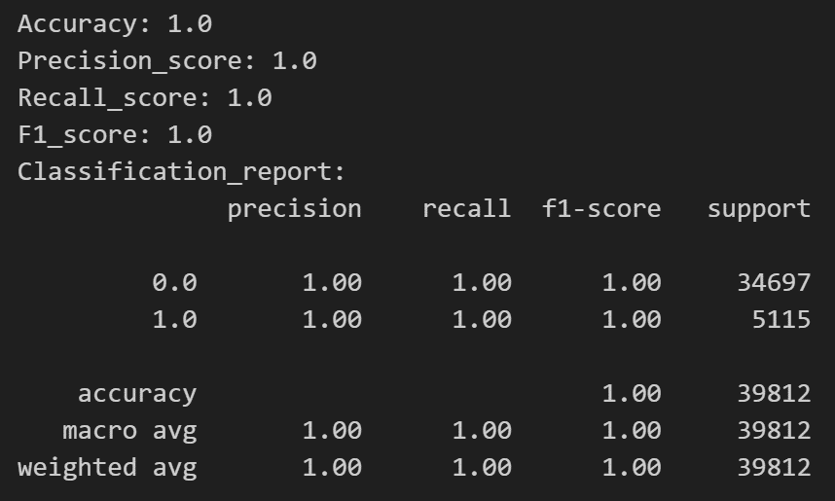
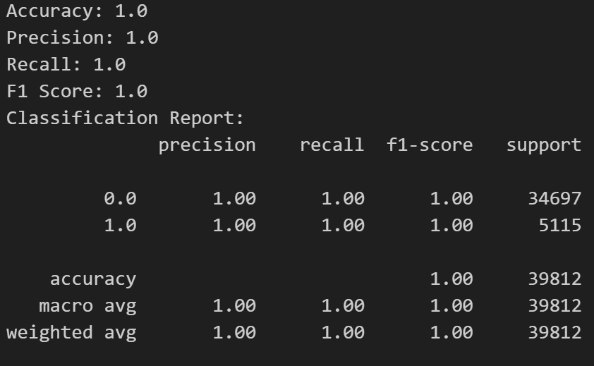
Handling Imbalance Data using Balanced:
Handling Imbalance Data using Under sampling:

Slide 35
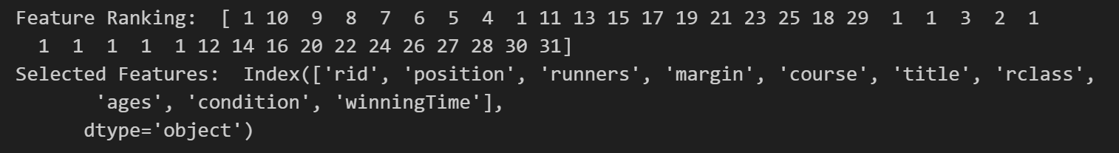
Recursive Features Elimination (RFE):

Slide 36
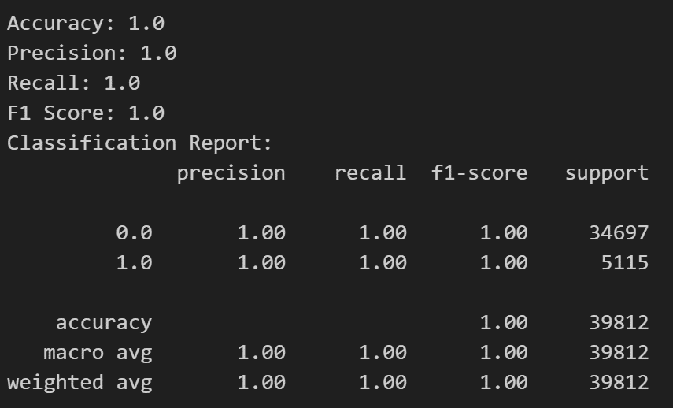
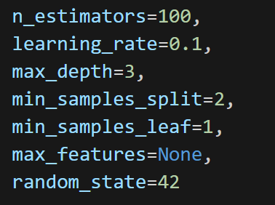
Regularization techniques to reduce model complexity and prevent overfitting:

Slide 37
Grid Search:
Hyperparameter Tuning:
Random Search:

Slide 38
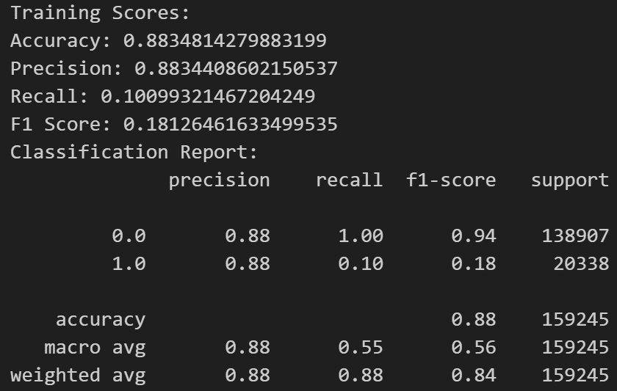
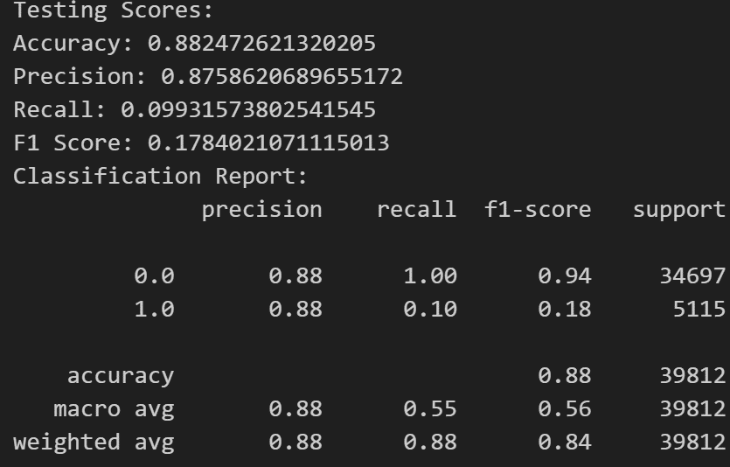
Normal Approach:
Evaluation Metrics of MLP:

Slide 39
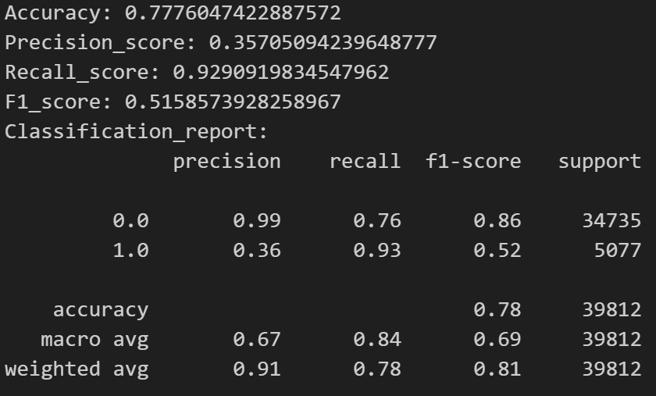
Cross Validation Approach for Accuracy:
Handling Imbalance Data using SMOTE:

Slide 40

Handling Imbalance Data using Balanced:
Handling Imbalance Data using Under sampling:
You're right; MLPClassifier does not directly accept the sample weight parameter in the fit method. Instead, we need to handle class imbalance differently for MLPClassifier. One common approach is to manually balance the dataset during training. This can be done using the resample function from sklearn.utils.

Slide 41
Recursive Features Elimination (RFE):

Slide 42


Regularization techniques to reduce model complexity and prevent overfitting:

Slide 43
Grid Search:
Hyperparameter Tuning:
Random Search:

