Slide 1
Toxic Tweets DATASET: NLp ProbLEM
Presented By: Ramkumar.K

Slide 2
Introduction:
Online platforms struggle with toxic behavior in tweets, ranging from offensive language to harassment.
This project aims to utilize Natural Language Processing (NLP) and machine learning techniques to classify tweets as toxic or non-toxic.
The goal is to develop models capable of identifying and flagging toxic content, thereby fostering safer and more inclusive online interactions.

Slide 3
Essential Libraries:
Pandas: Facilitates data manipulation and CSV file handling, pivotal for loading and preprocessing the toxic tweets dataset.
Matplotlib and Seaborn: Enable data visualization, crucial for depicting distribution of toxic vs. non-toxic tweets, ROC curves, and confusion matrices, aiding in result interpretation.
NLTK (Natural Language Toolkit): Provides tools for text preprocessing such as tokenization, stopwords removal, and stemming, enhancing the quality of input data for model training.
Scikit-learn: Offers a comprehensive suite of machine learning algorithms for model building and evaluation, including Decision Trees, Random Forest, Naive Bayes, K-NN Classifier, and SVM.

Slide 4
Data overview:
The dataset consists of tweets labeled as toxic (1) or non-toxic (0).
It provides information about the number of samples, features, and classes, aiding in understanding the dataset's structure.
Analysis of the distribution of toxic vs. non-toxic tweets offers insights into the dataset's balance and its implications for model training.

Slide 5
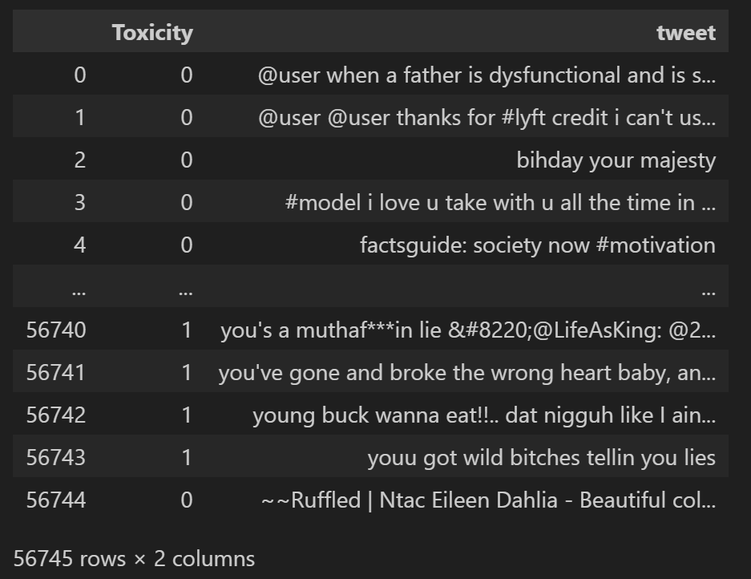
Dataset:

Slide 6
Preprocessing:
Conversion of CSV file to pandas DataFrame for data manipulation.
Text preprocessing involves steps like lowercasing, tokenization, and removal of stopwords to prepare the text data for analysis.
These preprocessing steps ensure that the input data is clean and ready for feature extraction and model training.

Slide 7
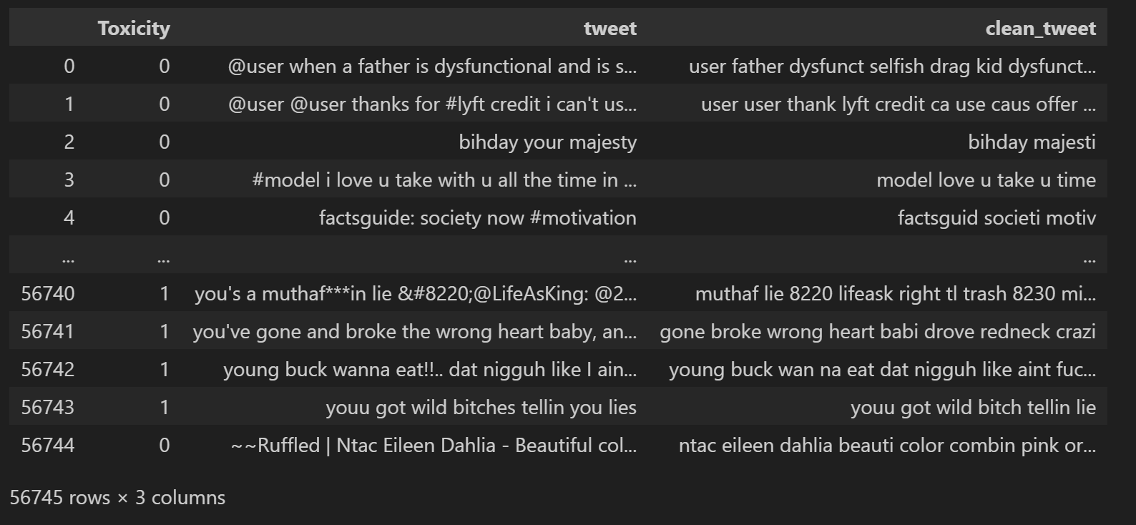
Cleaning words:

Slide 8
Feature Engineering:
Feature engineering involves converting raw text data into numerical representations that machine learning algorithms can understand.
Two common techniques used are:
Bag of Words (BoW): Represents text data as a matrix of word frequencies.
TF-IDF (Term Frequency-Inverse Document Frequency): Weighs the importance of words based on their frequency in the document and across the dataset.
These techniques transform the text data into meaningful features that can be used for model training.

Slide 9
Model Building
Decision Trees, Random Forest, Naive Bayes, K-NN Classifier, and SVM:
Overview of each model.
Explanation of their suitability for text classification tasks.
Training process and hyperparameter tuning.
Evaluation metrics used to assess model performance.
Model Training and Evaluation:
Splitting the dataset into training and testing sets.
Training the models on the training set.
Evaluating model performance on the testing set using various metrics like accuracy, precision, recall, and F1-score.
Visualization of model performance through ROC-AUC curves and confusion matrices.

Slide 10
Performance Evaluation:
Metrics: Precision, Recall, F1-Score
Precision: Proportion of correctly predicted toxic tweets among all tweets predicted as toxic.
Recall: Proportion of correctly predicted toxic tweets among all actual toxic tweets.
F1-Score: Harmonic mean of precision and recall, providing a balanced measure of model performance.
Confusion Matrix
Visualization of model predictions vs. actual labels, facilitating analysis of true positives, true negatives, false positives, and false negatives.
ROC-AUC Curve
Graphical representation of the trade-off between true positive rate (sensitivity) and false positive rate (1-specificity), assessing model performance across different classification thresholds.

Slide 11
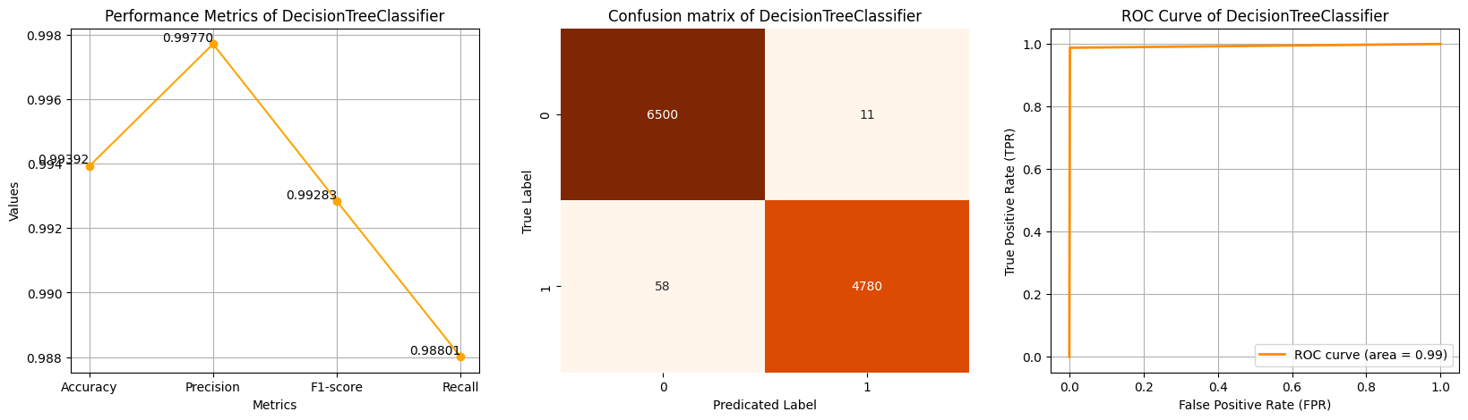
Model Performance of BAG:

Slide 12
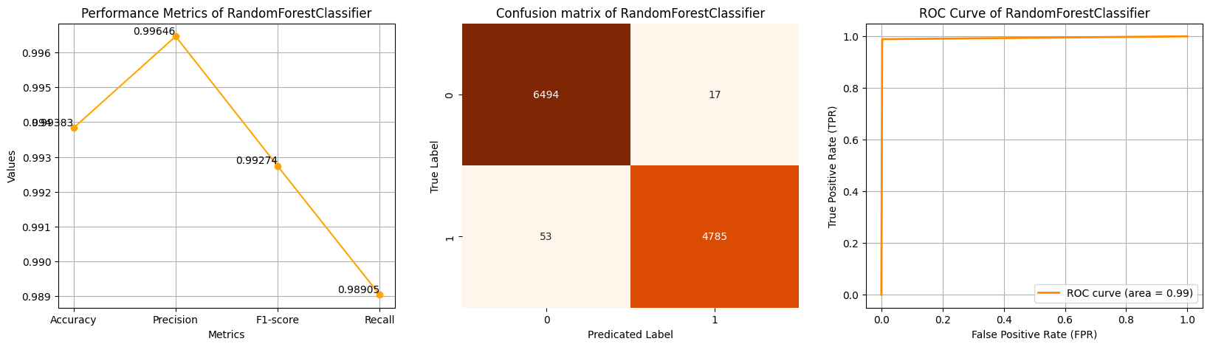
Model Performance of BAG:

Slide 13
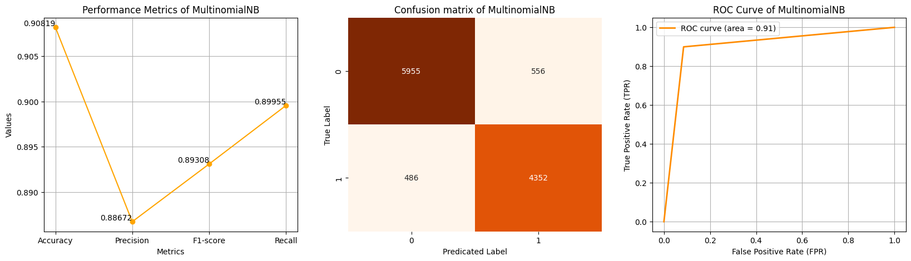
Model Performance of BAG:

Slide 14
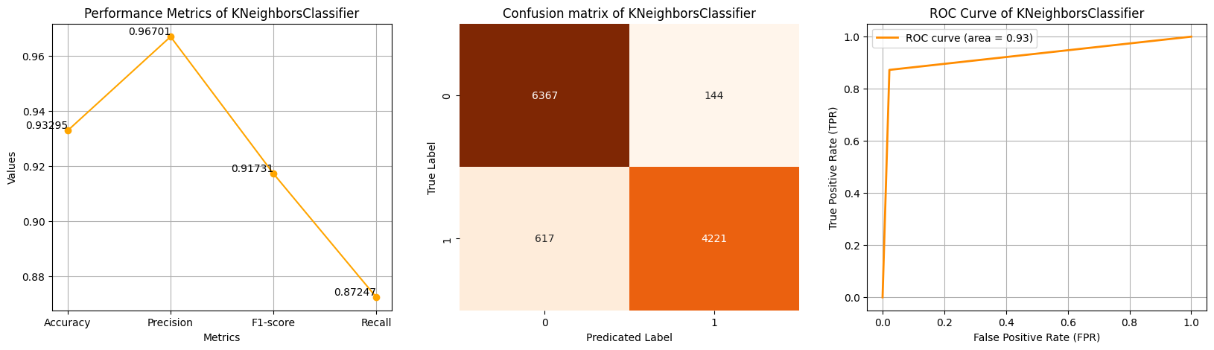
Model Performance of BAG:

Slide 15
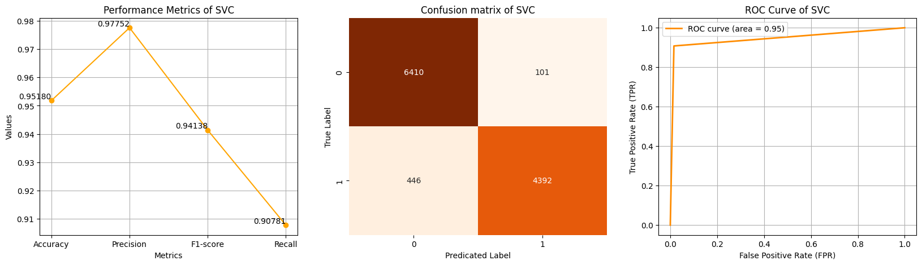
Model Performance of BAG:

Slide 16
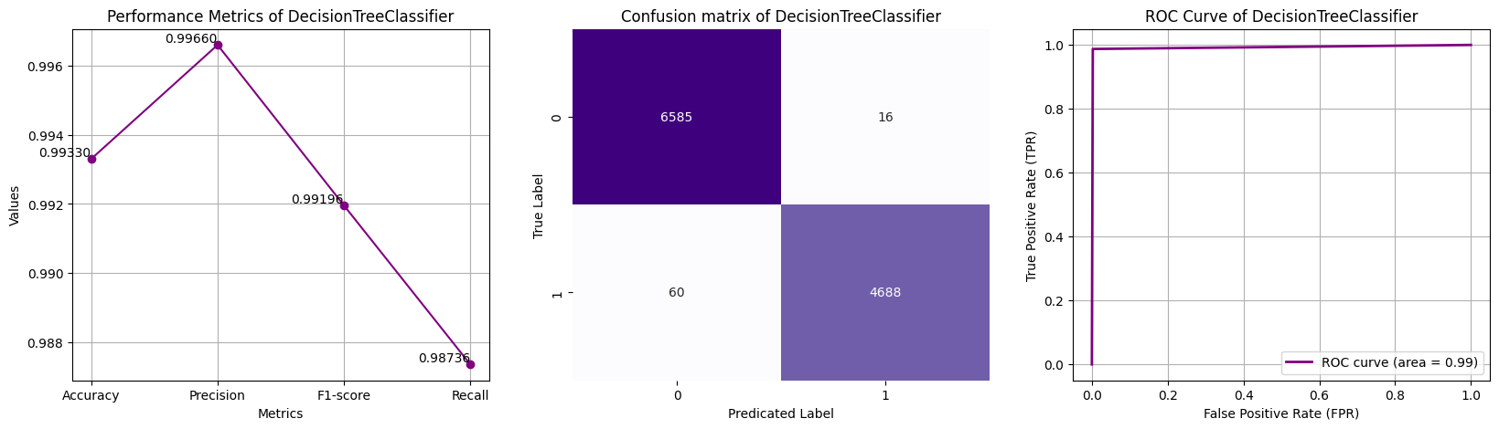
Model performance of TF-IDF:

Slide 17

Model performance of TF-IDF:

Slide 18
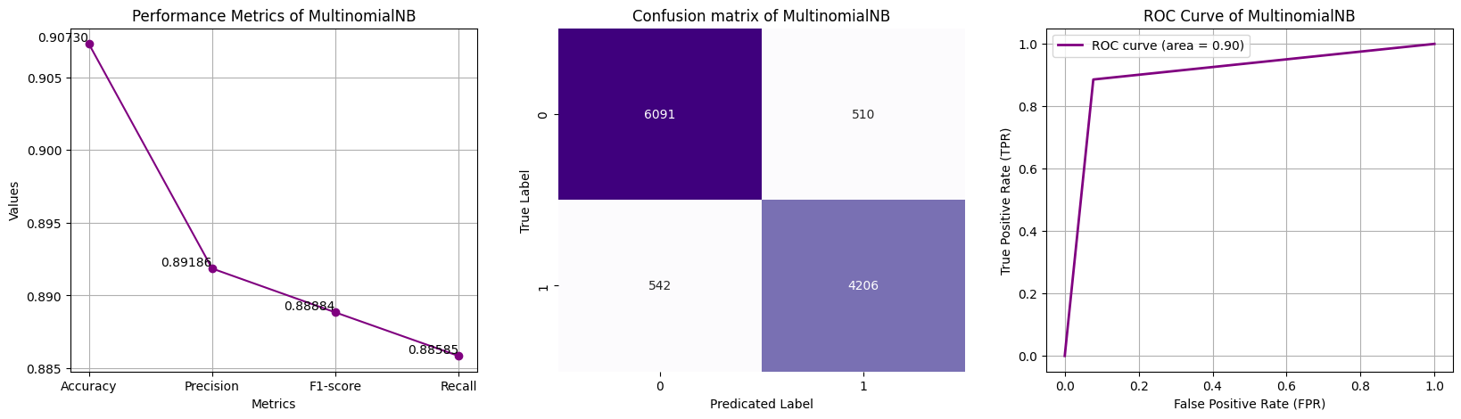
Model performance of TF-IDF:

Slide 19
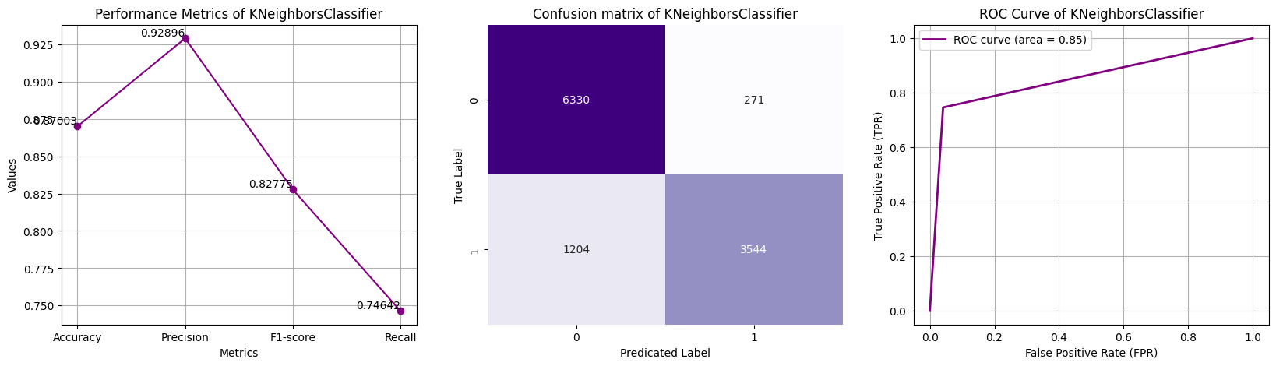
Model performance of TF-IDF:

Slide 20
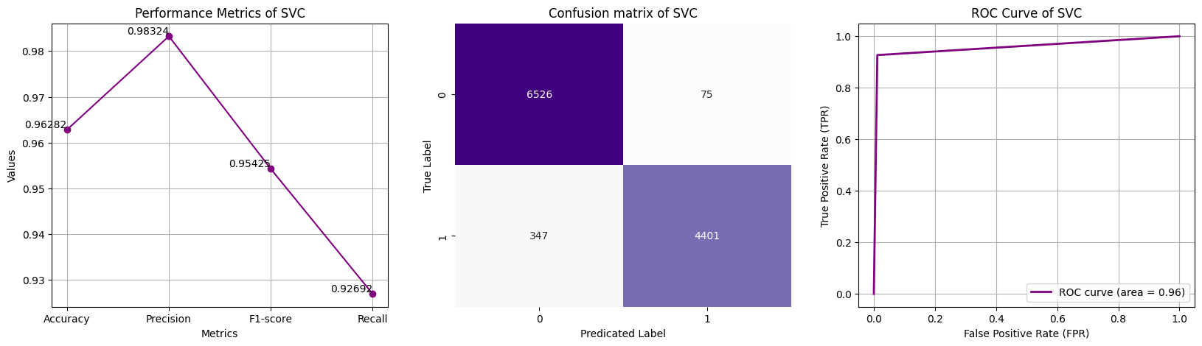
Model performance of TF-IDF:

Slide 21
Conclusion:
Summary of Findings: Recap key findings from the project, including the performance of different models and their effectiveness in classifying toxic tweets.
Future Directions: Suggest potential avenues for further improvement, such as fine-tuning model parameters, exploring advanced NLP techniques, or incorporating additional features for better classification.
Closing Remarks: Emphasize the significance of the project in addressing online toxicity and fostering safer online interactions. Highlight the importance of continued efforts in leveraging technology for social good and creating inclusive digital spaces.

