Slide 1
CHAPTER-9

Slide 2
Reduced Instruction Set Computing (RISC)
An important aspect of computer architecture is the design of instruction set for the processor.
The instruction set chosen for a particular computer determines the way, the machine language programs are constructed.
Many computers have instruction set that include more than 100 and sometimes even more than 300 instructions.
In 1980s, a number of computer designers recommended that computers use fewer instructions with simple construct so that they can be executed much faster within the CPU.
This type of computer is classified as reduced instruction set computing(RISC).
=> The greater the number of instructions in an instruction set, the larger the propagation delay. => For eg; if the CPU had 32 instruction, a 5 x 32 decoder would have been needed. This decoder would require more time to generate output than the smaller 4 x 16 decoder, which would reduce the maximum clock rate of CPU.

Slide 3
Characteristics of RISC:
Relatively few instructions.
Fixed-length instructions: => instructions of same size; format can be different.
Limited loading and storing instructions Access memory.
Fewer Addressing modes.
Instruction pipelining.
Large number of registers so as to so as to store many operands internally. When the operands are needed, the CPU fetches them from registers, rather than from memory, thereby reducing the access time.
Hardwired control unit rather than microprogram control so as to have a lower propagation delay.

Slide 4
RISC Instruction Set
The instruction set of RISC processor is reduced whereas CISC(Complex Instruction Set Computing) processor might have over 300 instructions in its instruction set, RISC CPU typically have less than 100.
These instructions perform a wide variety of function, each of which is being executed in a single clock cycle.
When developing a RISC instruction set, it is important not to reduce the set too much.
Consider, for example, the instruction set for a processor includes AND, OR, NOT and XOR instruction. Using De-Morgan’s law, an OR can be implemented using only AND and NOT. A OR B = NOT((NOT A) AND (NOT B))

Slide 5
Contd…
Similarly, an XOR can be realized using the same operation A XOR B = NOT ( ( NOT ( A AND ( NOT B ) ) ) AND ( NOT ( ( NOT A) AND B) ) )
Therefore, we can exclude OR and XOR instruction from the instruction set and still allow the CPU to perform the same function.

Slide 6
Instruction pipelining:
A pipeline is like an assembly line in which many products are being worked on simultaneously, each at a different station.
In RISC processors, one instruction is executed while the next is being decoded and its operands are being loaded, while the following instruction is being fetched.
By overlapping these operations, the CPU executes one instruction per clock cycle, even though each instruction requires three cycles to be fetched, decoded and executed.

Slide 7
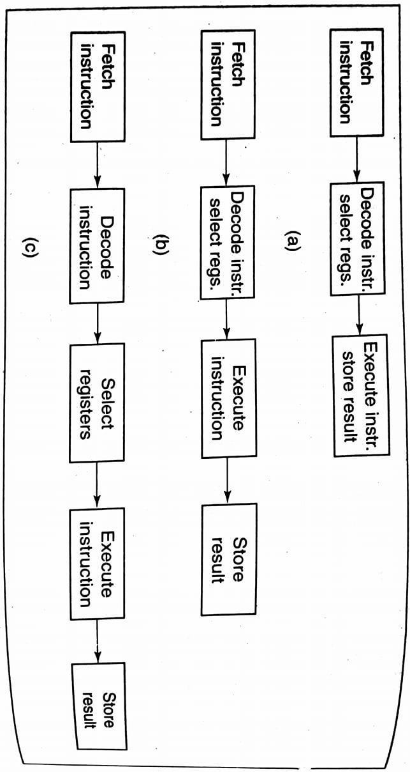
a) Three, b) four, and c) five stage RISC pipelines

Slide 8
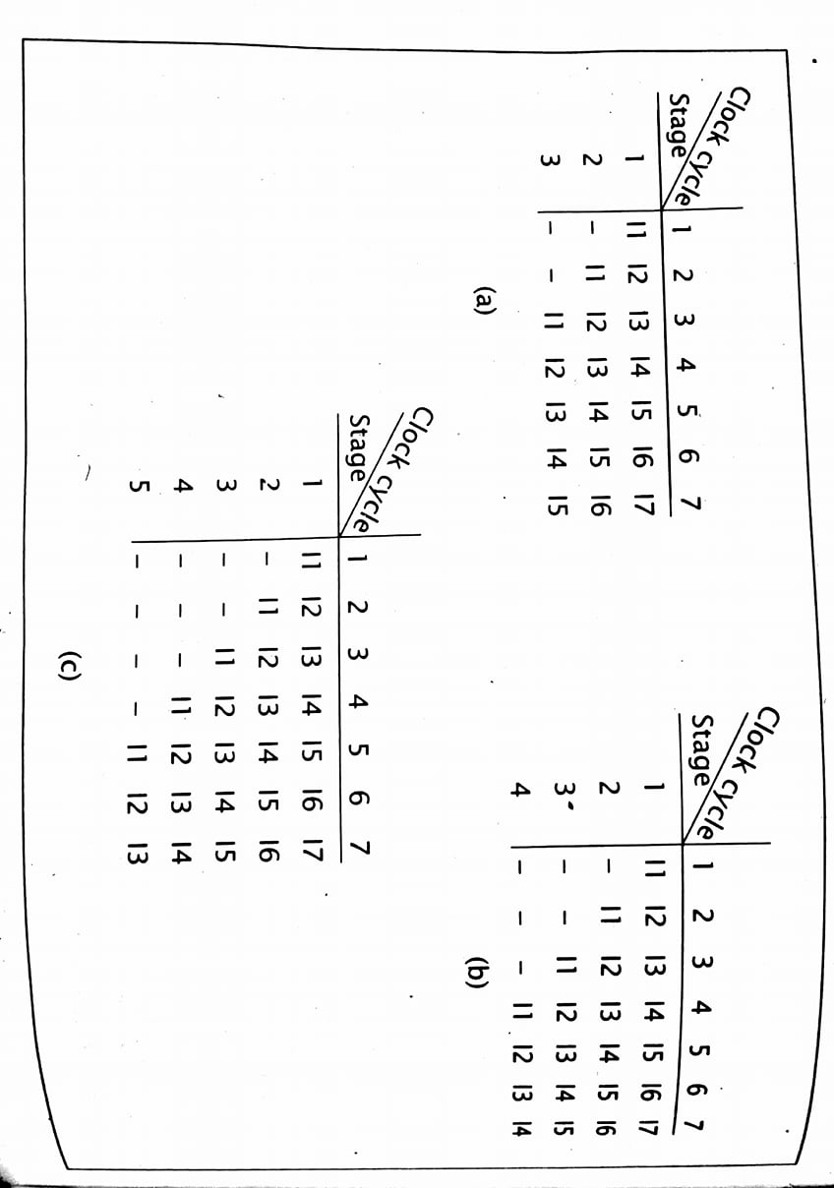
Data flow through a) three, b) four, and c) five stage RISC pipelines.

Slide 9
Register windows and Renaming:
The reduced hardware requirement of RISC processor leave additional space available on the chip for the system designer.
RISC CPU generally use this space to include a large number of registers, sometimes more than 100.
The CPU can access data in register more quickly than data in memory.
Although, a RISC processor has many register, it may not be able to access all of them at any time.
Most RISC CPU has some global register which are always accessible.
The remaining register are windowed such that only a subset of the registers are accessible at any specific time.

Slide 10
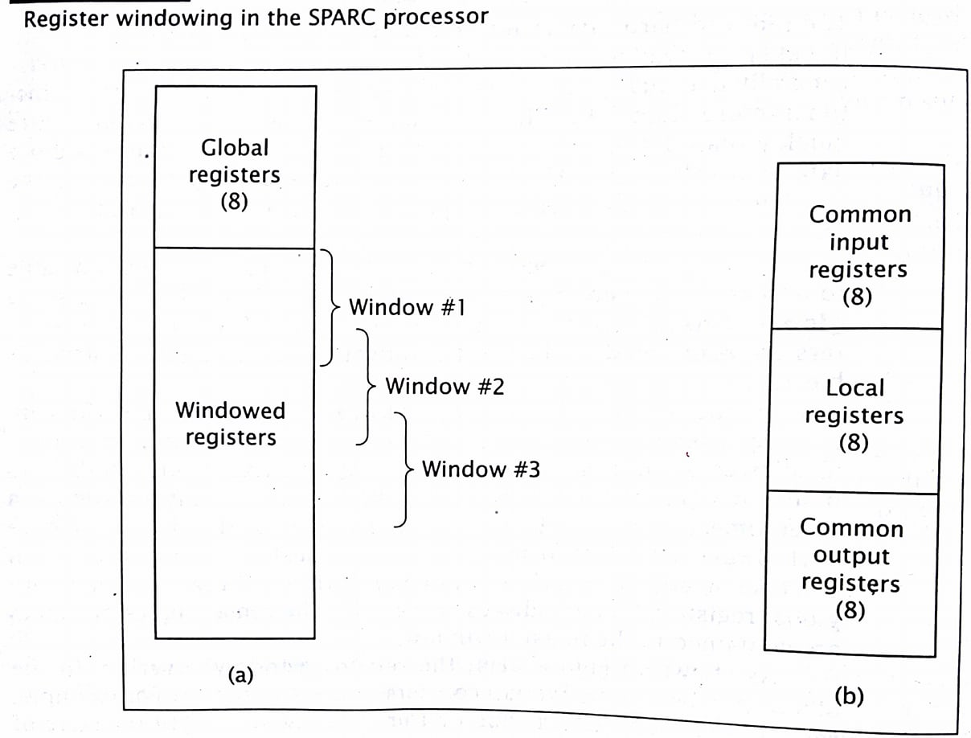
Contd…

Slide 11
Illustration:
Consider a CPU with 48 registers.
The CPU has four windows with 16 registers each, and an overlap of four registers between windows.
Initially, CPU is running a program using its first register window.
It must call a subroutine and pass three parameters to it.
The CPU stores these parameters in three of the four overlapping registers and calls subroutine.
The subroutine can directly access these parameters.
Subroutine calculates a result, stores the value in one of the overlapping registers and returns to main program.
This deactivates the second window; the CPU now works with the first window and can directly access the result.

Slide 12
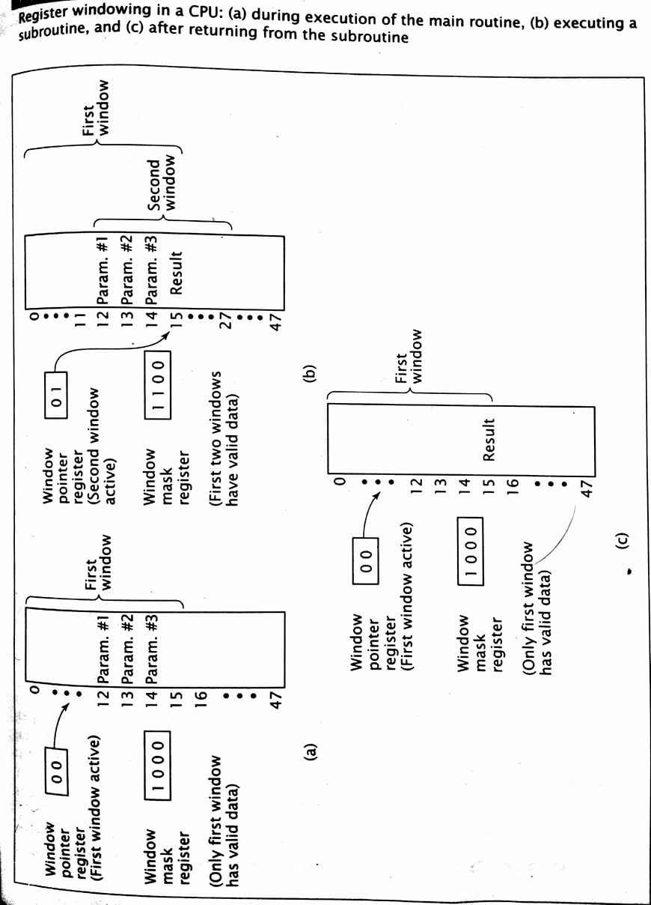
.

Slide 13
Register renaming
More recent processors may use register renaming to add flexibility to the idea of register renaming.
A processor that uses register renaming can select any register to comprise its working register window.
The CPU uses pointers to keep track of which registers are active and which physical register correspond to each logical register.

Slide 14
(Q). Calculate the window size and total number of registers. Given: No. of Global registers = 10, No. of local registers = 10, No. of common registers = 6, No. of windows = 4.
Total number of registers = G + W(L +C) = 10 + 4(10 + 6) = 74
Windows size = L + 2C + G = 10 + 2 x 6 + 10 = 32

Slide 15
Conflicts in Instruction Pipeline:
Data Conflict: Data Conflicts occur when the pipeline causes an incorrect data value to be used.
Branch Conflict: Branch Conflicts occur when a branch statement results in incorrect instructions being executed.

Slide 16
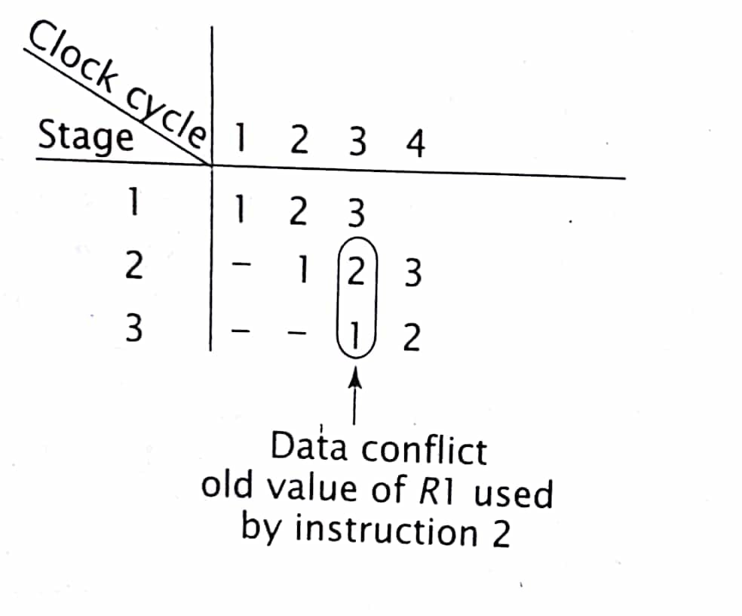
Data Conflicts:
Consider the following consecutive program statements: 1: R1←R2 + R3 2: R4←R1 + R3 3: R5←R6 + R3

Slide 17
Solutions to data conflict problem: No-op insertion
The simplest is to have the compiler detect data conflicts and insert no-ops to avoid the conflict. 1: R1←R2 + R3 N: no-op 2: R4←R1 + R3 3: R5←R6 + R3
The no-op statement in the second block delays the fetching of operands for the second instruction by one clock cycle.
This delay allows the last stage of the pipeline to store the new value of R1 before it is loaded for use in executing the second instruction, thus avoiding data conflict.

Slide 18
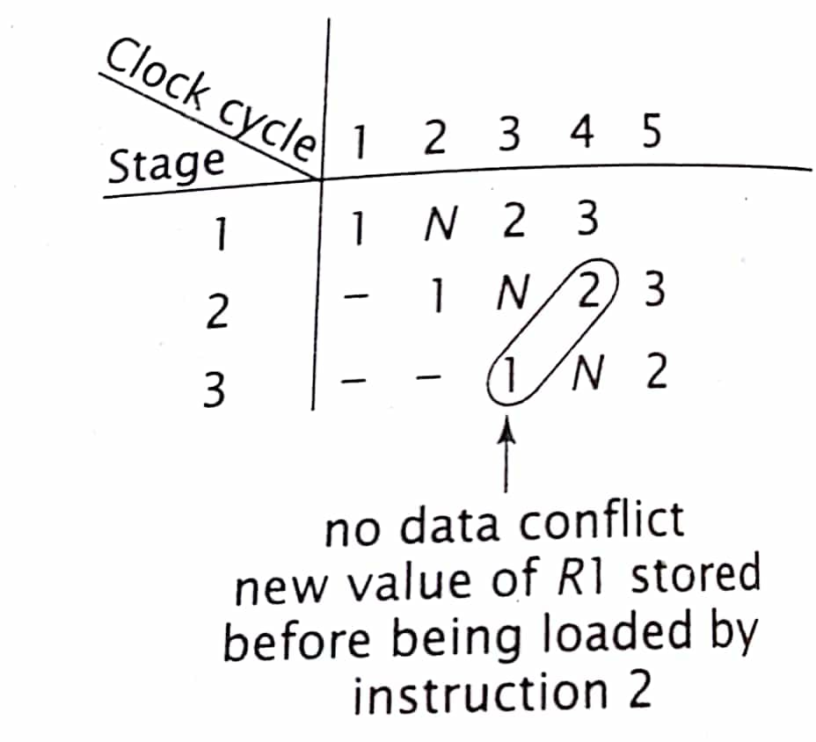
Contd…
It reduces the overall system performance.
The no-op instruction does not perform useful work and require an extra clock cycle.

Slide 19
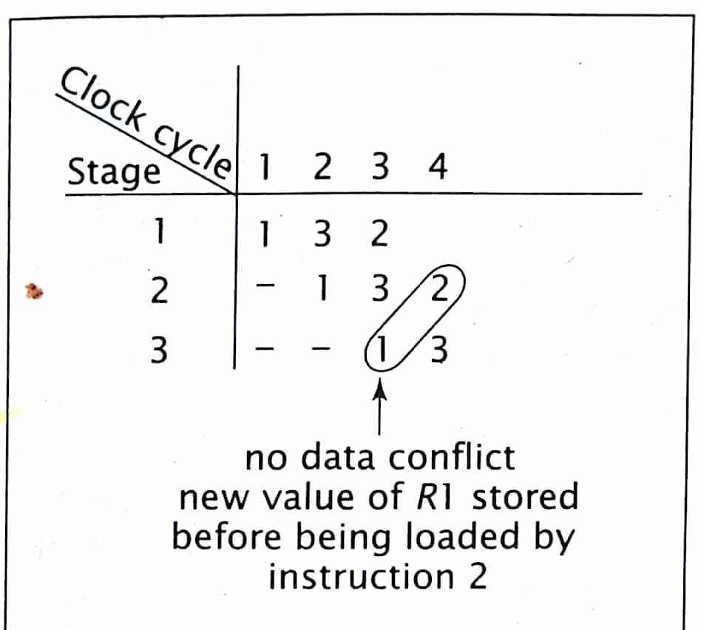
Instruction reordering:
For some programs, the compiler can reorder some of the instructions to remove the data conflict. 1: R1←R2 + R3 3: R5←R6 + R3 2: R4←R1 + R3
Instruction reordering resolves the data conflict by introducing a delay between the conflicting instructions.
Unlike no-op insertion, instruction reordering performs useful work during this time.

Slide 20
Contd…
It is not always possible to reorder the instructions of a program to avoid data conflicts. For example, the following code segment cannot be reordered successfully: 1: R1←R1 + R2 2: R1←R1 + R3 3: R1←R1 + R4
No-op insertion and instruction reordering resolve data conflicts using only the compiler.

Slide 21
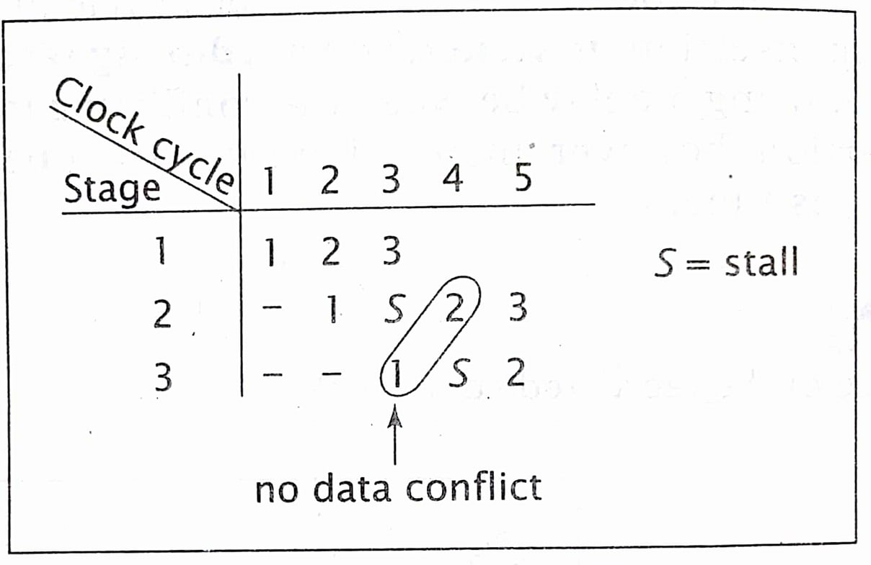
Stall insertion
Use additional hardware in the RISC instruction pipeline.
The additional hardware detects data conflicts between instructions in the pipeline and inserts stalls, or introduces delays, to resolve the data conflicts.
This is similar to no-op insertion, except it is handled by hardware, while the program is executing, rather than by the compiler while the program is being compiled.

Slide 22
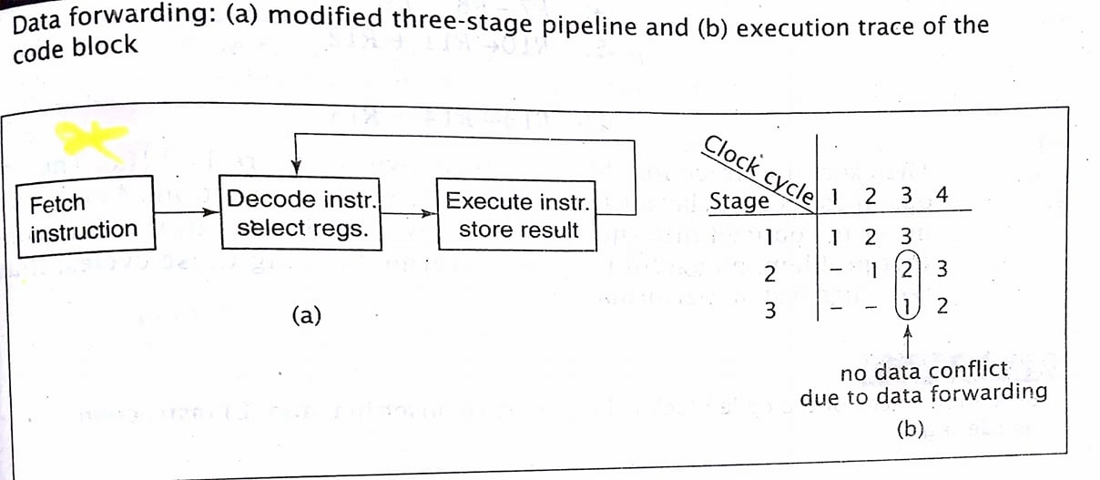
Data forwarding
Hardware solution to the data conflict problem.
After the instruction is executed, its result is stored just as before, but the result is also forwarded directly to the stage that selects registers(retrieves operands).
That stage gets the new value of the operand directly from the execute instruction stage of the pipeline before(or at the same time as) it is stored in the appropriate register.

Slide 23
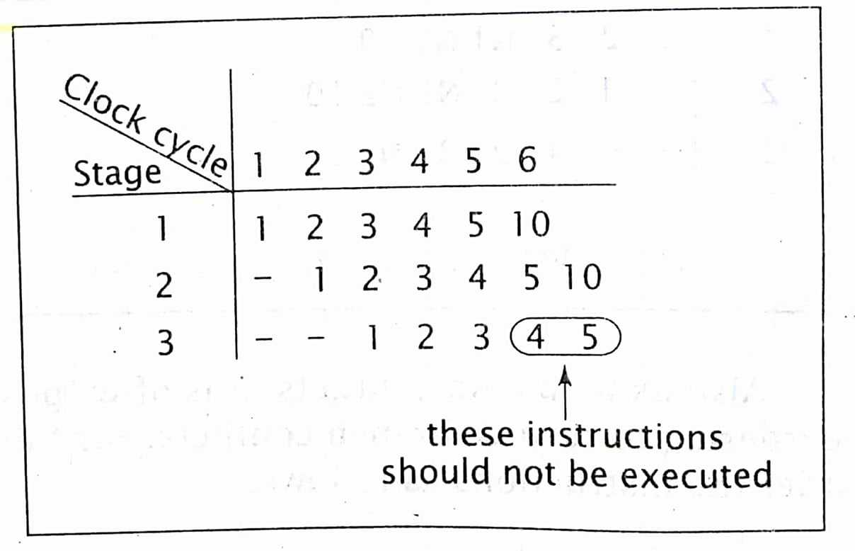
Branch conflicts:
The following code segment illustrates the branch conflict problem: 1: R1←R2 + R3 2: R4←R5 + R6 3: JUMP 10 4: R7←R8 + R9 5: R10←R11 + R12 : 10: R13←R14 + R15
After instruction 3 is executed, the CPU should branch to instruction 10; however, instructions 4 and 5 are already in the pipeline before instruction 3 executed.
Fig: execution trace of the code block illustrating a branch conflict

Slide 24
Solutions to branch conflict (consider the simpler case of unconditional branch instructions)
No-op insertion 1: R1←R2 + R3 2: R4←R5 + R6 3: JUMP 10 N1: no-op N2: no-op 4: R7←R8 + R9 5: R10←R11 + R12 : 10: R13←R14 + R15
The no-ops introduce a delay sufficient to ensure that instructions 4 and 5 are never introduced into the pipeline

Slide 25
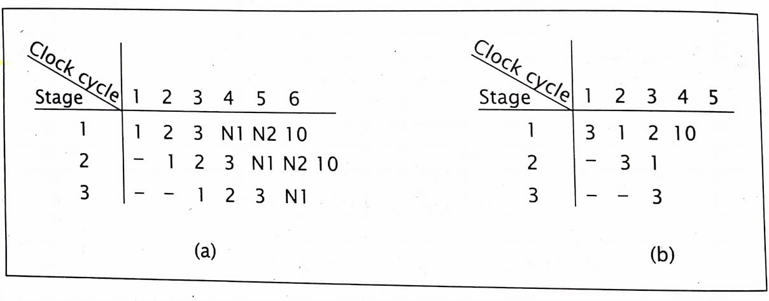
Contd…
Instruction reordering 3: JUMP 10 1: R1←R2 + R3 2: R4←R5 + R6 4: R7←R8 + R9 5: R10←R11 + R12 : 10: R13←R14 + R15
Stall insertion can also be used to handle branch conflicts.
When the pipeline recognized a branch instruction, it’d insert stalls into the pipeline to delay the fetching of next instruction until after the branch instruction had been completed.
Fig: execution traces of the code block using:
no-op insertion
Instruction reordering

Slide 26
Contd… Annulling
In annulling, the instructions proceed through the pipeline as they normally would.
If an instruction should not have been executed, because a previous instruction branched away from it, its result are not stored.
Even though it might have been executed, as long as no results are stored, it is as if the instruction was never processed.
1: R10← 10 2: R1← R1 + R3 3: R2← R2 + R3 4: R10← R10 – 1 5: IF(R10 ≠ 0) THEN GOTO 2 6: R4← R5 + R6 7: R7← R8 + R9
The statements 5, 6, and 7 are all in the pipeline during clock cycle 7, even though statement 5 should be followed by statement 2.
The execution of statements 6 and 7 are annulled by the pipeline hardware, which knows that the branch in statement 5 is taken.

Slide 27
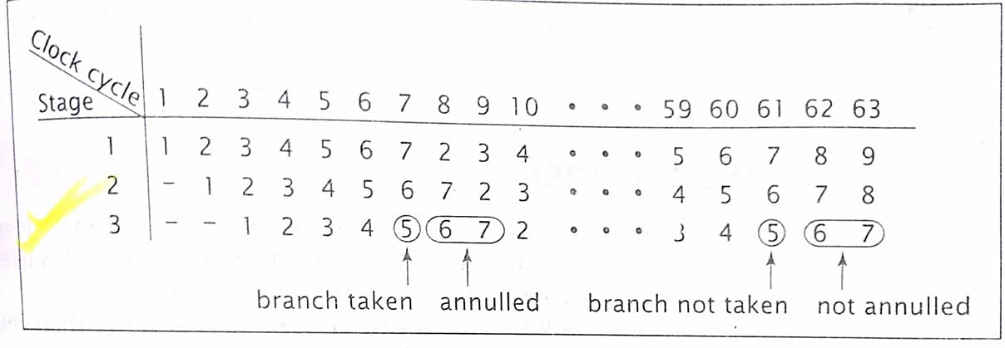
Contd…
During clock cycle 61, the branch is not taken and the loop terminates.
This time, the execution of statements 6 and 7 during the following two clock cycles are not annulled and their results are stored.

Slide 28
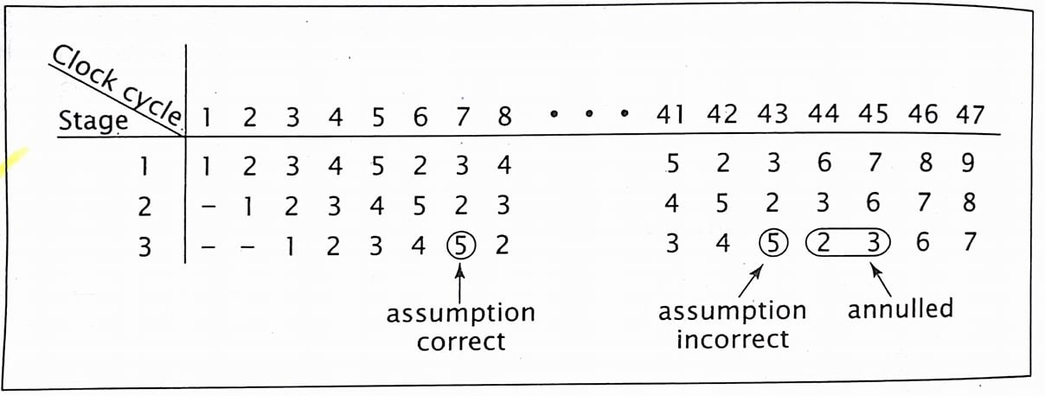
Branch prediction
Allows the compiler or pipeline hardware to make an assumption as to whether or not the conditional branch will be taken.
If its guess is right, the correct next instruction occurs immediately after the conditional branch instruction and is executed during the next clock cycle; no delay is introduced.
If the guess is wrong, the results are annulled before.

Slide 29
RISC vs. CISC
Let us take an example of multiplying two numbers; A = A * B
CISC approach | RISC approach
> The entire task of multiplying two numbers can be completed with one instruction: MULT A,B; which: | > The “MULT” command is divided into several command to perform multiplication.
Loads two values into separate registers. | 1. LOAD R1, A LOAD R2 , B
2. Multiplies the operands. | 2. PROD A , B
3. Stores the product in the appropriate register. | 3. STORE R3 , A
 | > All executed in one clock cycle.

Slide 30
Contd…
CISC | RISC
1. Emphasis on hardware | 1. Emphasis on software
2. Includes multi-clock | 2. Single clock
3. Complex instructions | 3. Reduced instruction only
4. “LOAD” and “STORE” incorporated in instructions | 4. “LOAD” and “STORE” are independent instructions
5. Small code size | 5. Large code size

