Slide 1
Predicting Student Outcome using Machine Learning
Chapter-wise Presentation
M. Umair Ul Islam | MS Data Science Thesis

Slide 2
Chapter 1: Introduction
• Shift to Virtual Learning Environments (VLEs) & MOOCs
• Problems: dropout, disengagement, redundancy in features
• Research Objectives: Build predictive pipeline on OULAD
• Compare FS methods: PSO, Gini, FAMD
• Evaluate ML & Ensembles with multi-metrics
• Significance: scalable & interpretable early-warning systems

Slide 3
Chapter 2: Related Work
• Datasets: OULAD, UCI, Moodle
• Feature categories: Demographic, Behavioral, Performance
• FS Approaches: Statistical, PSO/GA, FAMD
• ML Approaches: RF, GB, LR, ANN
• Gaps: Few comparative FS studies, over-reliance on accuracy
• Need balance: accuracy + interpretability + scalability

Slide 4
Chapter 3: Methodology
• Dataset: OULAD (32k+ students, 22 courses)
• Data preprocessing: missing values, encoding
• Feature Engineering: clicks, diversity, scores, ratios
• FS: PSO (43 features), Gini (10 features), FAMD (20 comps)
• Models: RF, GB, LR, ANN + Ensembles
• Evaluation: 5-fold CV, F1, AUC, Precision, Recall, Accuracy

Slide 5
Chapter 4: Analysis & Results
• Target distribution: 58% pass, 27% fail, 15% withdraw
• EDA: Failed students = low clicks, scores, submissions
• Key predictors: avg score, submission ratio, interaction diversity
• Performance: PSO & Gini > FAMD
• Best model: Ensemble RF+GB+ANN (F1=0.938, AUC=0.981)
• Comparable to DL models but more interpretable

Slide 6
Chapter 5: Conclusion & Future Work
• Conclusion: Multi-FS + Ensemble ML = strong performance
• Balances accuracy & interpretability for real-world systems
• Limitations: single dataset, limited DL exploration
• Future: multi-institution datasets, early-stage forecasting
• Integration with adaptive learning systems for real-time use

Slide 7
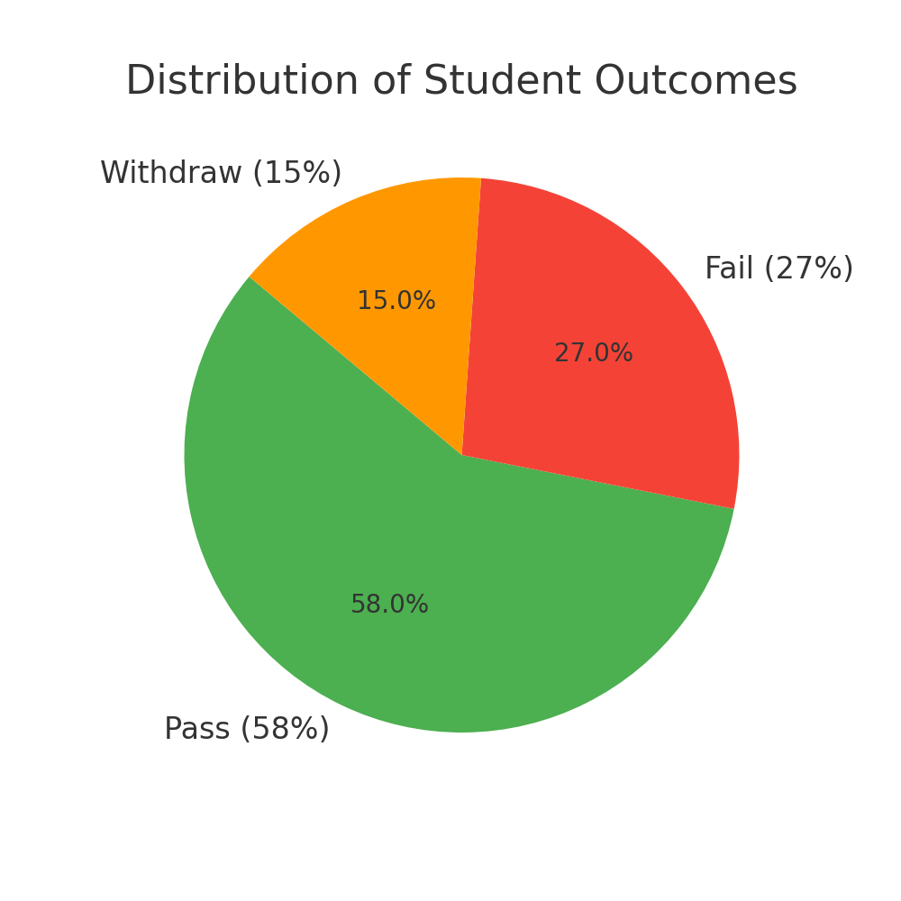
Class Distribution

Slide 8
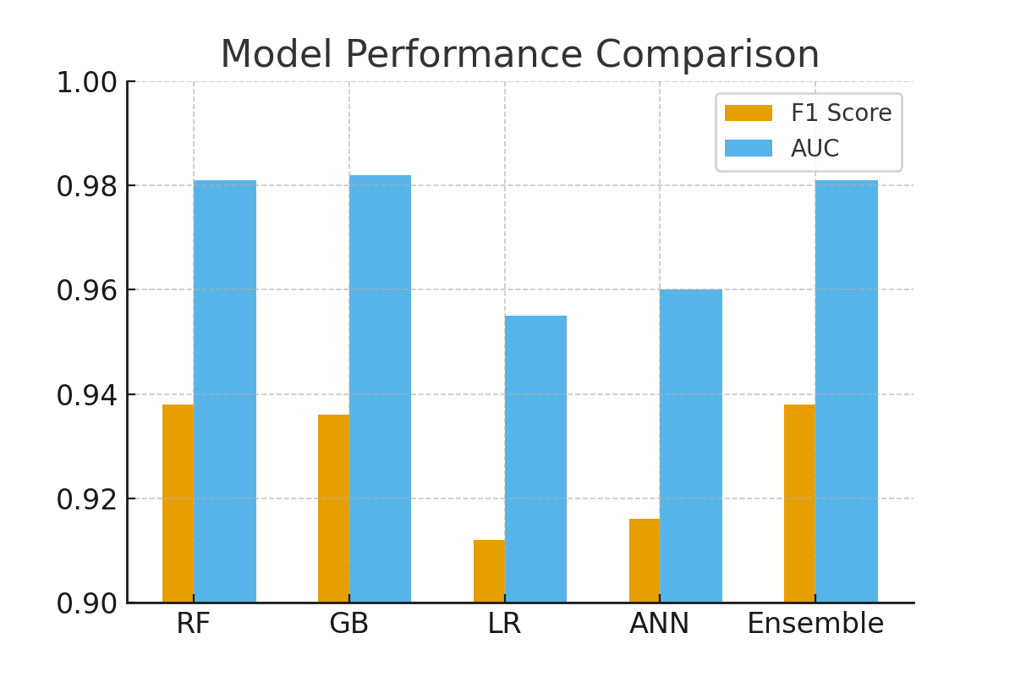
Model Performance Comparison

