Slide 1
Characteristics of compositional representations in neural networks

Slide 2
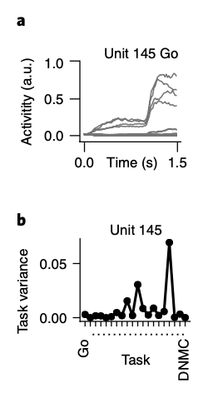
How to study functional neural representations
Characterize the response properties of neurons (ANN or biological) given a set of inputs
For more sophisticated approaches, we can use representational similarity analysis

Slide 3
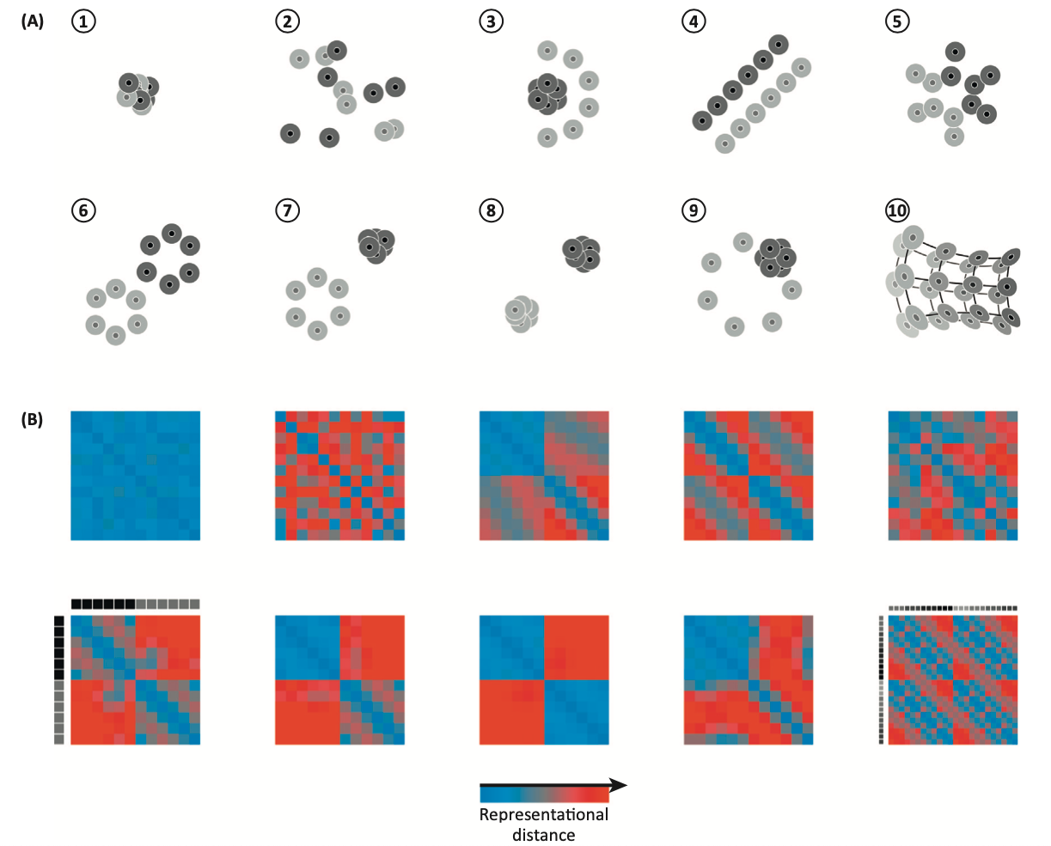
Representational similarity analysis (RSA) as an approach to constrain representations in ANNs
RSA characterizes the representational geometry of a set of features
Representational geometry: geometry of a set of entities represented as points in a space spanned by the dimensions of a neuronal population code.
Can we constrain models to only contain useful (or compositional) representations?
See: Kriegeskorte & Kievit (2013) TiCS

Slide 4
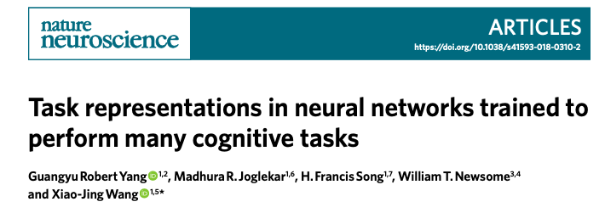
Primary objective:
What are the ‘ANN mechanisms’ that enable RNNs to perform many different tasks,
and are they related to brain mechanisms?

Slide 5
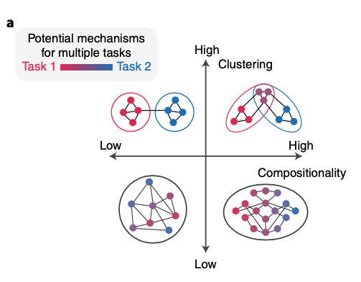
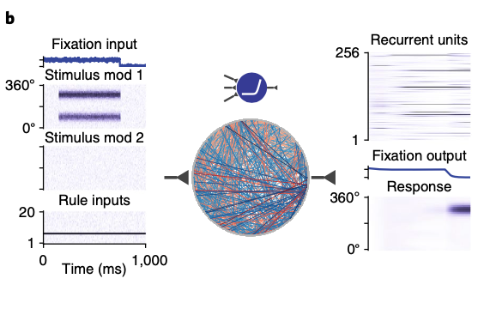
Competing mechanisms in the neural representation space
Train the model on 20 different tasks commonly used in cognitive neuroscience

Slide 6
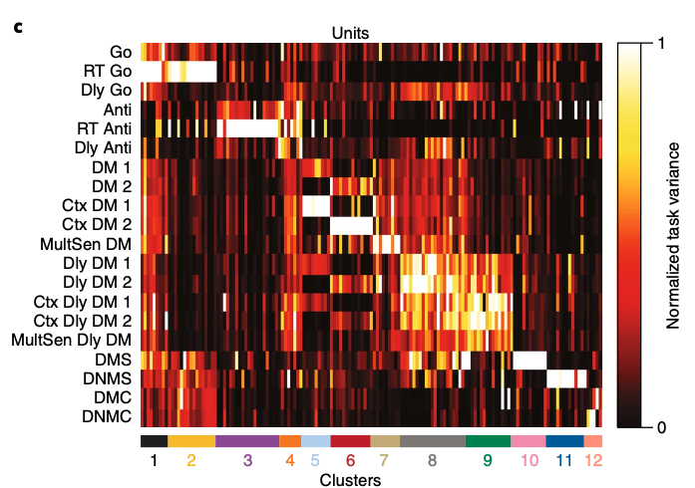
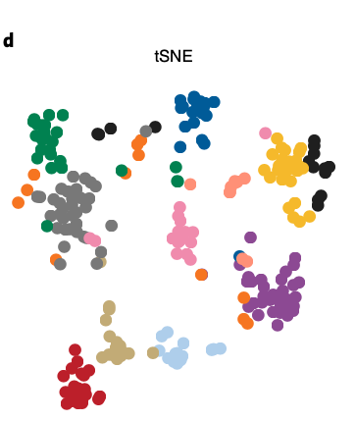
Detailed analysis of feature selectivity of individual neurons
Functionally specialized clusters emerge for distinct task representations
But, there are units that appear active across multiple tasks (”mixed selectivity”)

Slide 7
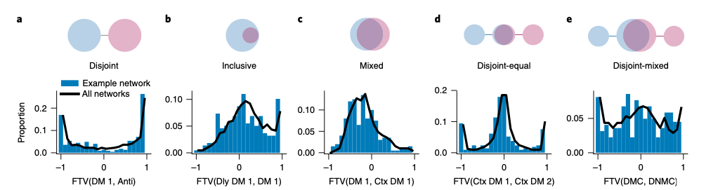
Identifying shared task features among all units between pairs of tasks
Some tasks use orthogonal (disjoint) units to perform the tasks
Some tasks reuse neural units
Reuse of neural units suggests compositional learning and representations

Slide 8
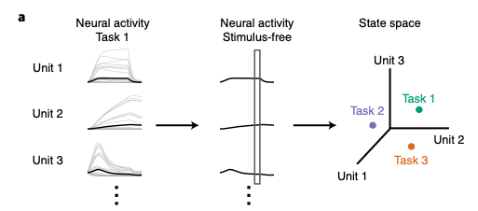
Identifying compositional representations
Projecting neural activity into a low-dimensional state space simplifies interpretation

Slide 9
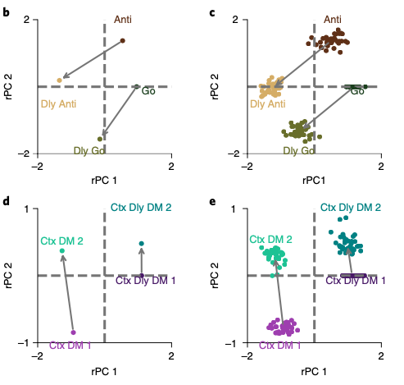
Identifying compositional representations
Compound representations are create by linearly/additively composing different representations
What sorts of architectures/objectives/optimizations might facilitate these sorts of compositional representations?

Slide 10
Some notes
Vanilla RNNs *are* capable of learning compositional representations
After training, lesion experiments reveal the importance of compositionality during tasks
Suggests compositionality is necessary for performance
Compositional learning required either:
Continual learning algorithms (i.e., Zenke et al. 2017; ”synaptic intelligence”)
Interleaved training
Thoughts:
Continual-learning techniques contrains the formation of compositional representations
Zenke et al. alters the cost function by penalizing previously important connections
Alternative approach: Directly require compositional representations during training

Slide 11
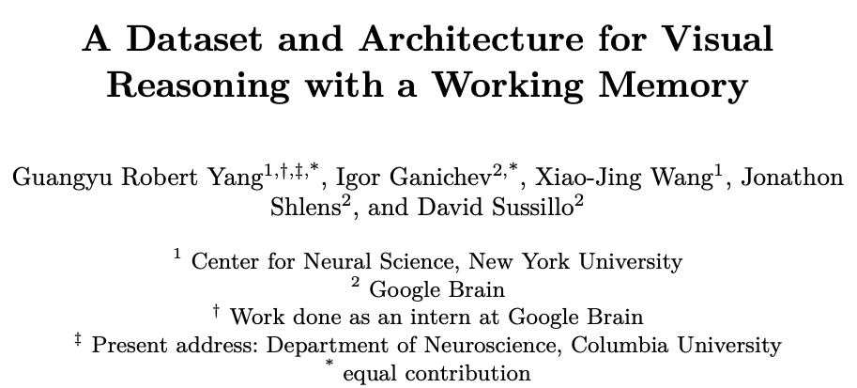

Slide 12
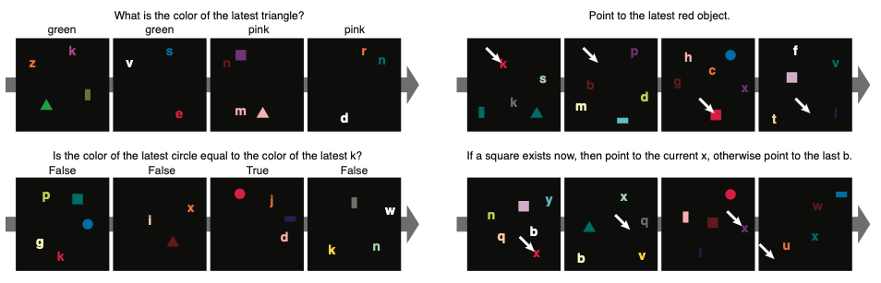
COG dataset
COG dataset meant to exercise compositional visual reasoning in time, similar to human experiments

Slide 13
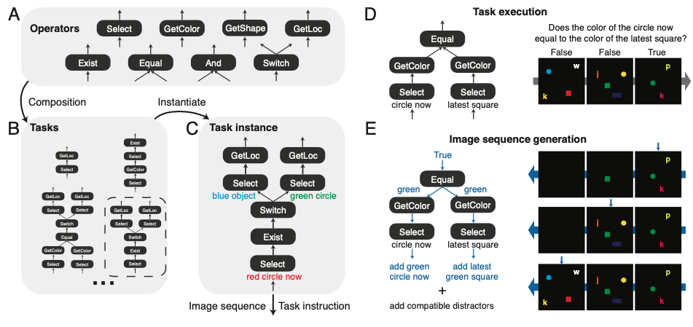
Directly generate stimuli from task composition

Slide 14
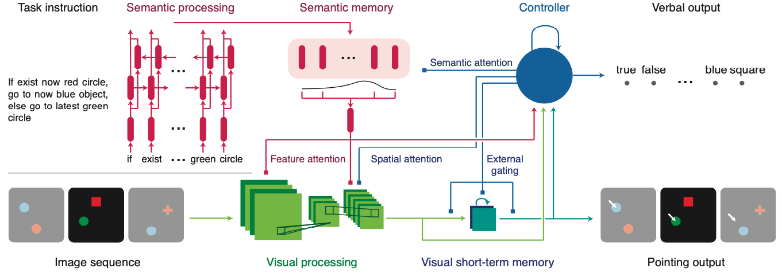
Main innovation of this study: visual working memory

Slide 15
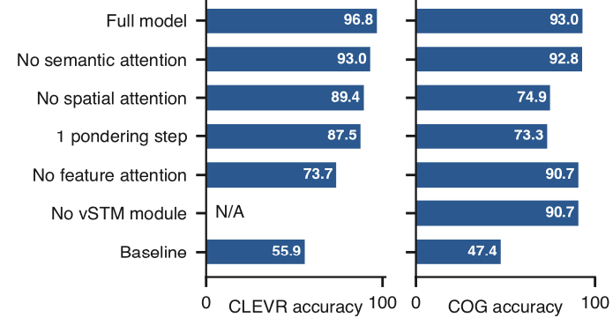
Ablation experiments

Slide 16
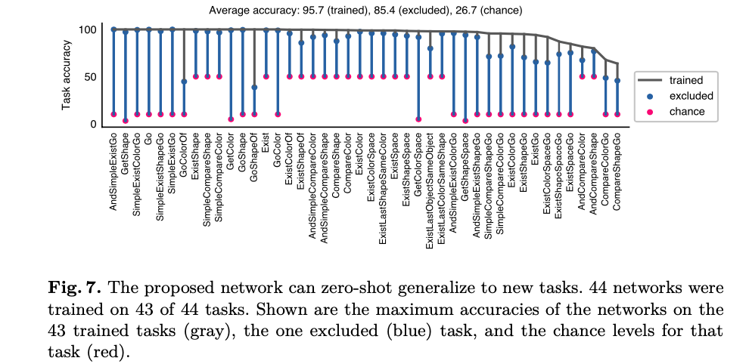
“Zero-shot generalization”

Slide 17
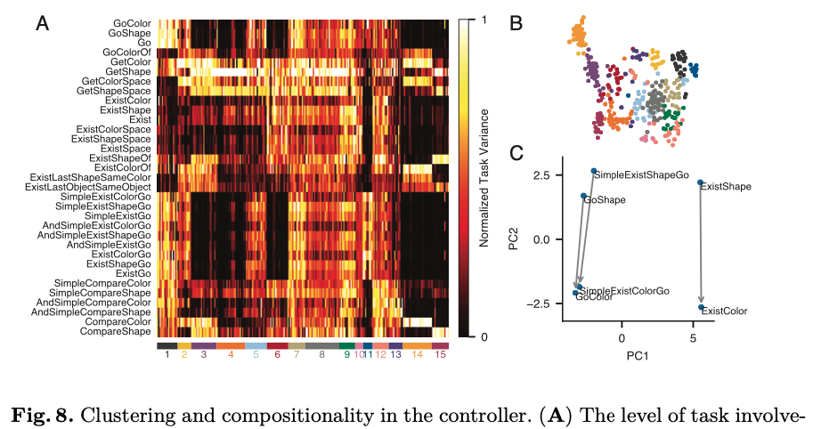
Clustering and compositionality of the controller representations

Slide 18
Thoughts
What to optimize for?
Typically, physical properties (ex. Continual learning)
Architecture parameters
Layers/nodes
Also typically, performance
Optimizers
Learning paradigms
What about optimizing for functional properties directly
Representational forms

