Slide 1
Convergence of compositional task structure in humans and artificial neural networks

Slide 2
Central question
Do human and artificial neural networks (ANNs) use the same computational strategies to perform compositional tasks?
Specific questions:
ANNs can solve tasks in a multitude of ways. Do ANNs that learn tasks compositionally exhibit similar behaviors to human behavior?
Do ANNs that learn tasks compositionally exhibit similar internal representations to human brain representations?

Slide 3
Analysis 1 - ANN
Build a model to perform the CPRO task
Train the model on 4 practiced tasks
Evaluate model performance on novel tasks, varied by task similarity

Slide 4
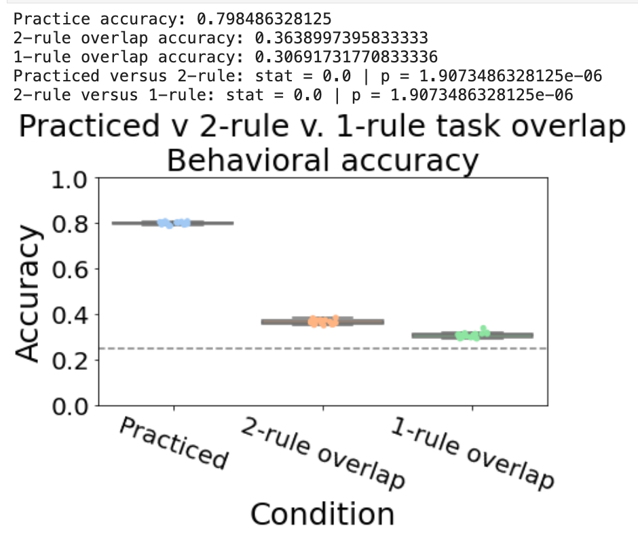
Train model on 4 tasks
Accuracy is close to chance levels on unseen ‘novel’ tasks
Practice training stops when network achieves 80% accuracy)

Slide 5
Analysis 2 - ANN
Build a model to perform the CPRO task
Pretrain the model on simplified tasks (e.g. task components) + 4 practiced tasks
Two simplified tasks:
Sensorimotor task:
If RED press LEFT MIDDLE
If VERTICAL press RIGHT INDEX
Logical-sensory tasks
If BOTH RED -> TRUE/FALSE
If NEITHER VERTICAL -> TRUE/FALSE
Intuition: pretraining on simple tasks forces network to have compositional structure

Slide 6
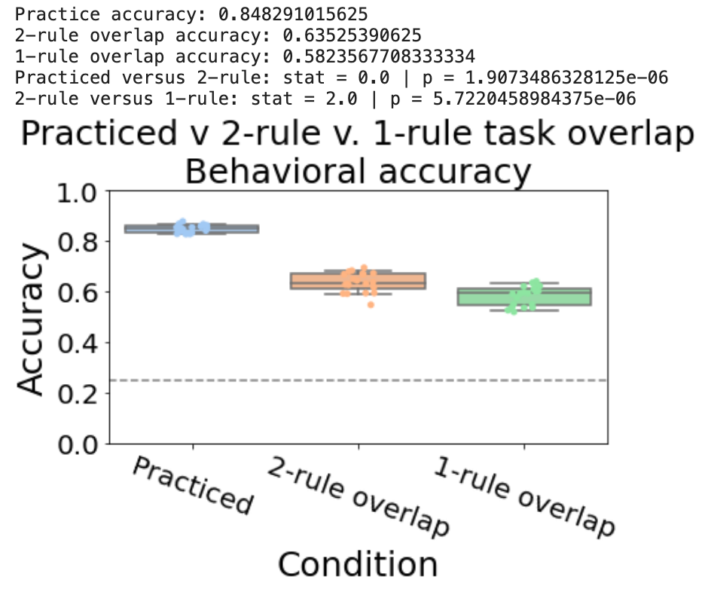
Evidence for compositionality Accuracy significantly improves on novel tasks (Practice training stops when network achieves 80% accuracy)

Slide 7
Analysis 2 - ANN
Model appears to reuse learned components to that enables it to generalize and perform novel tasks significantly above chance
Analysis TODO – Train on x tasks; test on 64-x tasks – evaluate how performance varies

Slide 8
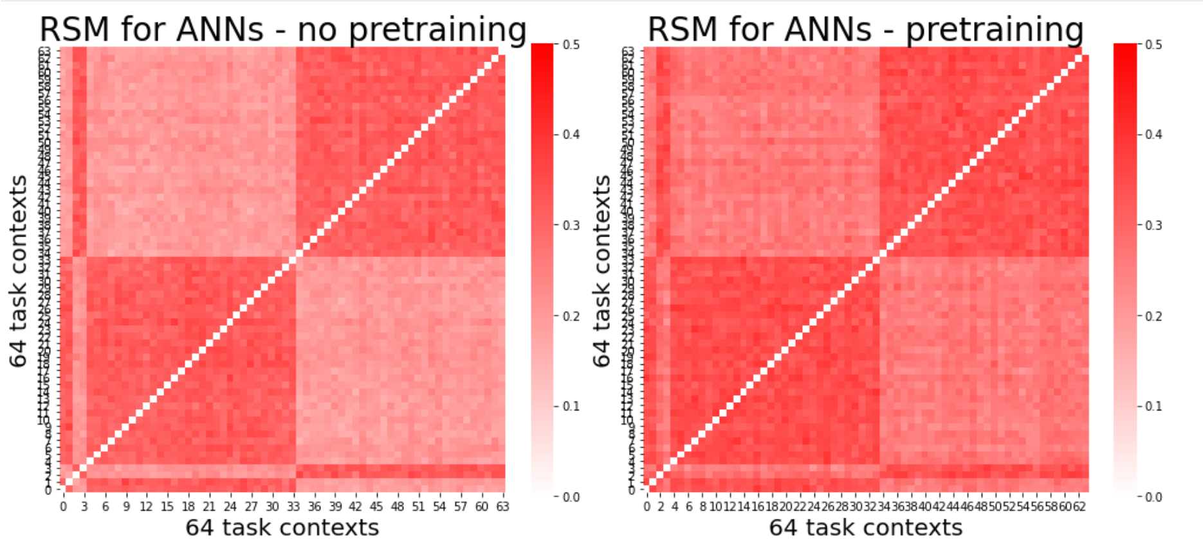
Do pretrained, compositional ANNs have more efficient (lower dimensional) representations?

Slide 9
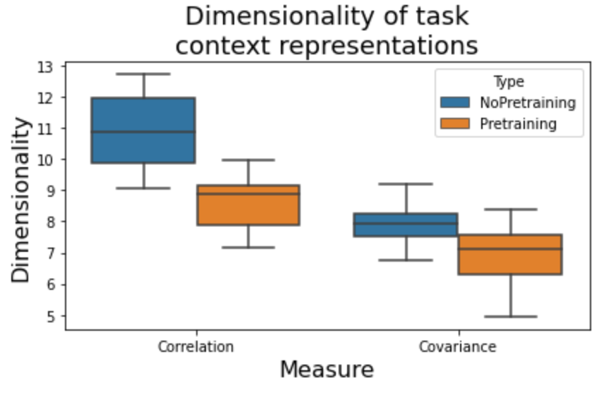
Do pretrained, compositional ANNs have more efficient (lower dimensional) representations?

Slide 10
What is the benefit of compressed, lower dimensional representations of the task context?
Do compressed context representations influence behavioral representations?

Slide 11
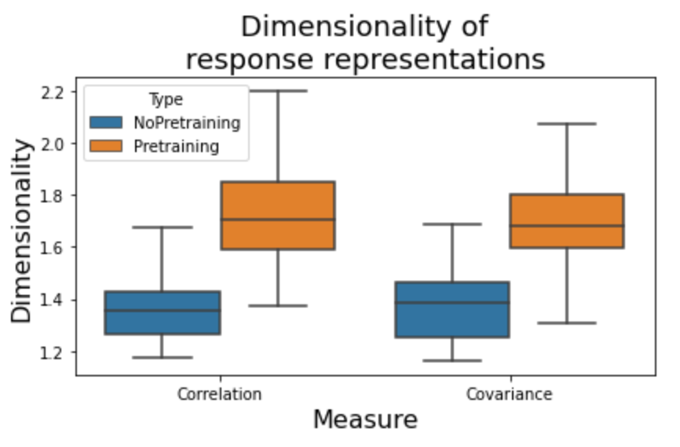
Do pretrained, compositional ANNs have higher dimensional behavioral representations (also have higher decoding accuracies)
Suggests abstract, compositional representations are useful for extracting relevant behavioral representations

Slide 12
Hypothesis / Prediction from model?
Makes 2 predictions: Increased compositionality leads to…
Improved behavioral representations for decoding
Lower dimensional context representations
Can be tested in empirical data by evaluating decodability of context and response (separately) as a function of rule presentation
*perhaps can serve as a hypothesis/explanation as to why PFC areas have such low decoding accuracies of context info

Slide 13
ANN experiment 2
Iteratively train networks on n practiced tasks, and test on 64 – n novel tasks
Tests for ‘one shot learning’
If networks are learning compositionally, they should likely improve performance as n increases
4 network types (all trained until performing 80% accuracy)
ANN with pretraining (SGD)
ANN with pretraining (Adam)
ANN (SGD) – no pretraining
ANN (Adam) – no pretraining

Slide 14
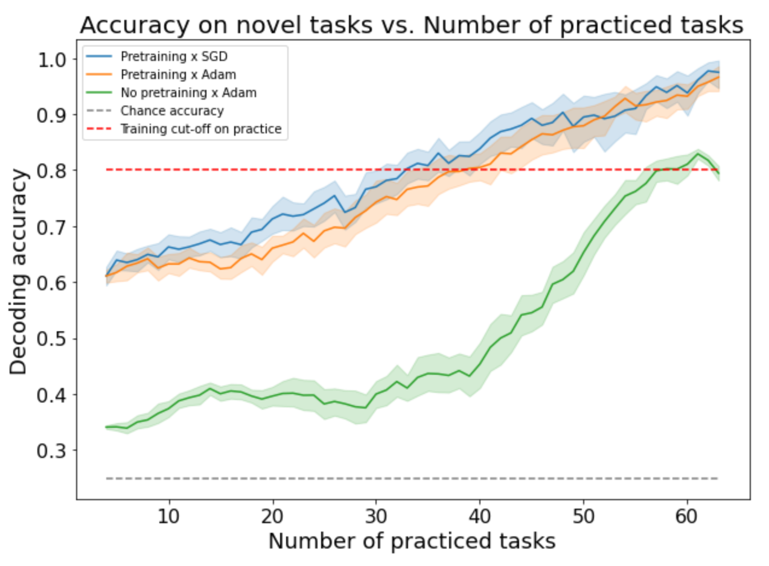
Pretraining significantly improves performance
Performance on novel tasks exceeds the performance on ‘practiced’ task cut-off
ANN without pretraining can only achieve cut-off accuracy on novel tasks
SGD and Adam with pretraining performs about the same
SGD without pretraining takes far too long to converge

Slide 15
Earlier hypothesis:
Lower dimensional task context representations
➔
Higher dimensional response representations
So, across training, does reduced context dimensionality correlate with response dimensionality?

Slide 16
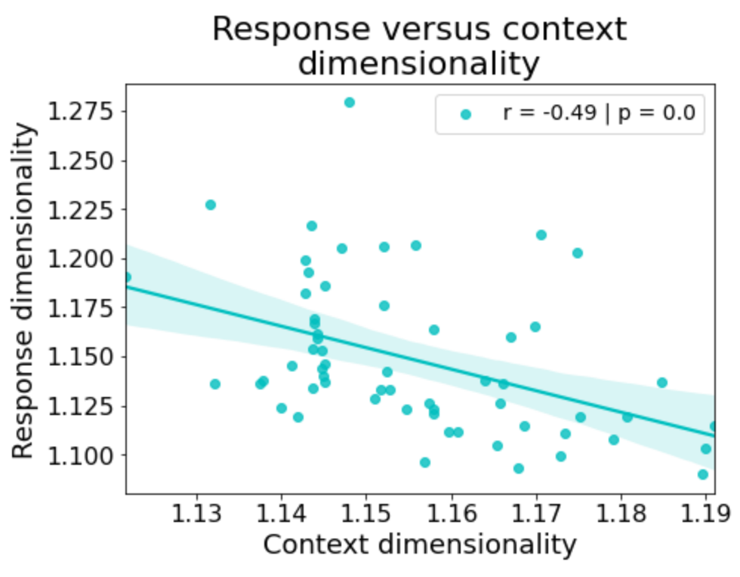
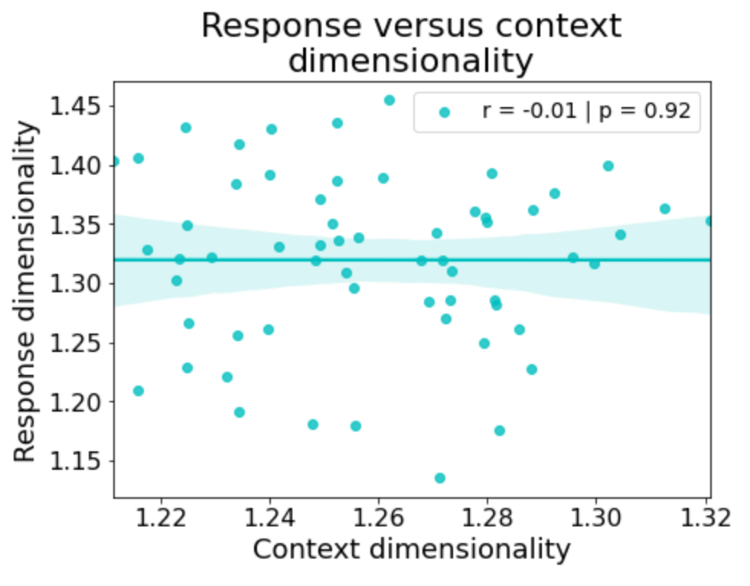
Adam + Pretraining
SGD + Pretraining
Unclear why there is this distinction… though Adam does train much more quickly/efficiently than SGD

Slide 17
Leads to a testable hypothesis in data:
Lower dimensional task context representations
➔
Higher dimensional response representations
In prefrontal areas
Can also evaluate how dimensionality is shaped across each presentation of a new rule

Slide 18
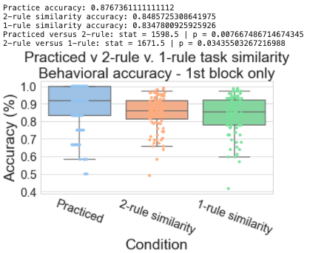
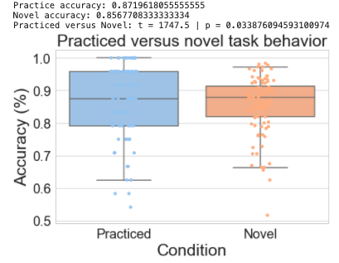
How does ANN behavior compare to human data?

Slide 19
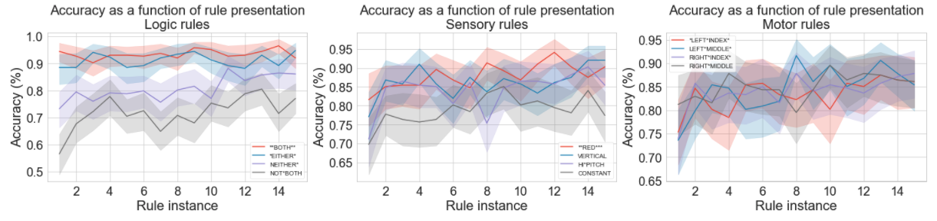
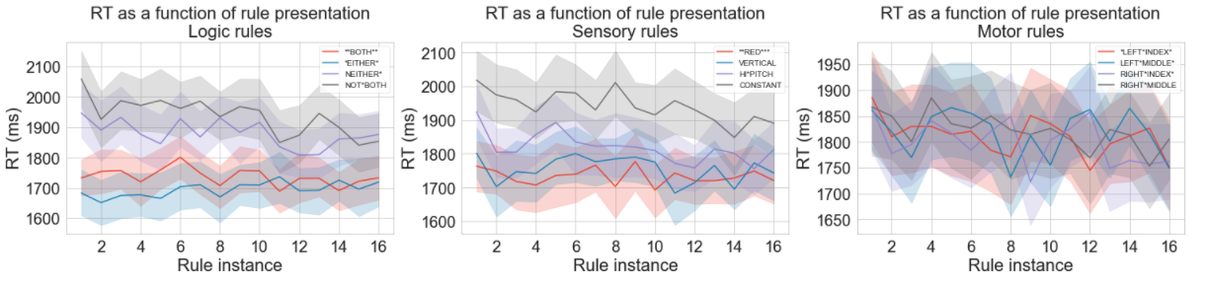
Human behavioral data

Slide 20
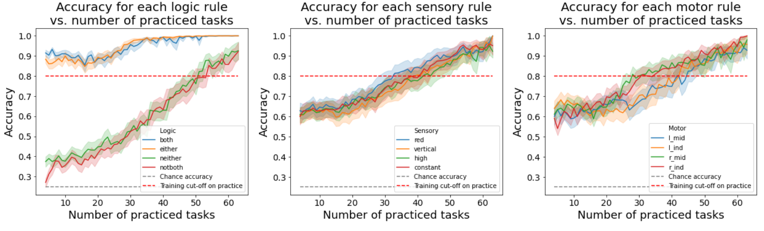
ANN equivalent of by-rule analysis – Adam x pretraining
“both” and ”either” are significantly easier than ”notboth” and “neither”

Slide 21
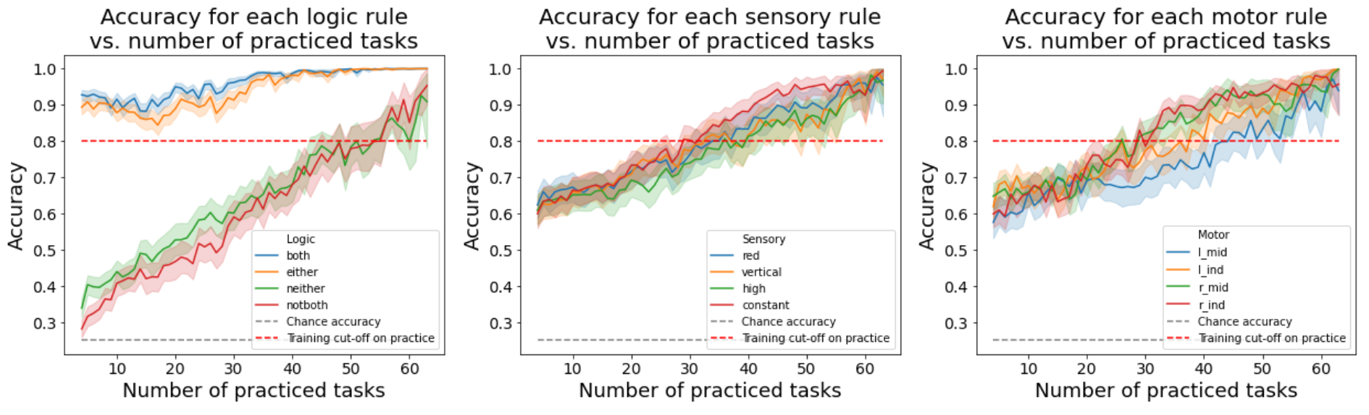
ANN equivalent of by-rule analysis – SGD x pretraining
“both” and ”either” no longer show ”notboth” and “neither”

Slide 22
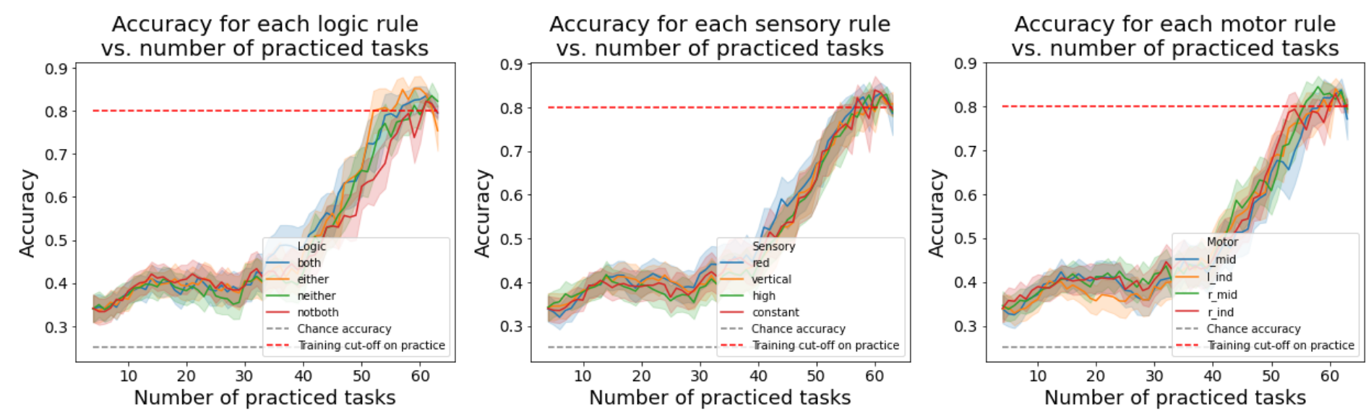
ANN equivalent of by-rule analysis – Adam x no pretraining
Without pretraining, you no longer see this distinctino

Slide 23
How are the task rule inputs modeled?
both
either
not
red
vertical
high
constant
lmid
lind
rmid
rind
Logic
Sensory
Motor

