Slide 1

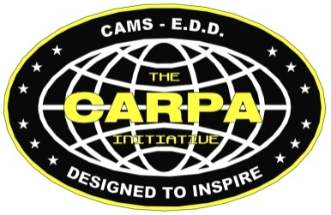
2019 CARPA Initiative
Project Challenge
Stardate 304319.5

Slide 2
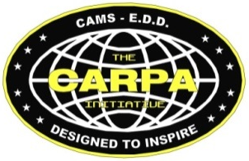
2019 CARPA Challenge
Are you ready?

Slide 3
2019 CARPA Challenge
You’ve waited a long time for this.

Slide 4
2019 CARPA Challenge
I mean, after all, it has been five weeks or so.

Slide 5
2019 CARPA Challenge
And that’s a pretty long time, right?

Slide 6
2019 CARPA Challenge
You can still back out…...

Slide 7
2019 CARPA Challenge
Nice Shark logo, huh?

Slide 8
2019 CARPA Challenge
I found it online.

Slide 9
2019 CARPA Challenge
But I had to fix the eye.

Slide 10
2019 CARPA Challenge
To make it look more aggressive.

Slide 11
2019 CARPA Challenge
OK, you asked for it.

Slide 12
2019 CARPA Challenge
Did I ever tell you the
story about……..

Slide 13
2019 CARPA Mission Challenge
For 2019, The CARPA Initiative is commissioning a project that will introduce new technology to our already impressive design portfolio.

Slide 14


Slide 15
Project Azorian

Slide 16

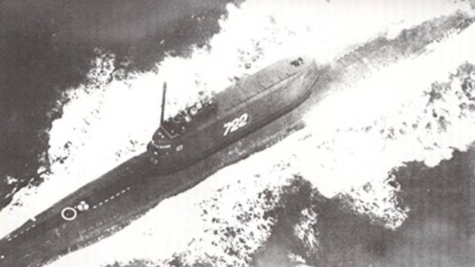
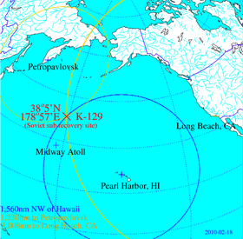
2019 - Project Azorian
K-129
K-129 was one of six strategic ballistic missile submarines attached to the 15th Soviet Submarine Squadron. On her final deployment, she was lost on 8 March 1968, due to a leaking missile tube, which caused the sub to sink, where it was crushed by the intense pressure of the ocean depths. The Soviet Navy deployed a huge flotilla of ships to search for her but never found her wreck. A secret US Navy sonar “net” on the bottom of the ocean heard the implosion that sank the submarine, and deployed the USS Halibut to use sonar to scan the ocean floor, finding the wreck at a depth of 4900 meters (3 miles) on the ocean floor.

Slide 17

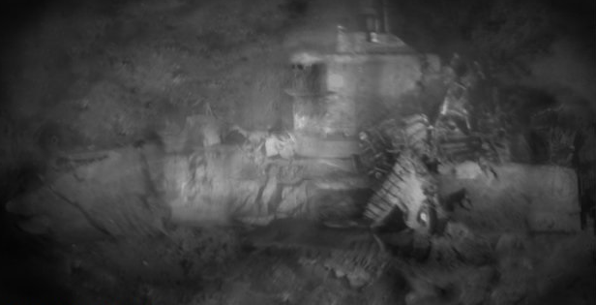
2019 - Project Azorian
K-129 Wreckage Site
In 1974, the Central Intelligence Agency (CIA) wanted to raise the vessel in an attempt to capture vital information from the Soviet Union, including codebooks, and naval protocol. The attempt to recover the vessel in a secret Cold War effort, was code-named Project Azorian. The vessel's position at 4900 meters (3 miles) below the ocean surface was the greatest depth from which an attempt had ever been made to raise a ship.

Slide 18
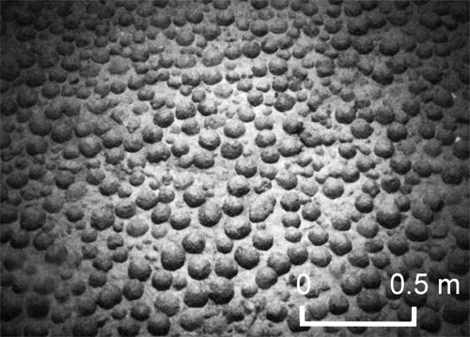
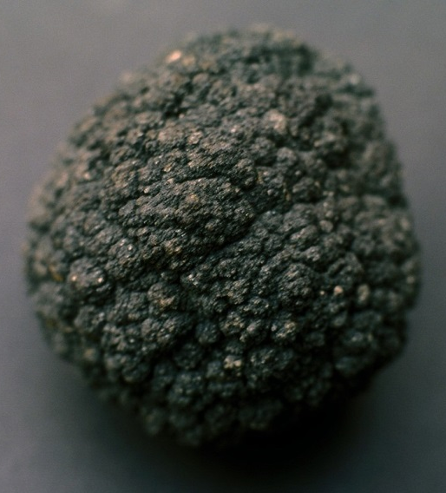
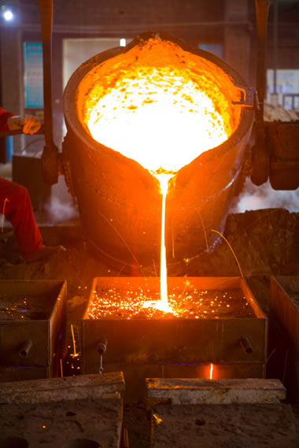
2019 - Project Azorian
Hughes Glomar Explorer
K-129 Wreckage Site
The CIA created a cover story, that the specialized salvage vessel was engaged in commercial undersea polymetallic nodule mining. Manganese nodules litter the ocean floor and are created over millions of years, from the minerals in seawater. They are rich in manganese, iron, nickel, copper and cobalt. Cultivating them could make the US independent from foreign markets for these materials.

Slide 19
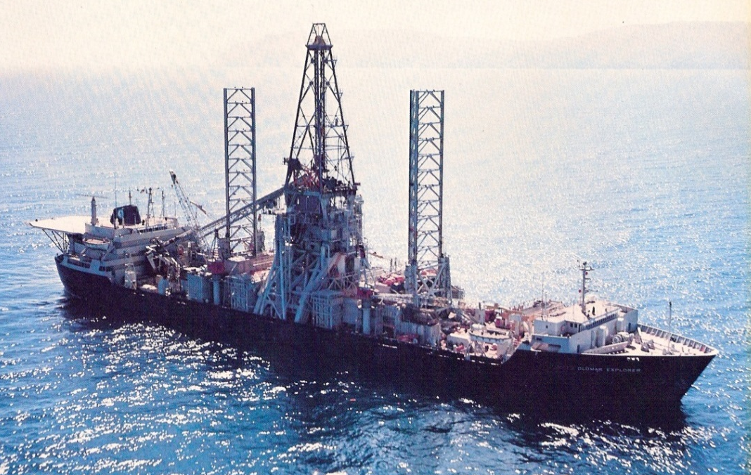
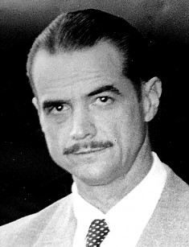
2019 - Project Azorian
Hughes Glomar Explorer
The CIA needed a crazy (but patriotic) billionaire to provide credibility to the mining story. They recruited Howard Hughes to float the cover story. Hughes formed Summa Corporation, to provide a way to commission the building of the recovery/mining vessel. They created a ship for the recovery mission was The Hughes Glomar Explorer. The ship was turned over to the Navy, retrofitted for deep sea drilling and eventually scrapped in 2015. Designed to mechanically lift a 2000 ton 328 ft. long submarine from a depth of 3 miles off of the ocean floor. It was the most sophisticated and craziest piece of equipment on the planet.

Slide 20
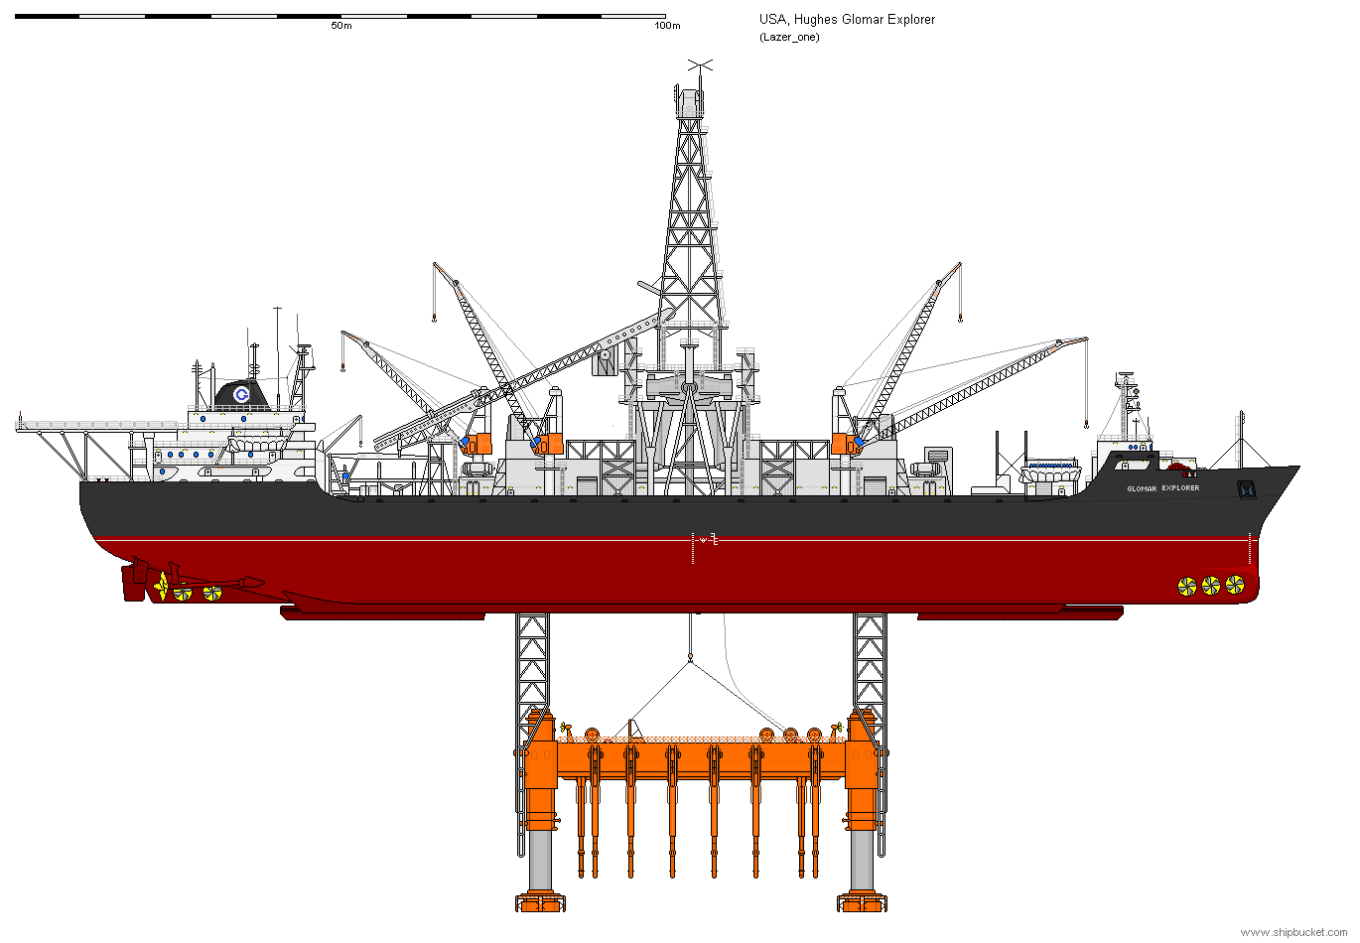
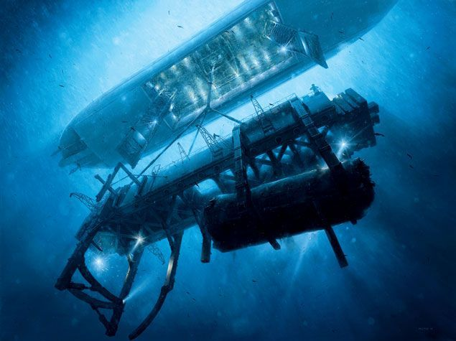
2019 - Project Azorian
The Glomar Explorer was essentially a large stabile ocean platform from which a claw-like capture vehicle could be launched through a central pool with doors on the bottom of the vessel that could open. The pool was large enough to contain the sub once it was brought from the ocean floor.

Slide 21
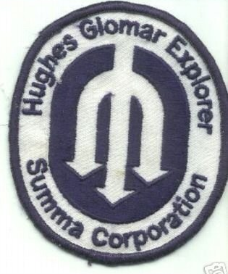
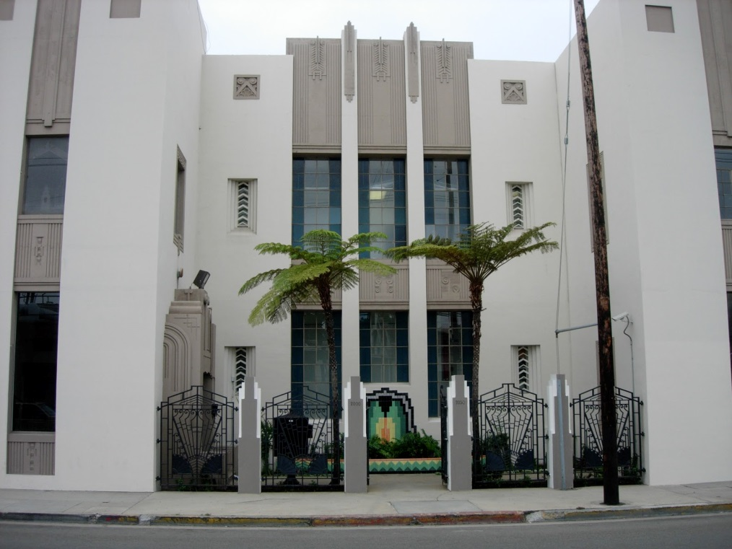
2019 - Project Azorian
In June of 1974, thieves broke into Summa Corporation’s head office and stole documents, linking Hughes to the CIA, and the recovery operation. Rumors of the operation began to leak out. The operation proceeded as planned but when the K-129 was being raised it broke apart and part of the sub was lost.

Slide 22
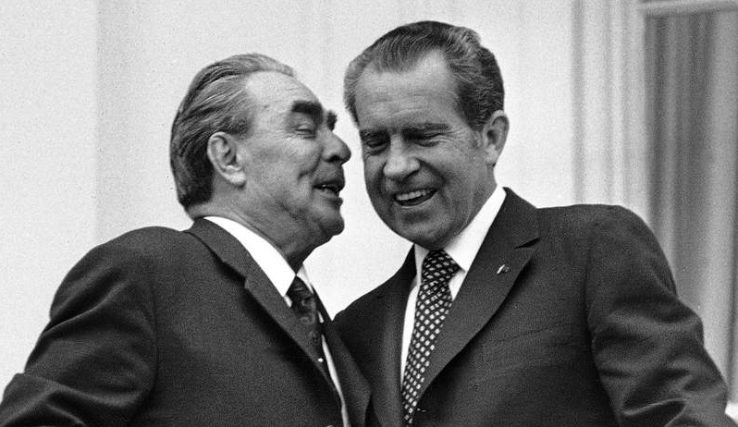
2019 - Project Azorian
“If we see that ship
in open water again,
we will sink it”
“Yeah….We figured that”
Brezhnev
Nixon
Further attempts to raise the lost portion of the wreckage had to be cancelled as news broke of the covert operation. It is still classified, as to exactly what was recovered, but it is speculated that the operation recovered the forward section of the sub, along with (3) nuclear torpedoes, and the remains of (6) Soviet sailors. As the Soviets were alerted to the recovery effort, all future salvage attempts were abandoned. This covert mission would take over six years to complete at a cost of three billion dollars in today’s currency.

Slide 23


The

Slide 24


2019 - Project Azorian
The CIA is interested in developing new recovery vehicle technology, to revisit the original wreckage site. The new recovery vessel must operate clandestinely, so as not to bring attention to the salvage operation, by entering the water “miles” from the site, and be able to pinpoint the wreck and recover items of interest.

Slide 25
2019 -Project Azorian
The Agency has contracted The CARPA Initiative to design, build, and demonstrate a hybrid multi-purpose Unmanned Aerial Vehicle/Unmanned Underwater Vehicle (UAV/UUV) system, code-named “Meglodon”, capable of flight in multiple fluid mediums (air and water).
The new technology will be showcased by revisiting the K-129 site and recovering various items of interest.

Slide 26
2019 -Project Azorian
An additional remotely operated vehicle, codenamed “Remora”, will be designed and built by the Interns of both teams, to locate the wreck, and signal for the Meglodon UAV/UUV. Both vehicles must be completely waterproof. The Meglodon device must possess both aerial and underwater propellers, for propulsion in the two different fluid mediums.

Slide 27
2019 -Project Azorian
The UAV/UUV must possess articulation methods to recover items of interest from the remaining debris from the wreckage. Objects of interest include: coding machines, a missing torpedo, (3) R-21 ballistic missiles, possibly tipped with nuclear warheads, and any possible remainder of the hull. Part of this new mission is to discover whether the K-129 was armed with nuclear tipped R-21 ballistic missiles, in violation of the 1971 Strategic Arms Limitation Treaty (SALT).

Slide 28
2019 -Project Azorian
“You’re Sharks. What did you think? You weren’t going to have an underwater mission? Especially with all of your collective ROV experience?”

Slide 29
2019 -Project Azorian
Mission Theater
Objects of interest, representing the downed submarine and any constituent parts, will be located at one end of a pool. The Remora Vehicle will enter the water, and locate the wreckage site using a conventional video feed. Once the wreck is located, the Remora will rest on the surface, and provide a beacon for the Meglodon Drone. The Meglodon Drone will fly over the pool, then dive into the pool and “fly” to the wreck underwater, to begin recovery efforts.

Slide 30
2019 -Project Azorian
Mission Theater
The Meglodon Drone is expected to have articulation, which will allow the vehicle to recover items and bring them to the surface. The demonstrated technology test (CDR 4) is slated to be conducted during the last week in May, possibly in the LBCC Pool. If the LBCC pool is unavailable, a secondary location will have to be identified. The CSUDH pool is currently undergoing a major renovation, and will be unavailable this year. The Meglodon device must travel 201.9 feet in the air, before it can enter the water.

Slide 31
2019 -Project Azorian
Mission Parameters
In addition to a mission camera, to provide live video, the Remora device must also carry an on-board UV light, representing a Geiger Counter, to ascertain whether the (3) R- 21 ballistic missiles contain “nuclear” material.

Slide 32
2019 -Project Azorian
Mission Parameters
The tips of each missile will contain glass beads, some of which may fluoresce under UV light, if “radioactive” material is present. If detected, the Meglodon drone must recover the missiles after the other items, and place them on the surface in a specially defined “lead lined” container. The drone must then jettison the salvage articulation, pick up the Remoras, and return to base.

Slide 33
2019 -Project Azorian
Mission Parameters (cont.)
A tether will not be allowed for the Meglodon UAV/UUV Drone.
A new method of communication may have to be developed for the drone, to be able to communicate with the Mission Base Station (MBS).The Remora device may be tethered, if necessary.

Slide 34
2019 -Project Azorian
Mission Parameters (cont.)
Traditional Wi-Fi and Bluetooth communications methods will not work underwater. A communication transceiver working between 100-3000Hz could be developed, as these are the only frequencies that can penetrate water, otherwise the drone would have to be “pre-programmed” for a completely autonomous deployment.

Slide 35
2019 -Project Azorian
Mission Parameters (cont.)
The salvageable items, will be scattered on the “ocean” floor, so the drone will have to repeatedly exit and enter the water during the salvage operation.

Slide 36
2019 -Project Azorian
Mission Deliverables
The Meglodon mechanism must:
Be completely waterproof.
Be capable of flight, in dual fluid mediums.
Fly 201.9 feet in the air to the pool, locate the pool, and dive into the pool, swimming to the wreckage.
Manipulate recovery articulation.
Be able to detect the beacon of the Remora, and retrieve it, once the salvage operation is complete.
The Remora mechanism must:
Be completely waterproof.
Be able to locate the wreckage site through a live video feed.
Provide a beacon for the Meglodon device.
Be able to detect radioactive activity, with UV light.
Additional Deliverables
Development of a communication method that will work between 100-3000Hz.

Slide 37
2019 -Project Azorian
DPM Assignments
Subsystem 1 is the aerial system.
Subsystem 2 is the underwater system.
Winner of the competition, and consequent Contract Award, is the vehicle that completes the most deliverables and recovers the most items from the “ocean” floor.

Slide 38
2019 - Project Azorian
You have 263 days to complete this mission.
Your time starts now.

