Slide 1

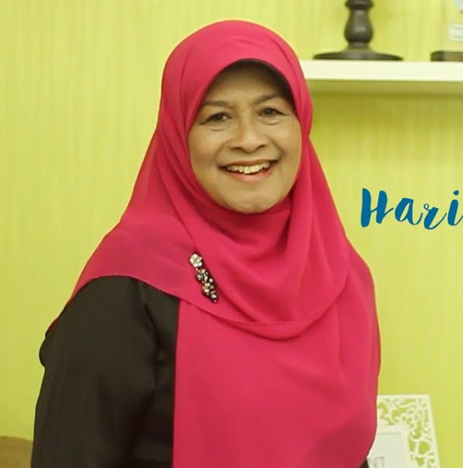
How to be a best Parents for our child
Presented by Itok toni

Slide 2

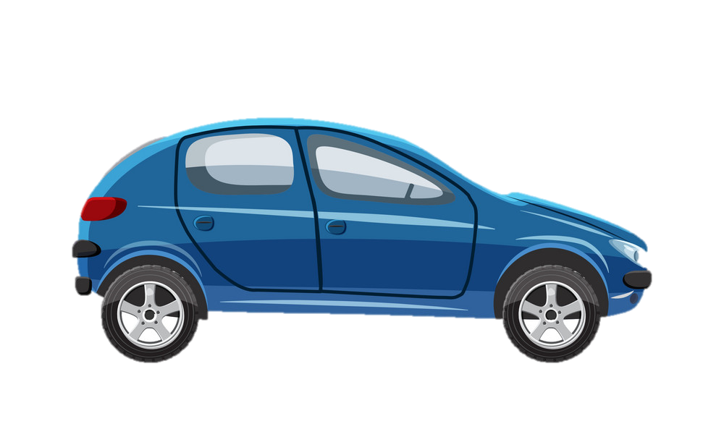

IS IT PARENTING IMPORTANT ?
I Want to Drive a Car

Slide 3

COMMON STATEMENT
Without Parenting
Time was Changing
We can see everything on
TV and Internet
In fact, it is become contradiction
Row Model
My Mom has succeeded
to support me to become a doctor
Decide

Slide 4
5 TIPS AND TRICK
become
Best Parents

Slide 5
OPTIMIZING THE GOLDEN AGE
1
Do you know ?
80% of a brain develops
How Old ?
Begin from 0 until 5 years
TRACK YOUR CHILD DEVELOPMENT

Slide 6
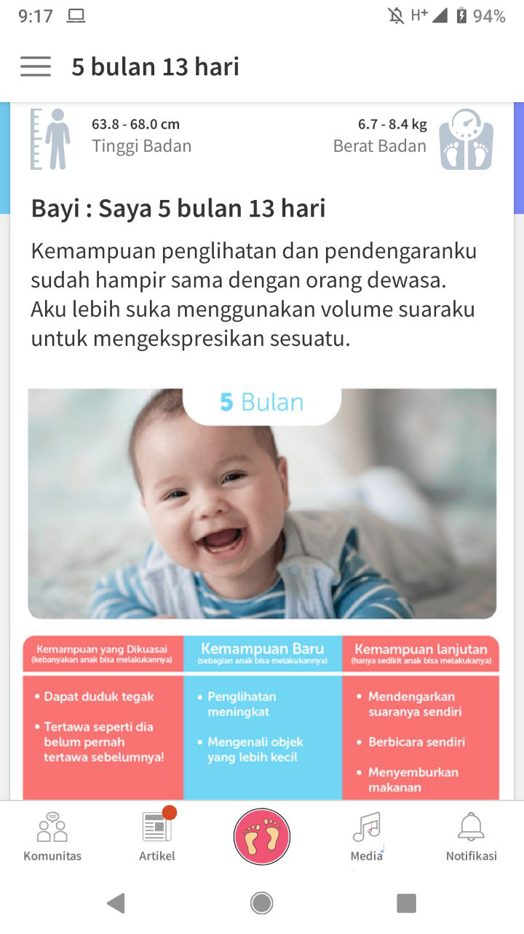
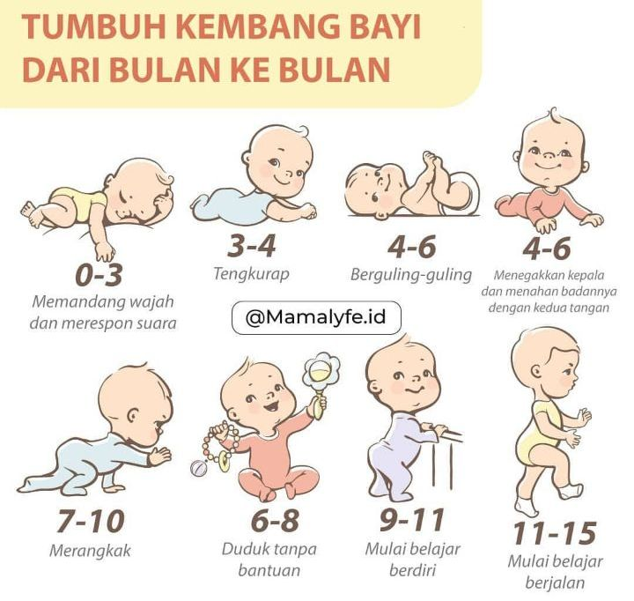
TIME TABLE
App on android : theasianparenting

Slide 7
STIMULATE WITH TIME PERIOD
2
Silent baby
Invite to play
Breast milk
6 month to give feed
Give Gadget
Already have Understanding
Invite to talk
soft textured food
Start from 7-9 years
give example mama sound
please do it with the right time, don’t because of your baby was cry,
so you let them to watch gadget or TV,
It will break of their motoric and brain development .

Slide 8
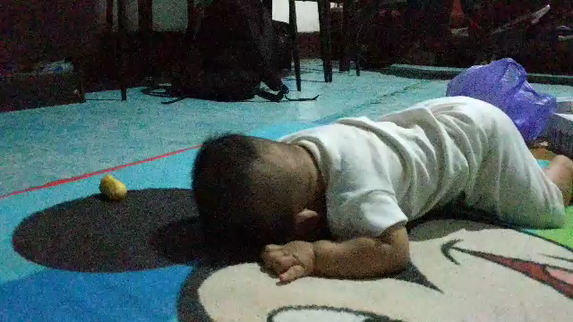
PRACTICE MAKE PERFECT

Slide 9
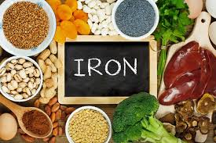
GIVE THE BEST NUTRITION
3
Research of WHO, 45% have deficiency iron
There are gaps in energy and iron requirements
that cannot be fulfilled only from breast milk
Suggestion
Give additional food contains
like banana, Broccoli, meat.

Slide 10
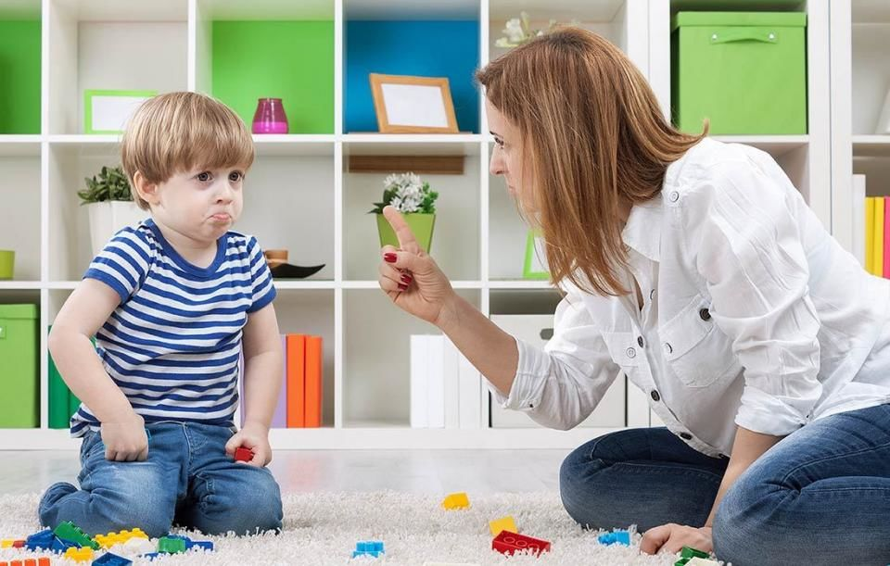
STAY WITH POSITIF SENTENCE
4
When you play with your child
Ooh my bad boy.. “Eh eh… nakale cah…”
Don’t be lazy..
Don’t throw..
You are very..

Slide 11



Kind of example book

Slide 12
Doing habit become character
5
Habit
Character
Tidy up his own toy
Tell about story
Sharing with another
Ask an opinions
Give a choice
Discipline
Honest
Social
Open Mind
Leader

Slide 13
Conclusion
To become a best parent : you have willing, make a note, give best nutrition, say a positive, and build a character.
Keep it learn and
apply to our child.

Slide 14
-Bill Gates
“Patience is a key element of success”
Thank You

