Slide 1
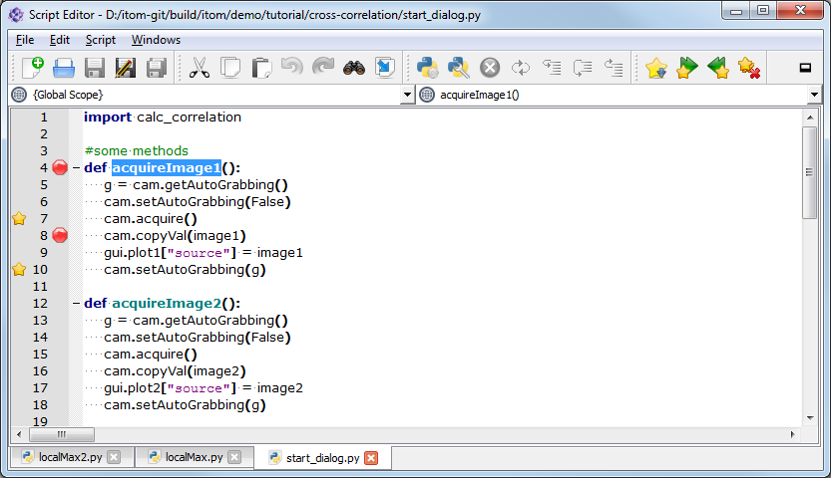
Run script
Debug script
List of classes
List of functions
(Un-)dock window
Breakpoints
Bookmarks
Tabs

