Slide 1
CharMeta
CharArrayMeta
char min
char max
char stepSize = 1
size_t numMin
size_t numMax
size_t numStepSize = 1
IntArrayMeta
size_t numMin
size_t numMax
size_t numStepSize = 1
IntMeta
int min
int max
int stepSize = 1
IntervalMeta
RangeMeta
int sizeMin
int sizeMax
int sizeStepSize= 1
intervalNotRange=true
intervalNotRange=false
ParamMeta
MetaRtti type
DoubleMeta
DoubleArrayMeta
double min
double max
double stepSize = 0.0
size_t numMin
size_t numMax
size_t numStepSize = 1
RectMeta
RangeMeta heightMeta
RangeMeta widthMeta
StringMeta
tType type
list allowedStrings
HWMeta
uint32 typeMask
ByteArray names

Slide 2
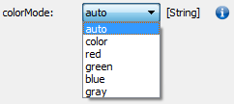
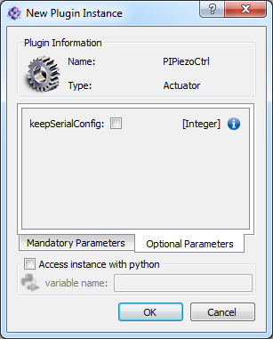
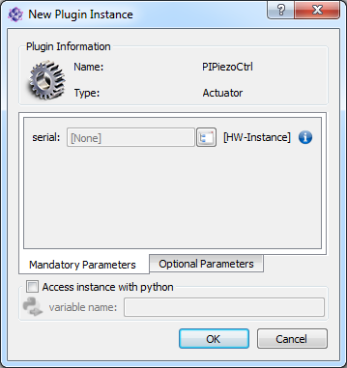
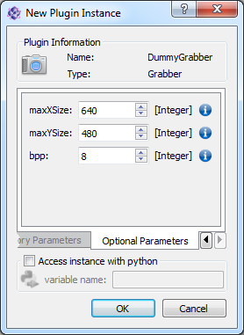

ito::ParamMeta
ito::CharMeta
ito::IntMeta
ito::DoubleMeta
ito::StringMeta
ito::HWMeta
FilterType (String, Wildcard, RegExp)
ListOfAllowedStrings
uint32 minType
char* m_pHWAddInName
Tp min
Tp max
Tp stepSize
(Tp is char/int/double)
String, [auto, color, …]
limitation to grabber, actuator, … or specific plugin name possible
int, 1, [0,1]
int, 8, [0,32]
RegExp, only numbers

