Slide 1
Evaluating Chip Multiprocessor Performance
Group Members:
Manuel Maldonado
Ming Tai Ha

Slide 2
Introduction
Evaluate the performance of Chip Multi-Processor (CMP) architecture
Done by running benchmarks and studying their performance
Provide explanation for any bottleneck

Slide 3
Hardware
Computer #1:
  OS: Linux Ubuntu 14.04
  4th Gen i7 4720HQ processor @2.6GHz, Haswell^{[1]} microarchitecture
  L1 cache 64KB per core, L2 cache 256 KB per core, L3 cache 6MB shared
  4 cores, 8 threads
Computer #2:
  OS: OS X 10.11 El Capitán
  5th Gen i7-5557U processor @3.1GHz, Broadwell^{[2]} microarchitecture
  L1 cache 64KB per core, L2 cache 256KB per core, L3 cache 4 MB shared
  2 Cores, 4 thread

Slide 4
Multi-Processing Platform
OpenMP:
  Specification for a set of compiler directives, library routines, and environment variables used to specify high-level parallelism in programs^{[3]}
  A standard platform for parallel programming on shared memory systems
  Provides code extensions/directives to make programs run in parallel
  Available for Fortran and C/C++ programs

Slide 5
Benchmark Suite – NPB 3.3.1
NASA Advanced Supercomputing (NAS) Parallel Benchmarks:
  Small set of programs designed to help evaluate the performance of parallel supercomputers^{[4]}
  Derived from computational fluid dynamics (CFD) applications
  Five Kernels and three pseudo-applications^{[5][6]}
  All benchmarks are Fortran programs and use OpenMP
    Note: Fortran uses ‘Col;umn-Major’ storage order^{[7]}

Slide 6
Five Kernels
Embarrassingly Parallel (EP):
  Used to provide an estimate the upper achievable limits for FP performance.
Multigrid (MG):
  Highly-structured long/short distance data communication
Conjugate Gradient (CG):
  Typical unstructured gird computations (e.g. matrix vector multiplication)
3-D Fast Furrier Transforms (FT):
  Rigorous test of long-distance communication performance
Integer Sort (IS):
  Integer computation speed and communication performance

Slide 7
Three Programs – Simulated CFD
Block Tri-Diagonal Solver (BT):
  Solves Block-Tridiagonal systems of 5×5 blocks in sequential manner along each dimension
Scalar Penta-Diagonal Solver (SP):
  Similar structure to BT but solving Scalar Penta-Diagonal bands of linear equations sequentially along each dimension.
Lower-Upper Gauss-Seidel Solver (LU):
  Uses symmetric successive over-relaxation (SSOR) method to solve a seven-block-diagonal system resulting from finite-difference discretization of the Navier-Stokes equations in 3-D by splitting it into block Lower and Upper triangular systems.

Slide 8
Benchmark Classes
The NPB benchmark comes in multiple classes (sizes):
  Class S:
    small for quick test purposes
  Class W:
    workstation size (a 90's workstation; now likely too small)
  Classes A, B, C: (our focus)
    standard test problems; roughly 4X size increase going from one class to the next
  Classes D, E, F:
    large test problems; roughly 16X size increase from each of the previous classes

Slide 9
Methods^{[8]}
Compilers used: GNU gcc and gfortran
Compilation done using the ‘-fopenmp’ flag on both
Classes A, B, C, S and W were compiled and run
Ran all classes with a defined number of threads and iterations
  Sets ‘OMP_NUM_THREADS’ to control the number of threads used by OpenMP
  OS took care of thread/core scheduling.
  Explored using ‘OMP_PROC_BIND’ and ‘OMP_PLACES’ for CPU affinity
All benchmark (raw) output was capture and kept
Times compiled and averaged, used for speedup calculations

Slide 10
Computer #1:
Speedup Results
Speedup per program class and speedups for all sub-sections for class C programs.
4 cores, 1-4 threads.

Slide 11
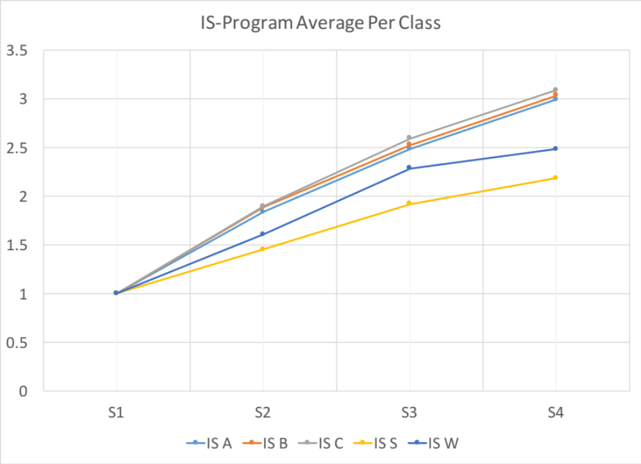
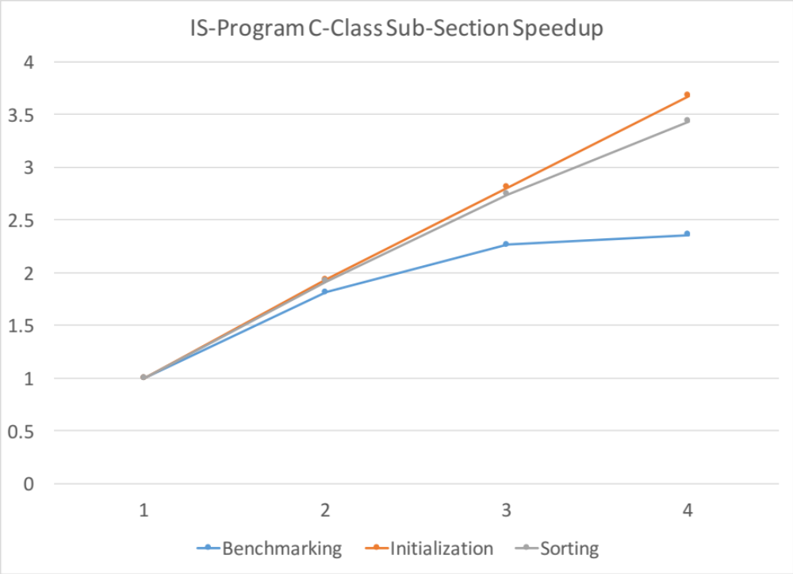
IS

Slide 12
IS – Discussion
Benefits greatly of parallelization and multi-processes, speedup of about +0.6969/core
Suffers from data dependencies on smaller classes as the same number of threads need to share a smaller amount of work
The ‘benchmarking’ sub-process is a for-loop going through all the data first, suffers from some data dependencies which bring the overall speedup down slightly

Slide 13
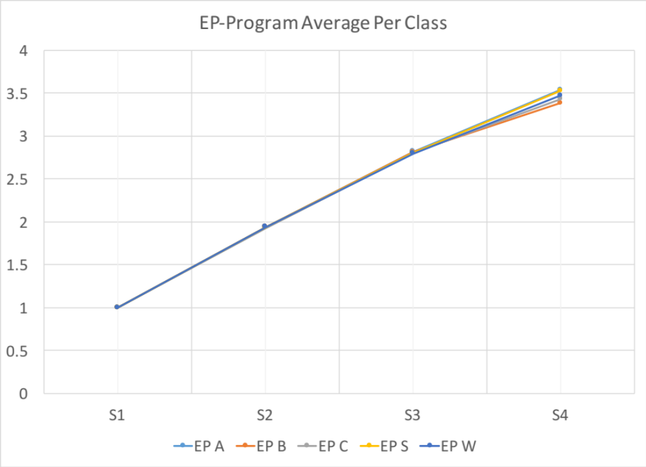
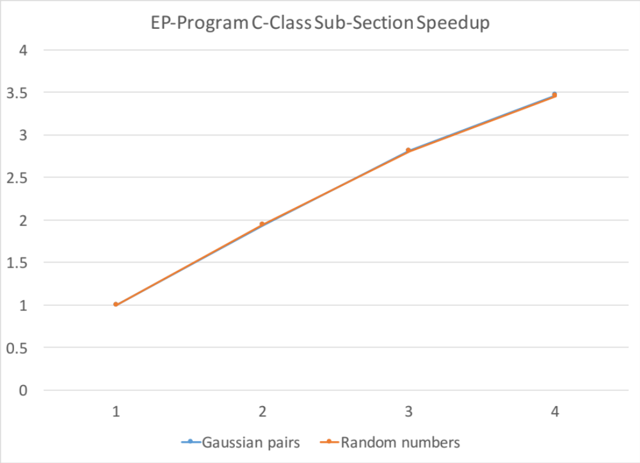
EP

Slide 14
EP – Discussion
As the name suggests, this is a highly parallelizable job. Speedup of about +0.8187/core
Speedup not being 4.0x can be explained by OS sharing resources (which we don’t control), thread creation/destruction overhead results being aggregated.

Slide 15
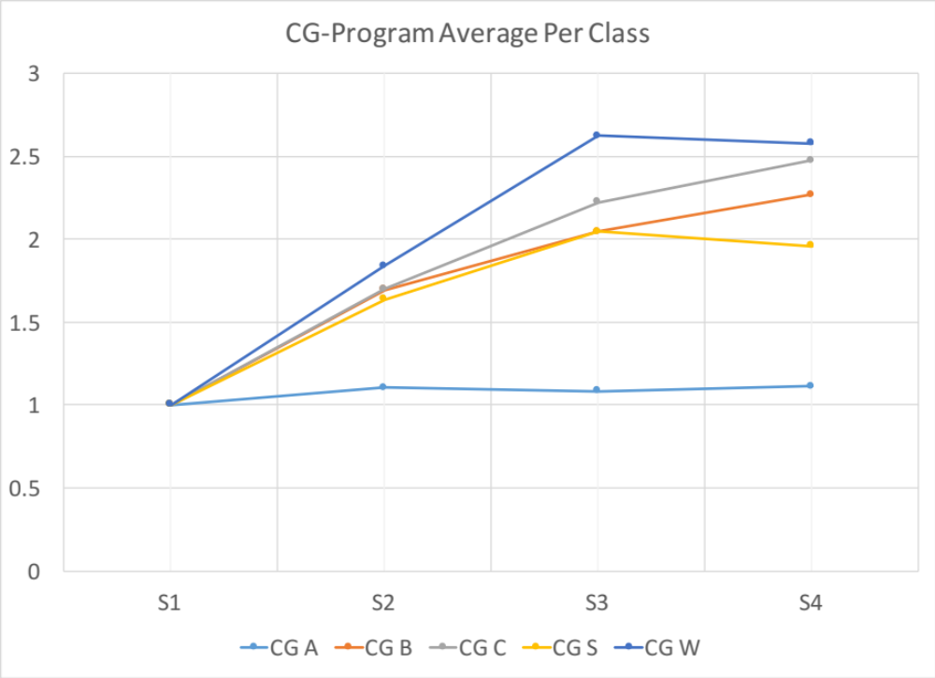
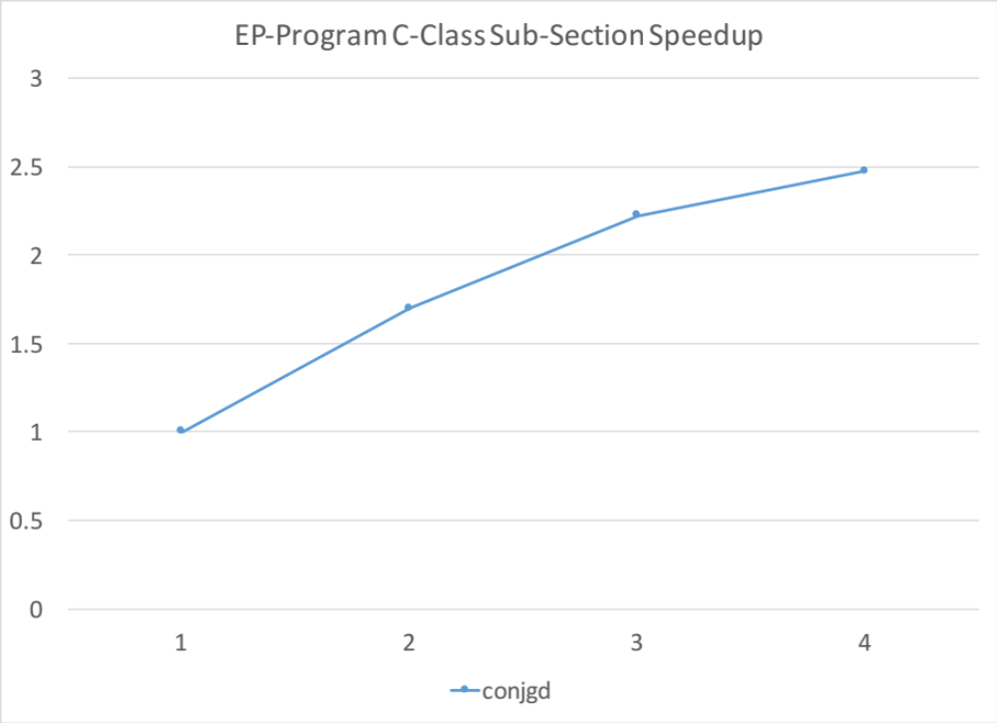
CG

Slide 16
CG – Discussion
Also benefits rather well from parallelization and multi-processes, speedup of about +0.4938/core.
Smaller classes don’t benefit as well from parallelization.
Since memory access is done randomly cache performance will impact it more.

Slide 17
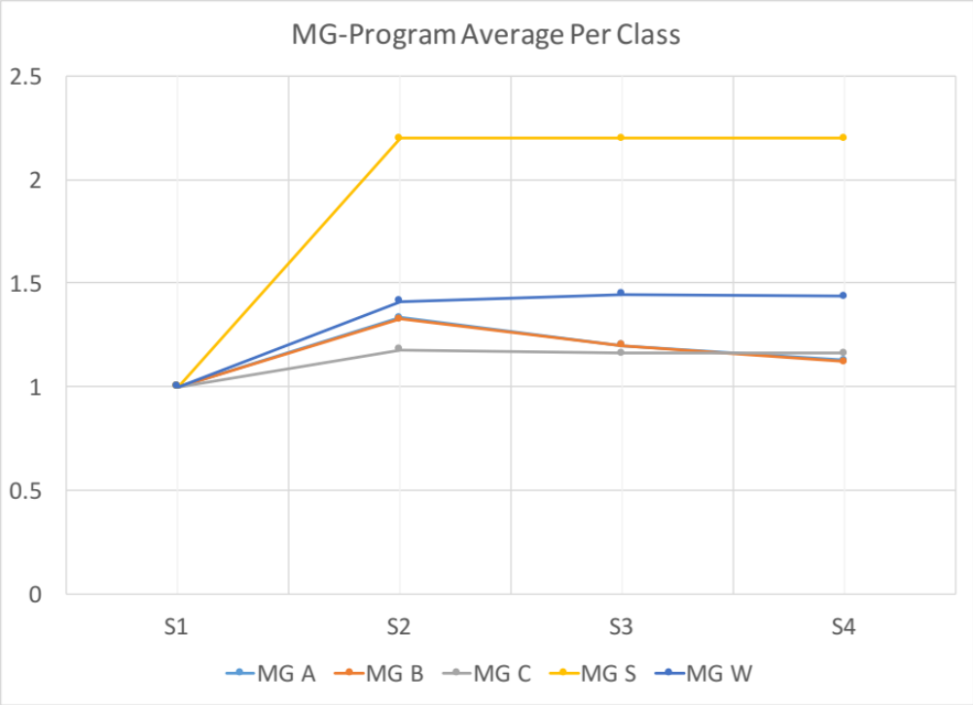
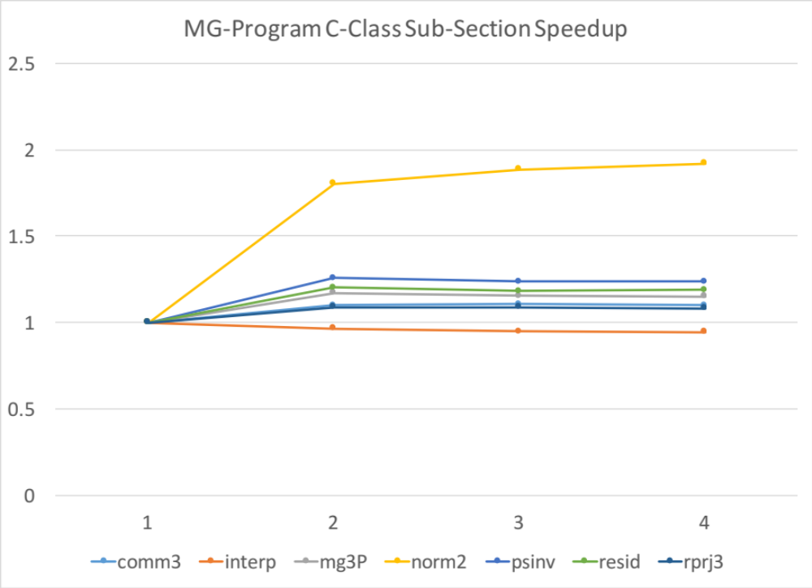
MG

Slide 18
MG – Discussion
This program traverses large distances when reading data, impact of the cache can bee seen here. Speedup of about +0.0472/core.
The smallest class benefitted the most since it is possible to fit most of the data in caches.
Although we get a speedup, the bottleneck of this program is memory architecture performance.

Slide 19
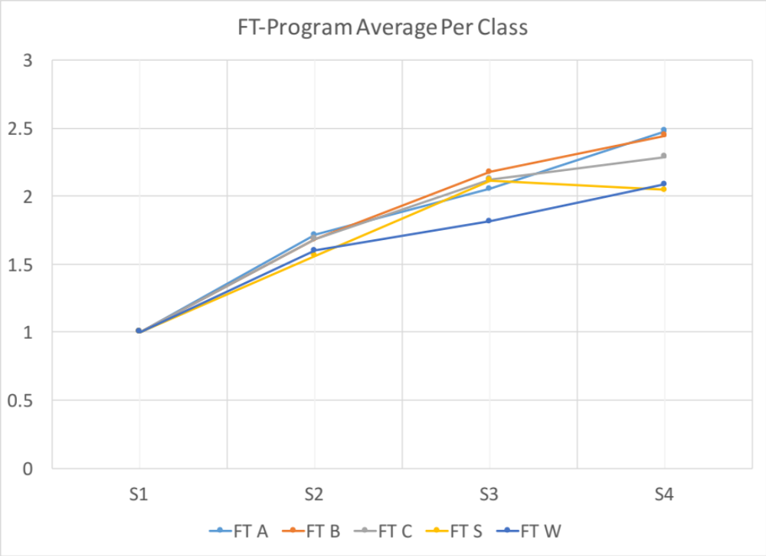
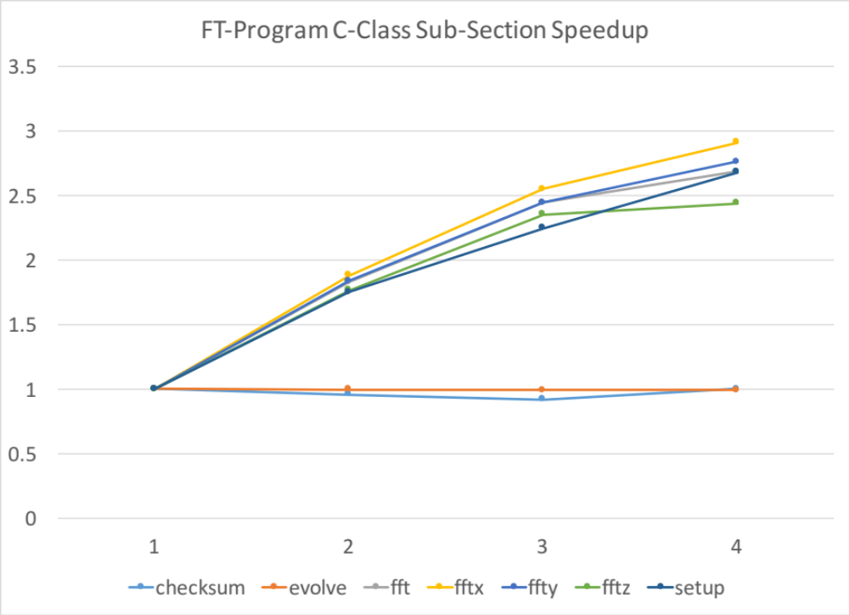
FT

Slide 20
FT – Discussion
Similar to the IS program, this also benefits greatly from parallelization and multi-processes. Even the smaller classes. Speedup of about +0.4304/core.
Suffers from data as threads do share some of the calculation.
Bottleneck of this program is the verification sub-process done via `checksum` and the `evolve` sub-process. Both are linear/sequential tasks.

Slide 21
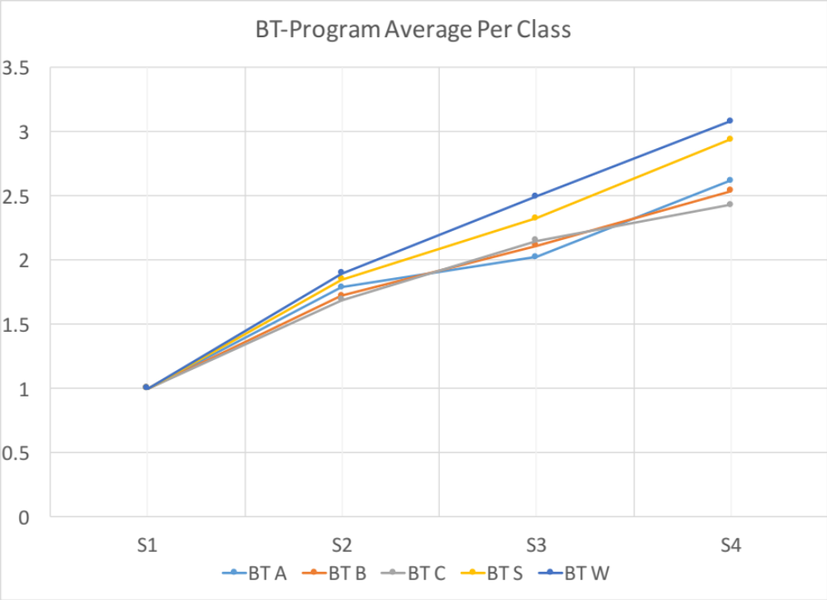
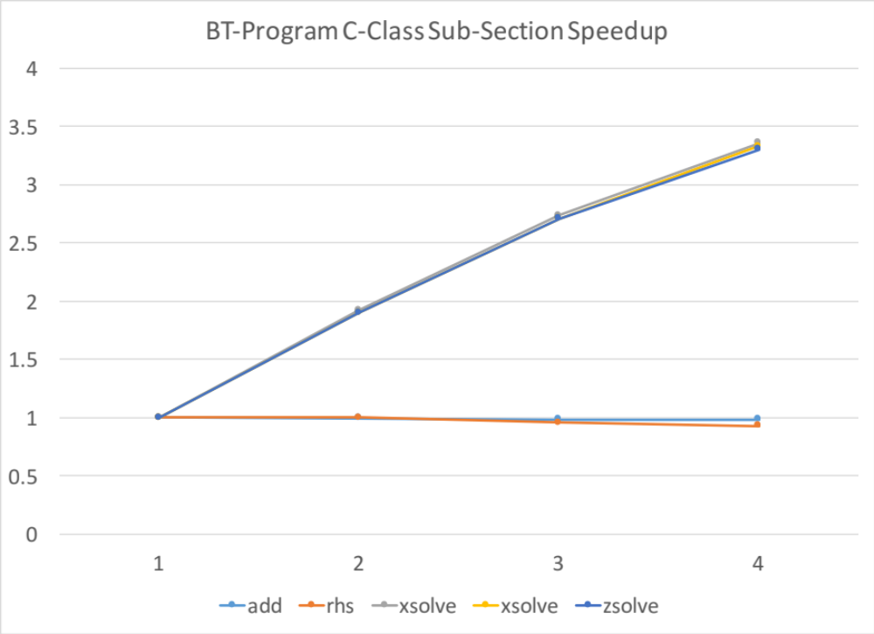
BT

Slide 22
BT – Discussion
Speedup of about +0.4750/core.
Loop was nested so that the fastest changing variable is the leftmost to ensure unit stride. This was not often enforced and so were more cache misses. This can be found in most components of the BT benchmark.
The equations are very long and thus create data dependence. There is also a low number of arithmetic units. Lots of array elements are used and thus there are many data memory accesses.
High memory requirements. Problem size scaled cubicly, given the stencil was performed on 3D matrices. There were also many auxilliary matricies used to calculated other terms used in the CFD simulations. Given the number of floating point operations and terms required, it used up cache memory. We see drop in performance as number of cores increased because of restricted cache size.
**The above points are prominent in xsolve, ysolve, and zsolve. Appears also in rhs*
True data dependencies in rhs& subroutine since many terms depend on terms calculated in previous iterations of the loop.

Slide 23
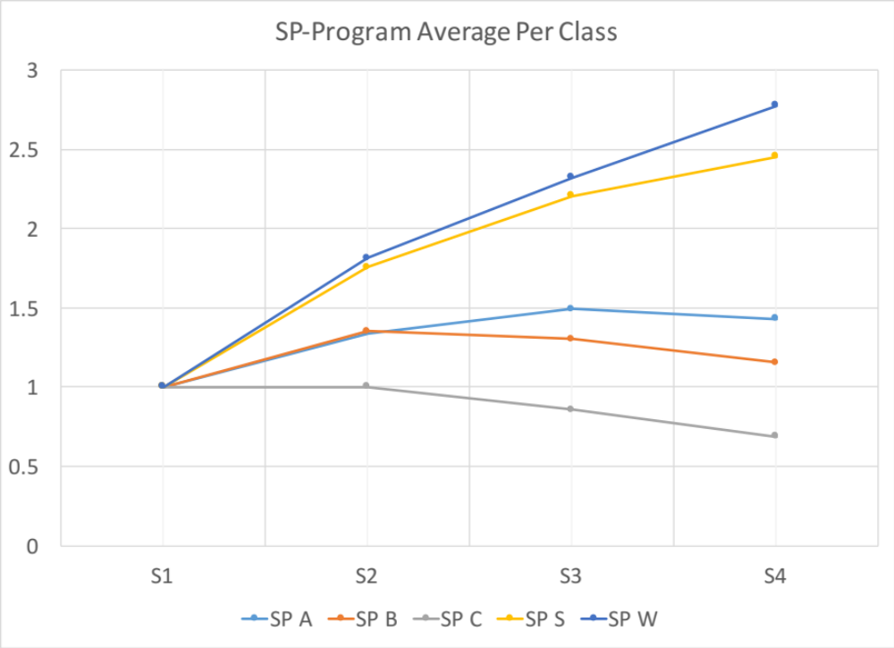
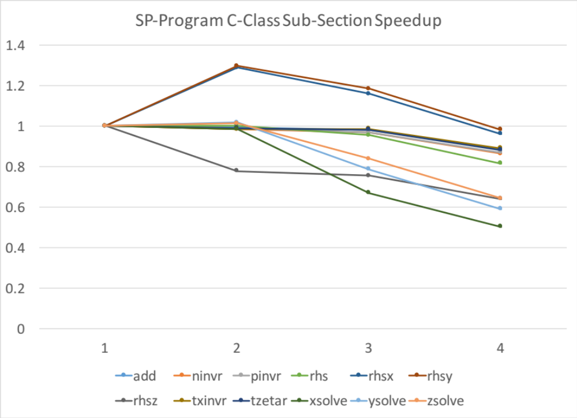
SP

Slide 24
SP – Discussion
Speedup of about -0.1071/core.
Loop was nested so that the fastest changing variable is the leftmost to ensure unit stride. This was not often enforced and so were more cache misses. This can be found in most components of the SP benchmark.
The equations are very long and thus create data dependence. There is also a low number of arithmetic units. Lots of array elements are used and thus there are many data memory accesses.
High memory requirements. Problem size scaled cubically, given the stencil was performed on 3D matrices. There were also many auxiliary matrices used to calculated other terms used in the CFD simulations. Given the number of floating point operations and terms required, it used up cache memory. We see drop in performance as number of cores increased because of restricted cache size.
**The above two points are prominent in rhs*, xsolve, ysolve, zsolve, . Appears also in rhs**
True data dependencies in rhs& subroutine since many terms depend on terms calculated in previous iterations of the loop.

Slide 25
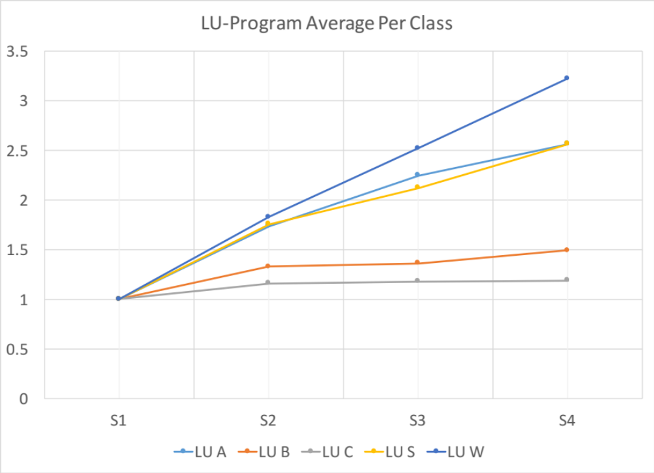
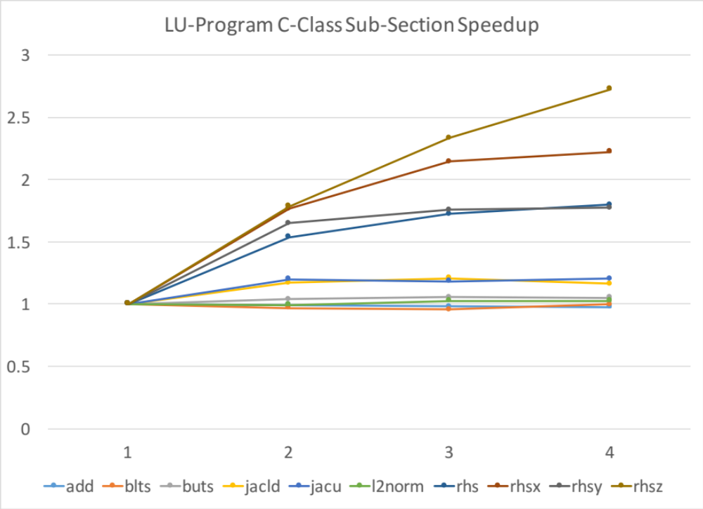
LU

Slide 26
LU - Discussion
Speedup of about +0.0584/core.
Loop was nested so that the fastest changing variable is the leftmost to ensure unit stride. This was not often enforced and so were more cache misses. This can be found in most components of the LU benchmark.
The equations are very long and thus create data dependence. There is also a low number of arithmetic units. Lots of array elements are used and thus there are many data memory accesses.
High memory requirements. Problem size scaled cubicly, given the stencil was performed on 3D matrices. There were also many auxilliary matricies used to calculated other terms used in the CFD simulations. Given the number of floating point operations and terms required, it used up cache memory. We see drop in performance as number of cores increased because of restricted cache size.
**The above two points are prominent in jacld, blts, jacu, buts. Appears also in rhs**
True data dependencies in rhs subroutine since many terms depend on terms calculated in previous iterations of the loop.

Slide 27
Conclusions
Speedup heavily influenced by data dependencies and architectural hazards
Theoretical speedup should increase linearly with number of processors, in reality, other processes (e.g. OS, etc.) interfere as well as overhe

Slide 28
References
    https://en.wikipedia.org/wiki/Haswell_(microarchitecture)
    https://en.wikipedia.org/wiki/Broadwell_(microarchitecture)
    http://openmp.org/
    https://www.nas.nasa.gov/publications/npb.html
    https://www.nas.nasa.gov/assets/pdf/techreports/1994/rnr-94-007.pdf
    https://www.nas.nasa.gov/assets/pdf/techreports/1999/nas-99-011.pdf
    http://h21007.www2.hp.com/portal/download/files/unprot/fortran/docs/vf-html/pg/pguaracc.htm
    https://github.com/itomaldonado/multiprocessor-benchmarking-exploration

Slide 29
Appendix
Extra charts and results

Slide 30
Computer #2:
Speedup Results
Speedup per program class and speedups for all sub-sections for class C programs.
2 Cores, 1-8 threads.
Demonstrates negative performance when overscheduling threads.

Slide 31
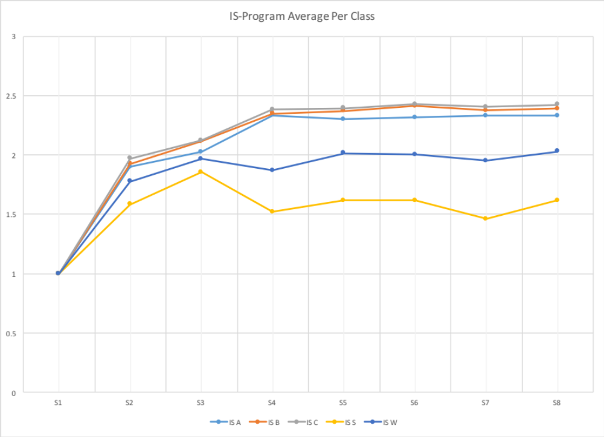
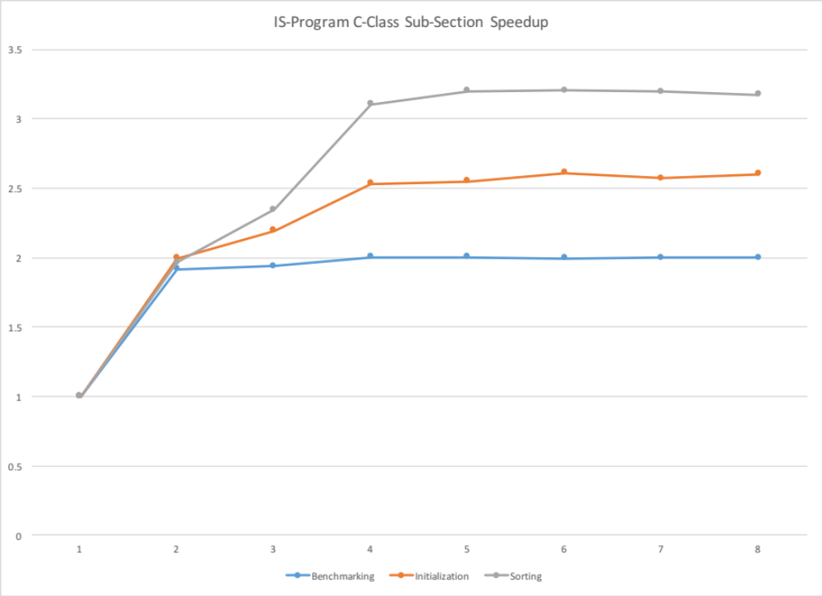
IS

Slide 32
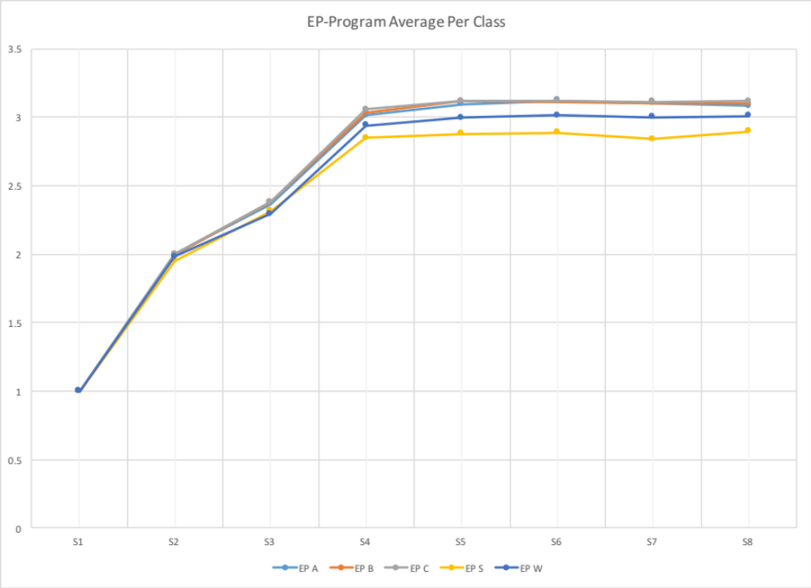
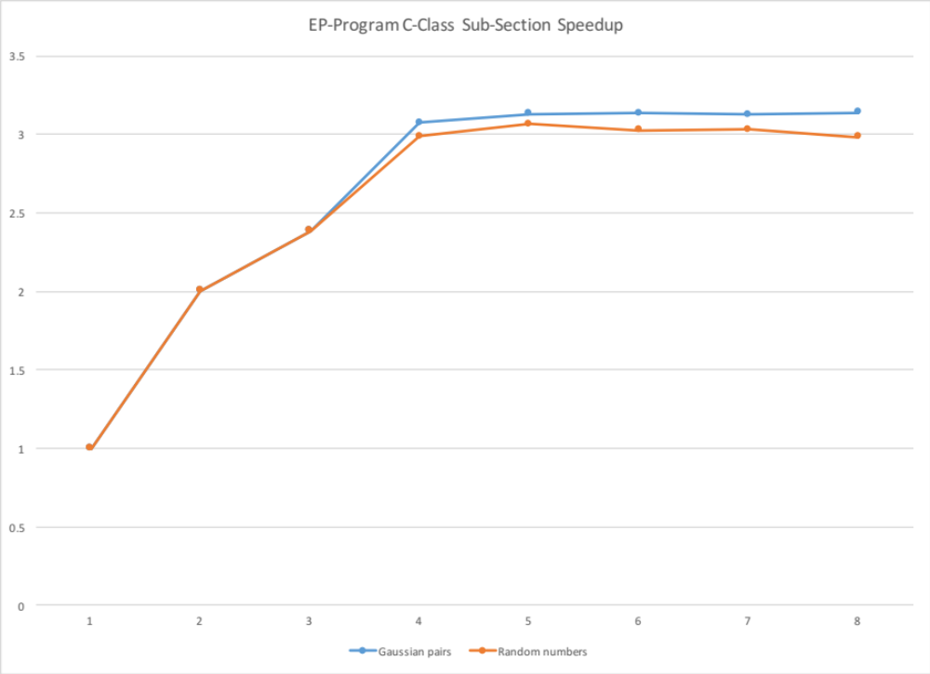
EP

Slide 33
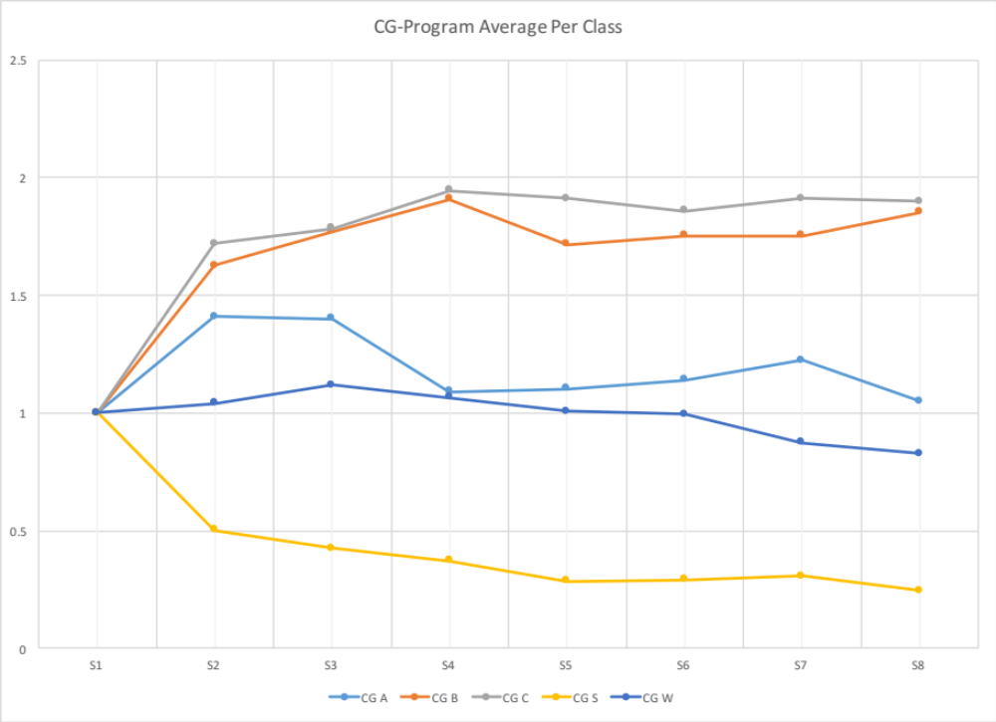
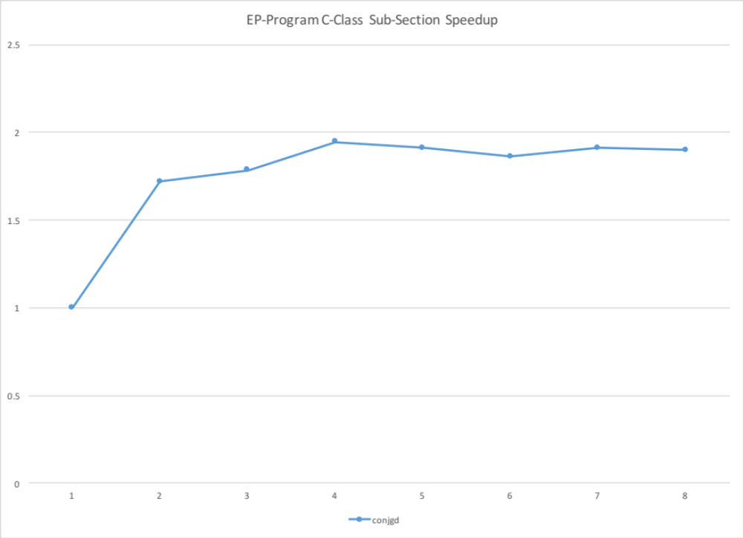
CG

Slide 34
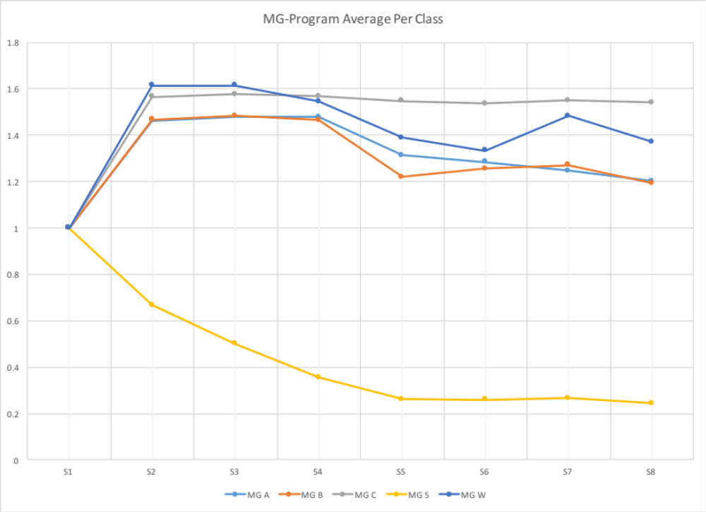
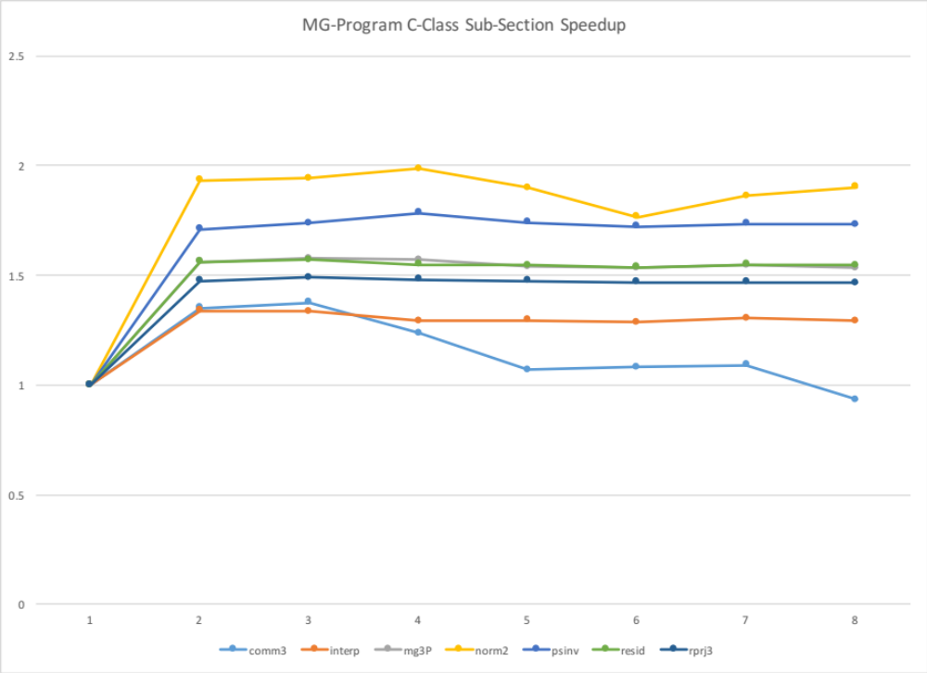
MG

Slide 35
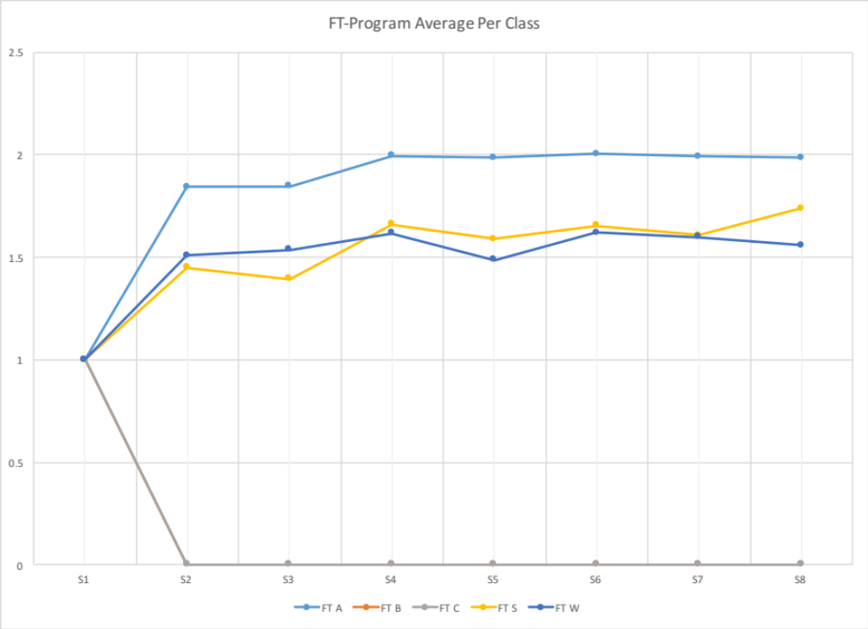
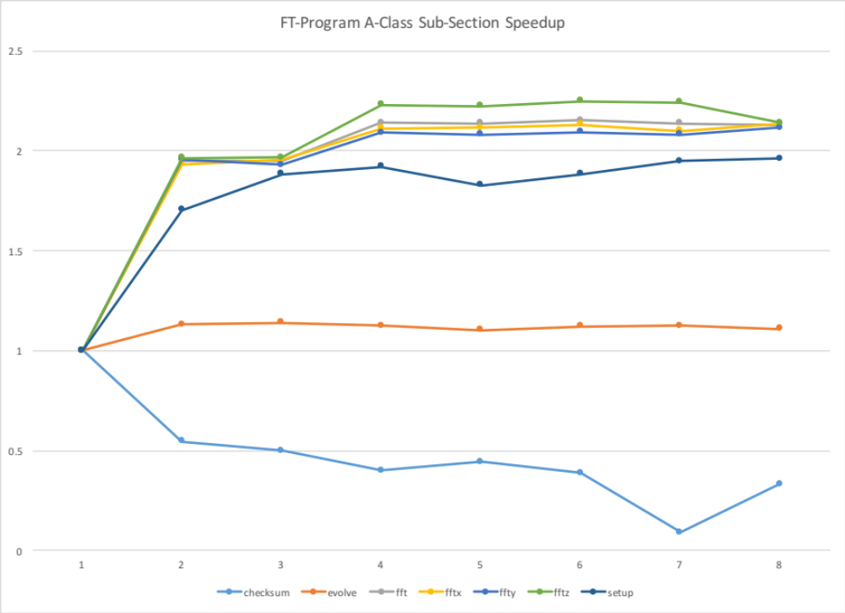
FT *A Class

Slide 36
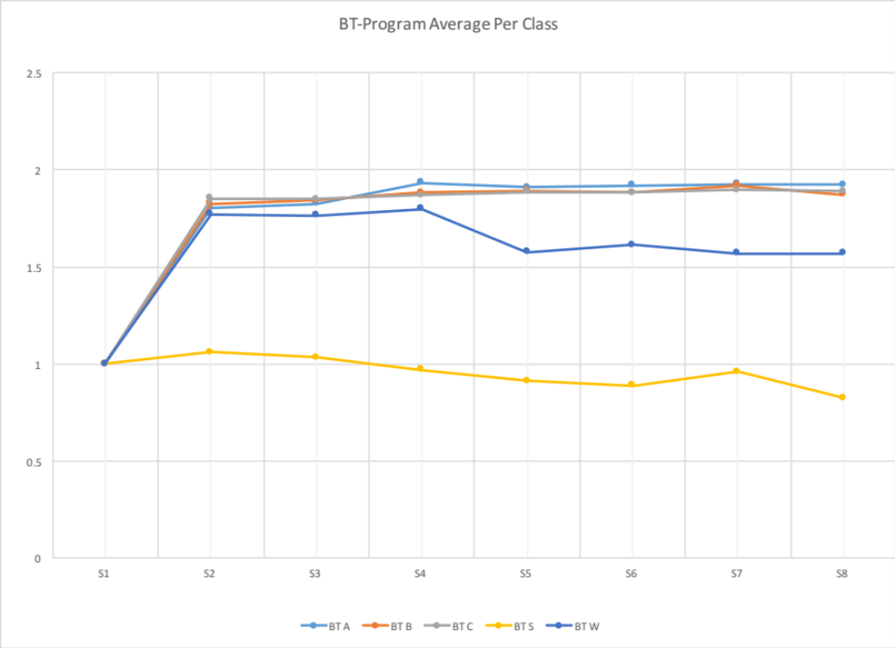
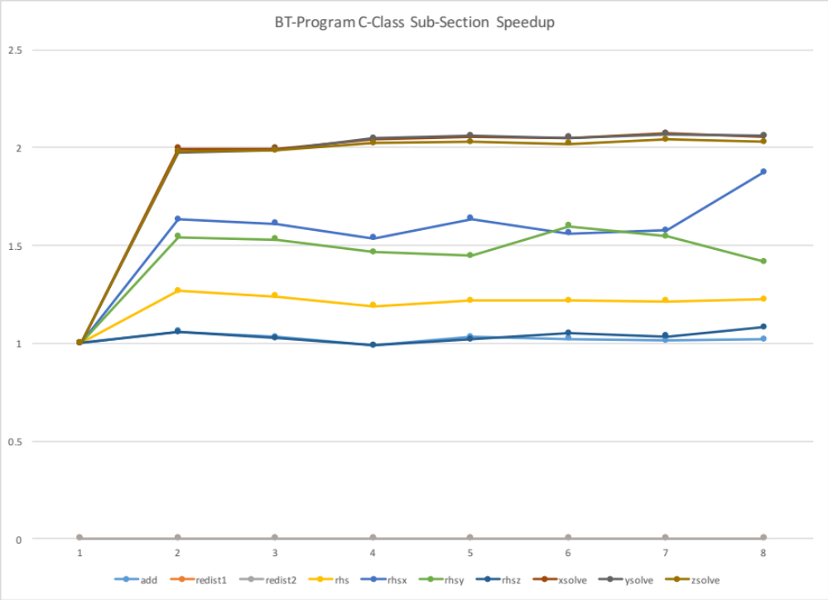
BT

Slide 37
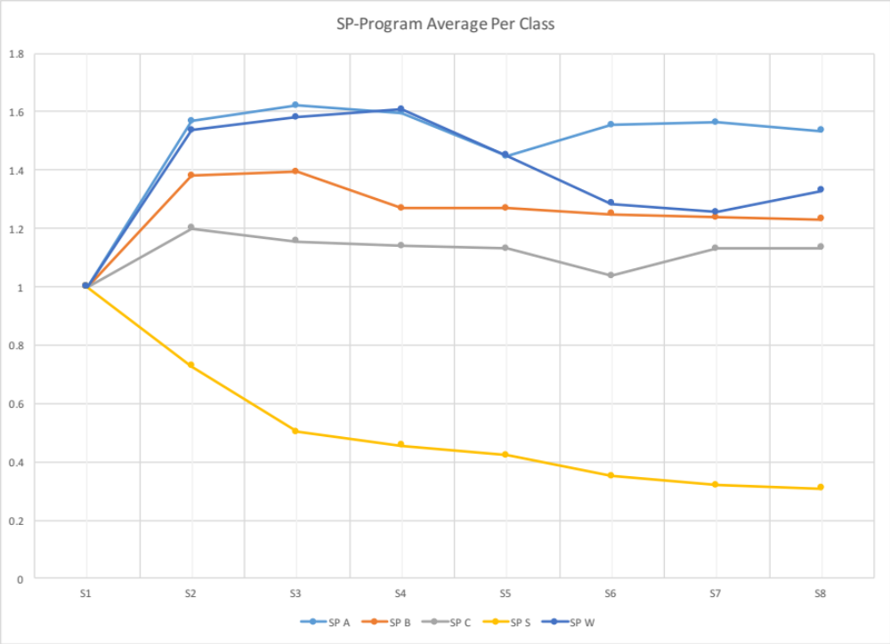
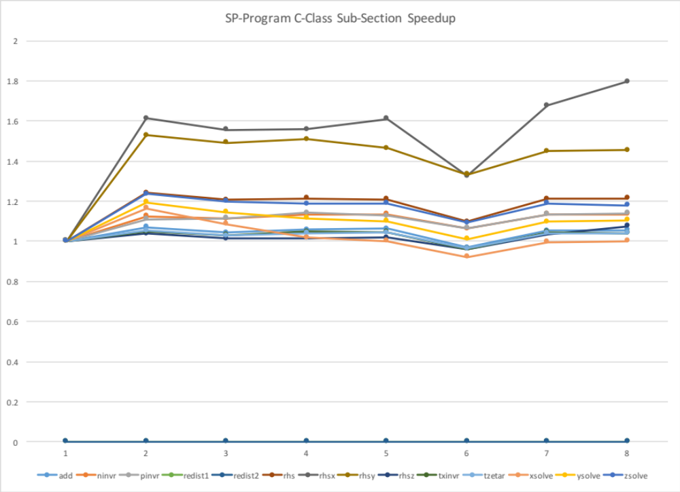
SP

Slide 38
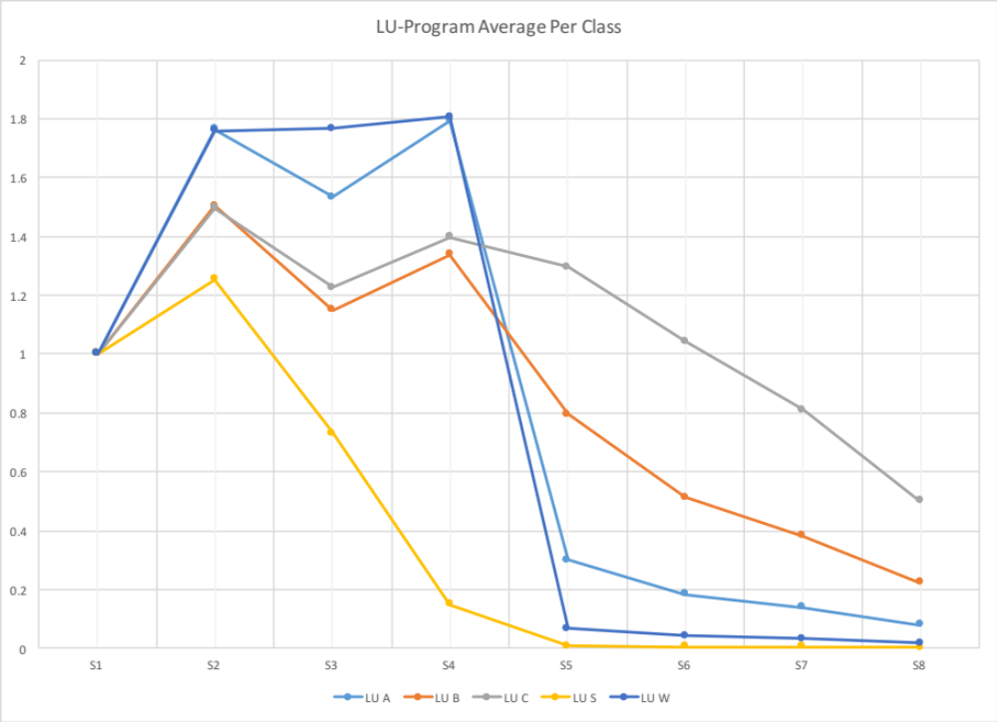
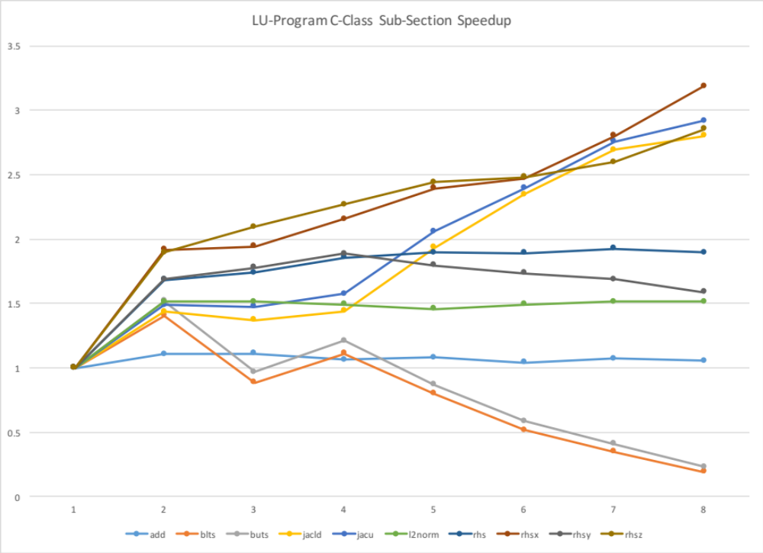
LU

