Slide 1

What makes a good red wine
Analytical approach to understanding the drivers behind high wine reviews
Presenter: Hristo Hristov
23-01-2024

Slide 2
Background
Problem statement
The quality of the red wine assortment needs to be further improved, but there is no clear definition of what a good wine is
Data
1599 red wines samples
Quality ratings on a scale from 3 to 8 (full scale is between 0 and 10 but there is no data for the other scores)
Approach
Perform exploratory data analysis
Explore and test different ML models that also provide model explanatory (i.e. feature importance)
Objectives
Understand and define what constitutes a good red wine (using wine rating as benchmark)
Provide recommendations for the assortment selection
11 red wine features (characteristics)
Use the best performing model to understand the main contributing features and use it as a classifier
Explore additional ML/visualization techniques to get additional insights
Build an API for model consumption

Slide 3
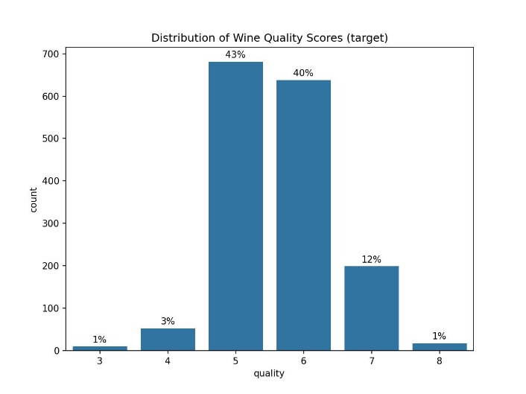
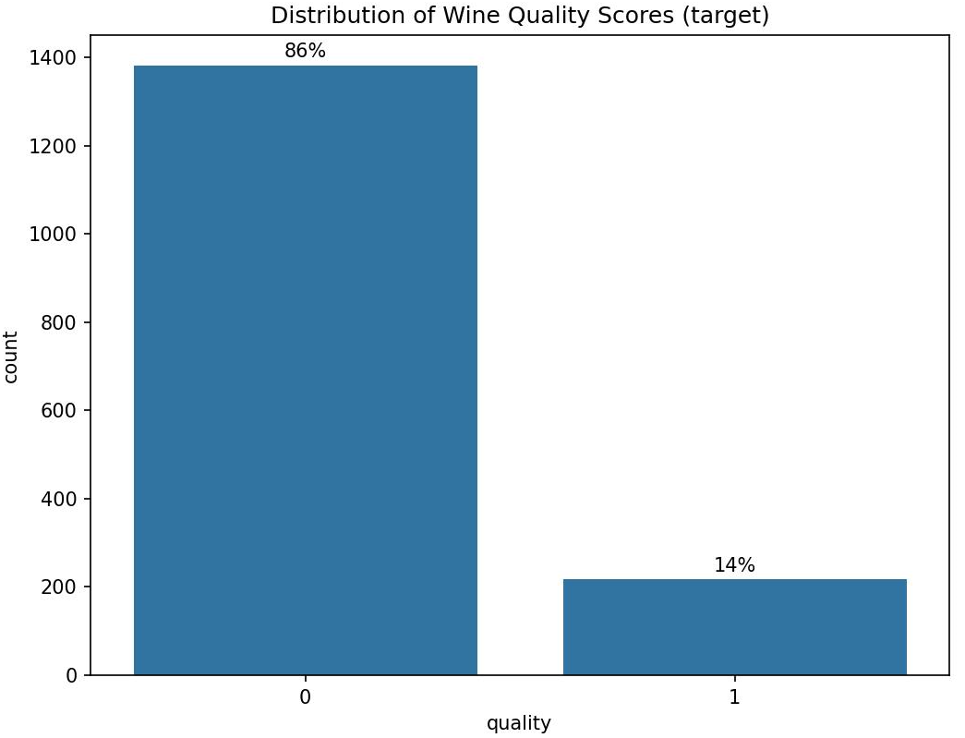
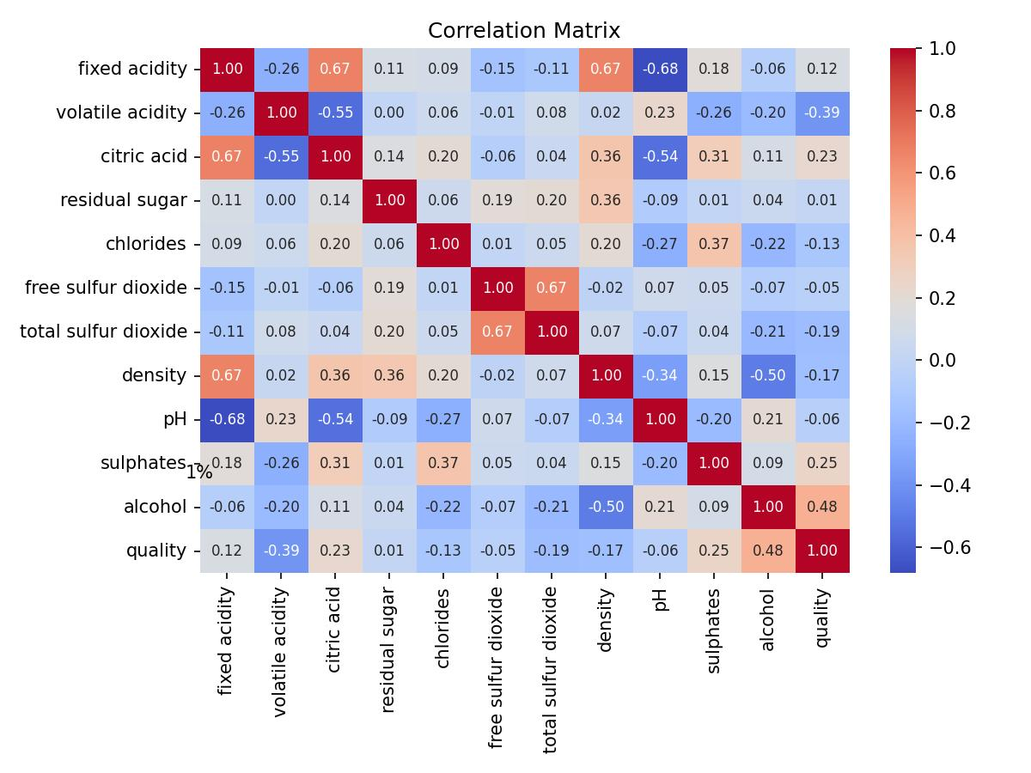
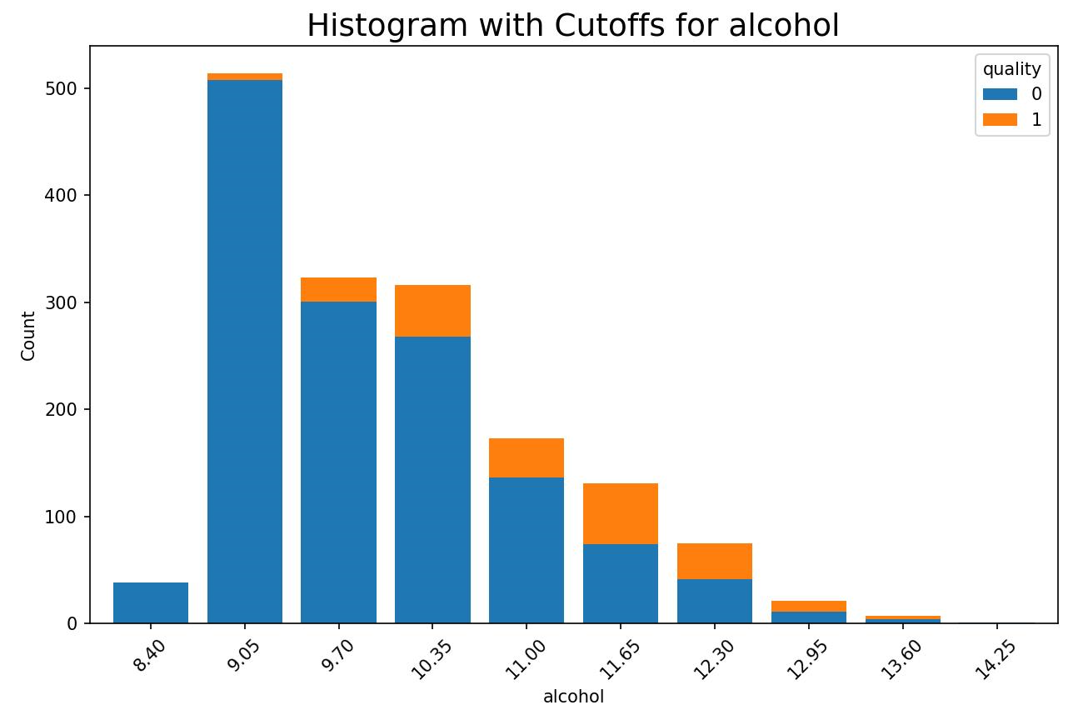
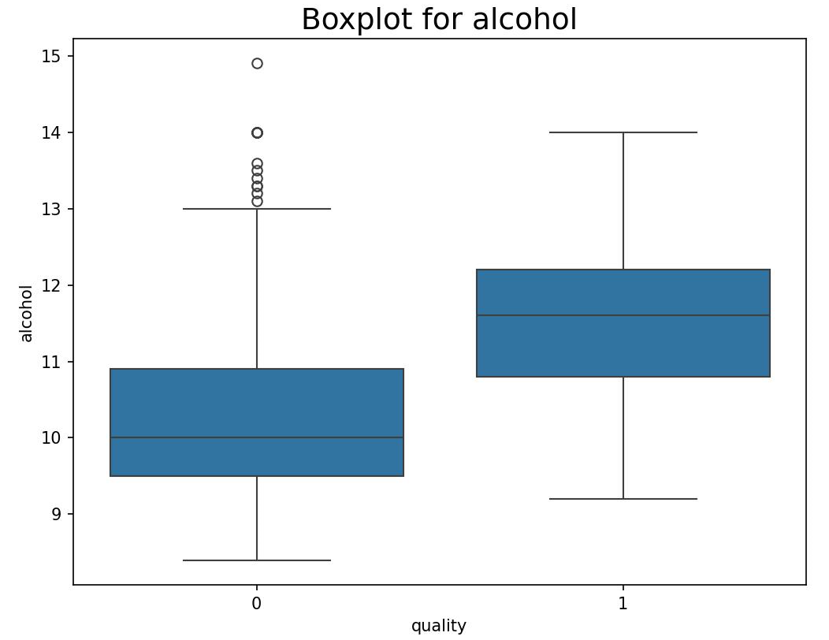
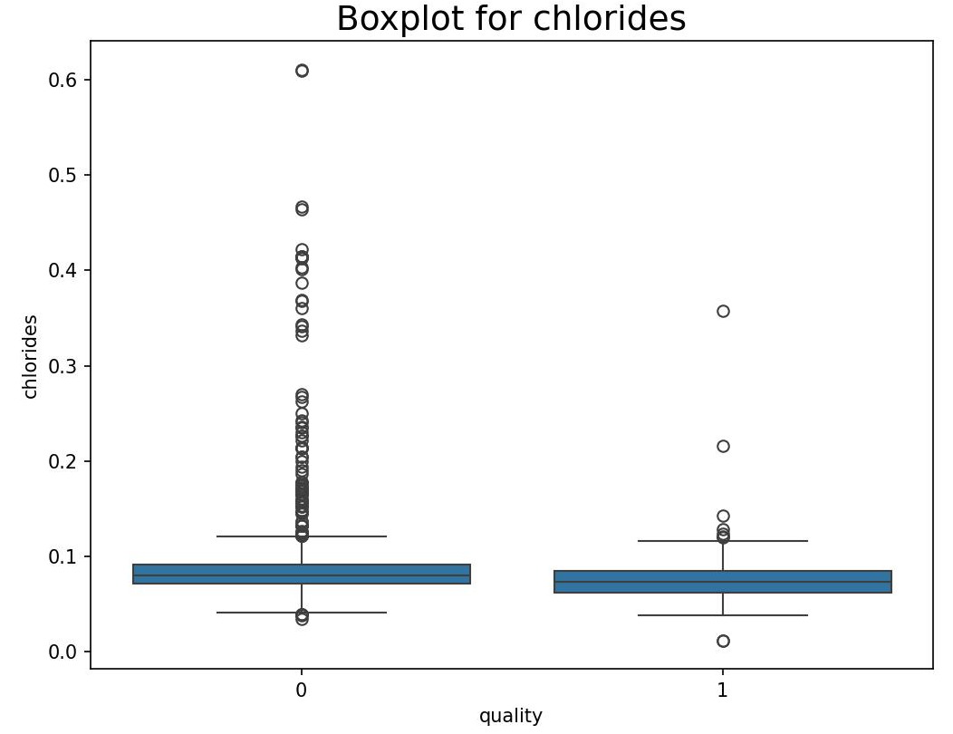
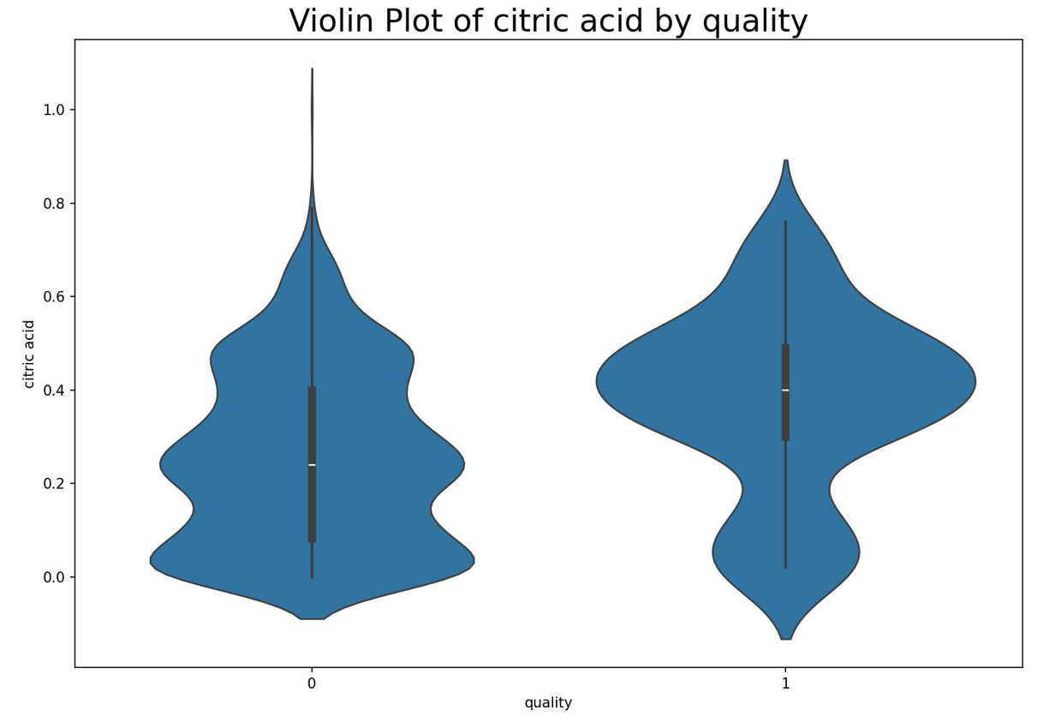
Exploratory data analysis
Target variable distribution
Correlation matrix
All features are numeric
No strong correlation between features
Alcohol, Volatile acidity, Citric acid and Sulphates suggest relation to the target variable
Correlation doesn’t take into account interaction between variables -> machine learning modeling would be applied
3 distinct quality groups – low (3, 4), regular (5, 6) and high (7, 8)
Sample for ‘low’ quality is small and as this group is not the focus, it would be grouped with ‘regular’
The dataset is unbalanced
The exploratory was done for the original and bucketeized quality groups
Outliers and feature distributions
Distribution of feature variables is not always normal -> IQR for flagging outliers will be used
Taking out the outliers from all variables leads to app. 30% reduction in the training data -> will focus on potentially important features only
There will be 3 data sets used: original, w/o outliers and scaled

Slide 4
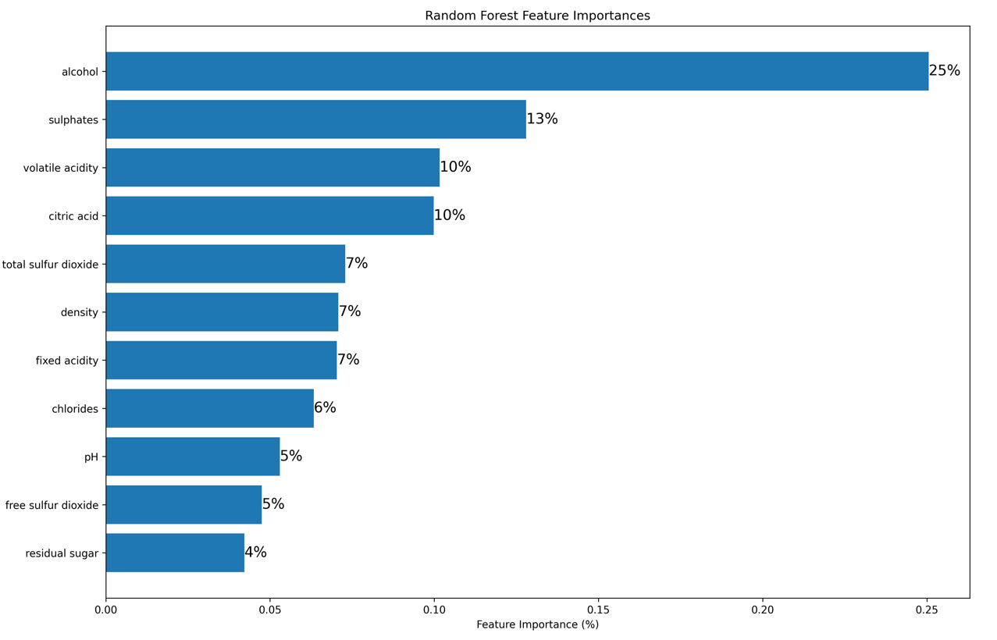
ML Model
Training details
5 types of explainable ML models were tested – Logistic regression, Decision Tree, Random Forest, GBM and GBM Lite
Grid search with 5-fold cross validation was done over the 3 data sets (80/20 split).
Overall more than 850 models were trained and tested
Random Forest was selected as the model with best performance. The focus is on the ‘high quality’ class (the minority class):
Precision: 0.80, Recall: 0.54, F1: 0.65
Consideration
Macro Precision was used as a scoring function. The reasoning is that the cost of introducing a low quality wine in the assortment would be high. Good precision means that it’s not likely that a wine marked as ‘high’ quality would turn out to be ‘regular/low’ quality. This would make even more sense if the goal is to add new wines in the assortment as the shelf space is limited and ideally it should be filled only with high quality wines
Conclusion
Alcohol, Sulphates, Volatile acidity and Citric acid are the most important components that determine a red wine rating
Their total contribution is app. 60%
The other features also have predictive power and adding value to the overall performance of the model
From data exploratory the relations are – higher Alcohol, Sulphates, Citric Acid and lower Volatile acidity, can be associated with better scores

Slide 5
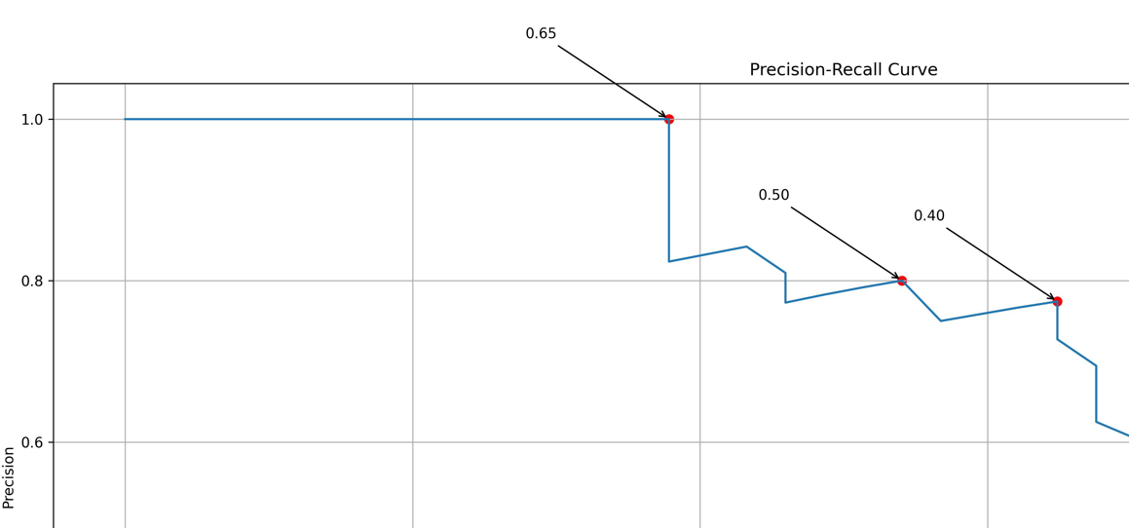
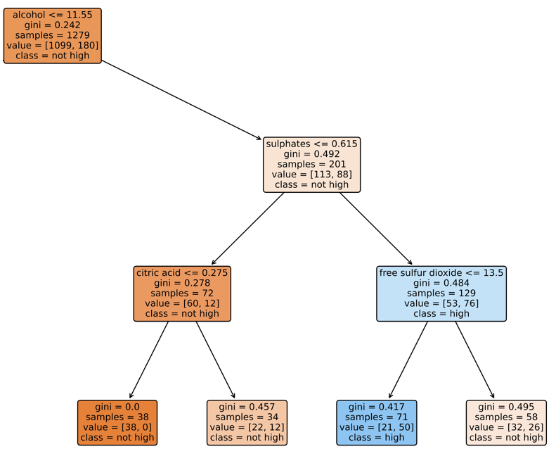
Recommendations
Based on the comprehensive analysis there two potential actions:
Option 1 is the recommended way forward as it provides very precise method to identify high quality red wines
Option 2 can be used in case there are challenges with implementing Option 1 (e.g. difficulties with data collection, challenges with deployment…)
Option 1: Fully automated ML model to label red wines. Model is exposed with an API
The trained Random Forest model was specifically tuned to provide recommendations with high precision. The cut-off point (default 0.5) can be further tuned depending on the need:
For new wines that are to be added it could be increased to 0.65 (P: 1.0, R: 0.4) This way any wine flagged as ‘high quality’ would almost certainly be one.
For scoring existing assortment the threshold could be lowered to 0.40 (P:0.8, R:0.6) to reduce the change of omitting high quality wines that are already in the assortment.
Option 2: Rule of thumb approach by analyzing a decision tree
A simple recipe for good red wine:
Alcohol higher than 11.5
Sulphates higher than 0.6
(Optional) Free Sulfur dioxide less than 13.6
Traversing the branches of a decision tree could uncover the pattern for distinguish a good red wine. This approach is taking into account the interaction between the different components

Slide 6
Thank you!
Q&A

