Slide 1

The Open Source OpenID Connect (OIDC) Framework

Slide 2
Outline
Motivate IdentityServer3
Hosting, Configuring and running IdentityServer3

Slide 3
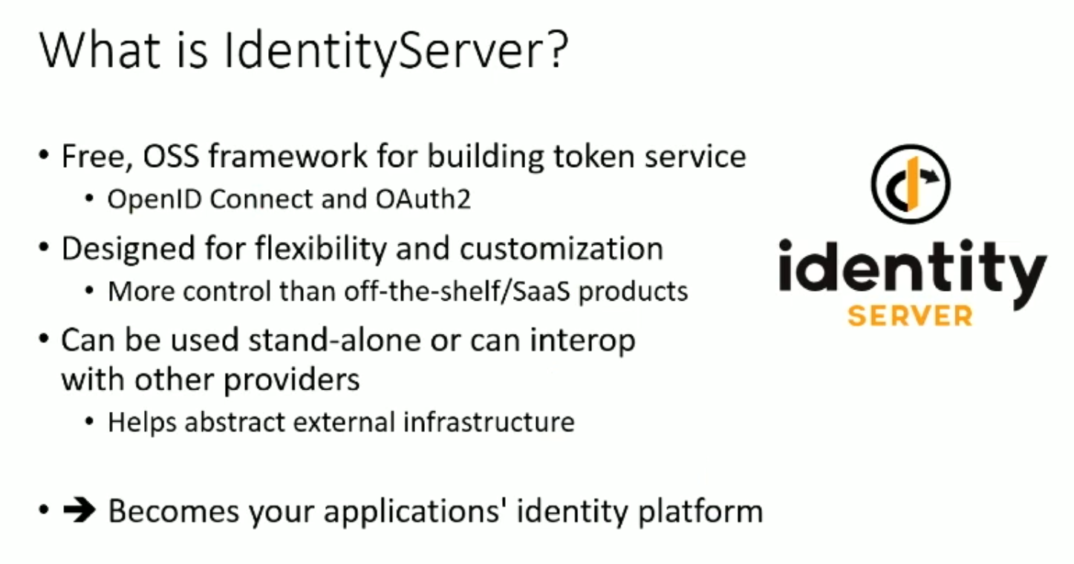
What is IdentityServer?
Framework for building application security
Single Sign-On (SSO)
Protecting Web APIs

Slide 4
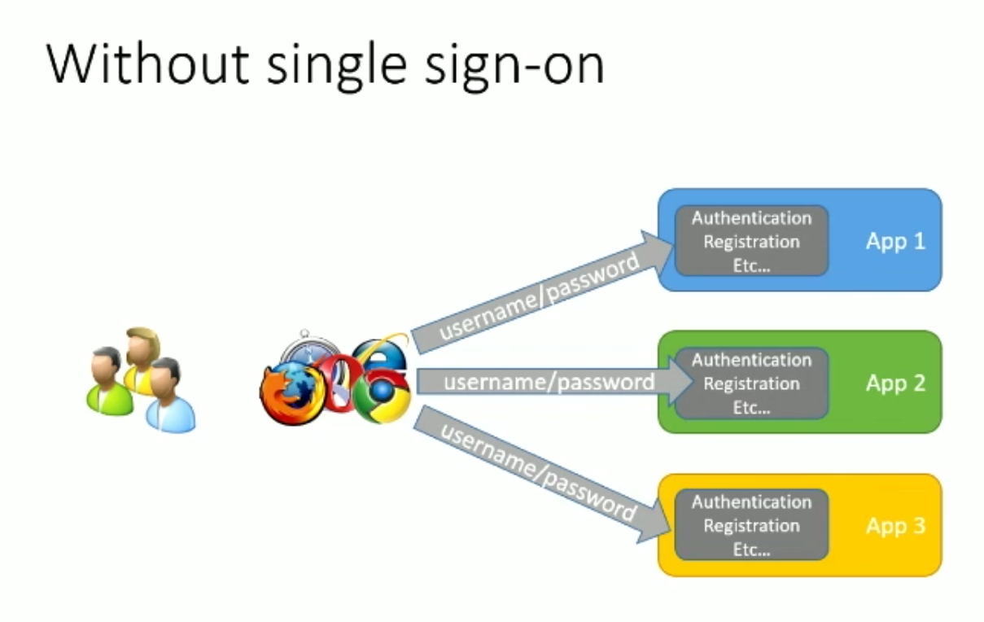
Without Single Sign-On (SSO)

Slide 5
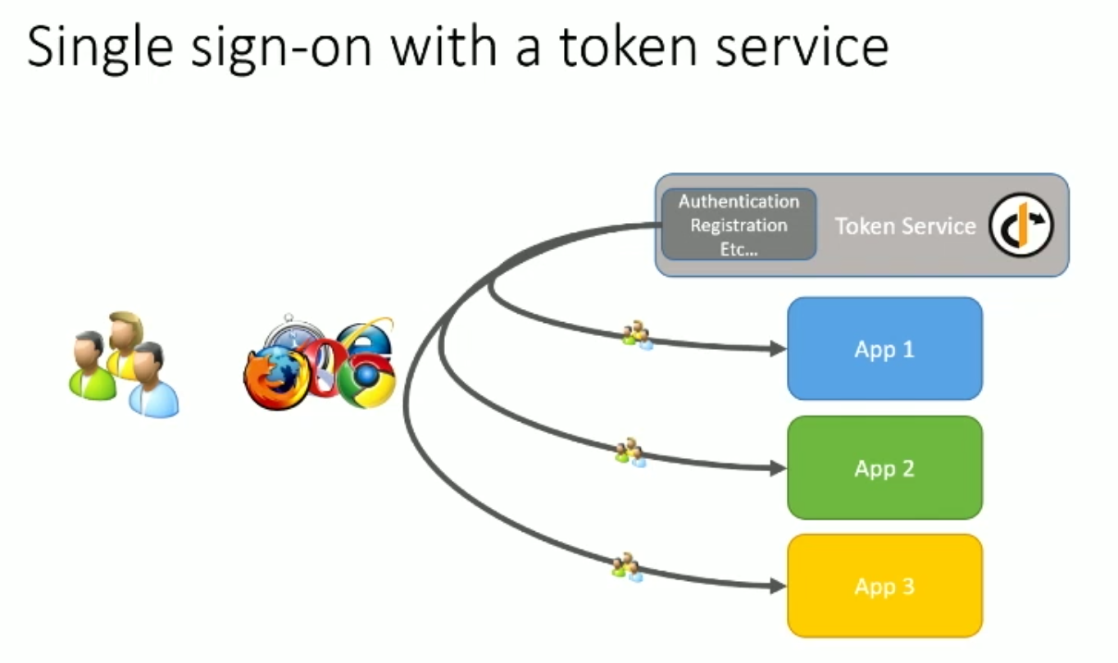
Single Sign-On with token service

Slide 6
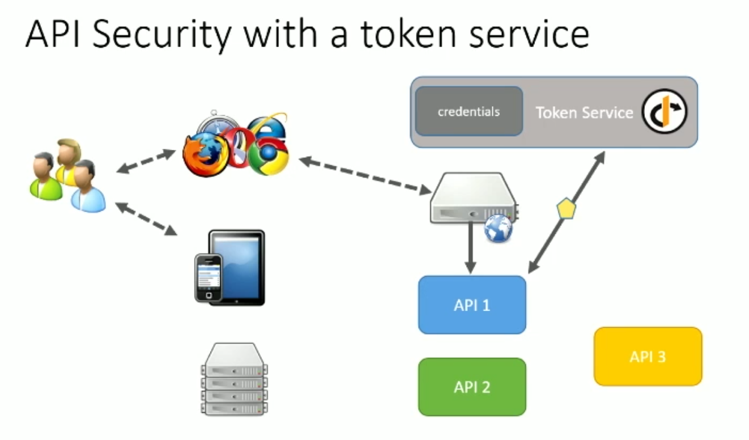
API Security with token service

Slide 7
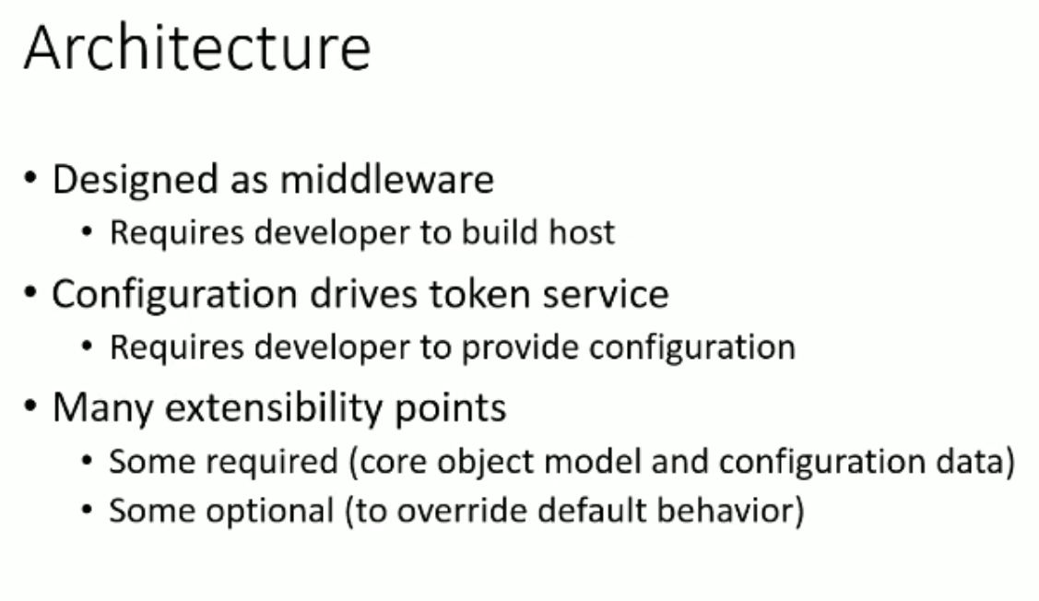
Architecture

Slide 8
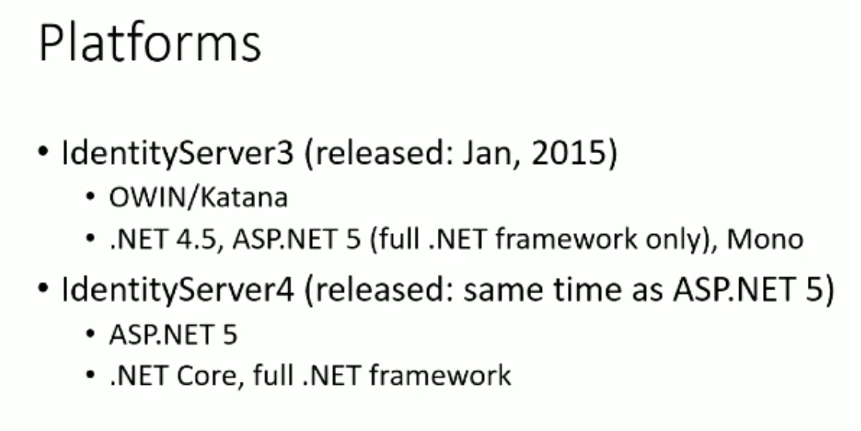
Platforms

Slide 9
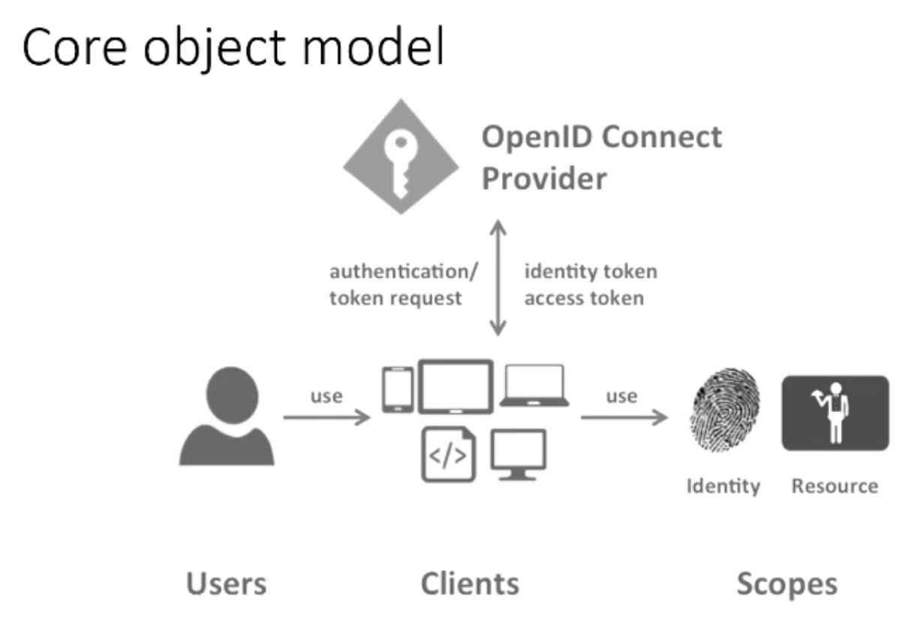
Core object model

Slide 10

Code

