Slide 1
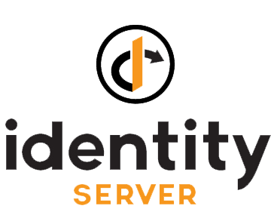
The Open Source OpenID Connect (OIDC) Framework
Abhimanyu Kumar Vatsa
Microsoft MVP | Software Developer
Twitter: @itorian | Email: itorian@live.in

Slide 2
Outline
What is IdentityServer ?
What is OIDC & SSO ?
API Security with IdentityServer ?
IdentityServer object model
IdentityServer Architecture ?
Flavors of IdentityServer ?
Demo

Slide 3
What is IdentityServer?
A full framework for building application security
Free, open source solution
OpenID Connect and OAuth2
Designed for flexibility and customization
More control than off-the-shelf/SaaS products
Becomes your application identity
Protects browser apps/web apps, web api, mobile apps

Slide 4
What is IdentityServer?
OpenID Connect
OpenID Connect was created for federated authentication, that is, letting a third-party authenticate your users for you, by using accounts they already have.
OAuth2
OAuth2 was created to remove the need for users to share their passwords with third-party applications.
Note: IdentityServer is OIDC Framework, with OAuth2 powered, so that your users may use OAuth2 on top of your OIDC.

Slide 5
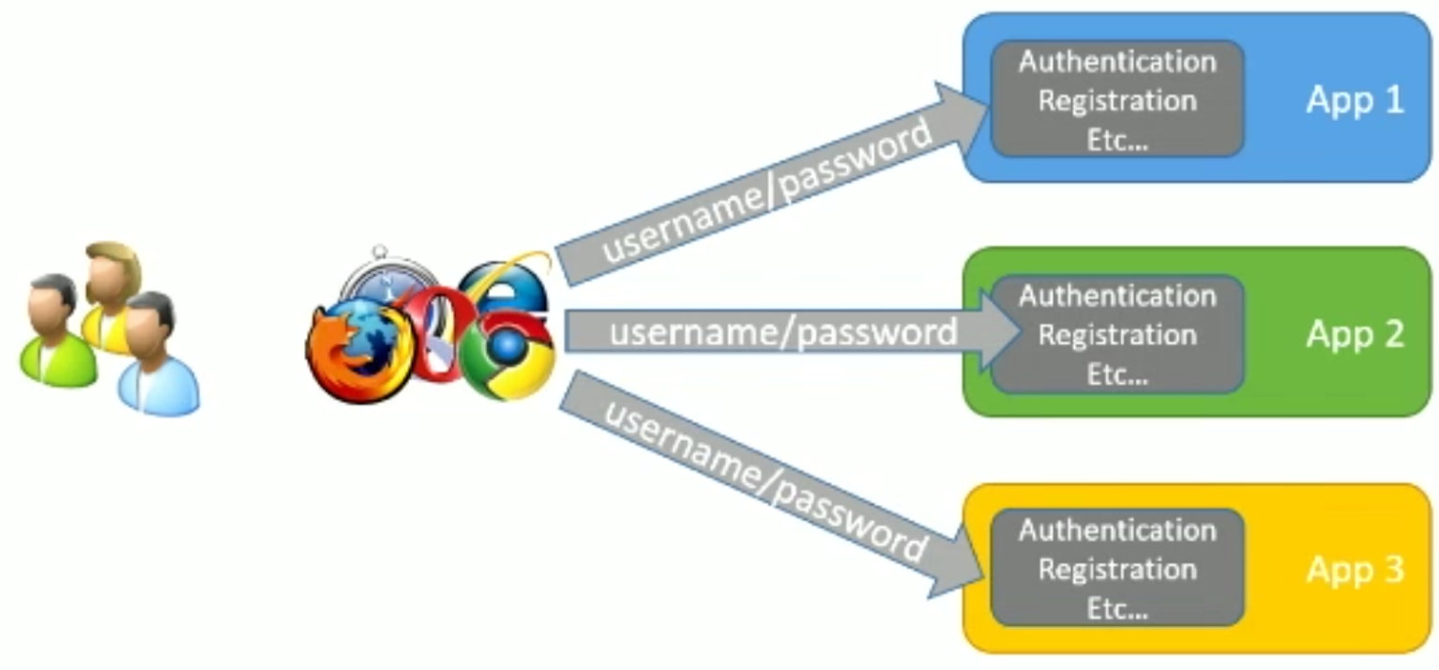
Without Single Sign-On (SSO)

Slide 6
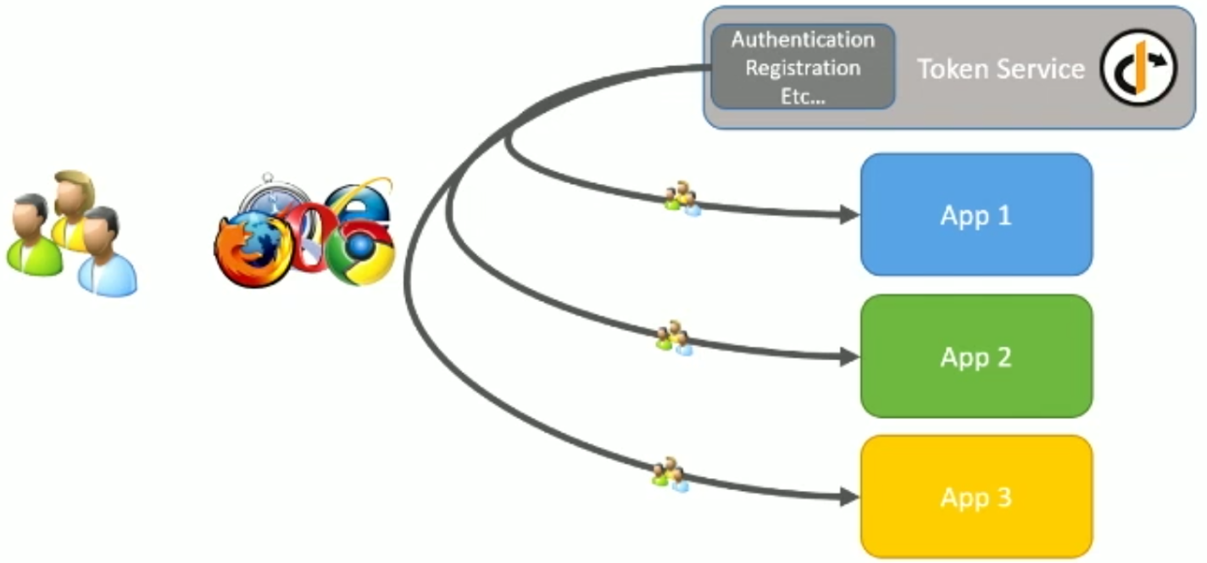
Single Sign-On with token service

Slide 7
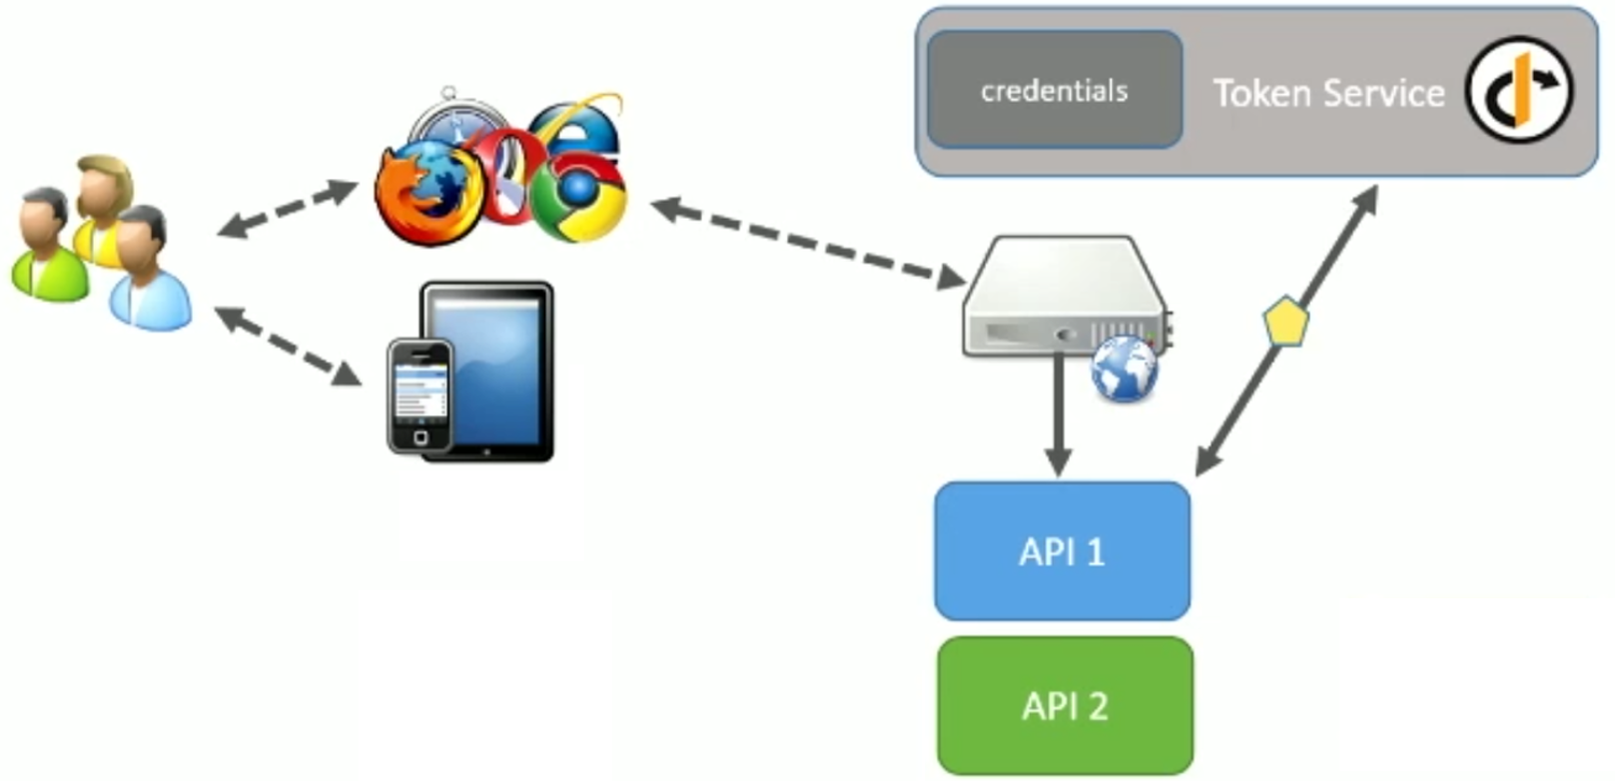
API Security with IdentityServer

Slide 8
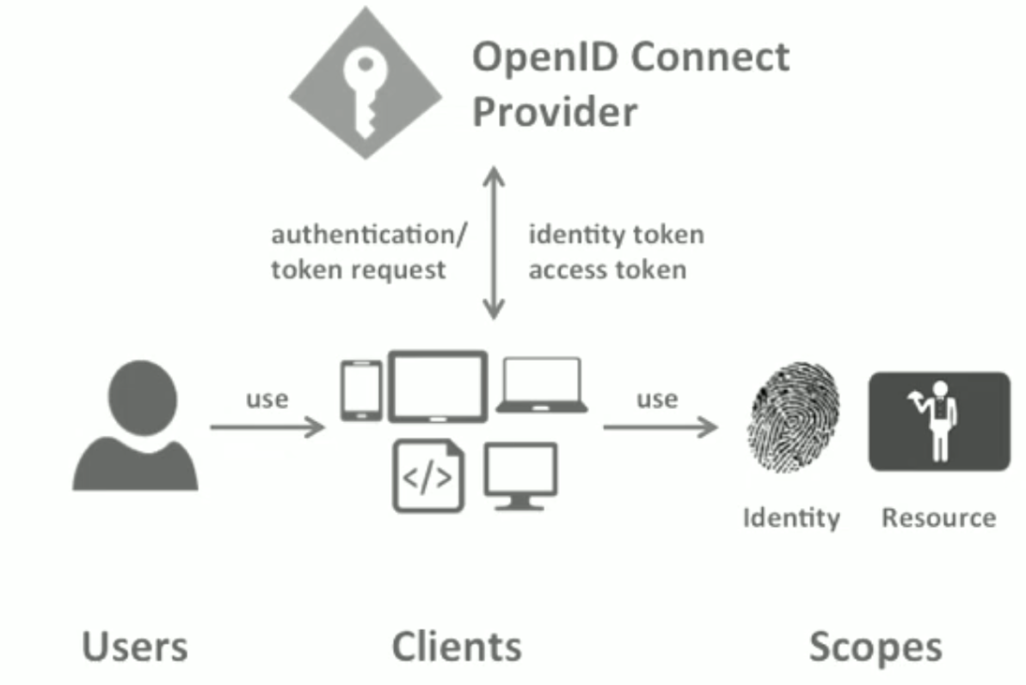
IdentityServer object model

Slide 9
IdentityServer Architecture
Designed as middleware, requires developer to build host
Configuration drives token service, requires developer to provide configuration
Many extensibility points, some required and some optional

Slide 10
Flavors of IdentityServer
IdentityServer3 (released: Jan, 2015)
OWIN/Katana
.NET 4.5, ASP.NET 5 (full .NET Framework only), Mono
IdentityServer4 (released: same time as ASP.NET 5)
ASP.NET 5
.NET Core, full .NET Framework

Slide 11
Further reading
MVC Step by step: https://identityserver.github.io/Documentation/docsv2/overview/mvcGettingStarted.html
Samples:
https://github.com/IdentityServer/IdentityServer3.Samples

Slide 12

Demo

