Slide 1
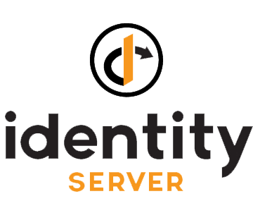
The Open Source OpenID Connect (OIDC) Framework

Slide 2
Outline
What is IdentityServer ?
What is OIDC & SSO ?
API Security with IdentityServer ?
IdentityServer object model
IdentityServer Architecture ?
Flavors of IdentityServer ?
Demo

Slide 3
What is IdentityServer?
A full framework for building application security
Free, open source solution
OpenID Connect and OAuth2
Designed for flexibility and customization
More control than off-the-shelf/SaaS products
Becomes your application identity
Protects browser apps/web apps, web api, mobile apps

Slide 4
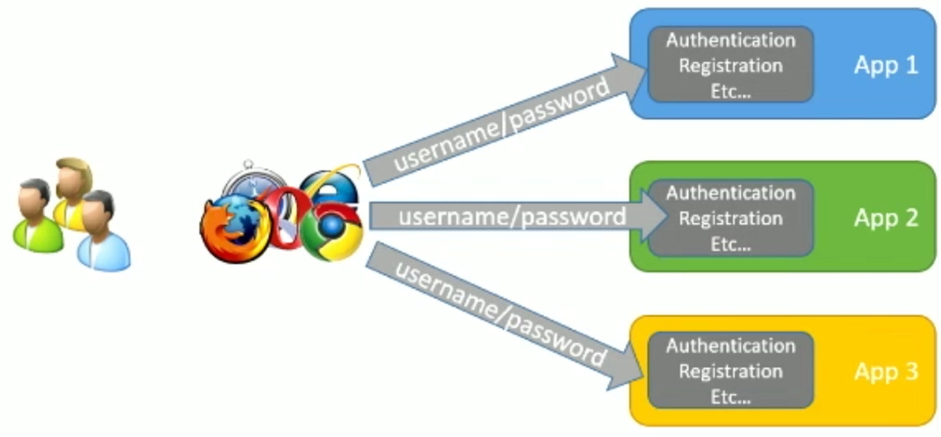
Without Single Sign-On (SSO)

Slide 5
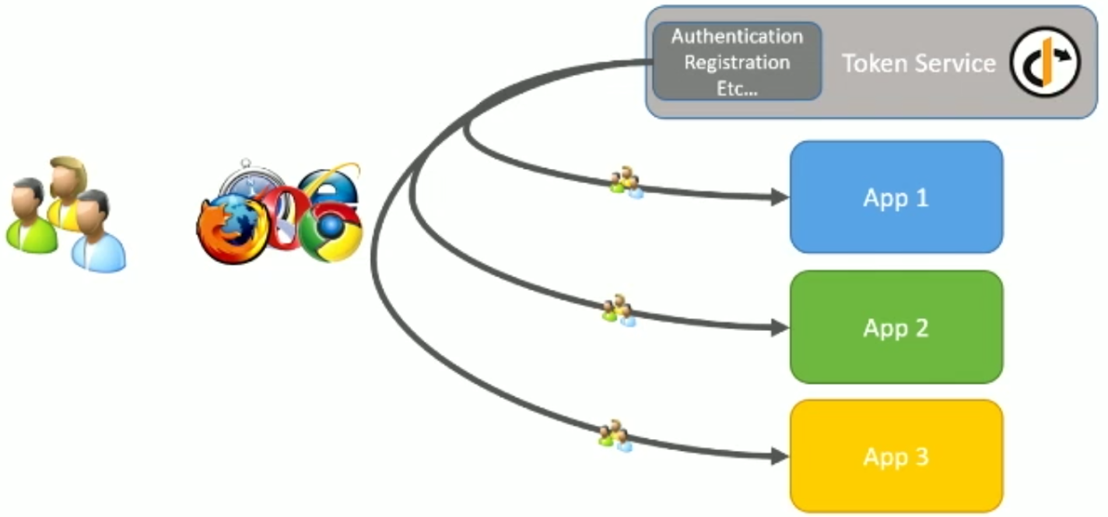
Single Sign-On with token service

Slide 6
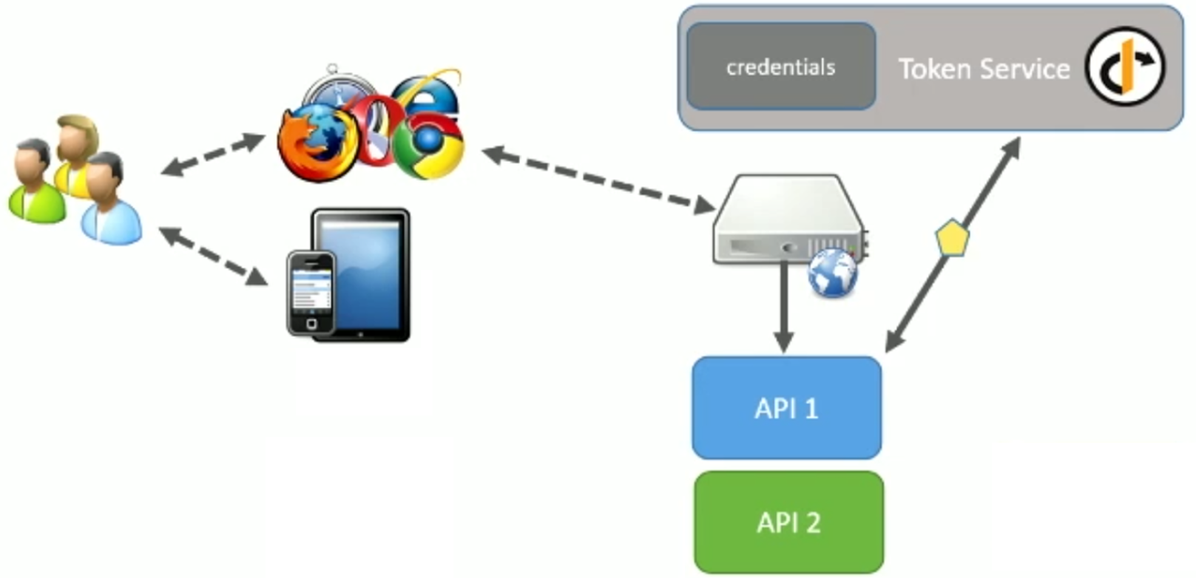
API Security with IdentityServer

Slide 7
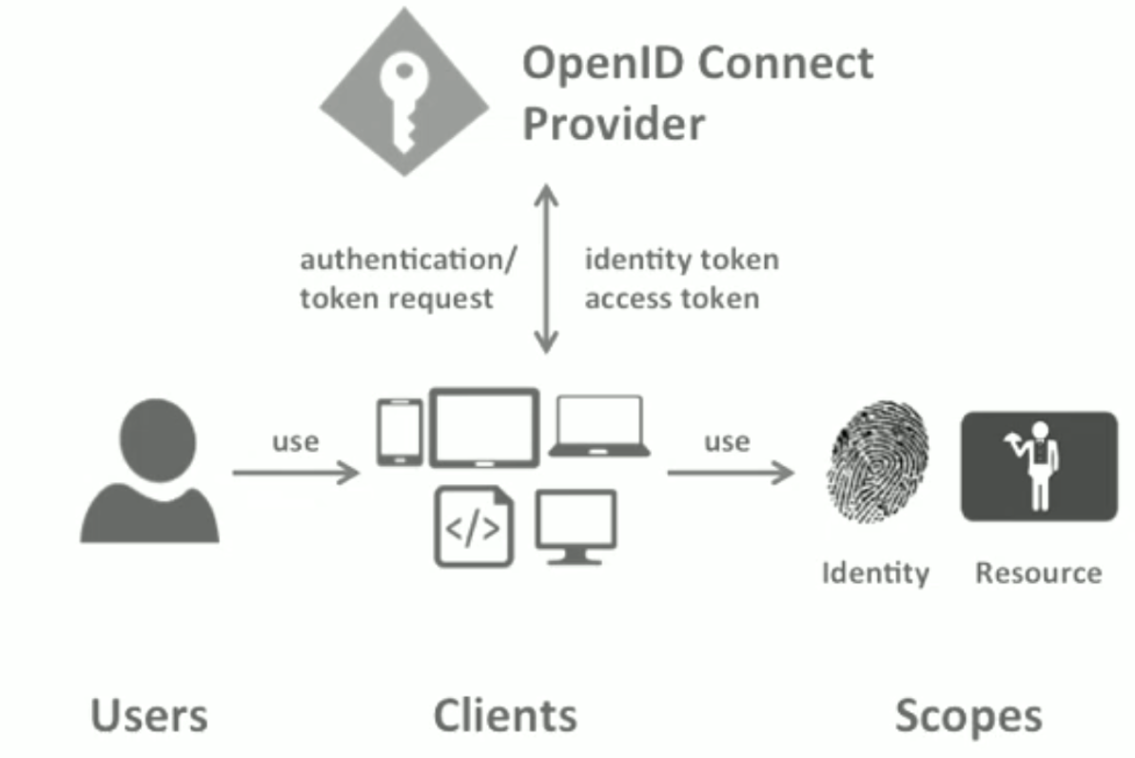
IdentityServer object model

Slide 8
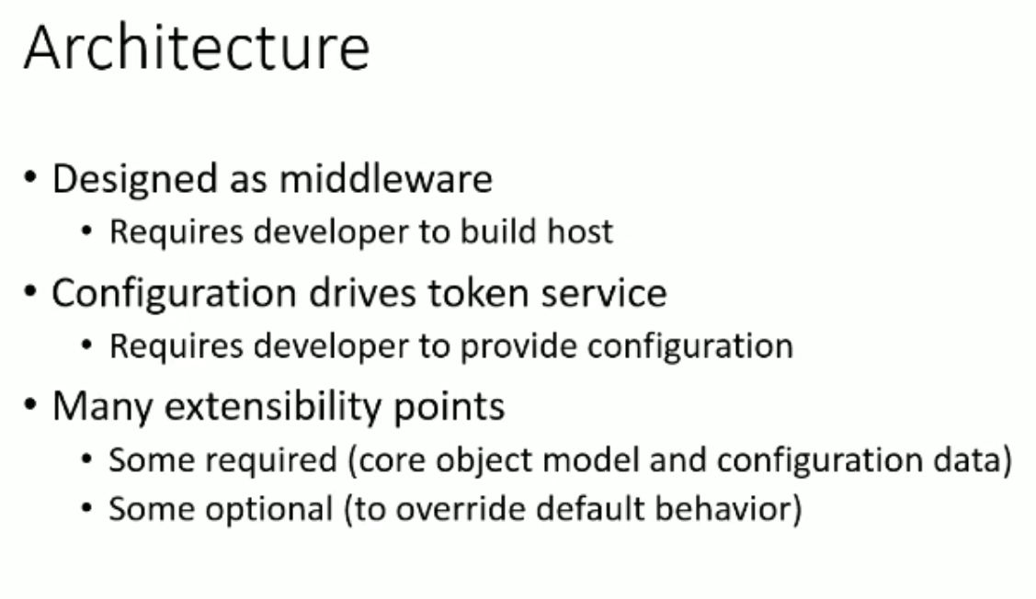
IdentityServer Architecture

Slide 9
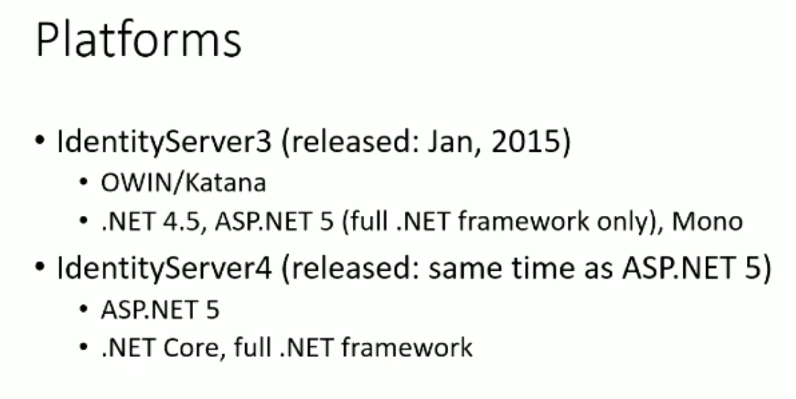
Flavors of IdentityServer
https://identityserver.github.io/Documentation/docsv2/overview/mvcGettingStarted.html

Slide 10

Demo

