Slide 1
Monte Carlo Integration
Digital Image Synthesis
Yung-Yu Chuang
11/29/2005
with slides by Pat Hanrahan and Torsten Moller

Slide 2
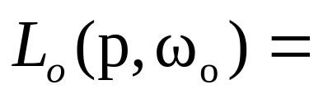
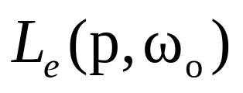
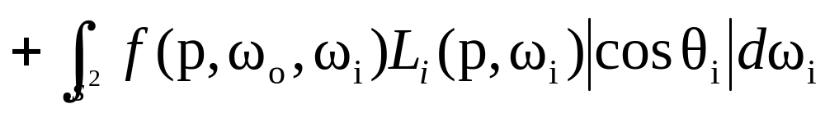
Introduction
The integral equations generally don’t have analytic solutions, so we must turn to numerical methods.
Standard methods like Trapezoidal integration or Gaussian quadrature are not effective for high-dimensional and discontinuous integrals.

Slide 3
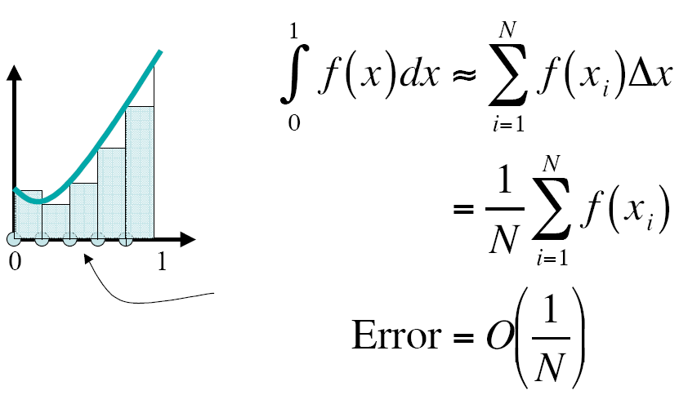
Simple integration

Slide 4
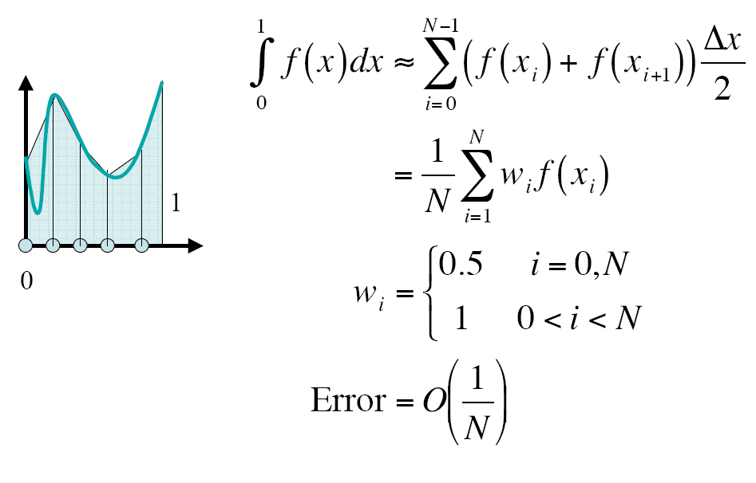
Trapezoidal rule

Slide 5
Randomized algorithms
Las Vegas v.s. Monte Carlo
Las Vegas: gives the right answer by using randomness.
Monte Carlo: gives the right answer on the average. Results depend on random numbers used, but statistically likely to be close to the right answer.

Slide 6
Monte Carlo integration
Monte Carlo integration: uses sampling to estimate the values of integrals. It only requires to be able to evaluate the integrand at arbitrary points, making it easy to implement and applicable to many problems.
If n samples are used, its converges at the rate of O(n^{-1/2}). That is, to cut the error in half, it is necessary to evaluate four times as many samples.
Images by Monte Carlo methods are often noisy.

Slide 7
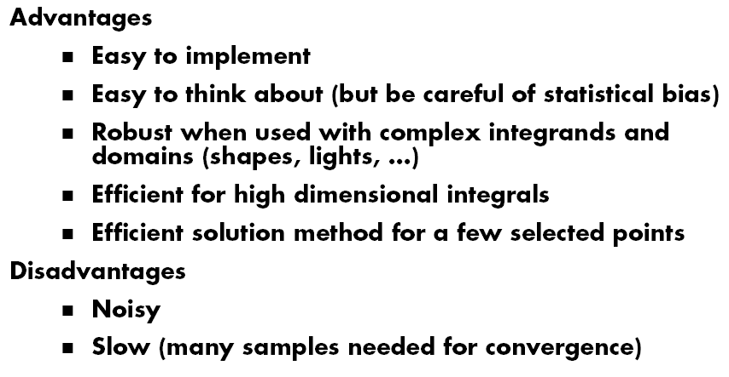
Monte Carlo methods

Slide 8
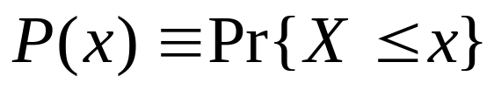
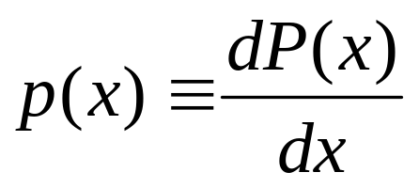
Basic concepts
X is a random variable
Applying a function to a random variable gives another random variable, Y=f(X).
CDF (cumulative distribution function)
PDF (probability density function): nonnegative, sum to 1
canonical uniform random variable ξ (provided by standard library and easy to transform to other distributions)

Slide 9
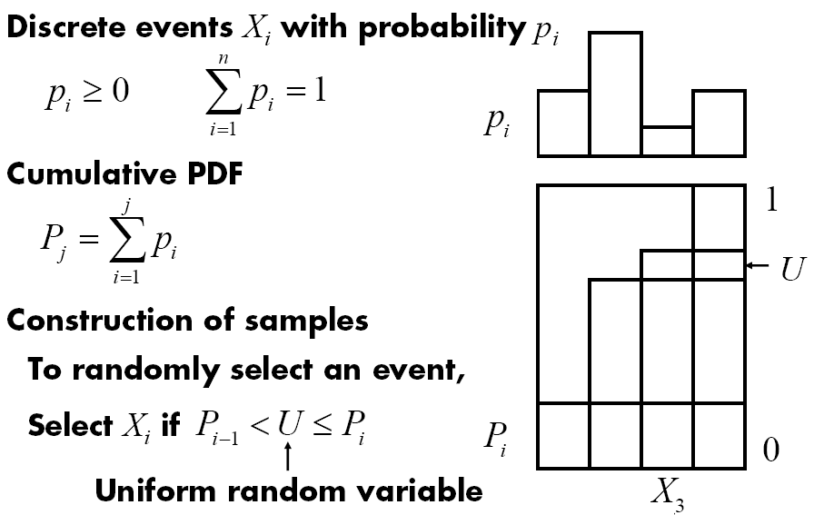
Discrete probability distributions

Slide 10
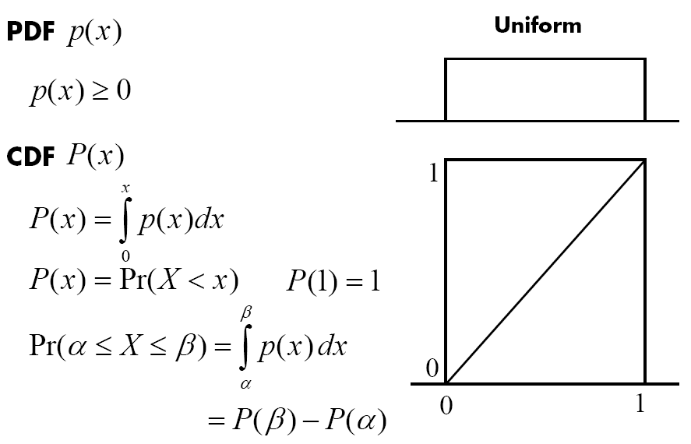
Continuous probability distributions

Slide 11
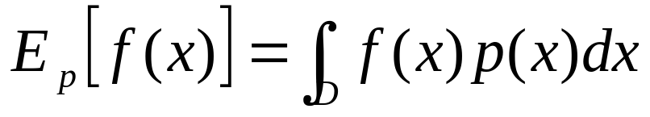
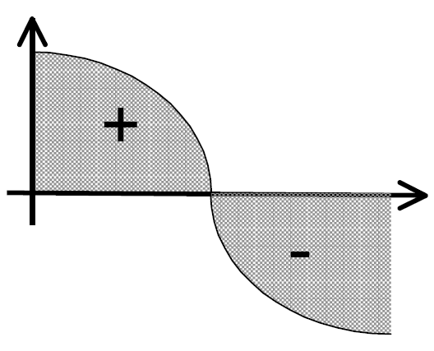
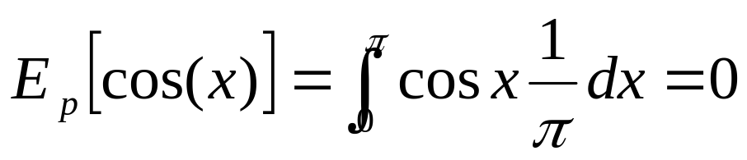
Expected values
Average value of a function f(x) over some distribution of values p(x) over its domain D
Example: cos function over [0, π], p is uniform

Slide 12
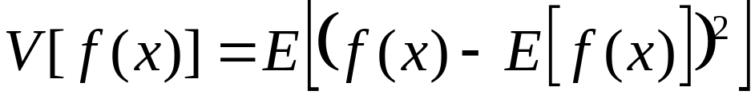
Variance
Expected deviation from the expected value
Fundamental concept of quantifying the error in Monte Carlo methods

Slide 13
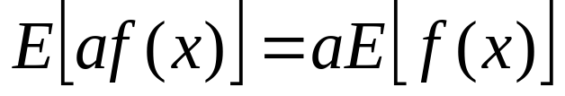
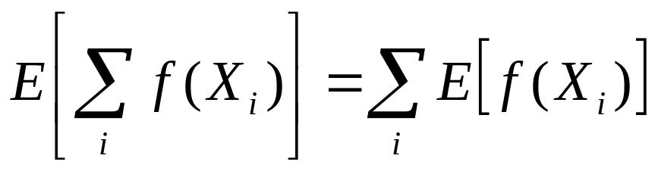
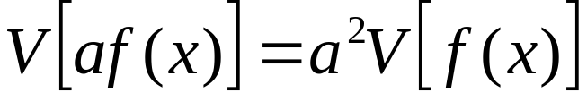
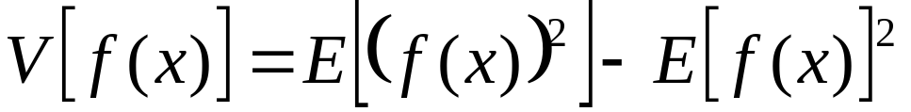
Properties

Slide 14
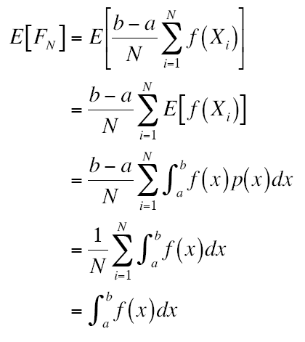
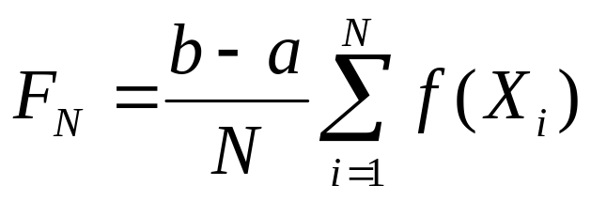
Monte Carlo estimator
Assume that we want to evaluate the integral of f(x) over [a,b]
Given a uniform random variable Xi over [a,b], Monte Carlo estimator says that the expected value E[F_{N}] of the estimator F_{N} equals the integral

Slide 15
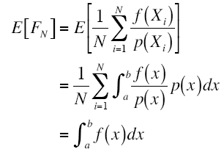
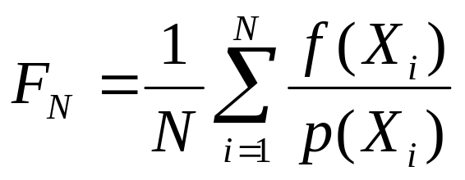
General Monte Carlo estimator
Given a random variable X drawn from an arbitrary PDF p(x), then the estimator is
Although the converge rate of MC estimator is O(N^{1/2}), slower than other integral methods, its converge rate is independent of the dimension, making it the only practical method for high dimensional integral

Slide 16
Choosing samples
How to sample an arbitrary distribution from a variable of uniform distribution?
  Inversion
  Rejection
  Transform

Slide 17
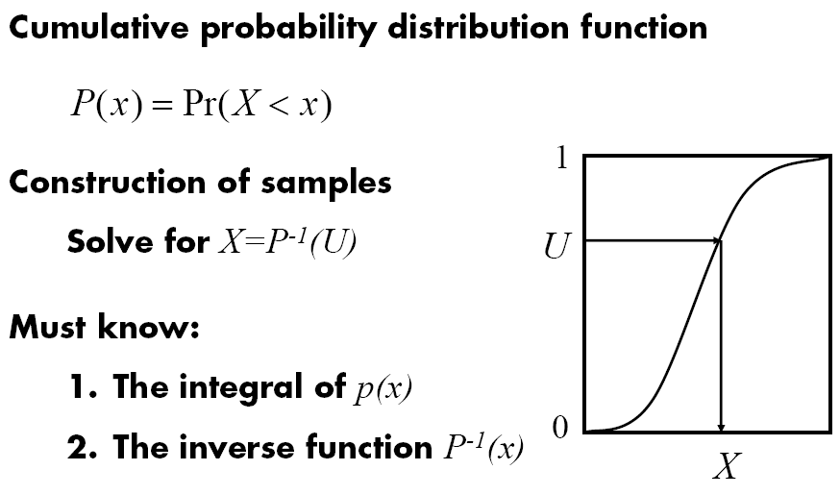
Inversion method

Slide 18
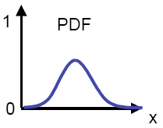
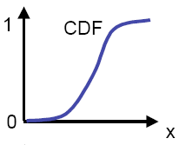
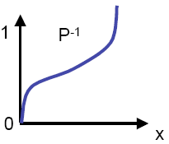
Inversion method
Compute CDF P(x)
Compute P⁻¹(x)
Obtain ξ
Compute X_{i}=P⁻¹(ξ)

Slide 19





Example: exponential distribution
, for example, Blinn’s Fresnel term
Compute CDF P(x)
Compute P⁻¹(x)
Obtain ξ
Compute X_{i}=P⁻¹(ξ)

Slide 20
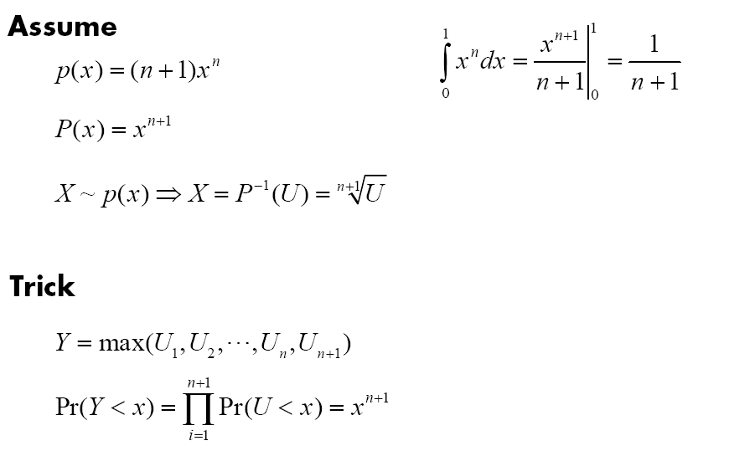
Example: power function

Slide 21
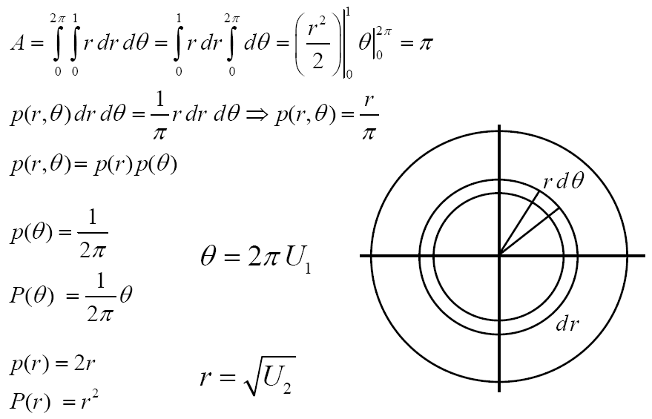
Sampling a circle

Slide 22
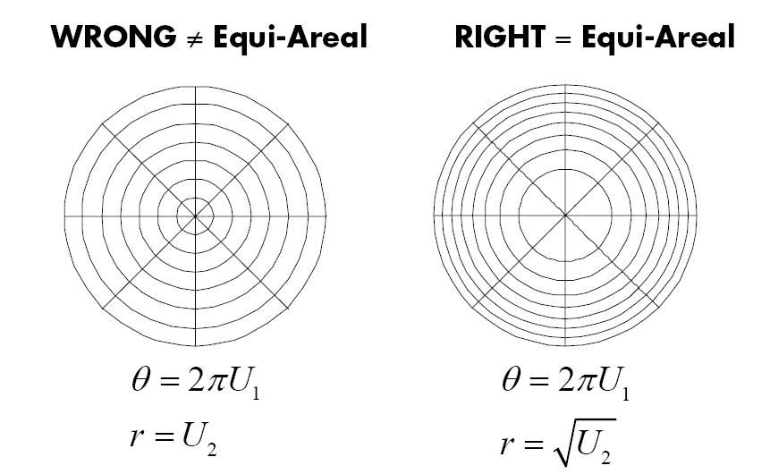
Sampling a circle

Slide 23
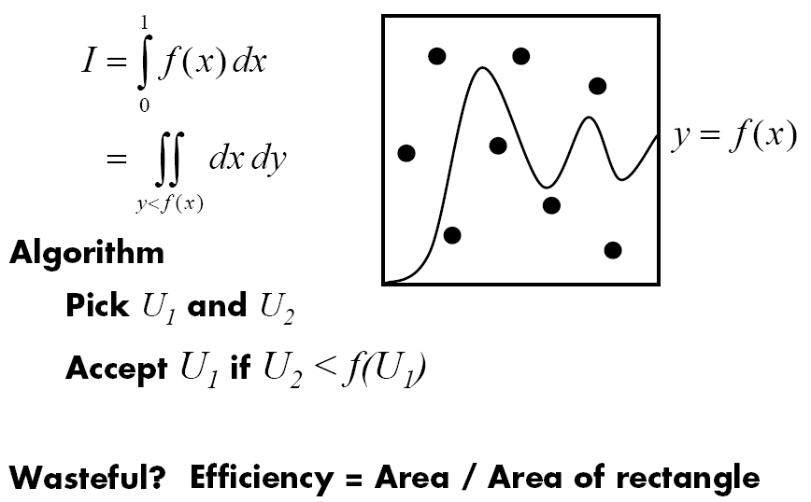
Rejection method

Slide 24
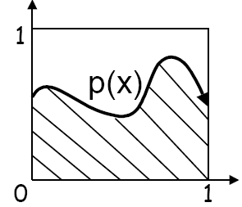
Rejection method
Sometimes, we can’t integrate into CDF or invert CDF
Rejection method is a fart-throwing method without performing the above steps
Find q(x) so that p(x)<cq(x)
Dart throwing
  Choose a pair (X, ξ), where X is sampled from q(x)
  If (ξ<p(X)/cq(X)) return X
Essentially, we pick a point
(X, ξcq(X)). If it lies beneath
p(X) then we are fine.

Slide 25
Example: sampling a unit sphere
void RejectionSampleDisk(float *x, float *y) {
float sx, sy;
do {
sx = 1.f -2.f * RandomFloat();
sy = 1.f -2.f * RandomFloat();
} while (sx*sx + sy*sy > 1.f)
*x = sx; *y = sy;
}
π/4～78.5% good samples, gets worse in higher dimensions, for example, for sphere, π/6～52.3%

Slide 26
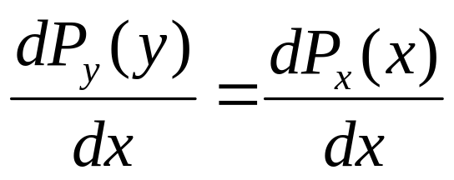
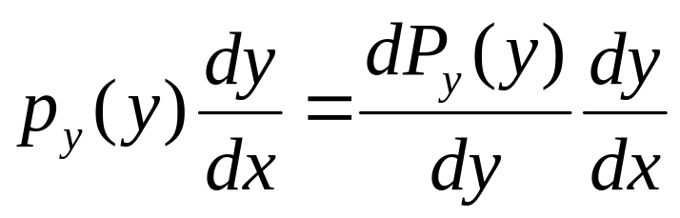
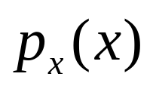
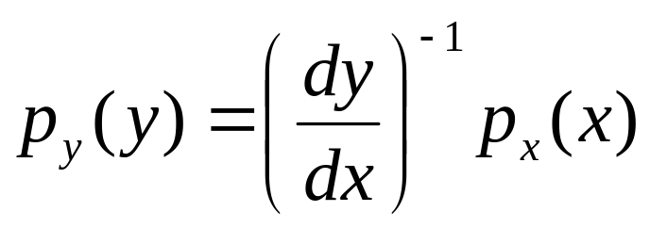
Transforming between distributions
Transform a random variable X from distribution p_{x}(x) to a random variable Y with distribution p_{y}(x)
Y=y(X), y is one-to-one, i.e. monotonic
Hence,
PDF:

Slide 27
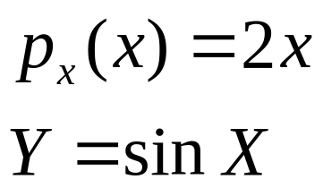
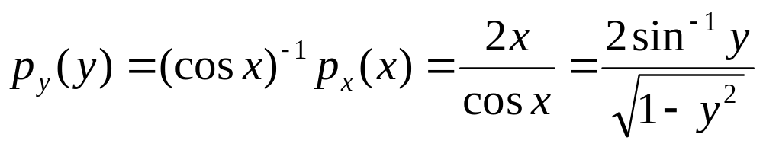
Example

Slide 28
Transform
Given X with p_{x}(x) and p_{y}(y), try to use X to generate Y.

Slide 29
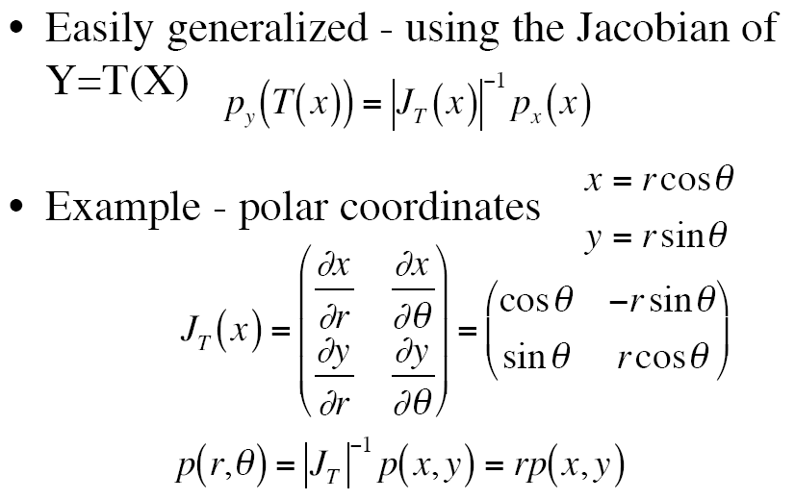
Multiple dimensions

Slide 30
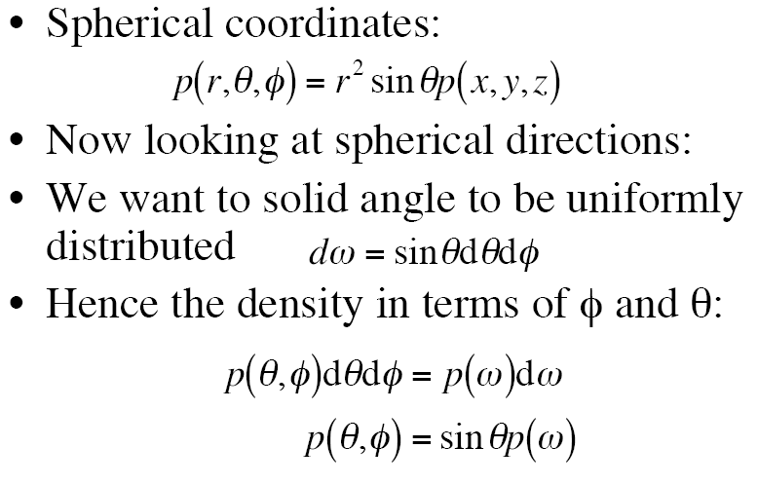
Multiple dimensions

Slide 31
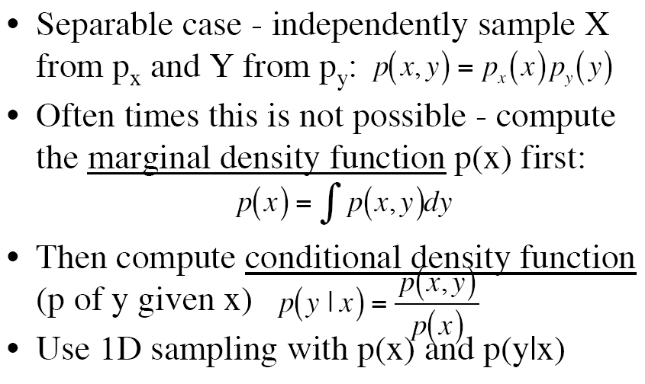
Multidimensional sampling

Slide 32
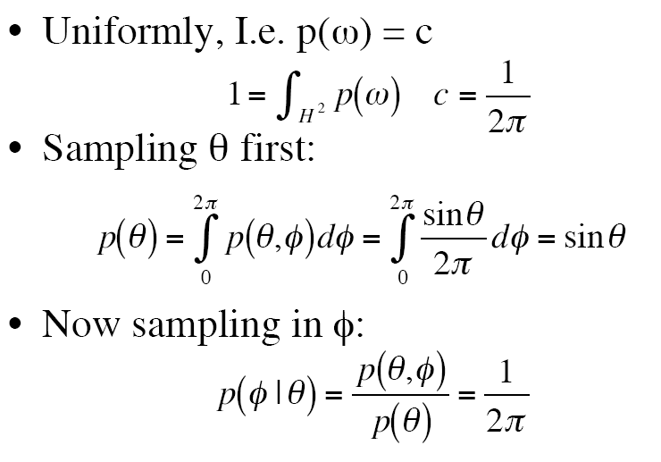
Sampling a hemisphere

Slide 33
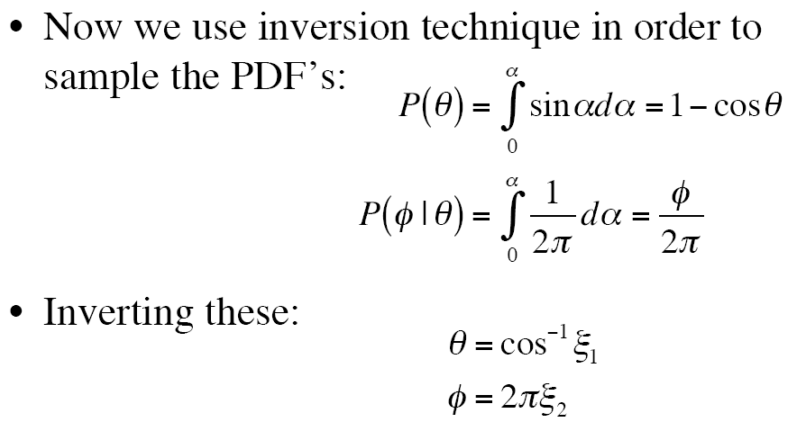
Sampling a hemisphere

Slide 34
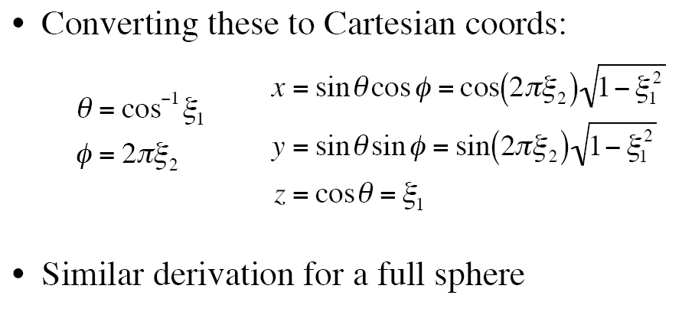
Sampling a hemisphere

Slide 35
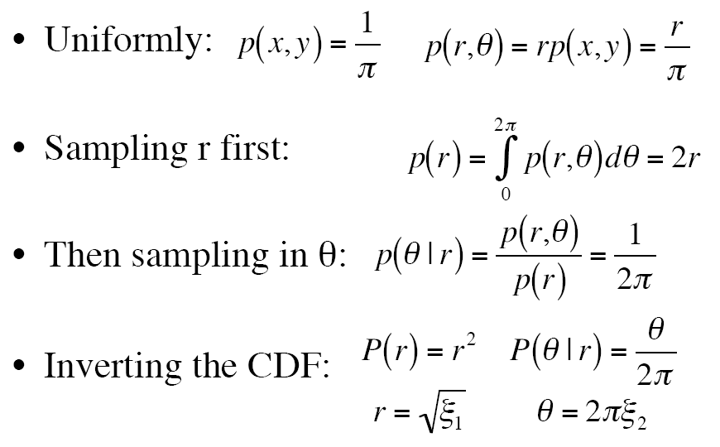
Sampling a disk

Slide 36
Sampling a disk

Slide 37
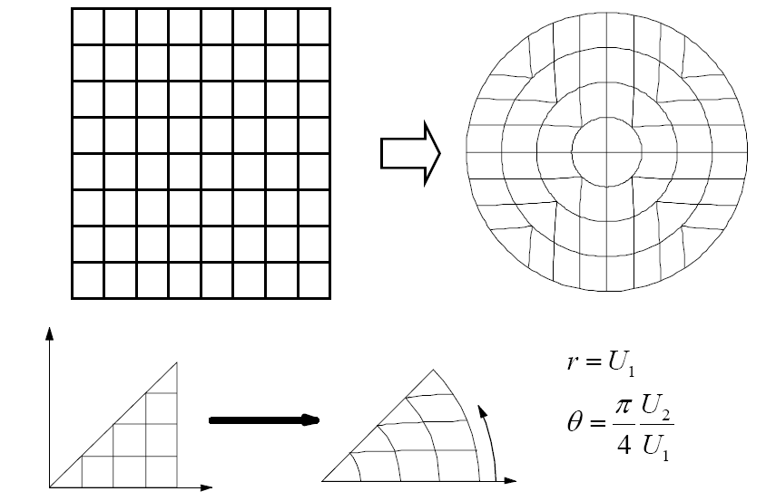
Shirley’s mapping

Slide 38
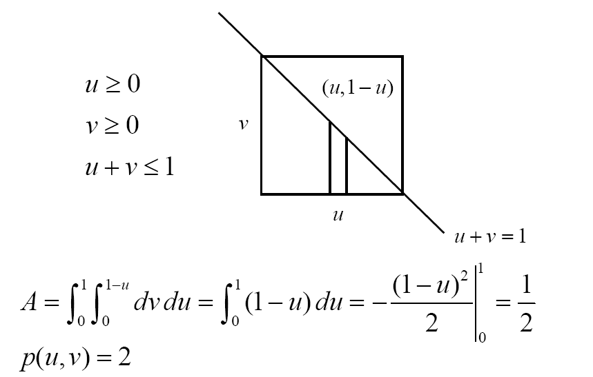
Sampling a triangle

Slide 39
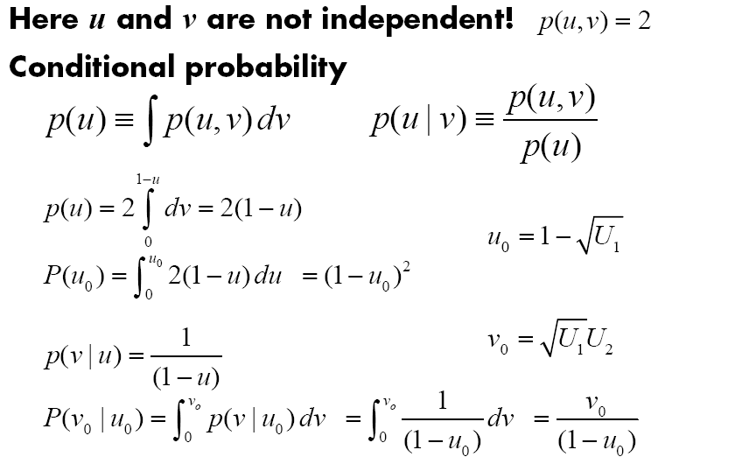
Sampling a triangle

Slide 40
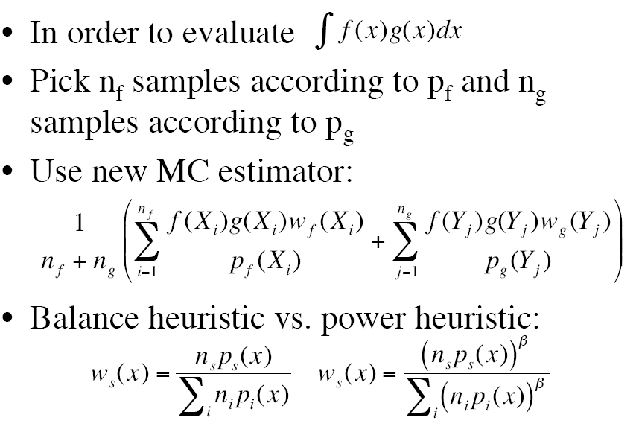
Multiple importance sampling

Slide 41
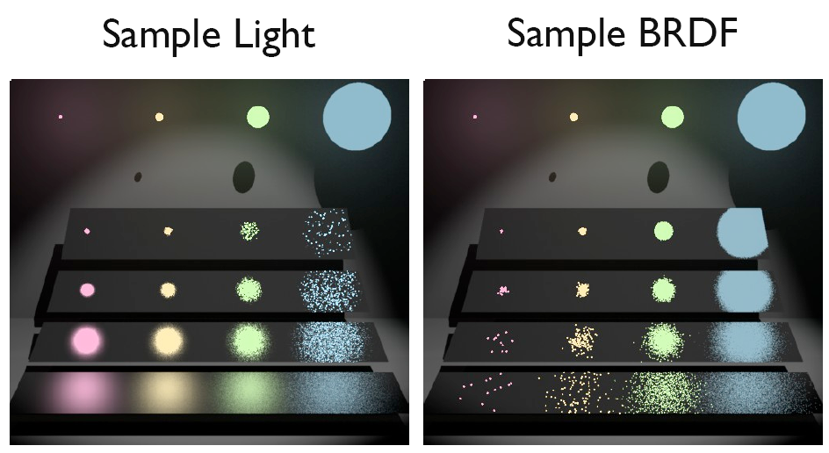
Multiple importance sampling

Slide 42
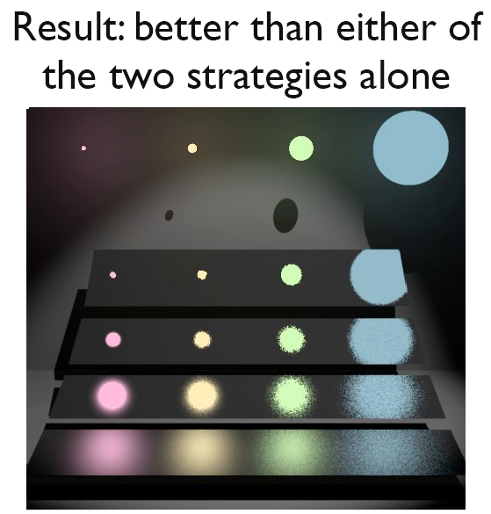
Multiple importance sampling

Slide 43
Monte Carlo for rendering equation
Importance sampling: sample ω_{i} according to BxDF f and L (especially for light sources)
If we don’t need anything about f and L, use cosine-weighted sampling of hemisphere to find a sampled ω_{i}

Slide 44








Cosine weighted hemisphere

Slide 45






Cosine weighted hemisphere

Slide 46
Cosine weighted hemisphere
Malley’s method: uniformly generates points on the unit disk and then generates directions by projecting them up to the hemisphere above it.
Vector CosineSampleHemisphere(float u1,float u2){
Vector ret;
ConcentricSampleDisk(u1, u2, &ret.x, &ret.y);
ret.z = sqrtf(max(0.f,1.f - ret.x*ret.x -
ret.y*ret.y));
return ret;
}

Slide 47






Cosine weighted hemisphere
Why Malley’s method works
Unit disk sampling
Map to hemisphere
here

Slide 48
Sampling reflection functions
Spectrum BxDF::Sample_f(const Vector &wo,
Vector *wi, float u1, float u2, float *pdf){
*wi = CosineSampleHemisphere(u1, u2);
if (wo.z < 0.) wi->z *= -1.f;
*pdf = Pdf(wo, *wi);
return f(wo, *wi);
}
For those who modified Sample_f, Pdf must be changed accordingly
float BxDF::Pdf(Vector &wo, Vector &wi) {
return SameHemisphere(wo, wi) ?
fabsf(wi.z) * INV_PI : 0.f;
}
This function is useful for multiple importance sampling.

Slide 49

Sampling microfacet model
Too complicated to sample according to f, sample
D instead.

Slide 50




Sampling Blinn microfacet model
Blinn distribution:
Generate ω_{h} according to the above function
Convert ω_{h} to ω_{i}
ω_{h}
ω_{o}
ω_{i}

Slide 51





Sampling Blinn microfacet model
Convert half-angle Pdf to incoming-angle Pdf, that is, change from a density in term of ω_{h} to one in terms of ω_{i}

Slide 52


Sampling anisotropic microfacet model
Anisotropic model (after Ashikhmin and Shirley) for the first quadrant of the unit hemisphere

Slide 53

Sampling BSDF (mixture of BxDFs)
Sample from the density that is the sum of individual densities
Three uniform random numbers are used, the first one determines which BxDF to be sampled and then sample that BxDF using the other two random numbers

Slide 54
Sampling light sources
Direct illumination from light sources makes an important contribution, so it is crucial to be able to
  Sp: samples directions from a point p to the light
  Sr: Generates random rays from the light source (for bidirectional light transport algorithms such as bidirectional path tracing and photon mapping)

Slide 55
Point lights
Sp: delta distribution, treat similar to specular BxDF
Sr: sampling of a uniform sphere

Slide 56
Spotlights
Sp: the same as a point light
Sr: sampling of a cone (do not consider the falloff)

Slide 57

Directional lights
Sp: like point lights
Sr: create a virtual disk of the same radius as scene’s bounding sphere and then sample the disk uniformly.

Slide 58
Area lights
Defined by shape
Add shape sampling functions for Shape
Sp: uses a density with respect to solid angle from the point p
Point Sample(Point &P, float u1, float u2, Normal *Ns)
Sr: generates points on the shape according to a density with respect to surface area
Point Sample(float u1, float u2, Normal *Ns)

Slide 59
Infinite area lights
Sp:
  normal given: cosine weighted sampling
  Otherwise: uniform spherical sampling
  Does not take directional radiance distribution into account
Sr:
  Uniformly sample two points p₁ and p₂ on the sphere
  Use p1 as the origin and p₂-p₁ as the direction
  It can be shown that p₂-p₁ is uniformly distributed (Li et. al. 2003)

