Slide 1
Computer Graphics
Dr. Norman I. Badler
Professor, Computer & Information Science
Director, SIG Center for Computer Graphics
University of Pennsylvania
CIS 460 / CIS 560
Fall 2015
Part D
© Norman I. Badler
(except where otherwise noted)

Slide 2
Rendering via Sampling

Slide 3
Combining Radiosity and Ray Tracing?
Radiosity (e.g., by finite element method): accounts for global diffuse illumination:
  Get area lights, soft shadows, color bleeding, participating media (“fog”).
  View independent.
  No arbitrary ambient terms.
  But expensive meshing and form factor pre-process step.
  And what about non-uniform, non-diffuse surface properties?
Ray tracing accounts for local specular reflections and translucency.
  View dependent.

Slide 4
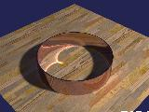
Disadvantage to Both:
Finally, neither approach can easily account for caustics: bright and shaped areas caused by the focusing and concentration of light by curved (lens-like) surfaces.
Leads to Monte Carlo Path Tracing and Photon Mapping.

Slide 5

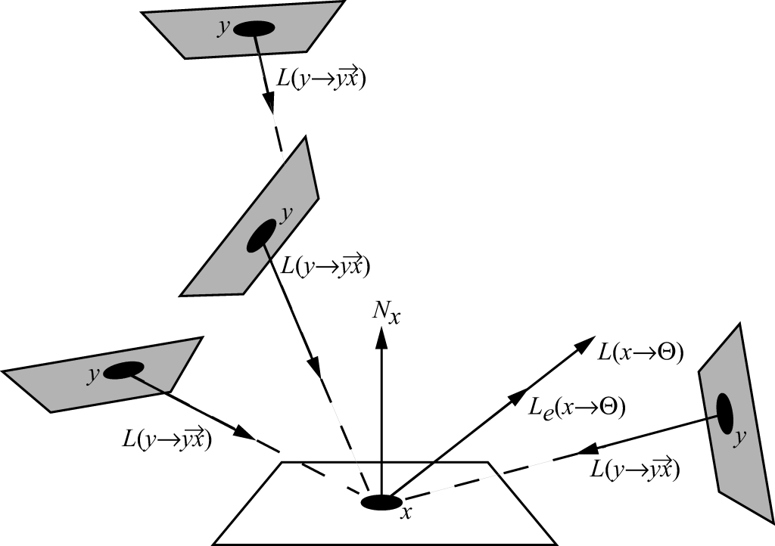
The Rendering Equation: Area Formulation
(e.g., Finite Elements)
Form factor &
visibility terms
FE solution: Integral reduced to a sum over a finite number of patches.
f_{r} is the Bidirectional Reflectance Distribution Function (BRDF)
for the surface at point x

Slide 6

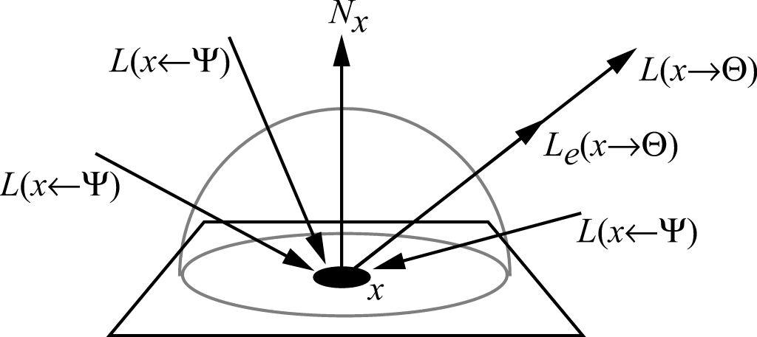
The Rendering Equation: Hemisphere Formulation
(e.g., General Irradiance Situation)
f_{r} is the Bidirectional Reflectance Distribution Function (BRDF)
for the surface at point x

Slide 7
Integration via Randomization Algorithm
In either of these formulations we have an integral over some domain (hemisphere or surface) that looks quite complicated to solve, since it is inherently recursive.
Solution: estimate integral over a finite number of samples.
But how to sample?
We examined the Finite Element approach, but it is costly and often results in poor images.
Use a randomized algorithm to sample incoming irradiance.
But how to randomize “nicely”?
We need to look into this question before we can return to the rendering equation itself.

Slide 8
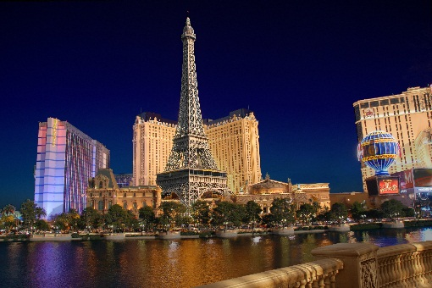
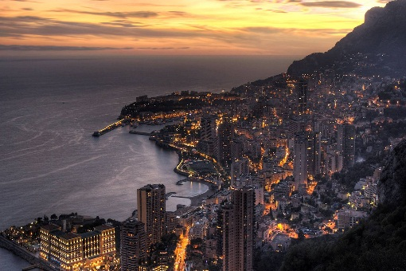

Las Vegas vs. Monte Carlo
Random Sampling
Las Vegas
  Always gives the same answer.
  E.g., QuickSort (selecting the pivot element randomly gives O(n log n) complexity, but it always converges to the sorted list whatever the pivot selection method).
Monte Carlo
  Gives the right answer on average.
  Used on functions that are difficult to evaluate or have no closed forms (such as our recursive integrals!).
  Slow convergence for N samples.
  But independent of dimensionality!
  Artifacts manifest as noise.

Slide 9

Naïve Integration via Discretization
f(x)
a
Δx
b
Can evaluate f(x), but don’t know an analytic way to integrate, e.g.
Simple discretization ⇒
Can also sample via Trapezoidal or Gaussian quadrature methods: same general idea.
Good in 1D
Error is O(1/N) or O(1/N²)

Slide 10


Monte Carlo Terminology
X, Y,… random variables (chosen by a random process).
Function of a random variable is a random variable , e.g., Y=f(X).
ξ is a canonical uniform random variable which takes values in domain [0,1) with equal probability.
x, y,… random values.
Pr ≡ “Probability of”.
P(x): Cumulative Distribution Function (CDF):
p(x): Probability Density Function (PDF)

Slide 11

Example for Uniform Random Variable
Uniform p(x) for ξ
1
0
0 1
P(x)
1
0
0 1

Slide 12

Example for Uniform Random Variable
Uniform p(x) for ξ
1
0
0 α β 1
P(x)c
1
0
} P(β) − P(α)
0 α β 1

Slide 13


Expected Value
The Expected Value is the mean or average value of the distribution
(integral of the function times its PDF):
E.g., the expected value of a cosine distribution between 0 and π:
…which is what we would expect from its graph.
+
‒

Slide 14


Expected Value Properties
Homogeneity (Linear)
Additivity (Linear)

Slide 15



Monte Carlo Estimator (Uniform random variable)
Goal: Evaluate
Let X_{i} (i=1,…,N) be a set of uniform random variables over [a,b].
The estimator F_{N} of f(x) over the interval [a,b] is:
The PDF p(x) must be a constant and integrate to 1 over [a,b]. i.e., p(x) =1/(b-a) {check: (b-a) p(x) = 1}
The expected value E[F_{N}] of the estimator F_{N} is indeed the integral:

Slide 16

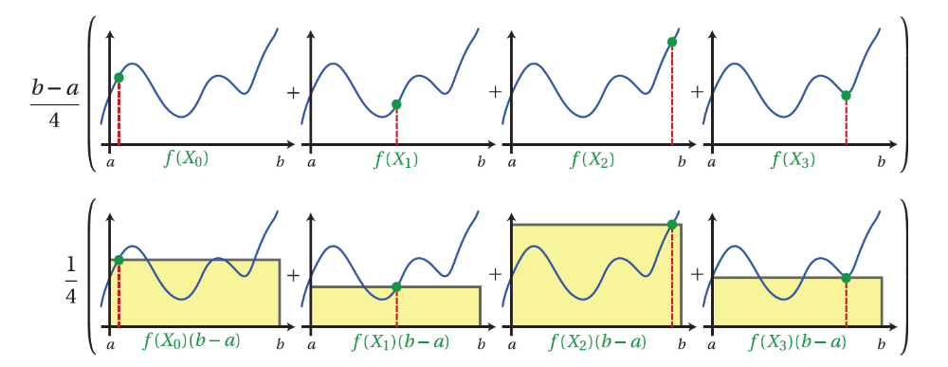
Visualizing MC Estimator from 4 Samples
http://www.cs.dartmouth.edu/~wjarosz/publications/dissertation/appendixA.pdf

Slide 17


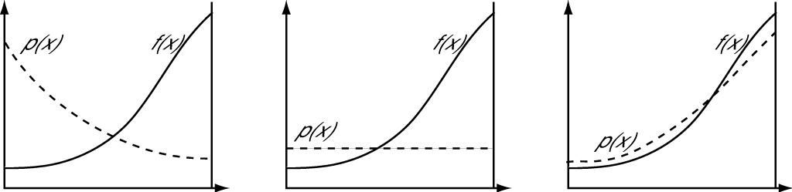
Monte Carlo Estimator (Arbitrary random variable)
If X is a random variable drawn from an arbitrary PDF p(x), then the estimator is:
(and p(X_{i}) ≠ 0 when |f(X_{i})|>0)
Choosing a “good” PDF is important. (Imagine p(x_{i}) are “weights” that integrate to 1.)
Notes:
Insert the two cases of using other PDFs to find the cosine estimator

Slide 18



Monte Carlo Estimator (Multiple Dimensions)
Suppose that N samples X_{i} are drawn from an arbitrary multidimensional (“joint”) PDF p(X), and the 3D integral is:
If samples are chosen uniformly from the box (x₀, y₀, z₀) to (x₁, y₁, z₁), then PDF p(X) is the constant
And the estimator is

Slide 19

Monte Carlo Properties
The number of samples can be chosen independently of the dimensionality of the integrand.
(Standard numerical quadrature is exponential in the dimension!)
The integral domain need not be a Cartesian box, but any domain (e.g., a hemisphere) as long as we can establish a suitable PDF.
Monte Carlo convergence rate is .
(Standard quadrature converges faster in 1D, but exponentially worse in higher dimensions.)
Monte Carlo is therefore the only practical numerical integration technique for high dimensional integrals!
Moreover, in computer graphics rendering using path tracing, the integrands are infinite dimensional!

Slide 20
So what do we need for Monte Carlo Integration?
N samples X_{i} and an “appropriate” PDF p(X_{i}):
We need to be able to evaluate f at any X_{i}.
Generating X_{i} samples: methods include
  Discrete bins
  Inversion
  Rejection
  Metropolis (not done here)
Assume uniform random variable ξ∈[0,1) generated by a pseudo-uniform random number generator.

Slide 21


Toy Example: Discrete Bins
Generate the following PDF using ξ (note ):
(each p_{i} is uniform)
Stack PDF to get CDF:
1
1
p₄
p₃
p₃
p₂
p₂
p₂
p₃
p₂
p₁
p₁
p₁
p₁
p₁
p₄
1 2 3 4
20% 30% 40% 10%

Slide 22
Toy Example: Discrete Bins
Generate a value for ξ ; then use selected p_{i} to generate X: X is generated uniformly within the p_{i} interval.
Suppose ξ ∈[0.9,1), then are in p₄
Suppose ξ ∈[0.5,0.9), then are in p₃
1
p₄
ξ =0.96
p₃
p₃
ξ =0.71
Suppose ξ ∈[0.2,0.5), then are in p₂
p₂
p₂
p₂
ξ =0.32
Suppose ξ ∈[0,0.2), then are in p₁
p₁
p₁
p₁
p₁
ξ =0.11
CDF
X
X
X
X

Slide 23

Inversion Method (If CDF is continuous and invertible)
Get PDF p(x)
Compute CDF
Compute inverse P⁻¹(x)
Get ξ
Compute X=P⁻¹(ξ)
1
P(x)
p(x)
ξ =0.3
PDF
CDF
X

Slide 24


Example: Power Distribution (arises from microfacet model)
Sampling from the power distribution

Slide 25

The Rejection Method (Throw darts!)
Can’t integrate f(x) to find its PDF?
Can’t analytically invert its CDF?
p(x) is “ugly” or “weird” or just complicated?
Then throw darts at it!
Suppose f(x) < (c p(x)) for some constant scalar c and we know how to sample from p(x).
loop forever (i.e., until “happy”):
sample X from p’s distribution
generate ξ
if ξ < f(X) / (c p(X)) then
return X
Works for any number of dimensions.
c*p(x)
ξ₂
ξ₁
f(x)
x₂
x₁

Slide 26
Examples of Rejection Sampling
Uniformly sample a disk (embedded in a unit square) by rejection sampling.
(Result IS uniform but “clumpy” in undesirable ways. Recall stratified sampling discussion.)

Slide 27



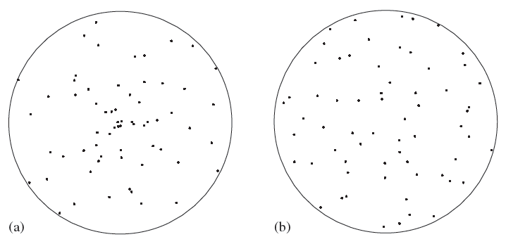
Direct Approach to Disk Sampling
Compute samples uniformly over a unit disk in polar coordinates.
An obvious sampling strategy is but this causes samples to “clump” toward the disk center (a).
Without proof, a good uniform sampling function for the unit disk is (b):
(The counteracts the disk “clumping”.)
(a)
(b)

Slide 28

Monte Carlo Integration: Sampling over a Hemisphere
We need to sample irradiance due to a light source over a hemisphere:
How to do this?
What might be good choices for p?

Slide 29


Sampling over Spheres and Hemispheres
Uniform direction samples over a complete sphere:
And uniform samples over a hemisphere:

Slide 30
Cosine-Weighted Hemisphere Sampling
Recall that for irradiance, incident energy is “more important” than grazing irradiance: i.e., energy importance follows a cosine distribution, just like Lambert’s Law.
So if we have to sample a hemisphere around a surface point, it makes sense that we should bias the samples in a cosine-weighted fashion: more samples near the surface normal.
We can find these sample directions using “Malley’s method” (no, not Adam’s ☺).

Slide 31




Malley’s Method
The PDF we want is proportional to the cosine:
Normalizing
So
Finally in terms of solid angle:
Note that this is non-negative over [0,π/2], and we insured it integrates to 1.

Slide 32


Projection into Hemisphere
Uniformly sample points on the unit disk and just project them up onto the unit hemisphere.
Vertical direction:
Circular direction:
θ
H²(N)
φ
samples

Slide 33



Forming the Sample Ray
To form sample ray:
Have surface point P,
Hemisphere sample point is S=(x,y,z) where (x,y) comes from (r,φ) sample:
And
θ
S
H²(N)
P
φ

Slide 34
Back to Monte Carlo Path Tracing
Summary
  Choose sample paths according to an appropriate Probability Density Function.
  Evaluate function at sample.
  Average these appropriately weighted values using a suitable estimator.
Error ⇒ slow convergence (twice as good ⇒ need 4 times more samples).
Variance in estimator ⇒ noise in image.
Good for high dimensional functions.
Theoretically best we can do (good estimator and more samples ⇒ better image).

Slide 35
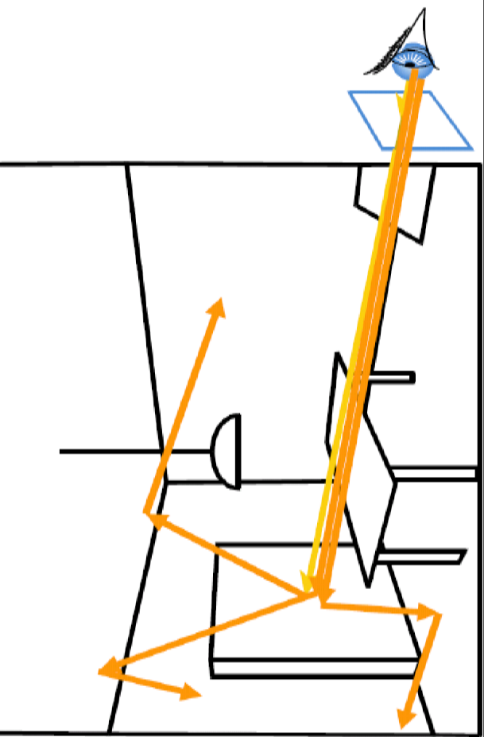
Monte Carlo Path Tracing
For each pixel, estimate radiance value as (appropriately chosen and weighted average of (lots of)) random paths along rays from eye through the pixel.
Compute radiance value for each visible point from Rendering Equation:
    Self Emission
    Direct Illumination (shadow rays)
    Indirect Illumination (Recursive)
Keep lengths of recursive paths manageable – Russian Roulette.
Cutler & Durand, MIT

Slide 36





More Samples = Higher Cost but Less Noise!
8 samples/pixel 40 samples/pixel 200 samples/pixel
13 sec 63 sec 5 min
1K samples/pixel 5K samples/pixel 25K samples/pixel
25 min 124 min 10.3 hrs
2.4 GHz Intel Core 2 Quad CPU using 4 threads. See www.kevinbeason.com/smallpt

Slide 37



Evaluating the Radiance Arriving at the Eye
pixel-wise sampling filter
emitted
reflected light
estimator for reflected light
Recursive step: form ray from x in direction Ψ_{i} and find irradiance from that direction

Slide 38
How to Stop Recursion?
Typically use “Russian Roulette”
  Unbiased
  Absorption probability P: α =1−P
  α is proportional to hemispherical reflectance
  Check:
    black non-reflective surface, α = 0, P = 1, so recursion must stop here;
    mirror (specular) surface, α = 1, P = 0, so recursion cannot stop here.
Threshold (fixed or adaptive)

Slide 39

Sampling L_{e}(x → Θ)
Direct Illumination: First Option
Sample each light source separately
G(x, y_{i}) is microfacet term in direction y_{i}→x.
V(x, y_{i}) is visibility (“shadow ray”) between x and y_{i} .
Possible PDFs:
  Uniform light area sampling
  Uniform sampling of solid angle subtended by light source

Slide 40

Sampling L_{e}(x → Θ)
Direct Illumination: Second Option
Combine light sources as one integral domain
G(x, y_{i}) is microfacet term in direction y_{i}→x.
V(x, y_{i}) is visibility (“shadow ray”) between x and y_{i} .
PDFs:
  Uniform source selection; uniform sampling of light area.
  Power proportional source selection; uniform sampling of light area.
Works well for “natural” light scenes (non-discrete sources), e.g., an (HDR) light field map or “baked-on” light “textures”.

Slide 41
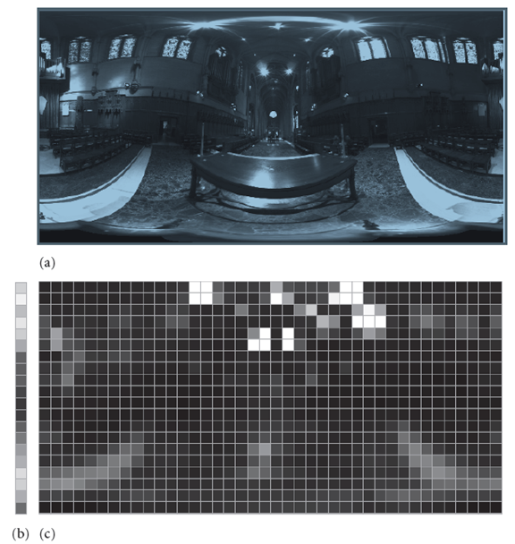
Sampling 2D Piecewise-Constant Functions
(Used for texture maps and environment maps)
(a) The original HDR environment map [u,v].
(b) A low-resolution version of the row-wise [v] density function.
(c) The piece-wise constant distributions for rows of the image.
First (b) is used to select a row [v] of the image to sample. Rows with bright pixels are more likely to be sampled.
Then, given a row, a value u is sampled from that row’s 1D distribution.
(HDR map from Paul Debevec.)
↑
v
(a)
u→
(b) (c)

Slide 42
Sampling L_{r}(x → Θ)
Indirect Illumination
Uniform hemisphere sampling
Importance sampling (PDF choice) of any of the following:
  Cosine
  BRDF
  Incident radiance
Combinations of any of the above: Multiple Importance Sampling

Slide 43
Multiple Importance Sampling
Variance dependent upon the choice of PDF of the estimator.
Importance sampling the integral means taking samples that are likely to contribute most significantly to the result.
(Reminds one of progressive radiosity method.)
Irradiance BRDF cosine

Slide 44
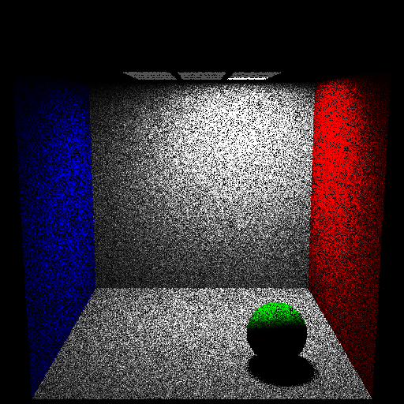
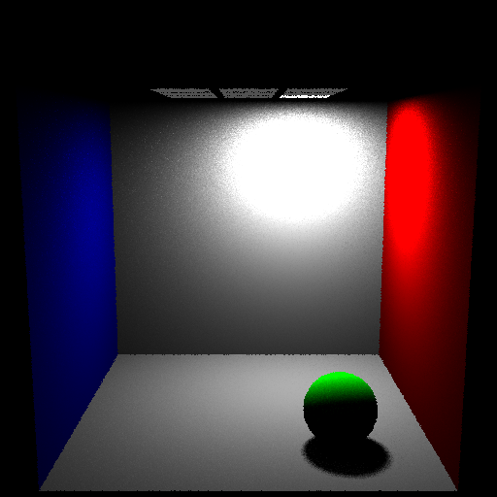
Importance Sampling: Light Source(s)
Uniform Light Source Sampling Power based Light Source Sampling
1 path per pixel – 1 shadow ray per point – Direct Illumination Only

Slide 45
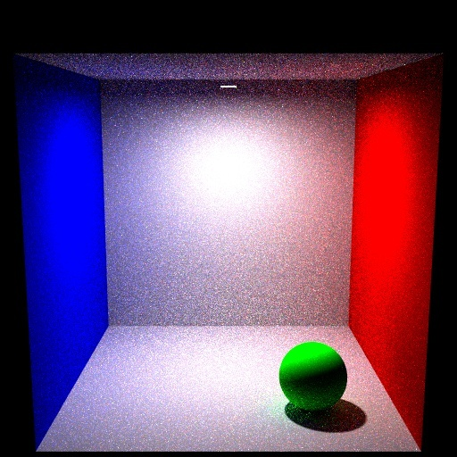
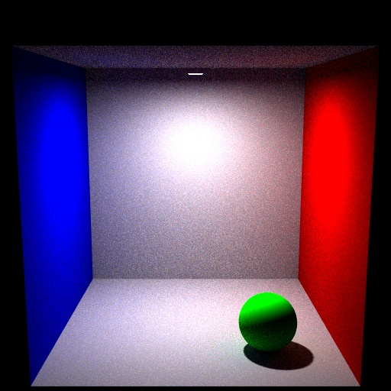
Importance Sampling: Cosine
Uniform Sampling of Hemisphere Importance Sampling (cosine) of Hemisphere
49 paths per pixel – 1 shadow ray per point – Max eye path depth = 10
Direct + Indirect Illumination

Slide 46
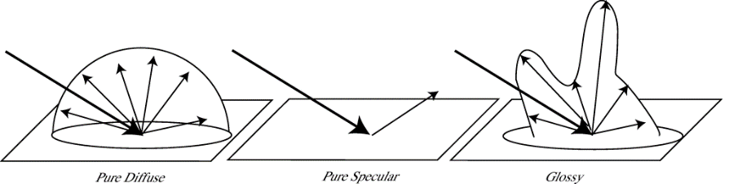
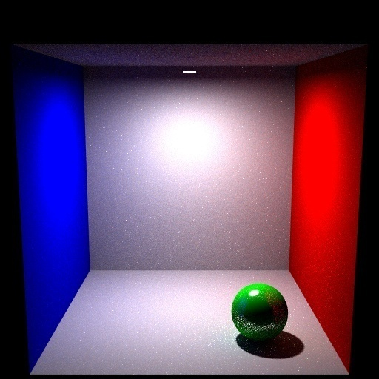
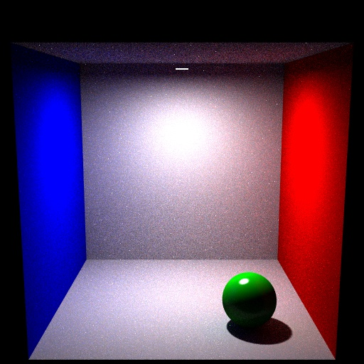
Importance Sampling: BRDF
Uniformly sampling a directional
BRDF produces noise
Uniform Sampling of BRDF Importance Sampling of BRDF
49 paths per pixel – 1 shadow ray per point – Max eye path depth = 10
Direct + Indirect Illumination

Slide 47
MC Path Tracing Difficult Case
Monte Carlo Path Tracing is a general technique, but it can do poorly in some scenes, especially with small areas of direct illumination and large areas lit by indirect illumination.
Rarely sampled lit area on ceiling.
Shadow feelers almost always miss hitting light.
Image will have high variance: mostly dark except for the few “lucky” paths that hit the ceiling area.

Slide 48
Bi-Directional Path Tracing
Trace paths forward from the camera (as in MC Path Tracing) BUT ALSO backward from the lights.
Path from camera: p₁, p₂, …, p_{i}
Path from light: q₁, q₂, …, q_{j}
For suitable i and j.
Then, by concatenation, a path from camera to light is p₁, …, p_{i} , q_{j}, …, q₁
A shadow feeler ray is traced from p_{i} to q_{j} to see if they are mutually visible.
Can re-use these paths by using combinations of prefixes: paths range from 2 to i+j vertices long, e.g.:
{[p₁, q₁], [p₁, p₂ , q₃, q₂, q₁], [p₁, p₂ , q₁], etc.}

Slide 49
Bi-Directional Path Tracing
Showing a couple of possible paths and one blocked path.
Various other optimizations possible.
q₁
p₂
×
[p₁, q₂, q₁]
[p₁, p₂, q₂, q₁]
q₂
×
[p₁, p₂, q₃, q₂, q₁]
q₃
p₁

Slide 50
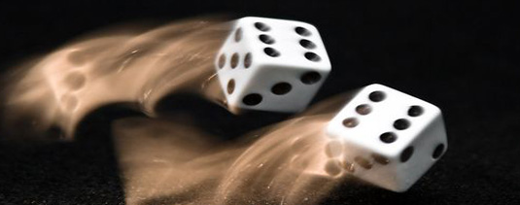
Temporal Anti-Aliasing -- Motion Blur
Blur image of moving object to combat high frequency jerkiness or strobing caused by frame-rate sampling.
Earliest work in 1984:
  Korein and Badler did spheres and polygons.
  Lucasfilm introduced spatial and temporal “noise” into ray-tracing: Monte Carlo or distribution path tracing.
Also applied to camera depth-of-field
http://acrisdesign.com/2009/10/60-marvelous-motion-blur-photos-for-inspiration/

Slide 51
Monte Carlo Path Tracing and Temporal Anti-Aliasing
Extend Monte Carlo path trace into time domain.
Because a small amount of noise is added, it is best to supersample and filter.
Can also do camera depth-of-field.

Slide 52
Monte Carlo Path Tracing in Time/Camera Space
light
sample
point
surface
image
plane
lens
For each primary ray:
1. Jitter spatial location on image plane within the pixel.

Slide 53
Monte Carlo Path Tracing in Time/Camera Space
light
sample
point
surface
image
plane
lens
For each primary ray:
2. Jitter time T within inter-frame interval.

Slide 54
Monte Carlo Path Tracing in Time/Camera Space
light
sample
point
surface
image
plane
lens
For each primary ray:
3. Move camera and objects to position at that time T.

Slide 55
Monte Carlo Path Tracing in Time/Camera Space
light
sample
point
surface
focal
point
image
plane
lens
For each primary ray:
4. Determine focal point.

Slide 56
Monte Carlo Path Tracing in Time/Camera Space
light
sample
point
surface
focal
point
image
plane
lens
For each primary ray:
5. Jitter lens location.

Slide 57
Monte Carlo Path Tracing in Time/Camera Space
light
sample
point
surface
focal
point
image
plane
lens
For each primary ray:
6. Determine surface intersection via standard ray trace
with rays going through sampled lens point and focal point.

Slide 58
Monte Carlo Path Tracing in Time/Camera Space
light
sample
point
reflected
ray
surface
focal
point
image
plane
lens
For each primary ray:
7. Trace reflection ray, importance sampling according to BRDF.

Slide 59
Monte Carlo Path Tracing in Time/Camera Space
light
sample
point
surface
focal
point
image
plane
lens
refracted
ray
For each primary ray:
8. Trace a refraction ray, if appropriate, sampling according to specular transmission function (STDF).

Slide 60
Monte Carlo Path Tracing in Time/Camera Space
light
sample
point
surface
focal
point
image
plane
lens
For each primary ray:
9. Trace shadow ray, sampling location on light based on light (power) distribution function.

Slide 61
Monte Carlo Path Tracing in Time/Camera Space
sample
point
surface
focal
point
image
plane
lens
Look at another possible sample for the same pixel...
Notice how the MC distribution samples some other contributing
but possibly VERY DIFFERENT part of the scene.

Slide 62
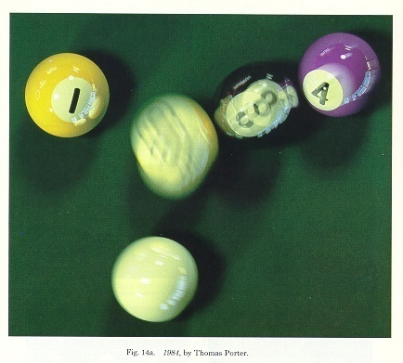
Monte Carlo Path Tracing With Temporal Anti-Aliasing

Slide 63
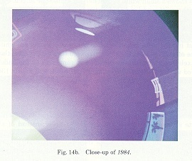
Detail from the Example

Slide 64
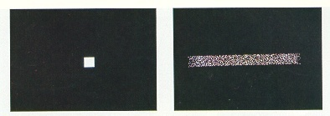
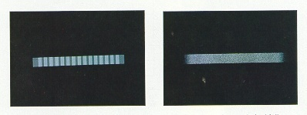
Motion Blur Test Cases
regular grid, 1 sample/pixel jittered grid, 1 sample/pixel
regular grid, 16 samples/pixel jittered grid, 16 samples/pixel

Slide 65
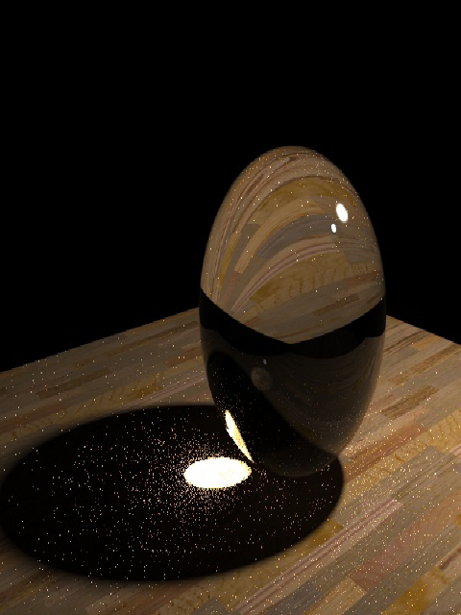
Monte Carlo Path Tracing: Pros and Cons
Arbitrary geometry – point primitive (just ray—object intersection).
Very low memory consumption.
Theoretically “best” possible with infinite (time) resources.
Paths in both time and space.
View dependent (paths start at eye).
Does not reuse illumination information.
Not efficient for diffuse surfaces.
Slow.
Noisy.
Expensive on caustics.
May have high image variance.

