Slide 1

Beyond HTTP Microservices with Spin Ivan Towlson
Wasm I/O 2023

Slide 2


HTTP

Slide 3
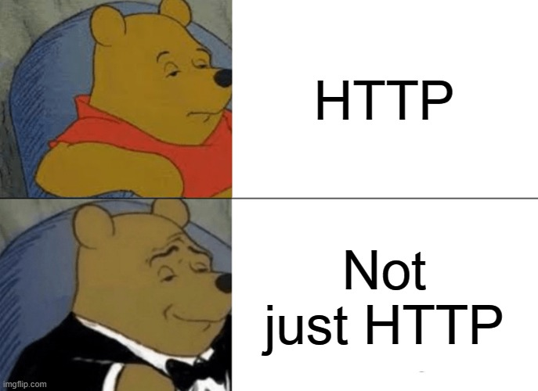

Slide 4
gRPC
STORAGE
CRON
QUEUE
STREAMS
ALERTS

Slide 5


Slide 6
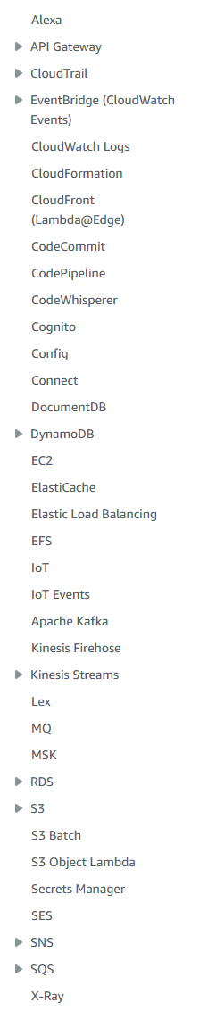
λ

Slide 9
thanks!
https://github.com/itowlson/wasmio23
https://github.com/fermyon/spin-trigger-sqs
https://github.com/fermyon/spin/tree/main/examples/spin-timer
ivan.towlson@fermyon.com | @ppog_penguin@mastodon.nz

