Slide 1

Beyond HTTP Microservices with Spin Ivan Towlson
Wasm I/O 2023

Slide 2


HTTP

Slide 3
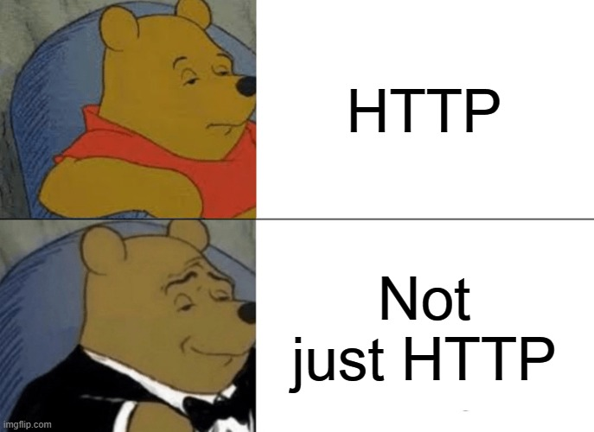

Slide 4
gRPC
STORAGE
CRON
QUEUE
STREAMS
ALERTS

Slide 5


Slide 6
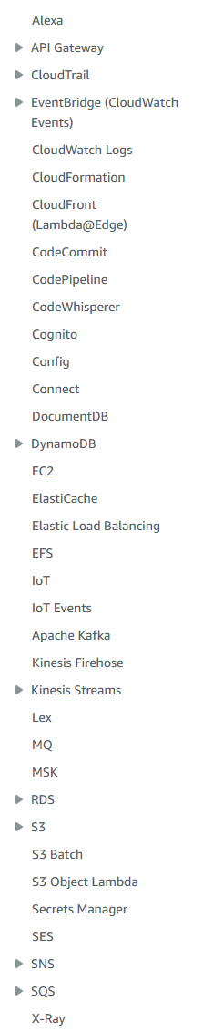
λ

Slide 7


spin

Slide 8
spin up
spin trigger

Slide 9
spin up
spin trigger

Slide 10
spin up
spin trigger

Slide 11
YOUR PROGRAM HERE
spin up
spin <plugin>

Slide 12
YOUR PROGRAM HERE
spin up
spin <plugin>

Slide 13
YOUR PROGRAM HERE

Slide 14

YOUR PROGRAM HERE
spin up
spin <plugin>

Slide 15
spin.lock
app object development time definition
--address --token
command line flags runtime operator config

Slide 16
spin.lock
app object development time definition
--address --token
command line flags runtime operator config
listener

Slide 17
source
defined
wit
listener
???
HTTP, Redis,
SQS, cron, etc.

Slide 18
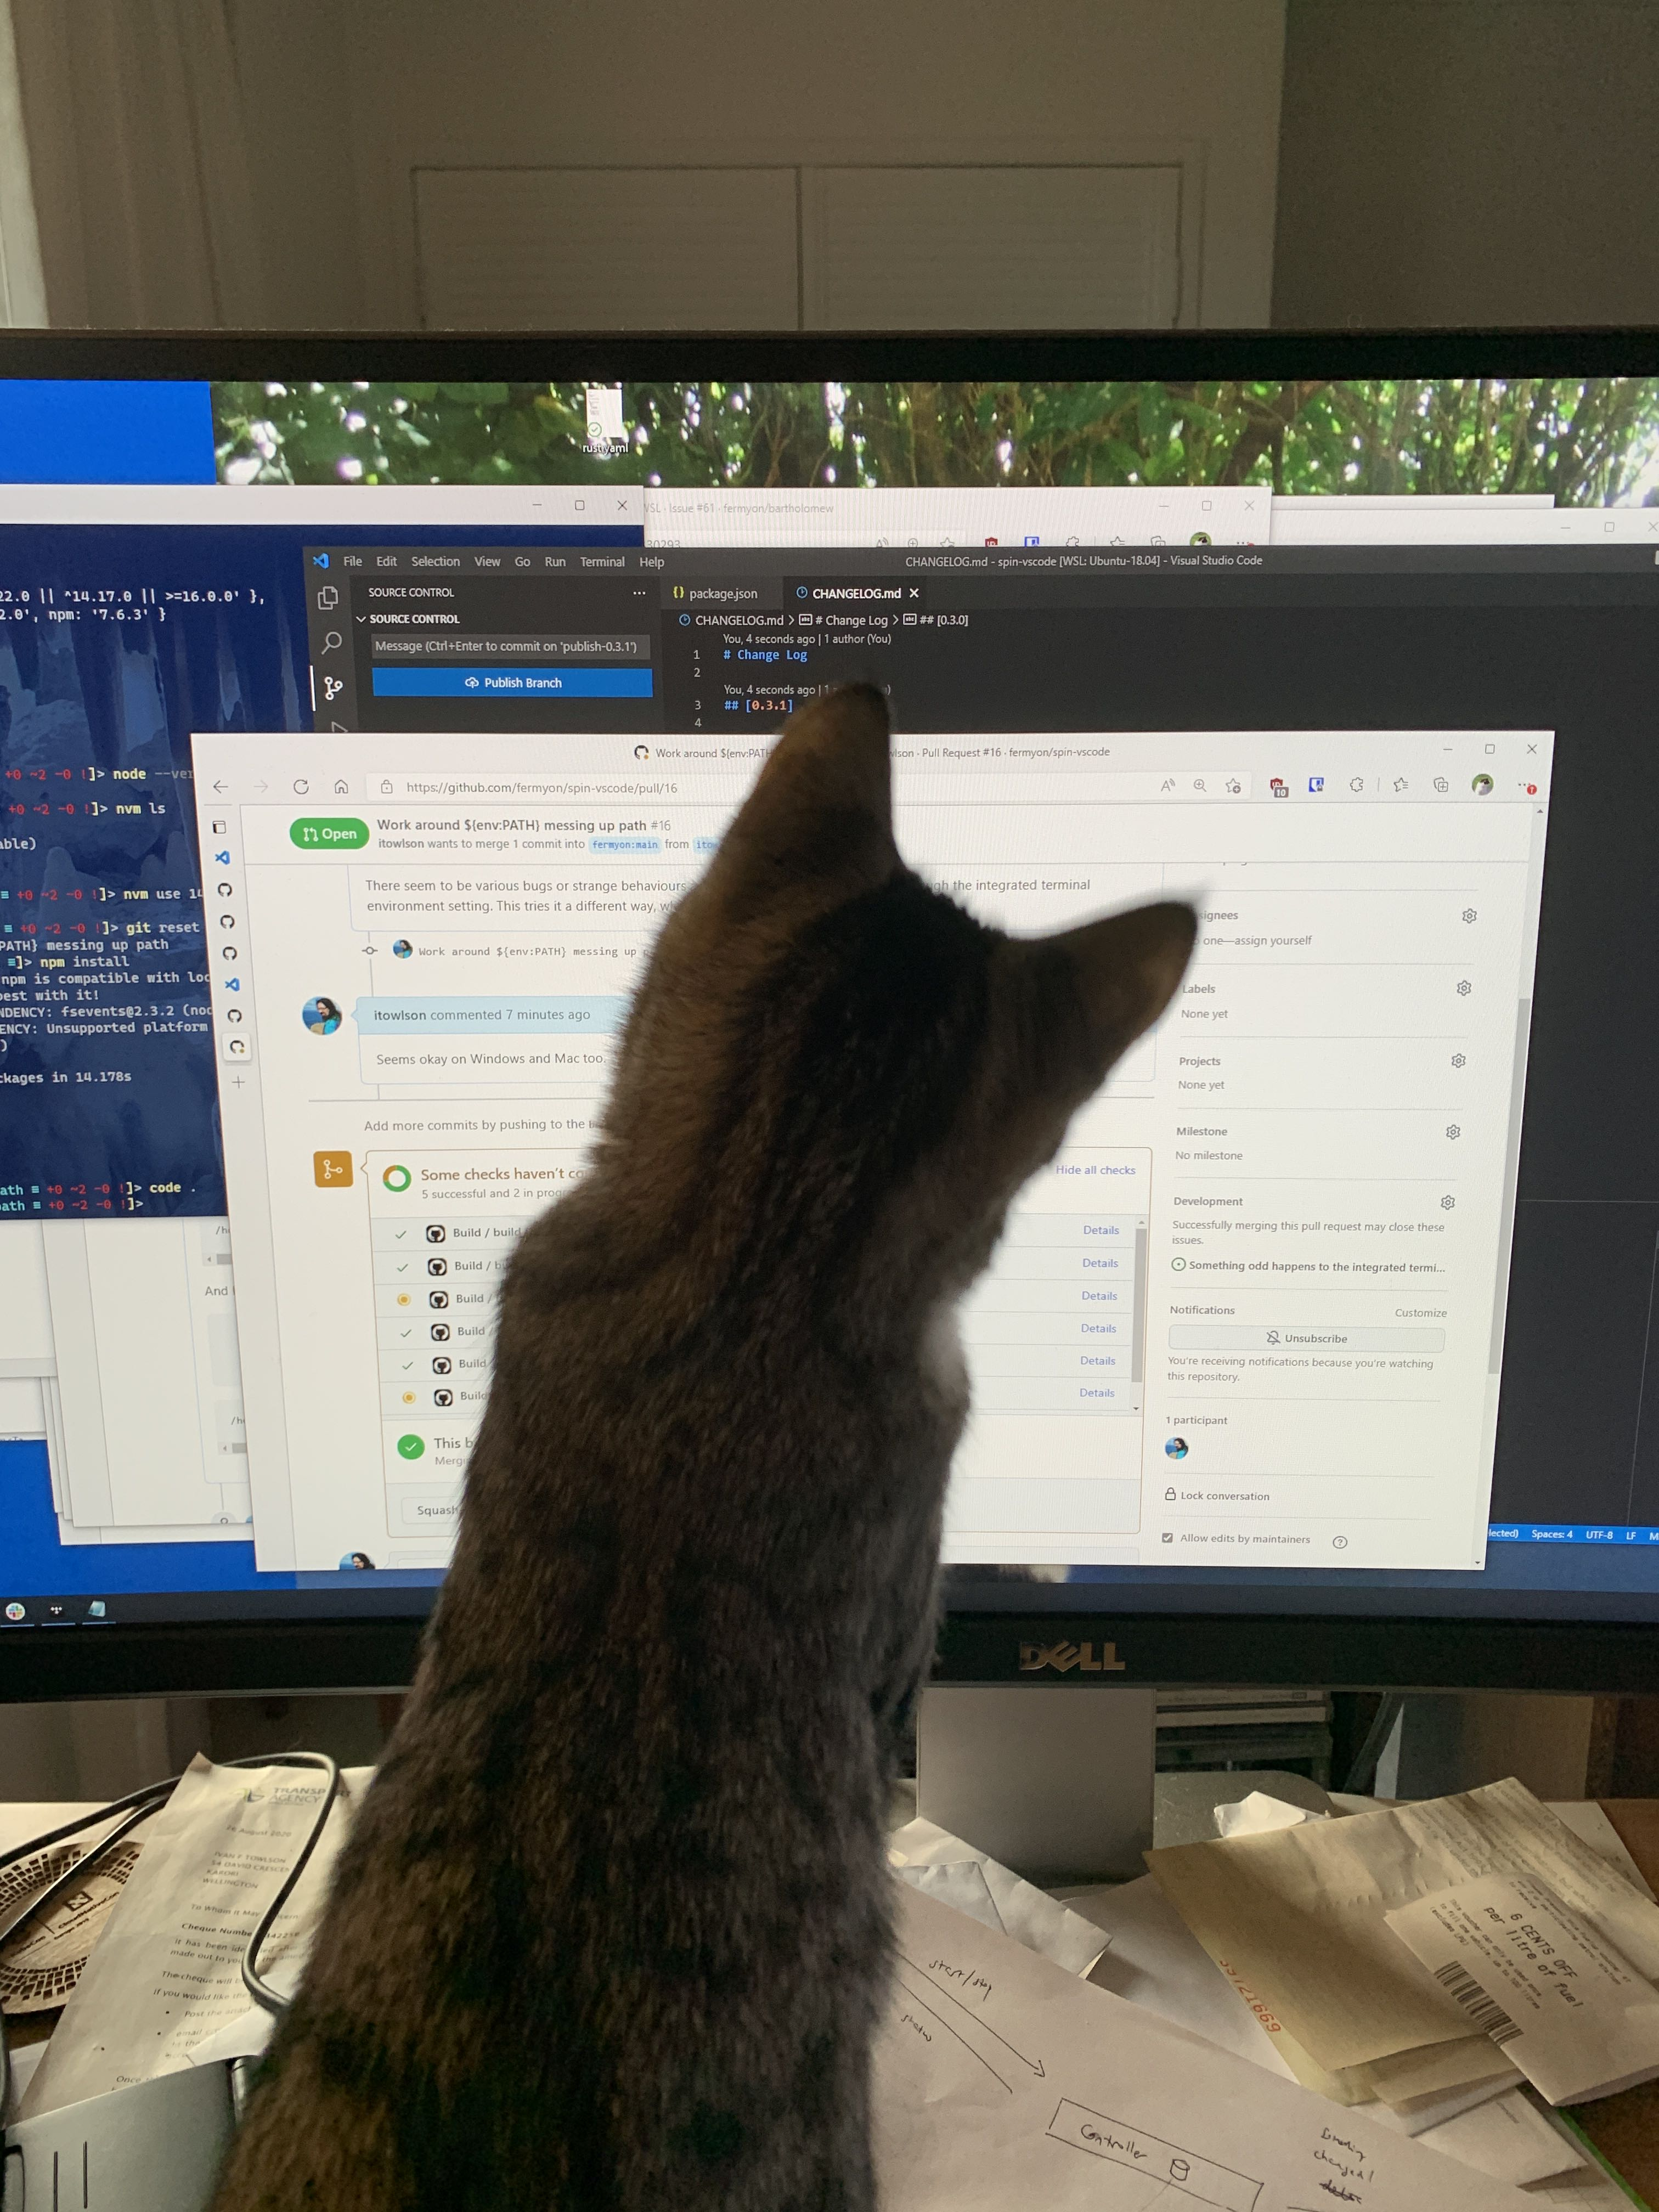
SHOW ME THE CODE

Slide 19
source
defined
wit
listener
???
HTTP, Redis,
SQS, cron, etc.

Slide 21


Slide 22

thanks!
https://github.com/itowlson/wasmio23
https://github.com/fermyon/spin-trigger-sqs
https://github.com/fermyon/spin/tree/main/examples/spin-timer
ivan.towlson@fermyon.com | @ppog_penguin@mastodon.nz
Join the community on Discord: bit.ly/fermyondiscord
Follow along on Twitter: @fermyontech @spinframework

