Slide 1
Outer boundaries
Double Pancake → number of windings in poloidal direction must be even
Width of coil in toroidal and poloidal direction < 5 cm
Max water pressure generated: 20 bar, ideal below 4 bar
(Ideal, if voltage is below 60 Volt)

Slide 2
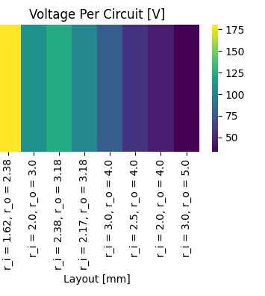
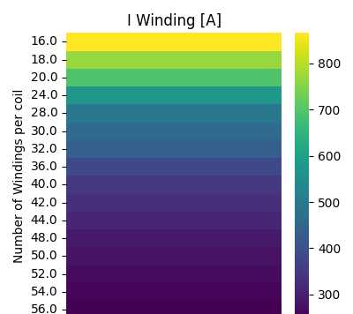
Voltage and current

Slide 3
For voltage < 60 Volt, only the configurations with
Outer diameter 10 mm, Thickness 2 mm
Outer diameter 8 mm, Thickness 2 mm
Outer diameter 8 mm, Thickness 1.5 mm
hold up.

Slide 4
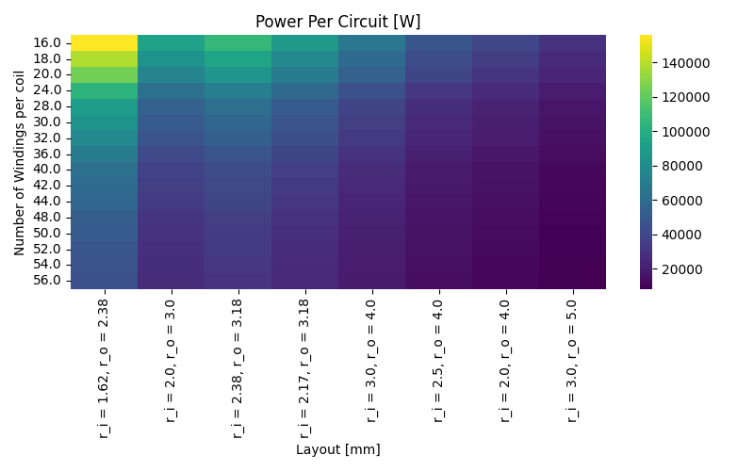
Power loss per circuit [W]

Slide 5
In the following, only values for
width of coil in toroidal and poloidal direction < 5 cm
Pressure below 4 bar
are shown

Slide 6
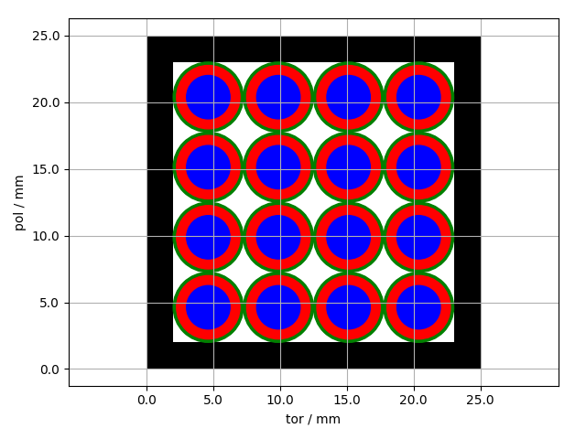
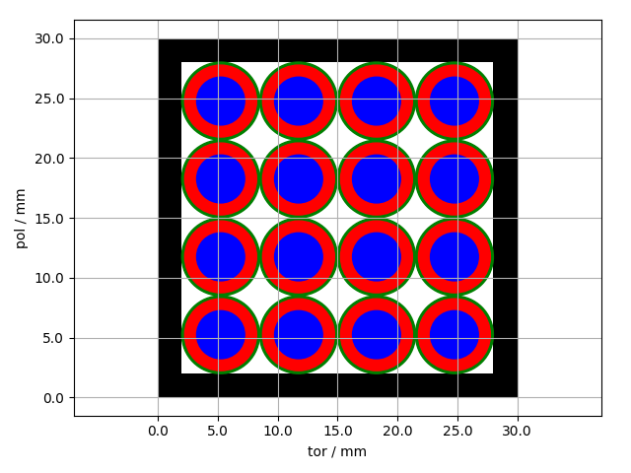
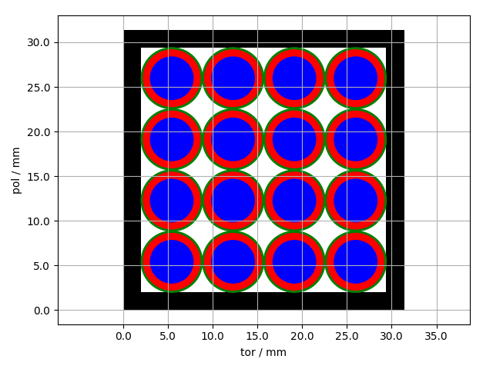
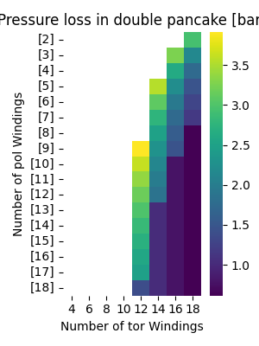
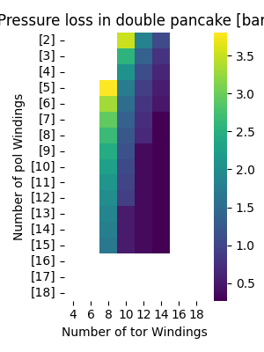
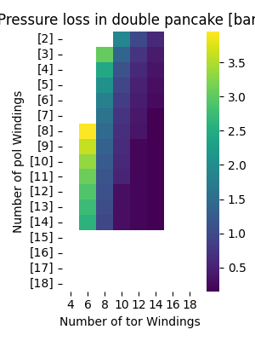
Pressure loss in double pancake [bar]
Outer diameter 4.75 mm
Thickness 0.75 mm
Outer diameter 6 mm
Thickness 1 mm
Outer diameter 6.35 mm
Thickness 0.79 mm

Slide 7
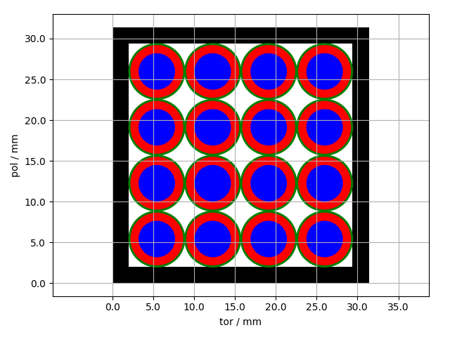
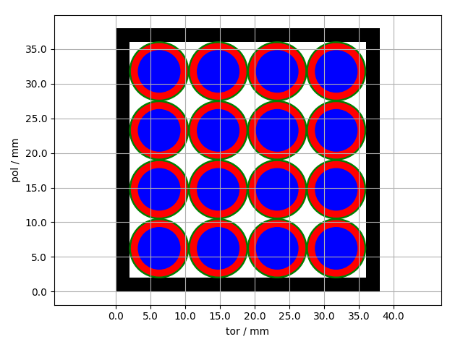

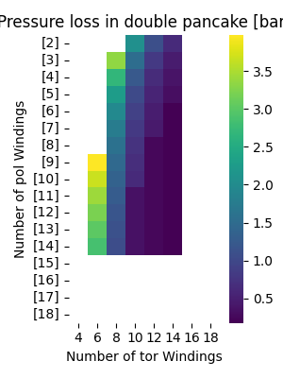
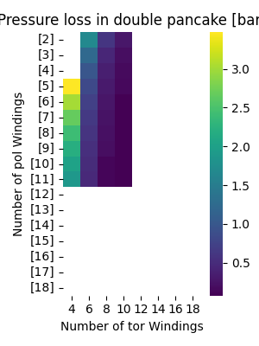
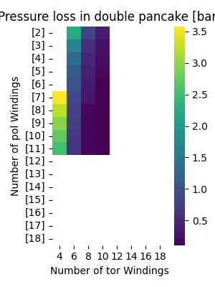
Pressure loss in double pancake [bar]
Outer diameter 6.35 mm
Thickness 1 mm
Outer diameter 8 mm
Thickness 1 mm
Outer diameter 8 mm
Thickness 1.5 mm

Slide 8
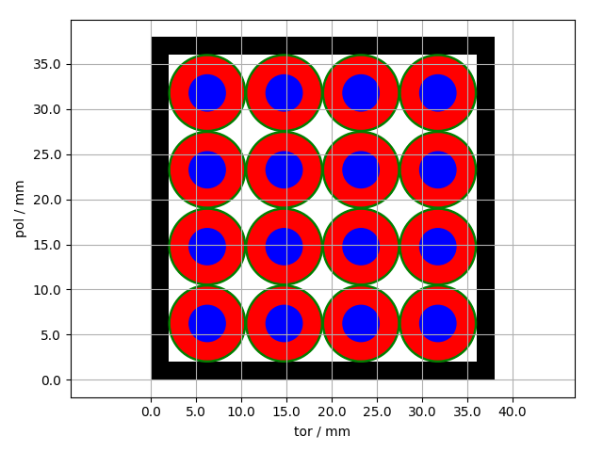

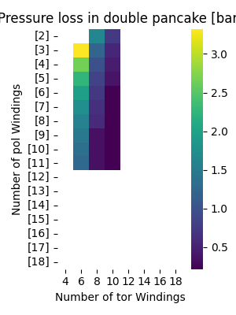
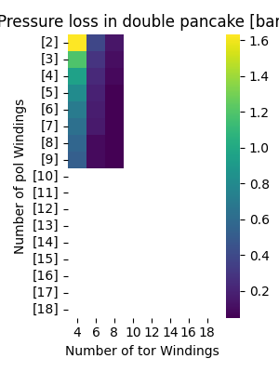
Pressure loss in double pancake [bar]
Outer diameter 8 mm
Thickness 2 mm
Outer diameter 10 mm
Thickness 2 mm

